Slide 1
ok128

Slide 2
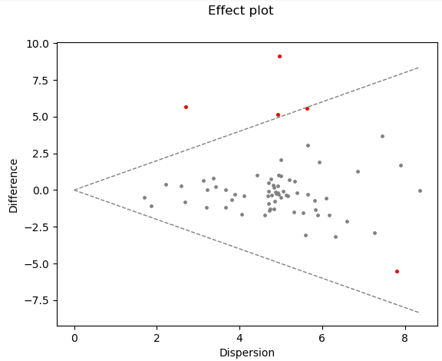
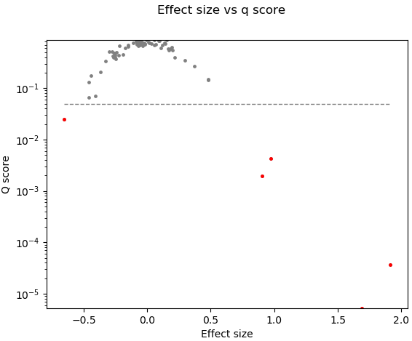
Compositional analysis: bko vs. wt
OTU | rab.win.bko | rab.win.wt | diff.btw | diff.win | effect | P value
k__Bacteria;p__Bacteroidetes;c__Bacteroidia;o__Bacteroidales;f__Bacteroidaceae;g__Bacteroides | 1.02419217 | 10.023716 | 9.138394 | 5.049377 | 1.679245 | 1.17E-06
k__Bacteria;p__Bacteroidetes;c__Bacteroidia;o__Bacteroidales;f__Prevotellaceae;g__Prevotella | 2.41945411 | 8.0776529 | 5.674893 | 2.764129 | 1.91669 | 1.01E-07
k__Bacteria;p__Deferribacteres | -8.38645044 | -3.019321 | 5.320643 | 4.562689 | 1.064646 | 0.000119

Slide 3
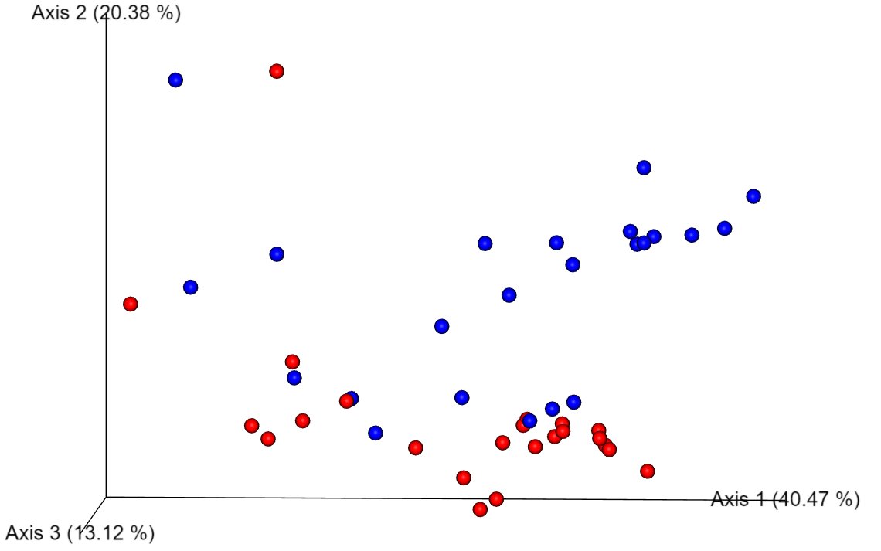

Genotypes: wt vs. bko
Beta-diversity
PCoA: Weighted UniFrac (P=0.002)
Alpha-diversity
not significant

Slide 4
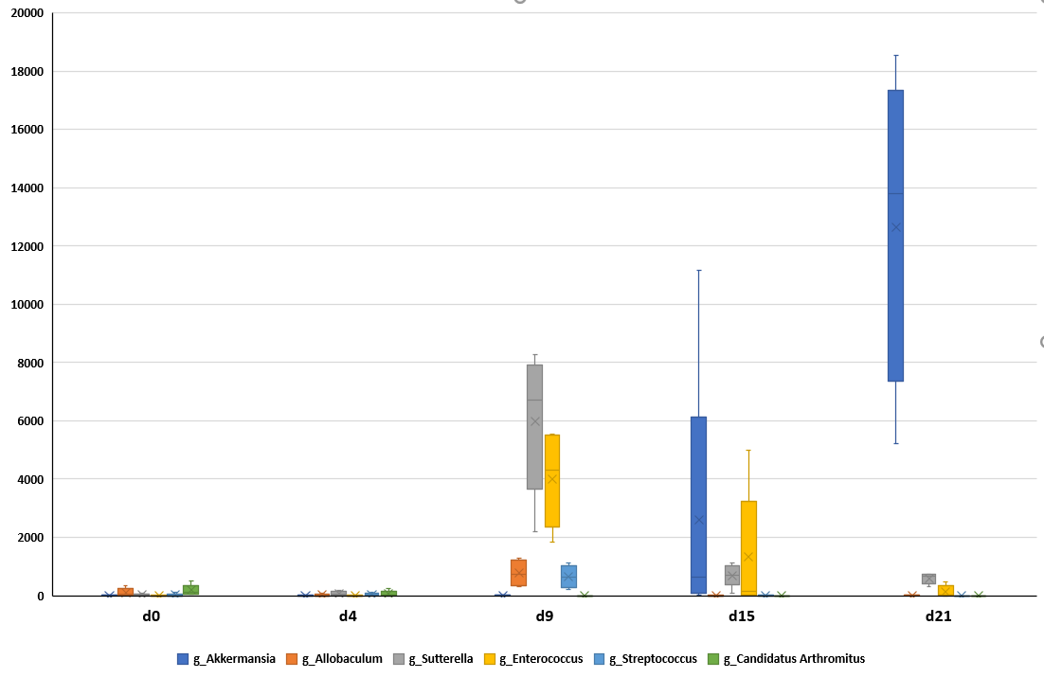
Compositional analysis: bko during the experiment

Slide 5
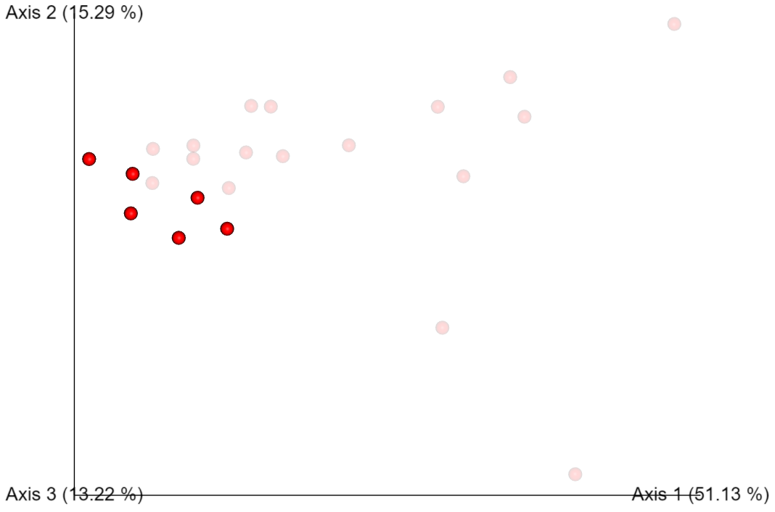
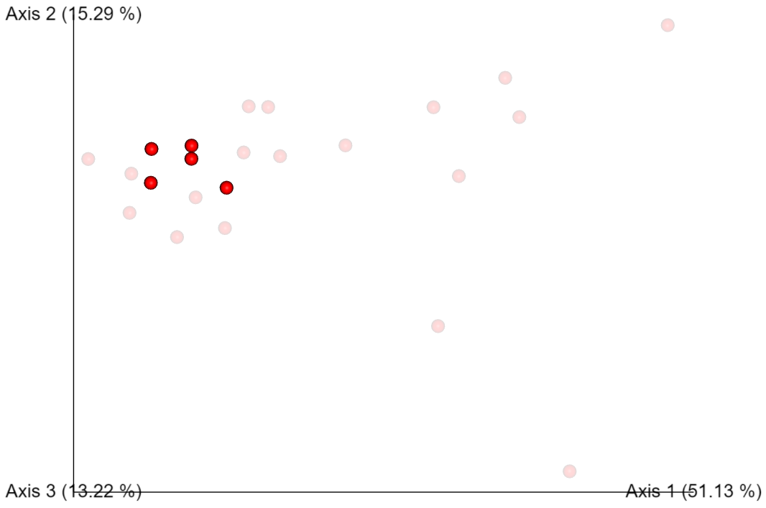

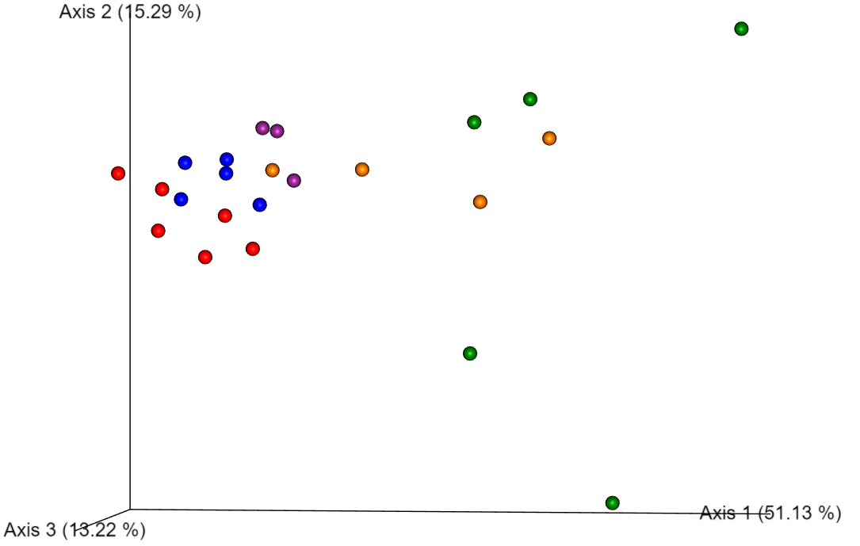
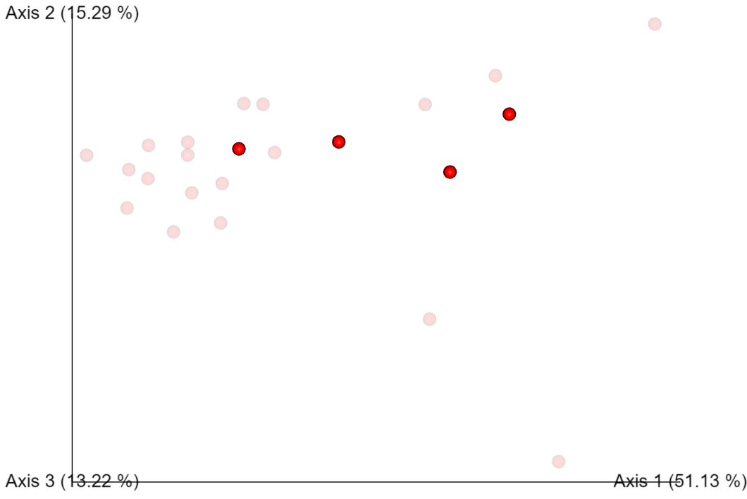
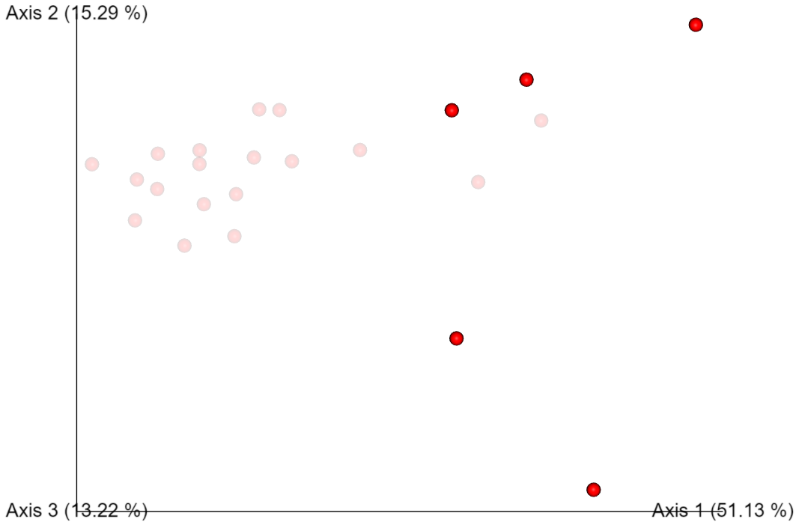
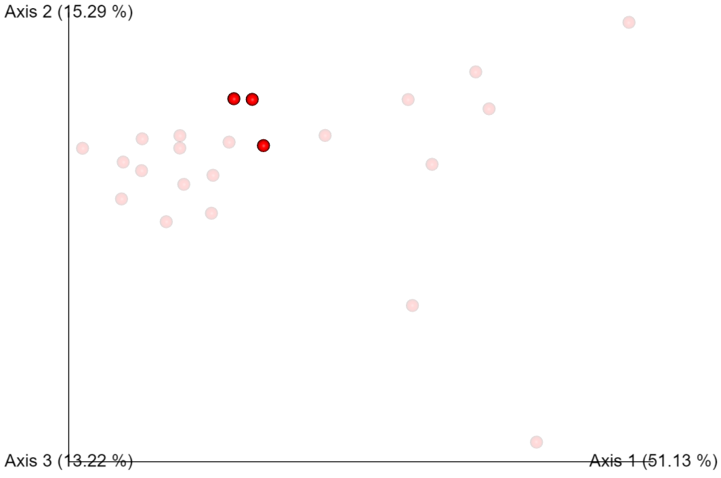
Genotype: bko during the experiment
Alpha-diversity
Beta-diversity
not significant
PCoA: Weighted UniFrac (P=0.001)
d0
d4
d9
d15
d21

Slide 6
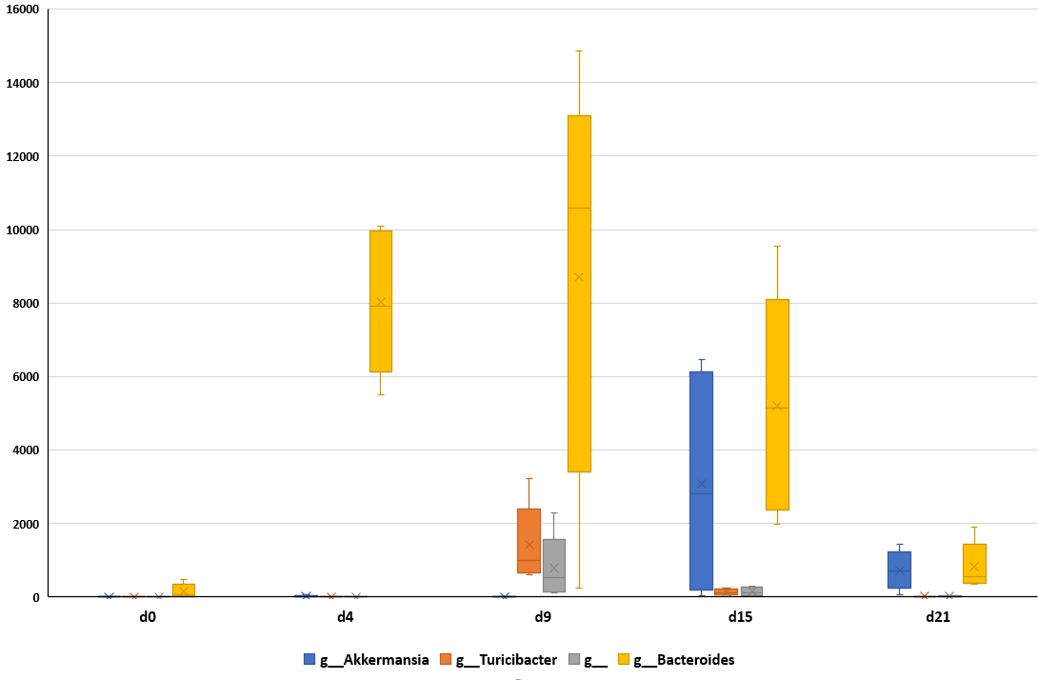
Compositional analysis: wt during the experiment

Slide 7
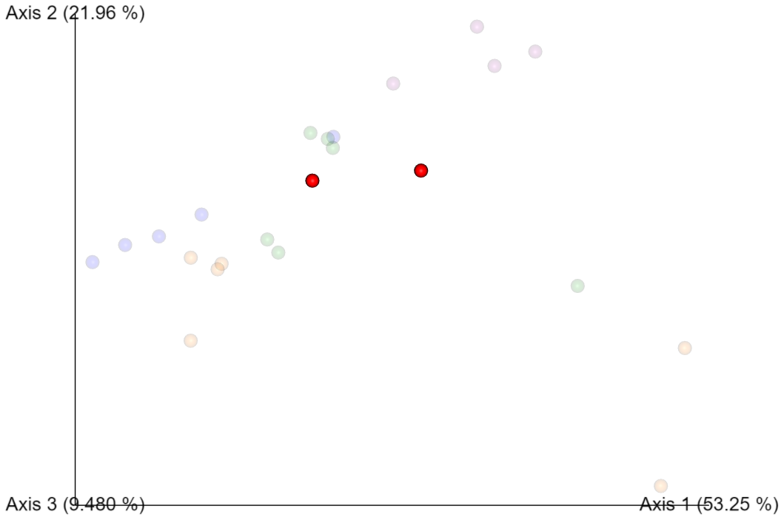
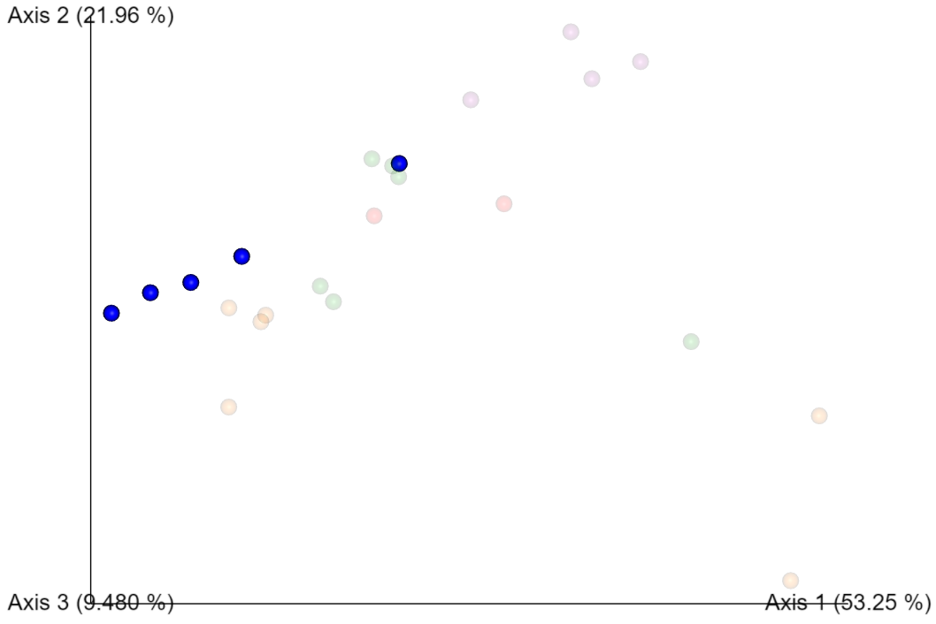
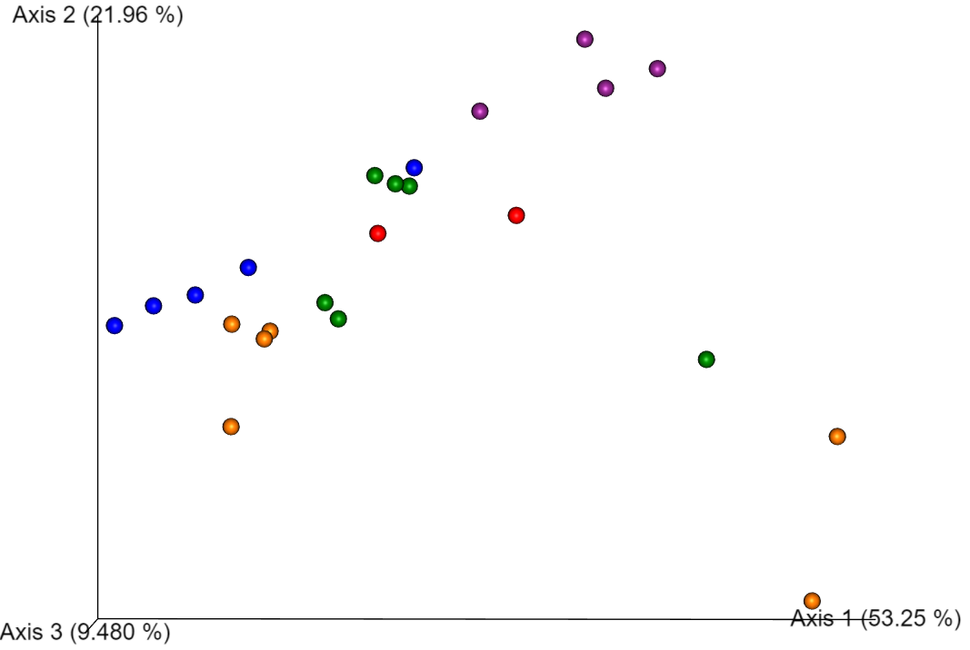
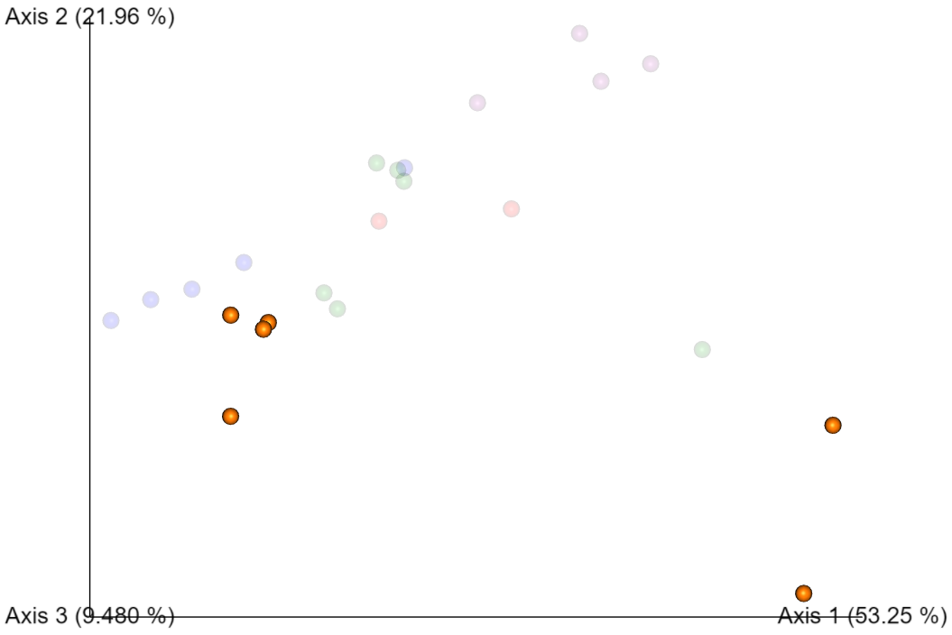
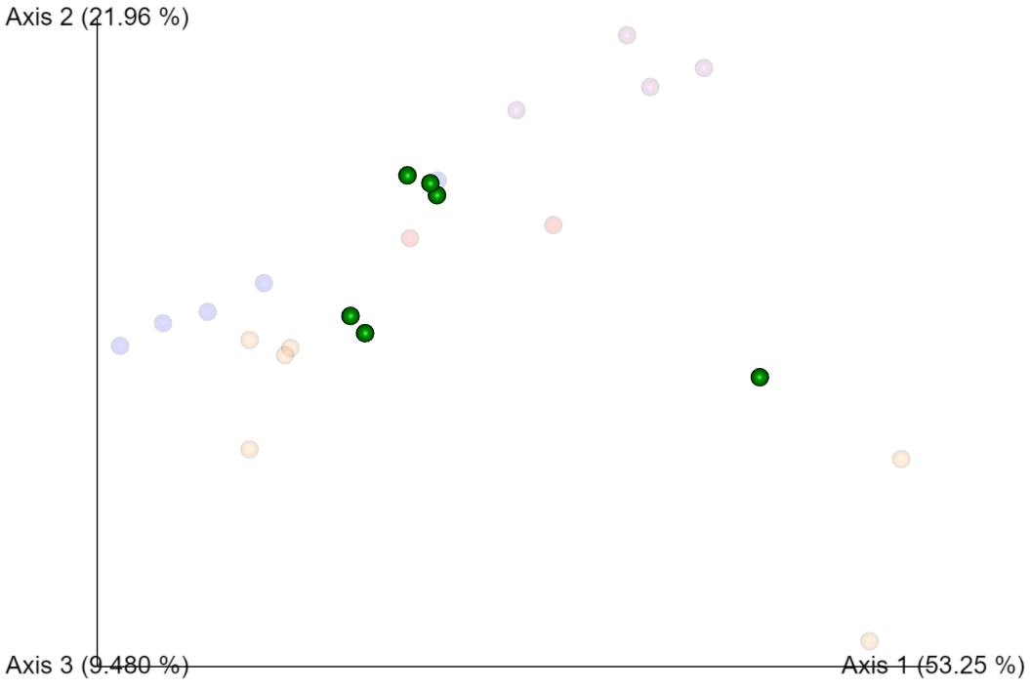
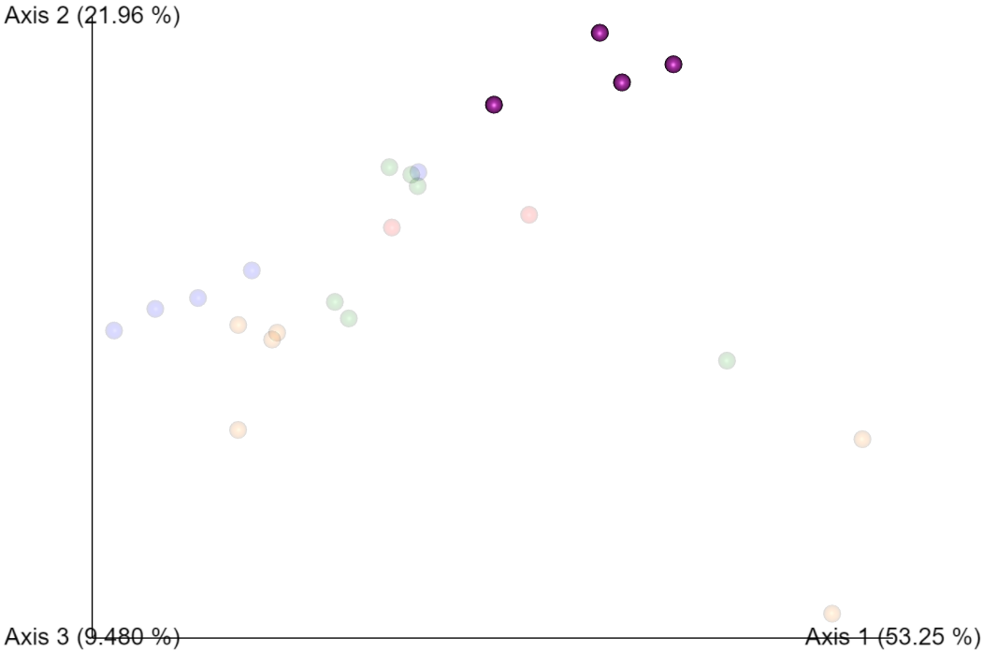
Genotype: wt during the experiment
Alpha-diversity
not significant
Beta-diversity
PCoA: Weighted UniFrac (P=0.004)
d0
d4
d9
d15
d21

