Slide 1
VirusGraph Team
Evan Biederstedt, Jan Buchmann, Alex Gener, Joan Martí-Carreras, Harihara Muralidharan, Alexis Norris, Surya Saha, Mike Tisza, & Valerie Virta

Slide 2
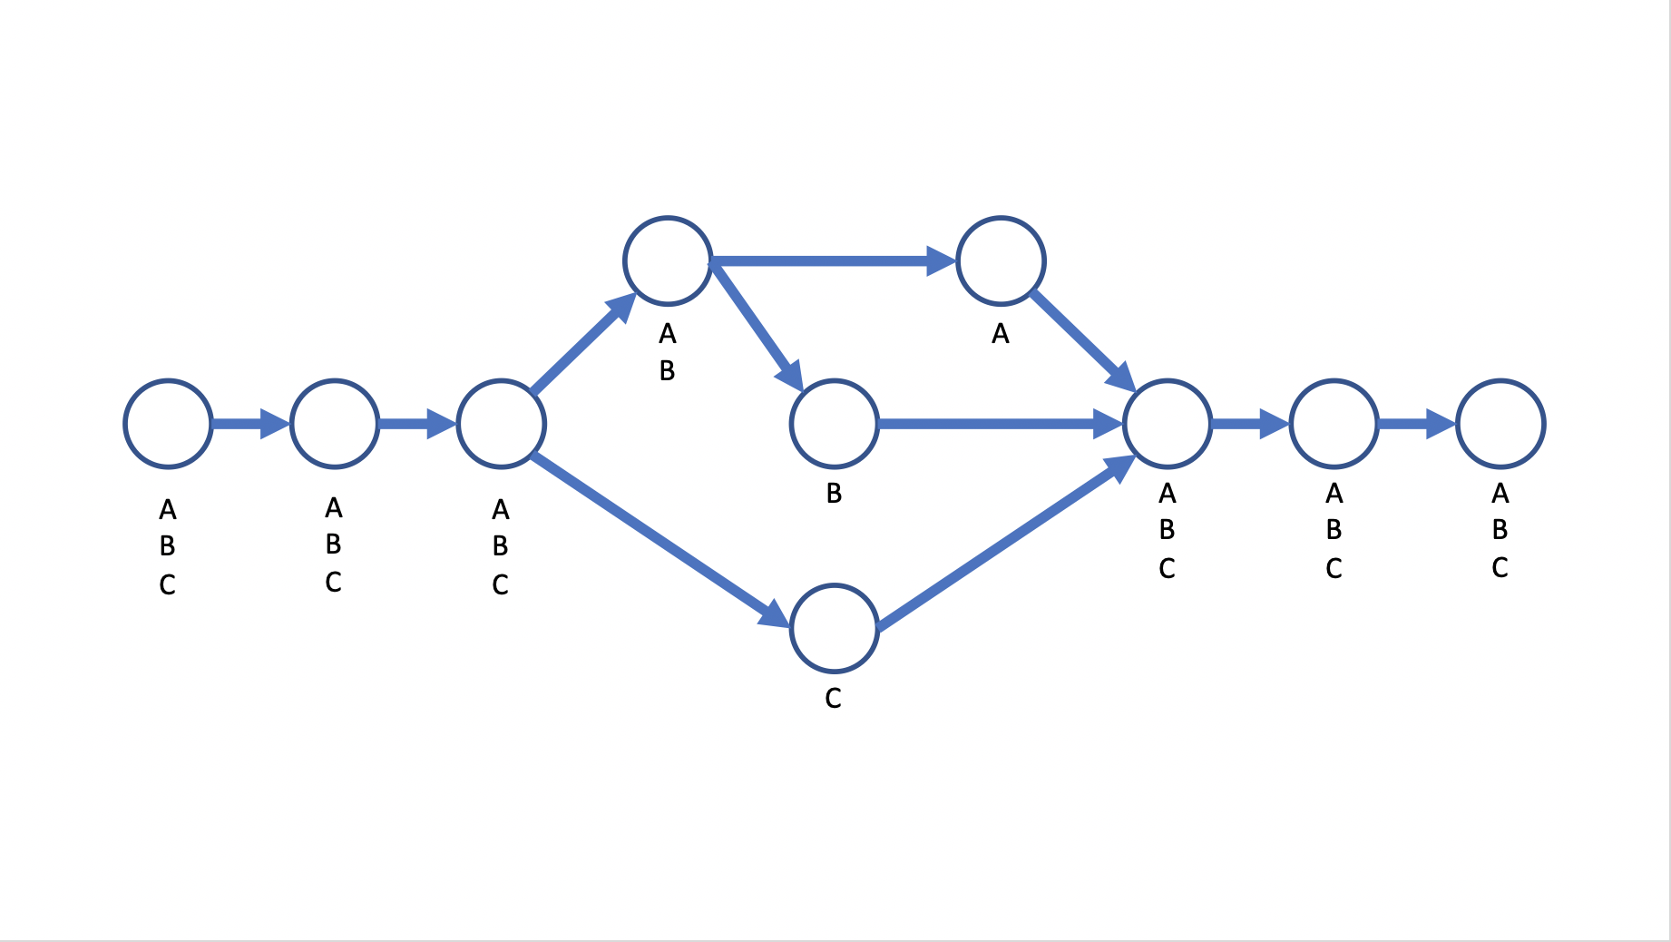
An example of HIV inference obtained using Next Generation Sequencing data

Slide 3
Materials & Methods
Sequence files:
T4 virus
HIV with references
Genome graphing software programs:
vg —
NovoGraph
SWIGG

Slide 4
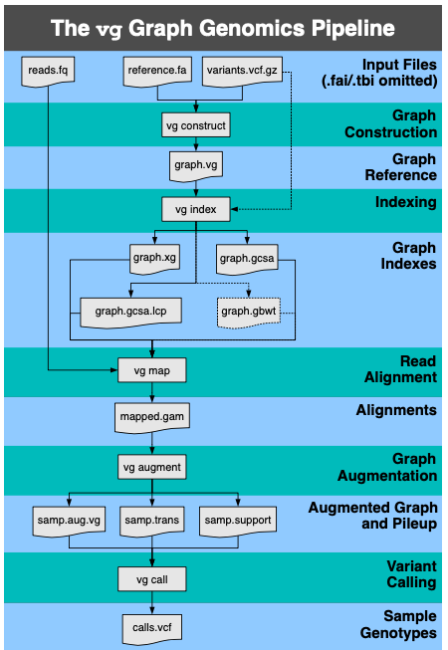
How vg works

Slide 5
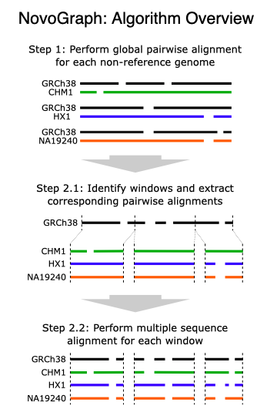
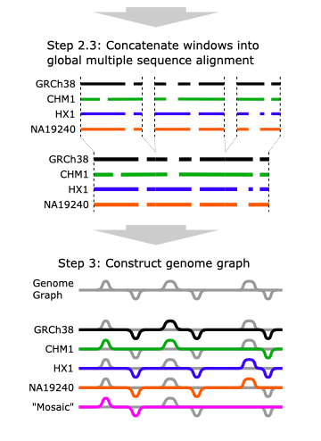
NovoGraph — novel approach for graphing long-read sequence assemblies

Slide 6
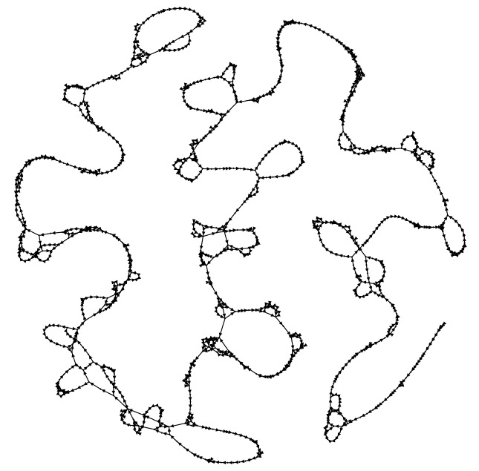
SWIGG — Automated pipeline builds graphs quickly using k-mer approach

Slide 7
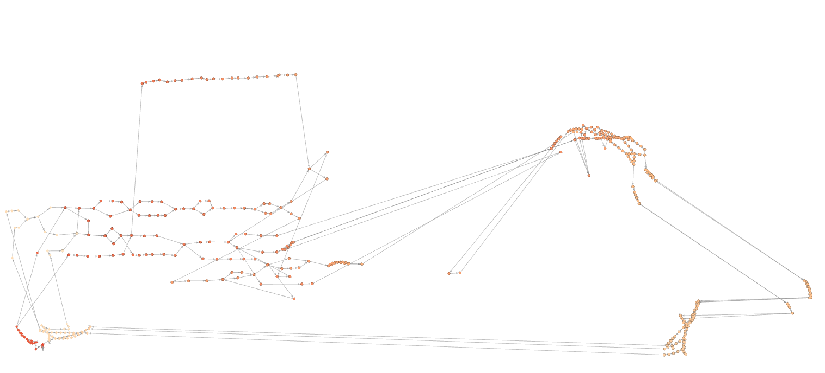
SWIGG output into Gephi of HIV sequence

Slide 8
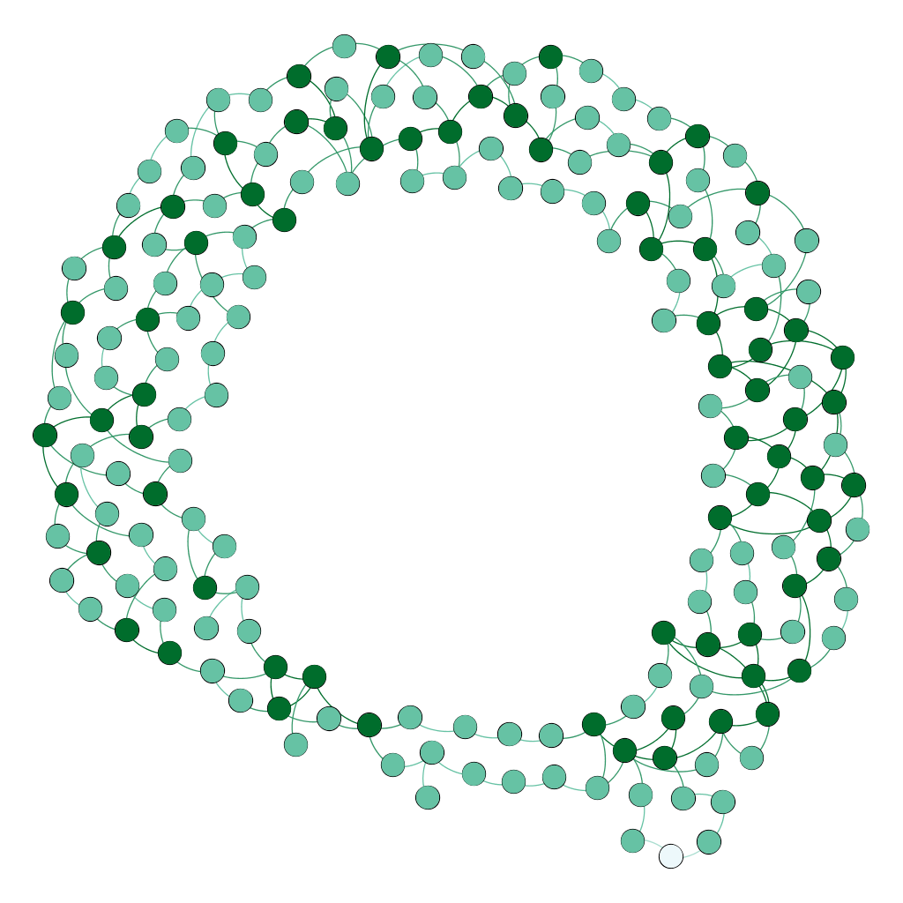
HIV Clades A-J, K=41, threshold >=2

