Slide 1
PLAYER PERFORMANCE ANALYSIS AND PREDICTION BUI MANH CUONG 20204871 HOANG ANH CHUNG 20204901 NGUYEN QUANG MINH 20204884

Slide 2
Introduction (Minh)
Overview (Minh)
Data collection (Chung)
Data development (Chung)
Data visualization and EDA (Minh & Cuong)
Data & analysis (Chung)
Models
Check outlier by SelectFromModel method (Chung)
Experiment result

Slide 3
1
INTRODUCTION

Slide 4
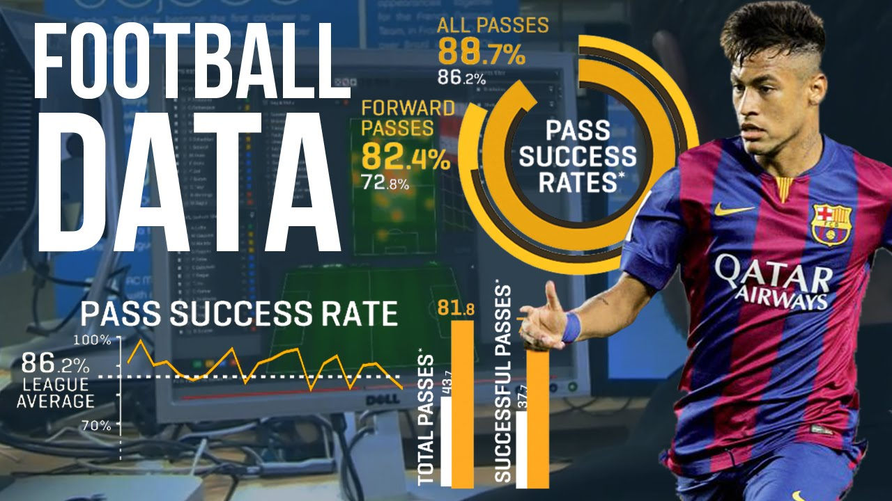
Introduction
Nowadays, football teams and organizations are always interested in player performance data to predict the quality of a player to make plans for that player
Our main aim: make that task easier

Slide 5
Introduction
Some model that we will use:
Random forest
Artificial neural network
Ridge regression with features chosen.
The task of evaluate data, visualize graphs, create are easier.

Slide 6
2 OVERVIEW

Slide 7
Overview
Problem is a supervised regression problem, defined by formula (T, E, P)
Task (T): Predict the correct rating of football players
Performance (P): The loss error of the prediction, which is the difference between the real rating and predicted rating
Experience (E): List of the rating of previous performances’ statistics of the players

Slide 8
3 DATA COLLECTION

Slide 9

Data crawling & scrapping
Data collection by Scrappy_playwright
High performance
Adaptive with DynamicJS
Better headless browser than Selenium

Slide 10
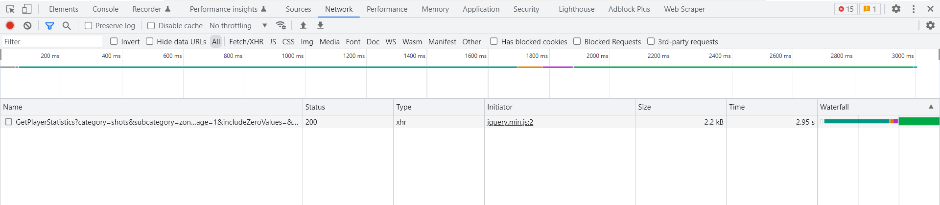
- Data crawling
Crawling by GUI JS dynamic is hard
Smarter idea: Use network tracking to track URL source of data

Slide 11
Data crawling
Sample url: https://1xbet.whoscored.com/StatisticsFeed/1/GetPlayerStatistics?category=shots&subcategory=zones&statsAccumulationType=0&isCurrent=true&playerId=&teamIds=&matchId=&stageId=20934&tournamentOptions=2&sortBy=Rating&sortAscending=&age=&ageComparisonType=0&appearances=&appearancesComparisonType=0&field=&nationality=&positionOptions=%27FW%27,%27AML%27,%27AMC%27,%27AMR%27,%27ML%27,%27MC%27,%27MR%27,%27DMC%27,%27DL%27,%27DC%27,%27DR%27,%27GK%27,%27Sub%27&timeOfTheGameEnd=5&timeOfTheGameStart=0&isMinApp=&page=1&includeZeroValues=&numberOfPlayersToPick=10
Use extract stageId, category from each website position, save in JSON files.
Use them to generate URL

Slide 12
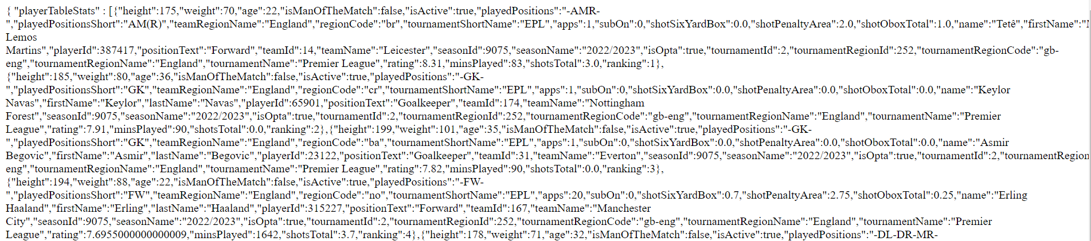
Data crawling
Parse js by json -> dict -> dataframe -> csv

Slide 13
4 DATA DEVELOPMENT & ANALYSIS

Slide 14
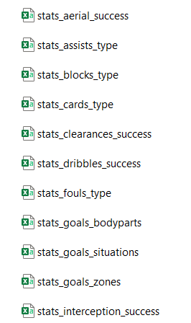
Database development
There are 23 csv tables with each pair of(category, subcategory)
Contains duplicate attributes
as individual information
Hint to normalize to database

Slide 15
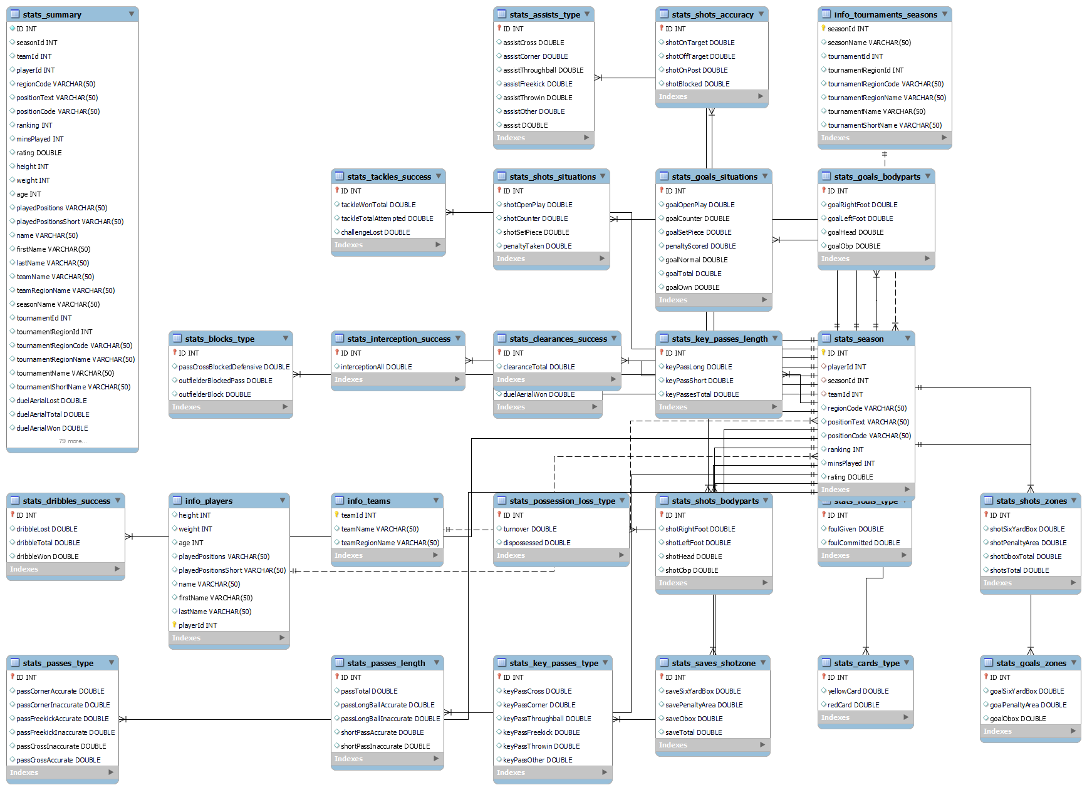

Slide 16
5 DATA VISUALIZATION AND EDA

Slide 17
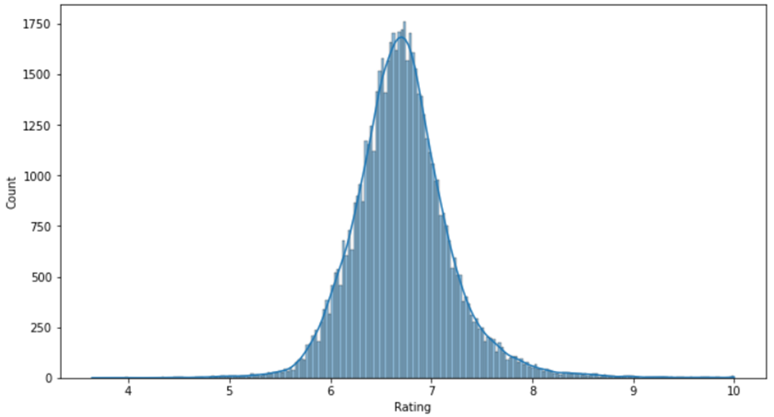
Data visualization and EDA

Slide 18
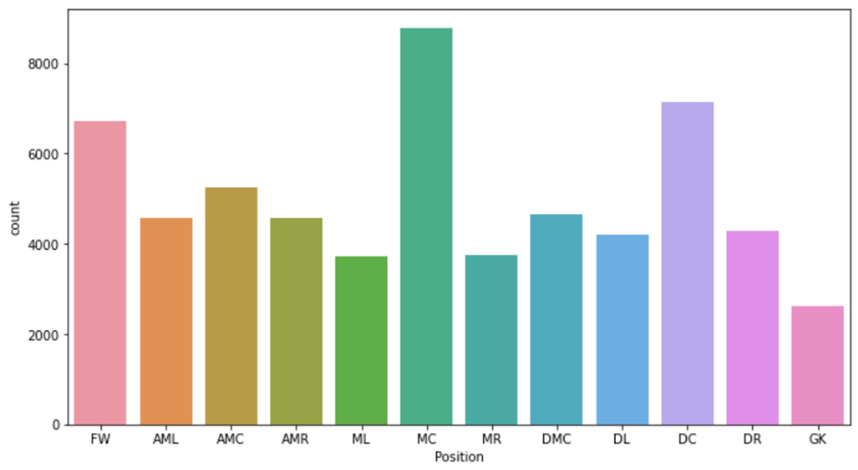
Data visualization and EDA

Slide 19
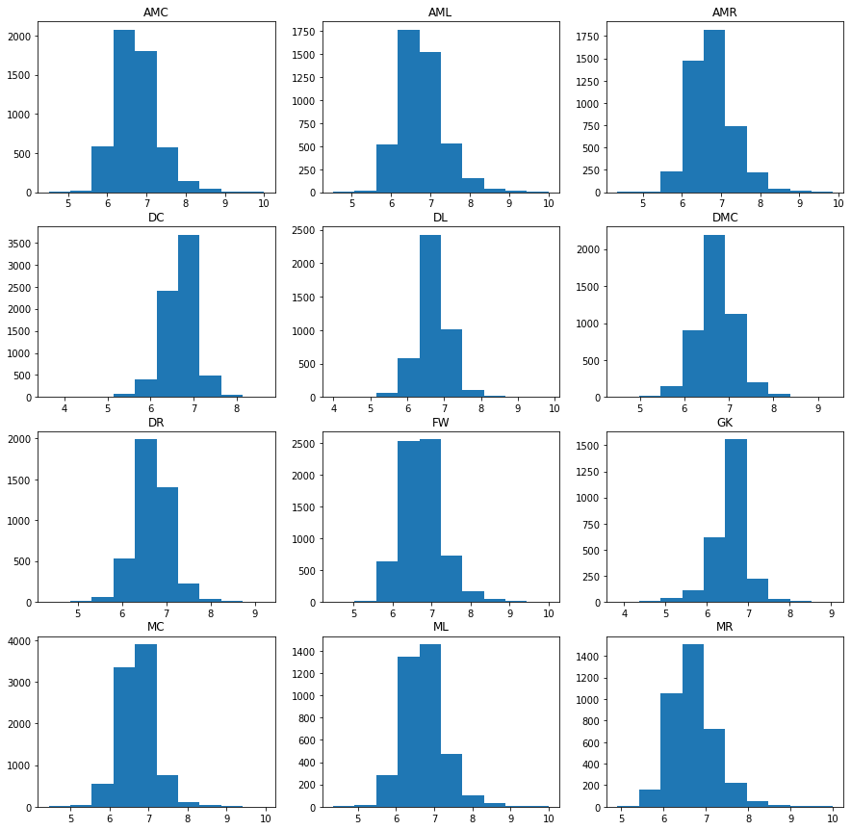
Rating distribution for each position

Slide 20
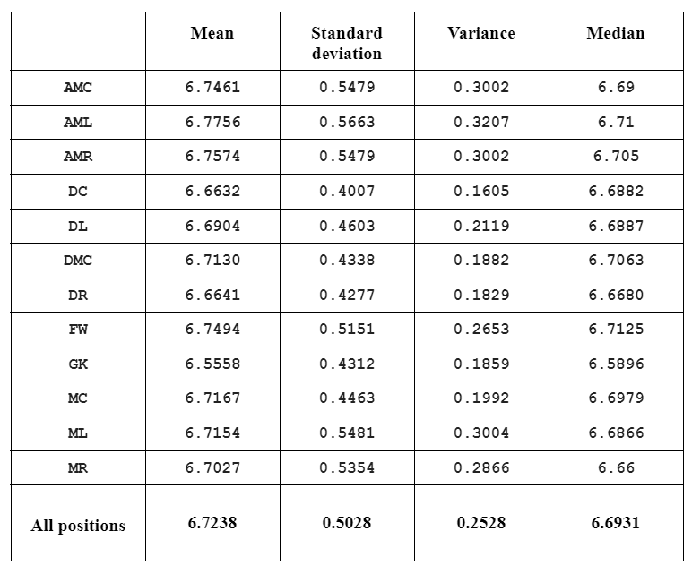
Some distribution values

Slide 21
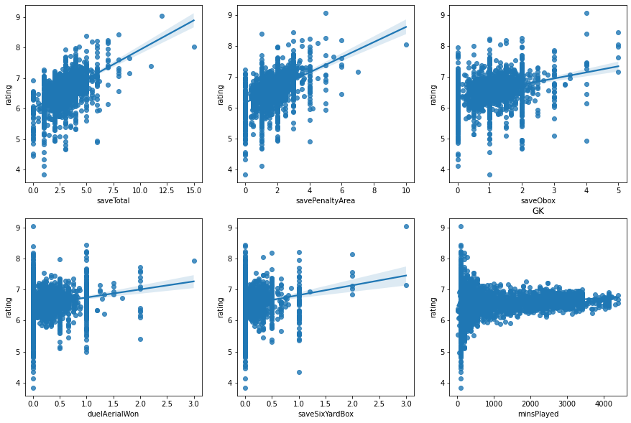
Data visualization and EDA

Slide 22
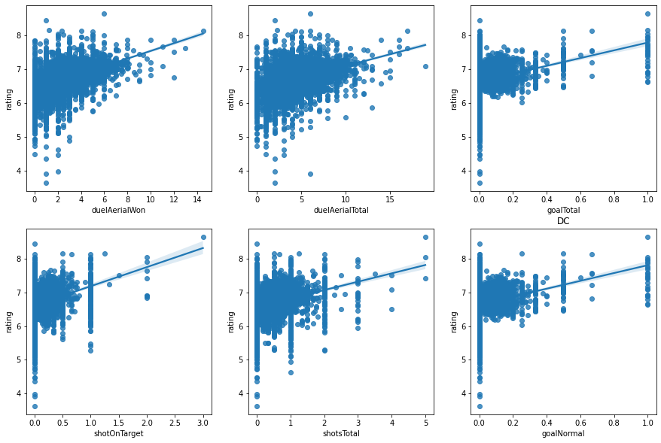
Data visualization and EDA

Slide 23
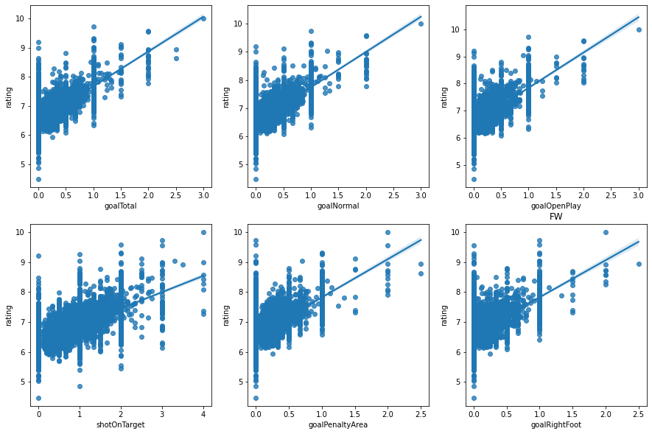
Data visualization and EDA

Slide 24
6 Data analysis

Slide 25

Clustering analysis
Each position contains a set outperform indicators than others.
Use clustering analysis to detect the similarity between
$\left|Save_{GK_{1}}−Save_{FW_{1}}\right|+\left|Goal_{GK_{1}}−Goal_{FW_{1}}\right|>\left|Save_{GK_{1}}−Save_{GK_{2}}\right|+\left|Goal_{GK_{1}}−Goal_{GK_{2}}\right|$

Slide 26
Data normalization before analysis
Before analysis, we normalize data by average actions each sample by the games or appearances

Slide 27
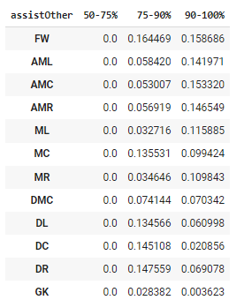
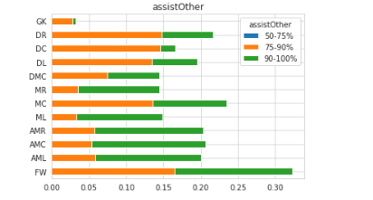
Quantile analysis

Slide 28
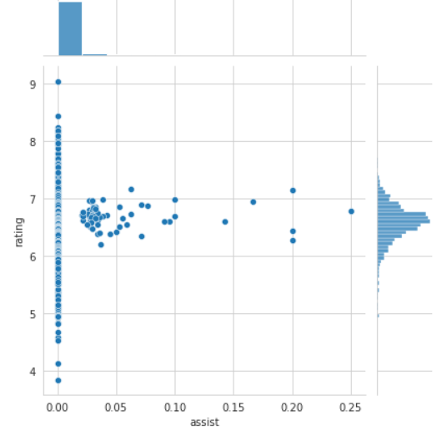
Mutual information analysis
Some information in
Range (6, 7) of rating in assist although out of
range not
Hint to use mutual
Information score.

Slide 29
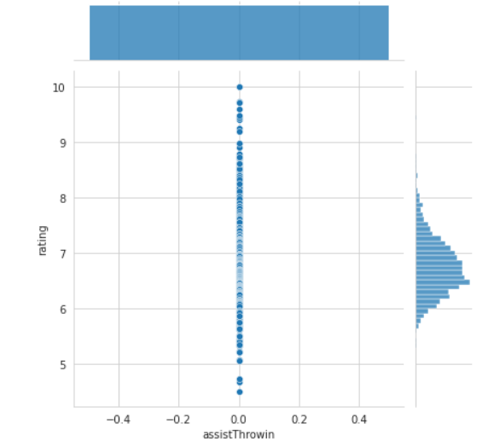
Mutual information score
Feature assist
For AMC contains tons
Of zeros =>
No information

Slide 30
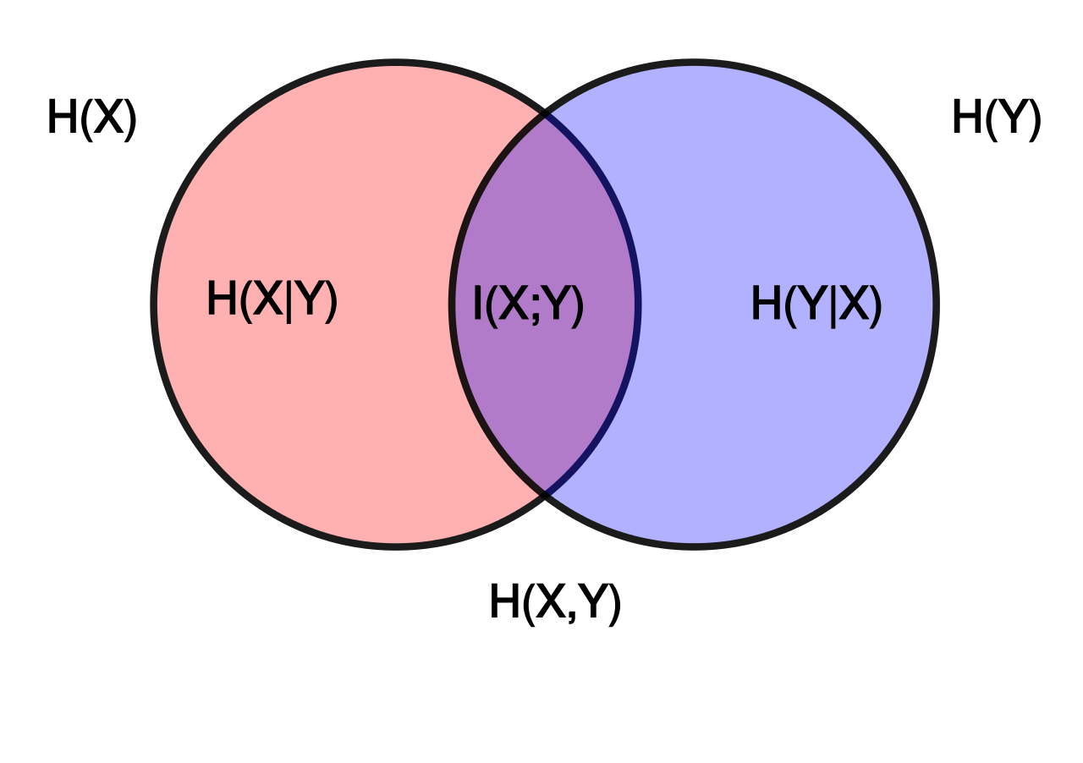

Mutual information score
- Mutual information is a quantity that measures a relationship between two random variables that are sampled simultaneously
I$\left(X,Y\right)=\sum_{x∈X}{\sum_{y∈Y}{P\left(x,y\right).log⁡\frac{P(x,y)}{P\left(x\right).P(y)}}}$

Slide 31
7 MODELS

Slide 32
Models
Random forest
Ensemble learning method, operates by constructing a multitude of decision trees at training time
For regression tasks, the mean or average prediction of the individual trees is returned.
Artificial neural network
A method that focus on the complex relationships of the features and target variable
A group of interconnected node, that resemble the neurons in a biological brain. ANNs consist of an input layer, one or more hidden layers and an output layer.

Slide 33

Artificial Neural Network
In parameter learning, the goal is to minimize an empirical loss function:
In this problem we are going to use two hidden layers with ten neurons each and one output layer with one neuron. The activation function for the first hidden layer is ReLU and the second is hyperbolic tangent

Slide 34
Ridge with data analysis
Why use? As usual, calculate rating by increase or decrease the weight of indicator
Use Ridge to avoid overfitting with L2 generalization

Slide 35
8 Check outlier by SelectFromModel method

Slide 36
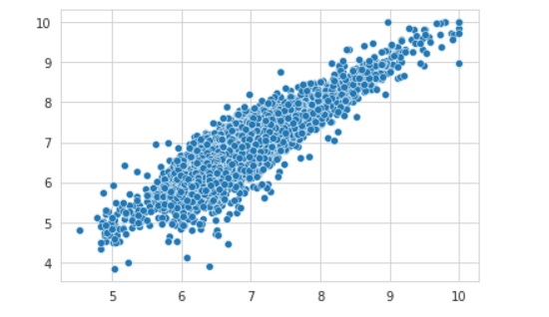
Any significant outlier?
- Scatterplot in training result.

Slide 37
9
EXPERIMENTS RESULTS

Slide 38
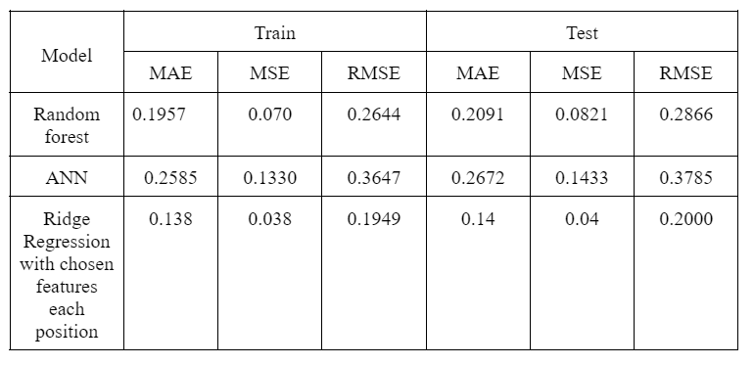
Result

