Slide 1

A02 A Comparative Analysis of Machine Learning and Deep Learning Tools and Frameworks
Department of Science, Technology, Engineering & Math
Team 5
Contributors: Martin Demel, Bradley Johnson, Jesus Ocampo, Ethan Phan
22nd of January

Slide 2

What is NLP?
Introduction
Importance of NLP Tools
Presentation Goal
Natural Language Processing (NLP) deals with enabling computers to understand, interpret, and generate human language.
As text data grows exponentially, robust NLP libraries are essential for tasks like sentiment analysis, information extraction, and language modeling.
Provide a clear overview and comparison between NLTK and spaCy.
FOCUS: NLTK vs. spaCy
NLTK:
A pioneering toolkit well-known in academia for teaching and prototyping
spaCy:
A newer, production-oriented library known for its speed and efficiency.

Slide 3
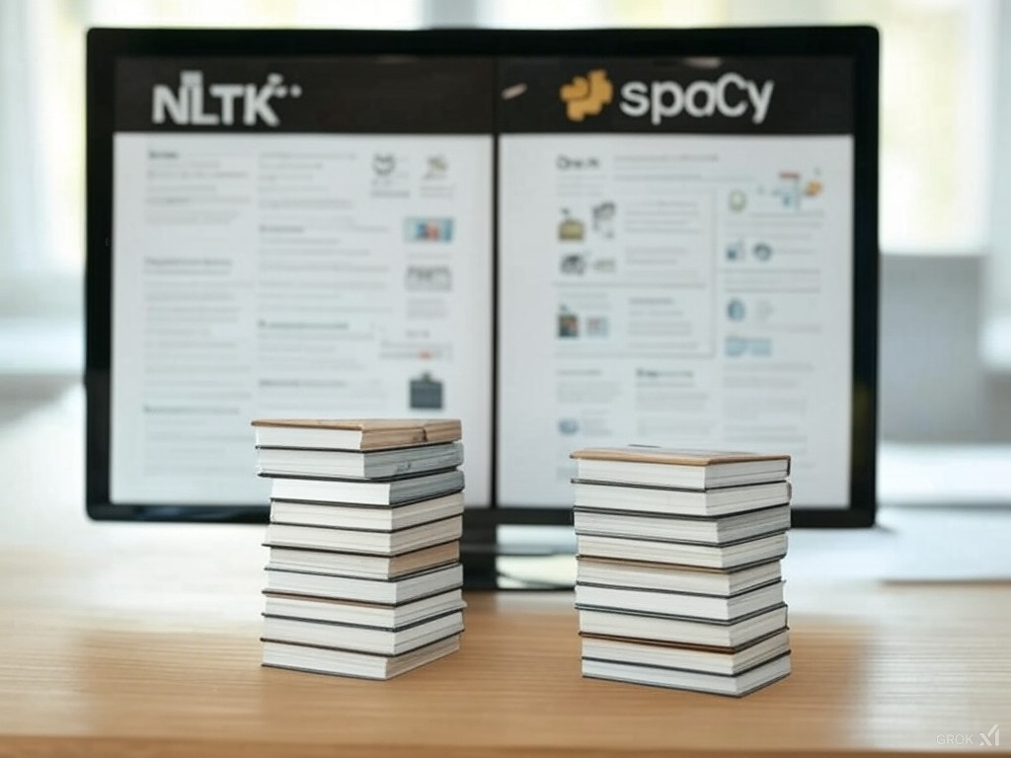
A Brief History
NLTK
Origin & Development
Developed at the University of Pennsylvania in 2001.
Created to support teaching and research in computational linguistics
Purpose
Offers a broad range of text processing libraries for both symbolic and statistical NLP.
Ideal for academic use, learning, and rapid prototyping.
spaCy
Origin & Development
Developed by Explosion AI, first released in 2015
Designed for industrial-strength NLP taks
Purpose
Emphasizes speed, efficiency, and scalability
Well suited for production environments and large-scale text processing.

Slide 4
Real World Applications

Slide 5
Demonstration

Slide 6
Conclusion

Slide 7
Sources

Slide 8
Thank you.

