Slide 1
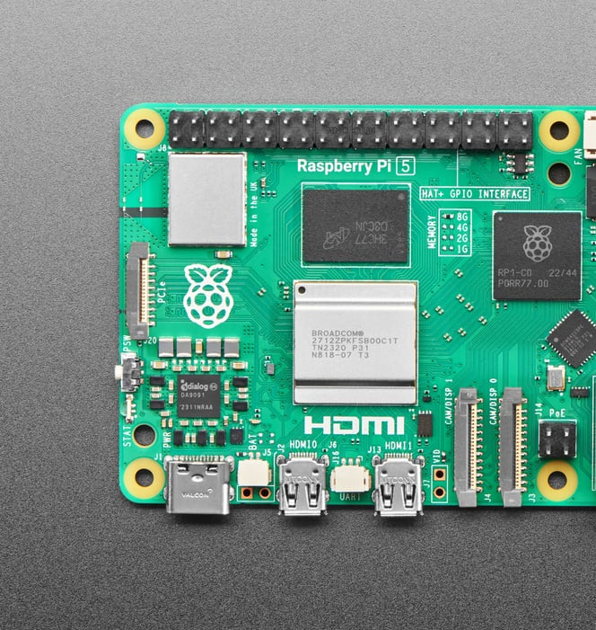
Raspberry Pi 5
The Latest Generation of Single-Board Computing
Jesus Ocampo
Ahad Maredia
ITAI 2374

Slide 2
Introduction
Single-board computer created by Raspberry Pi Foundation (UK)
First launched in 2012, with millions sold worldwide
Purpose: affordable and accessible computing for students, hobbyists, and engineers
Used in STEM education, DIY projects, IoT, robotics, and more

Slide 3
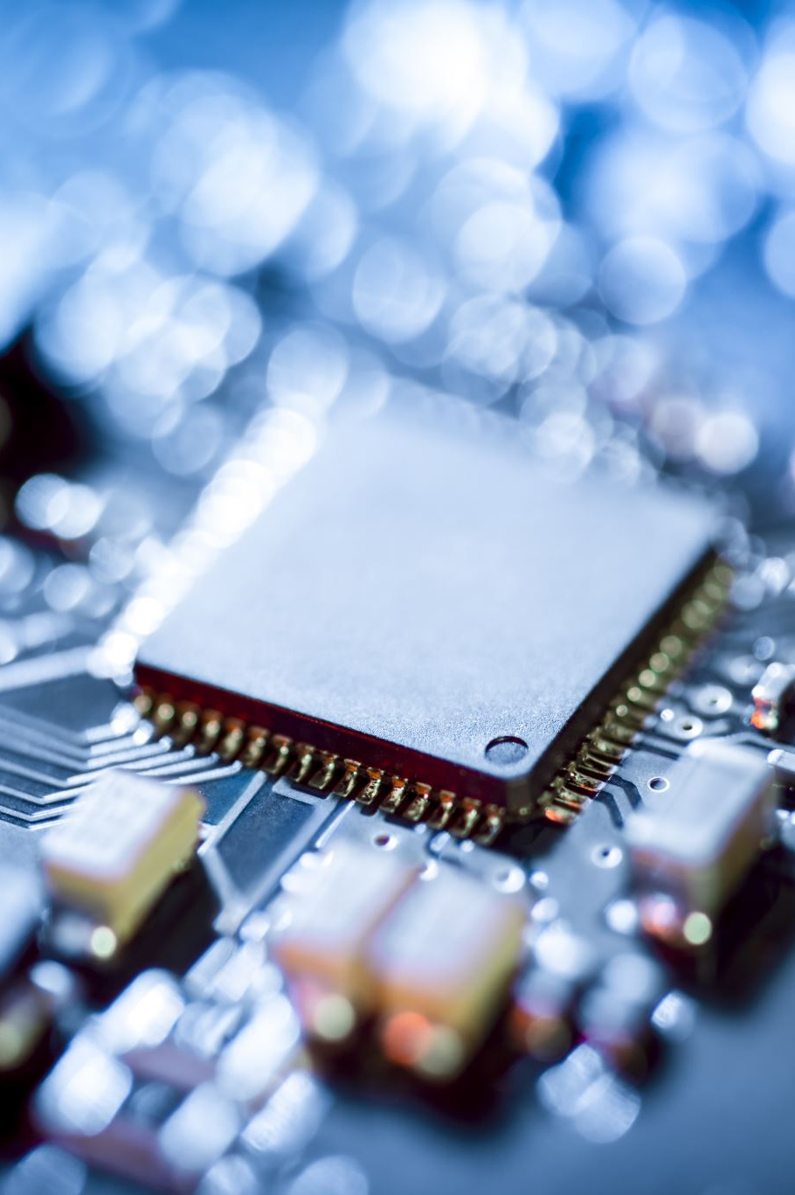
Raspberry Pi 5 Overview
Released in October 2023
Fifth generation of Raspberry Pi boards
Brings desktop-like performance at a very low cost (around $60 - $70)
Available in 4GB and 8GB RAM versions
Supports Raspberry Pi OS and other operating systems

Slide 4
Key Innovations in Pi 5
2–3× faster CPU performance vs. Pi 4
New GPU (VideoCore VII) for 4K video and smoother graphics
First Pi with PCIe expansion support
New RP1 I/O Controller chip
Dual 4K display support at 60fps

Slide 5
Types / Models of Raspberry Pi
Earlier versions: Pi 1, Pi 2, Pi 3, Pi 4
Special editions: Pi Zero, Pi Pico (smaller, low-power boards)
Current flagship: Raspberry Pi 5 (2023)
Options: 4GB LPDDR4X RAM or 8GB LPDDR4X RAM

Slide 6
Hardware Specifications
Broadcom BCM2712, quad-core ARM Cortex-A76 @ 2.4GHz
GPU: VideoCore VII @ 800MHz
Up to 8GB LPDDR4X RAM
2 × HDMI 2.1 ports (dual 4K@60fps)
MicroSD slot with SDR104 high-speed support
PCIe 2.0 (1 lane) via FFC connector

Slide 7

Power Requirements
USB-C power input (5V/5A recommended)
Typical consumption ~12W
Active cooling recommended
Optional Raspberry Pi Active Cooler

Slide 8
Connectivity
2 × USB 3.0 ports + 2 × USB 2.0 ports
Gigabit Ethernet
Wi-Fi 802.11ac (dual-band)
Bluetooth 5.0

Slide 9
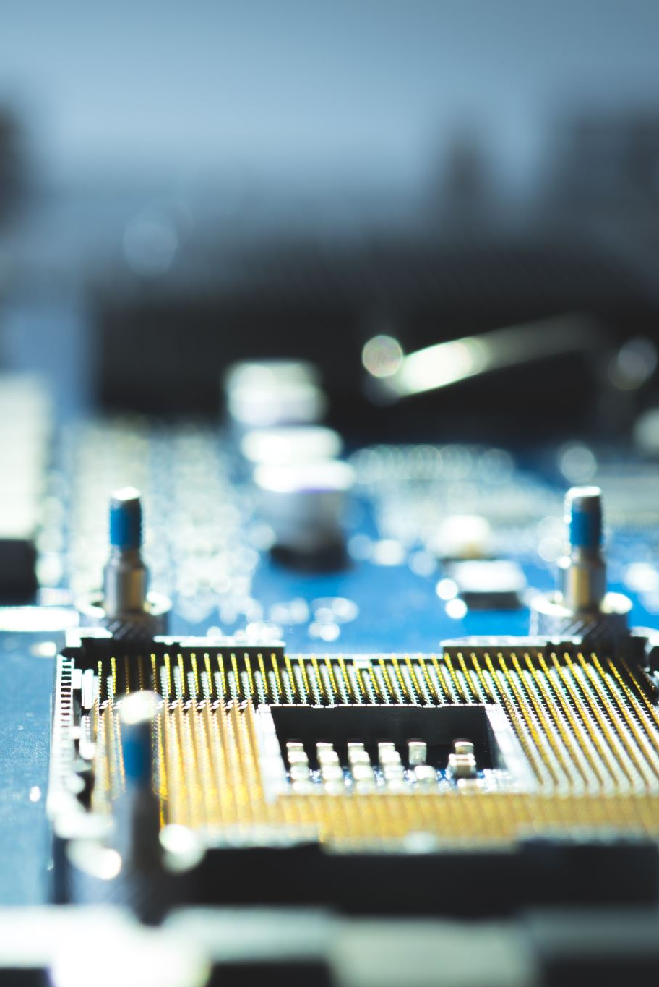
Storage & Expansion
Boot from microSD or external SSD
PCIe slot for NVMe storage expansion
40-pin GPIO header for electronics projects

Slide 10
Use Cases
Affordable desktop replacement
Robotics & IoT projects
Media center (Kodi, Plex, 4K streaming)
Home automation
AI & ML experiments

Slide 11
Comparison: Pi 4 vs Pi 5
CPU: Cortex-A72 @ 1.5GHz → Cortex-A76 @ 2.4GHz
GPU: VideoCore VI → VideoCore VII
USB: 2× USB 3.0 → 2× USB 3.0 + PCIe
Power: 5V/3A → 5V/5A

Slide 12
Advantages & Limitations
✅ Faster performance
✅ PCIe expandability
✅ Dual 4K displays
⚠️ Higher power requirement
⚠️ Needs cooling for heavy use

Slide 13
Conclusion
Raspberry Pi 5 is the most powerful Pi yet
Brings desktop-class computing in small form factor
Ideal for students, makers, and developers

Slide 14

References
Raspberry Pi Official Website: https://www.raspberrypi.com
NetworkChuck. “the Raspberry Pi 5.” YouTube, 28 Sept. 2023, www.youtube.com/watch?v=jsKqQvFk7Sk.

