Slide 1
AI Job Market Intelligence
Business Insights for Hiring & Compensation Strategy
Jerel Velarde | Business Presentation | March 2026

Slide 2
Executive Summary
$112K
2-3x
~56%
41%
Average AI Salary
Executive vs Entry Gap
US-Based Roles
Salary Variance Explained
We analyzed 565 data science job records from 2020-2022 to identify the key drivers of AI compensation. Experience level emerged as the single most important factor, with executive-level professionals earning 2-3x entry-level salaries. US-based roles command significantly higher pay, and company size plays a meaningful role in salary determination.
These findings can guide hiring managers in benchmarking offers, help HR teams build equitable compensation frameworks, and inform talent acquisition strategy.

Slide 3
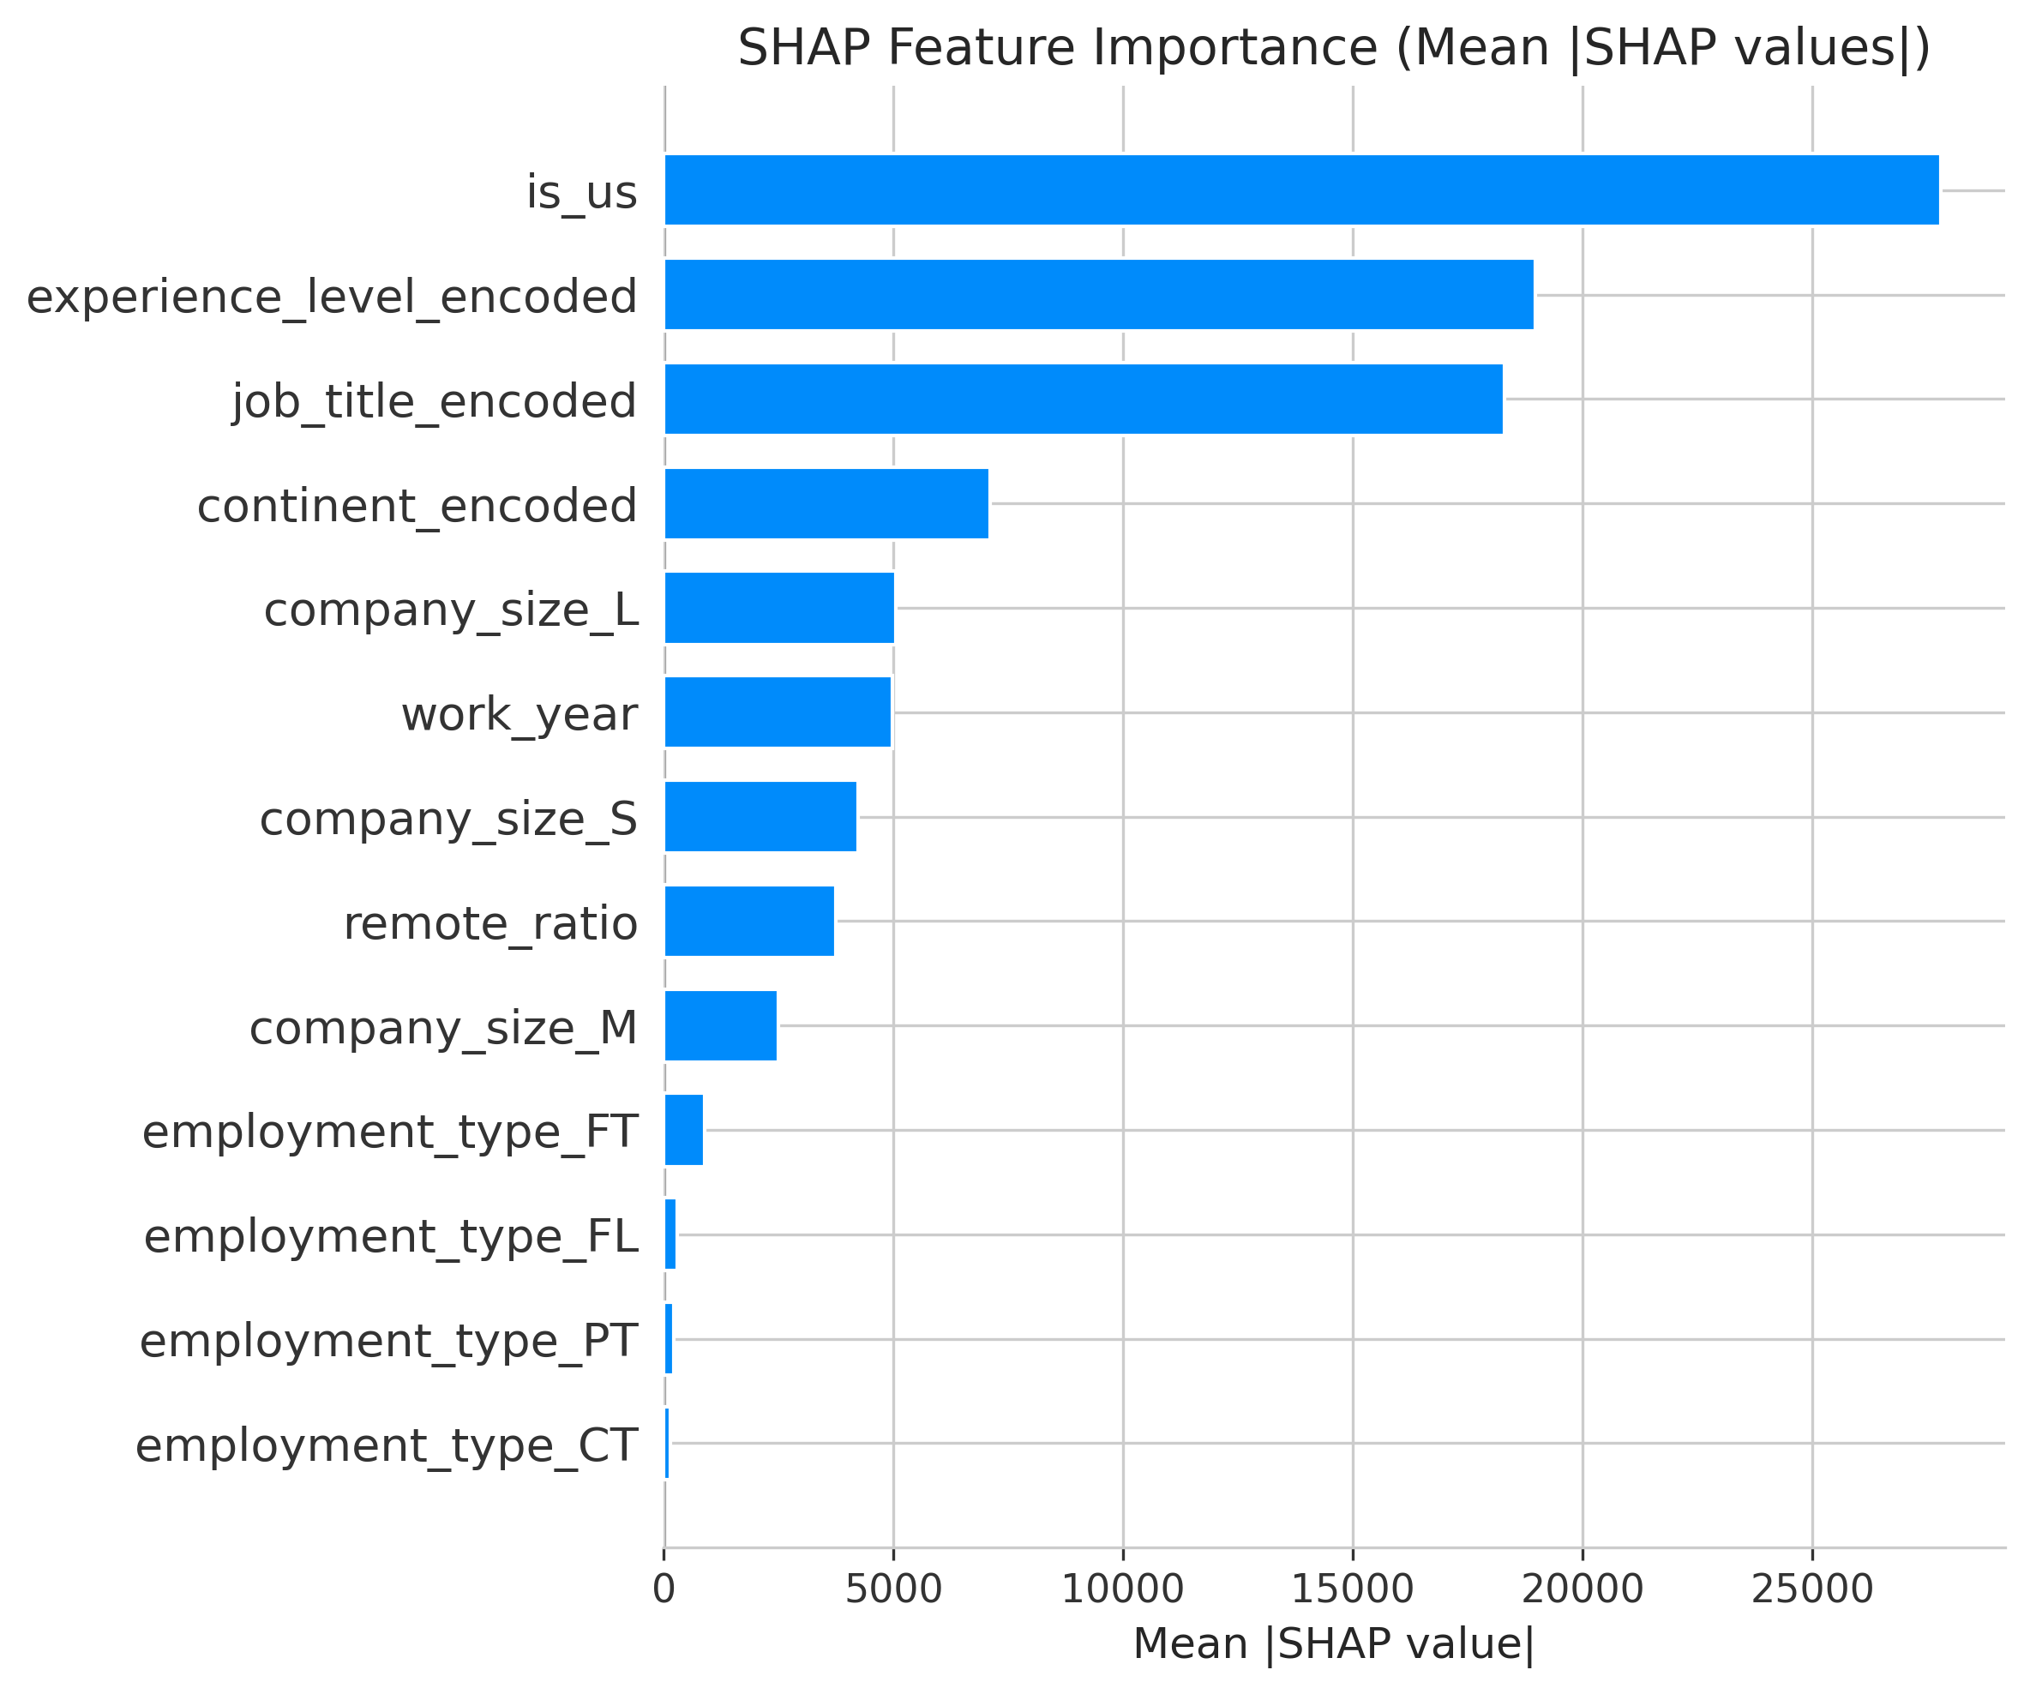
What Drives AI Salaries?
Salary Impact Ranking
1. Experience Level — the dominant factor driving compensation differences
2. Job Title — specialized roles (ML Engineer, Data Architect) command premium pay
3. Company Size — larger organizations offer higher base salaries
4. Geography — US-based roles significantly out-earn international counterparts
5. Remote Ratio — modest impact, with some remote premium observed

Slide 4
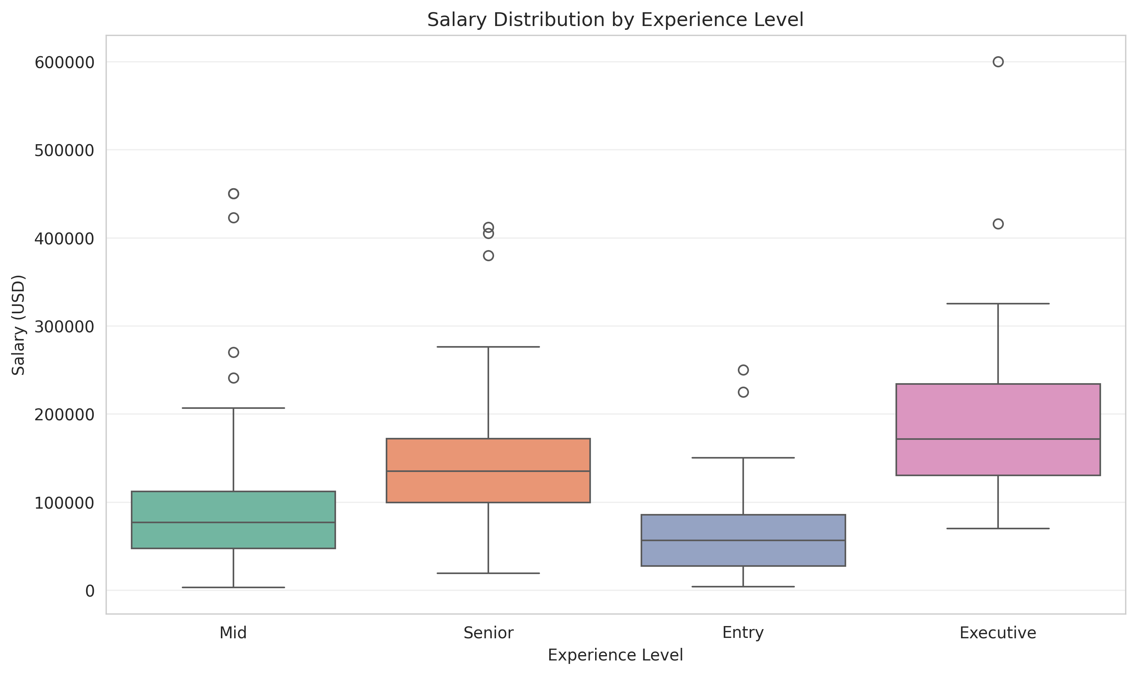
Experience Level Impact on Compensation
Entry (EN)
~$55K
Mid (MI)
~$85K
Senior (SE)
~$120K
Executive (EX)
~$175K
Recommendation: Budget 2-3x salary growth for senior AI hires. Entry-level talent offers strong ROI with mentorship investment.

Slide 5
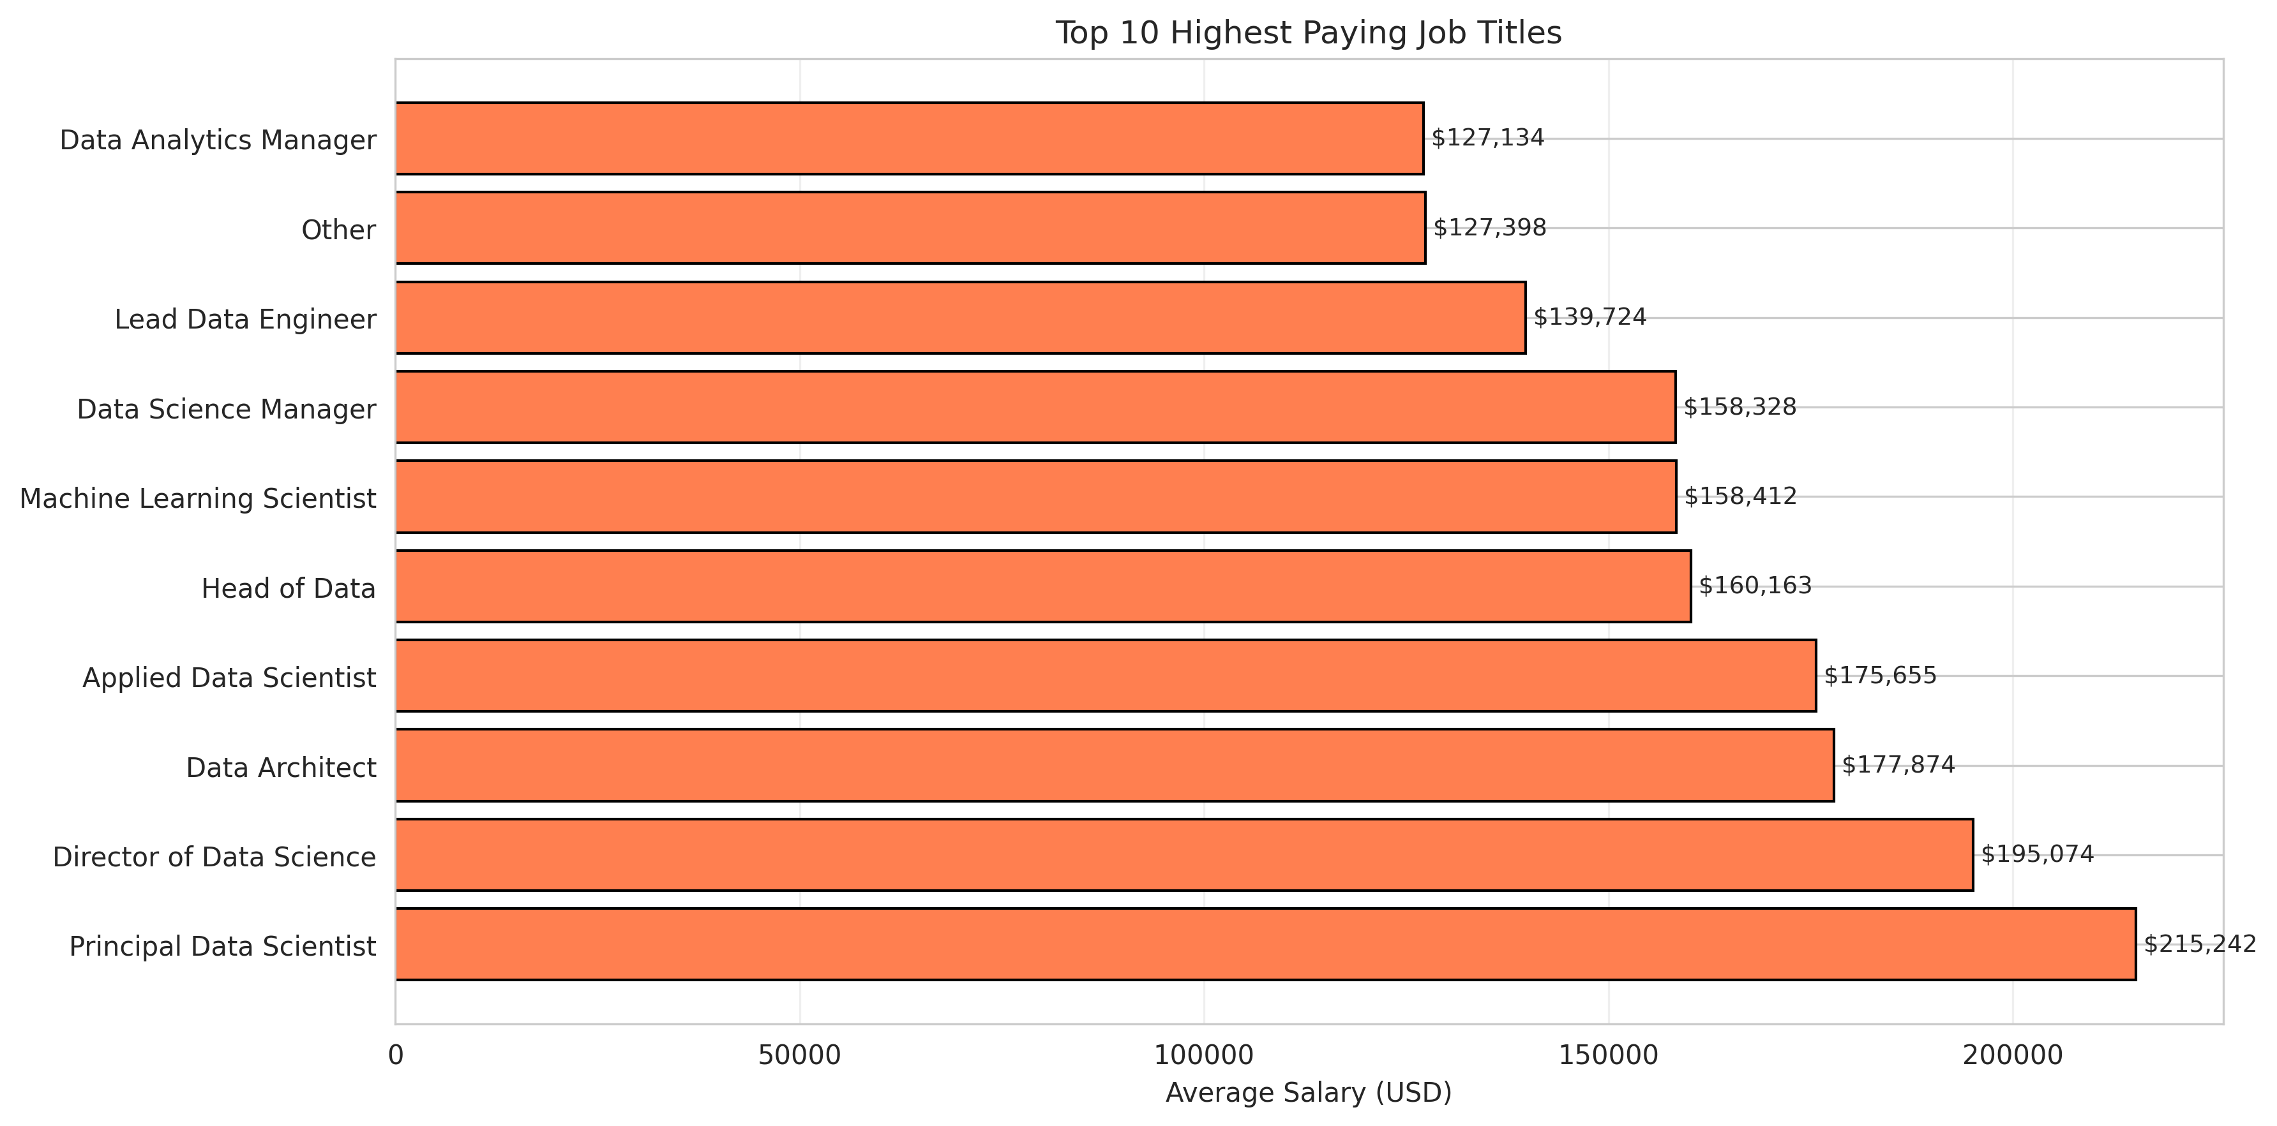
Top-Paying AI Roles & Skills
Specialized roles like Data Analytics Lead, Principal Data Engineer, and ML Engineer command the highest premiums. Companies competing for these profiles need above-market offers to attract top talent.

Slide 6
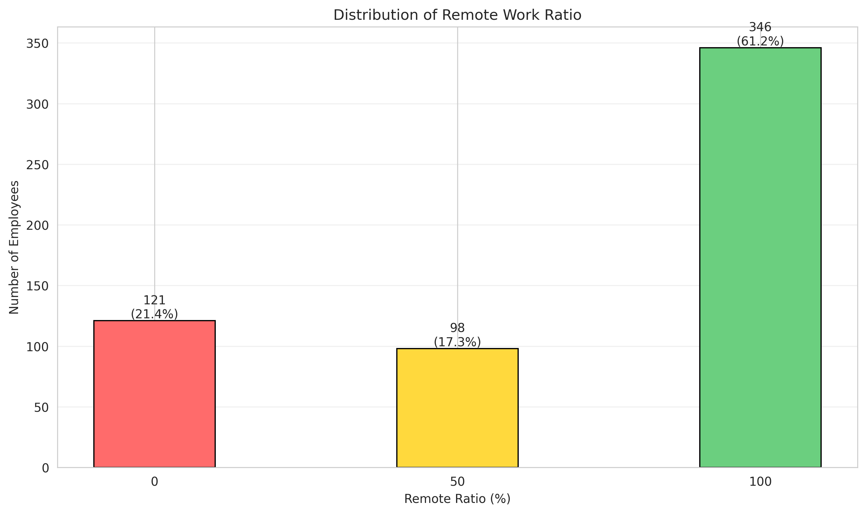
Remote vs On-Site Salary Analysis
Remote Work Trends
Majority of AI roles offer full remote (100%) or full on-site (0%) — hybrid remains uncommon
Remote roles show a slight salary premium, likely reflecting talent competition across geographies
Remote-first policies expand the candidate pool but may increase salary expectations
Action: Consider location-adjusted bands for remote hires vs. single global rate

Slide 7
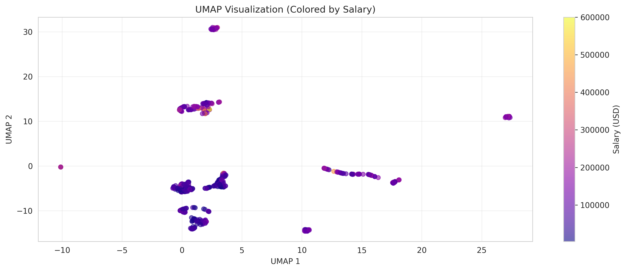
AI Job Market Trends (2020-2022)
Market Insights
Dataset spans 2020–2022 with growing representation of remote and senior roles
Demand for senior/executive AI talent significantly outpaces supply
Job title proliferation shows market maturation — more specialized roles emerging
UMAP clustering reveals distinct salary segments driven primarily by experience and specialization

Slide 8
Recommendations
For Hiring Managers
Benchmark offers using experience level as the primary anchor. Budget 2-3x for senior hires vs entry-level. Specialized titles warrant 15-25% premiums.
For HR / Compensation
Build transparent salary bands tied to experience level tiers. Consider location-adjusted remote rates. Audit for geographic and company-size bias in current pay scales.
For Talent Acquisition
Prioritize remote-friendly policies to access wider talent pools. Highlight growth paths — the experience premium is the strongest salary motivator for candidates.
For Leadership
Invest in internal training pipelines (Entry → Mid → Senior) for cost-effective talent development. The 2-3x experience premium makes retention far cheaper than external hiring.
Jerel Velarde — AI Job Market Intelligence — March 2026

