Slide 1
AI Job Market Intelligence
Predicting AI Salaries from Skills & Job Attributes
Jerel Velarde | Pillar 5 Capstone | March 2026

Slide 2
Problem Statement
565
Objective
Build a regression model to predict AI/Data Science salaries (salary_in_usd) from job attributes such as experience level, employment type, company size, remote ratio, and location.
Why It Matters
Understanding salary drivers helps job seekers negotiate, employers benchmark compensation, and educators align curricula with market demand.
cleaned rows
11
original columns
USD
salary_in_usd

Slide 3
Dataset Overview
Feature | Type | Description
work_year | Integer | Year salary was paid (2020-2022)
experience_level | Categorical | EN / MI / SE / EX
employment_type | Categorical | FT / PT / CT / FL
job_title | Categorical | 50 unique titles (grouped for modeling)
salary_in_usd | Integer | Target — range $2,859 to $600,000
remote_ratio | Integer | 0 (on-site), 50 (hybrid), 100 (remote)
company_size | Categorical | S / M / L
Source: Kaggle — "Data Science Job Salaries" by Ruchi Bhatia (CC0 License)

Slide 4
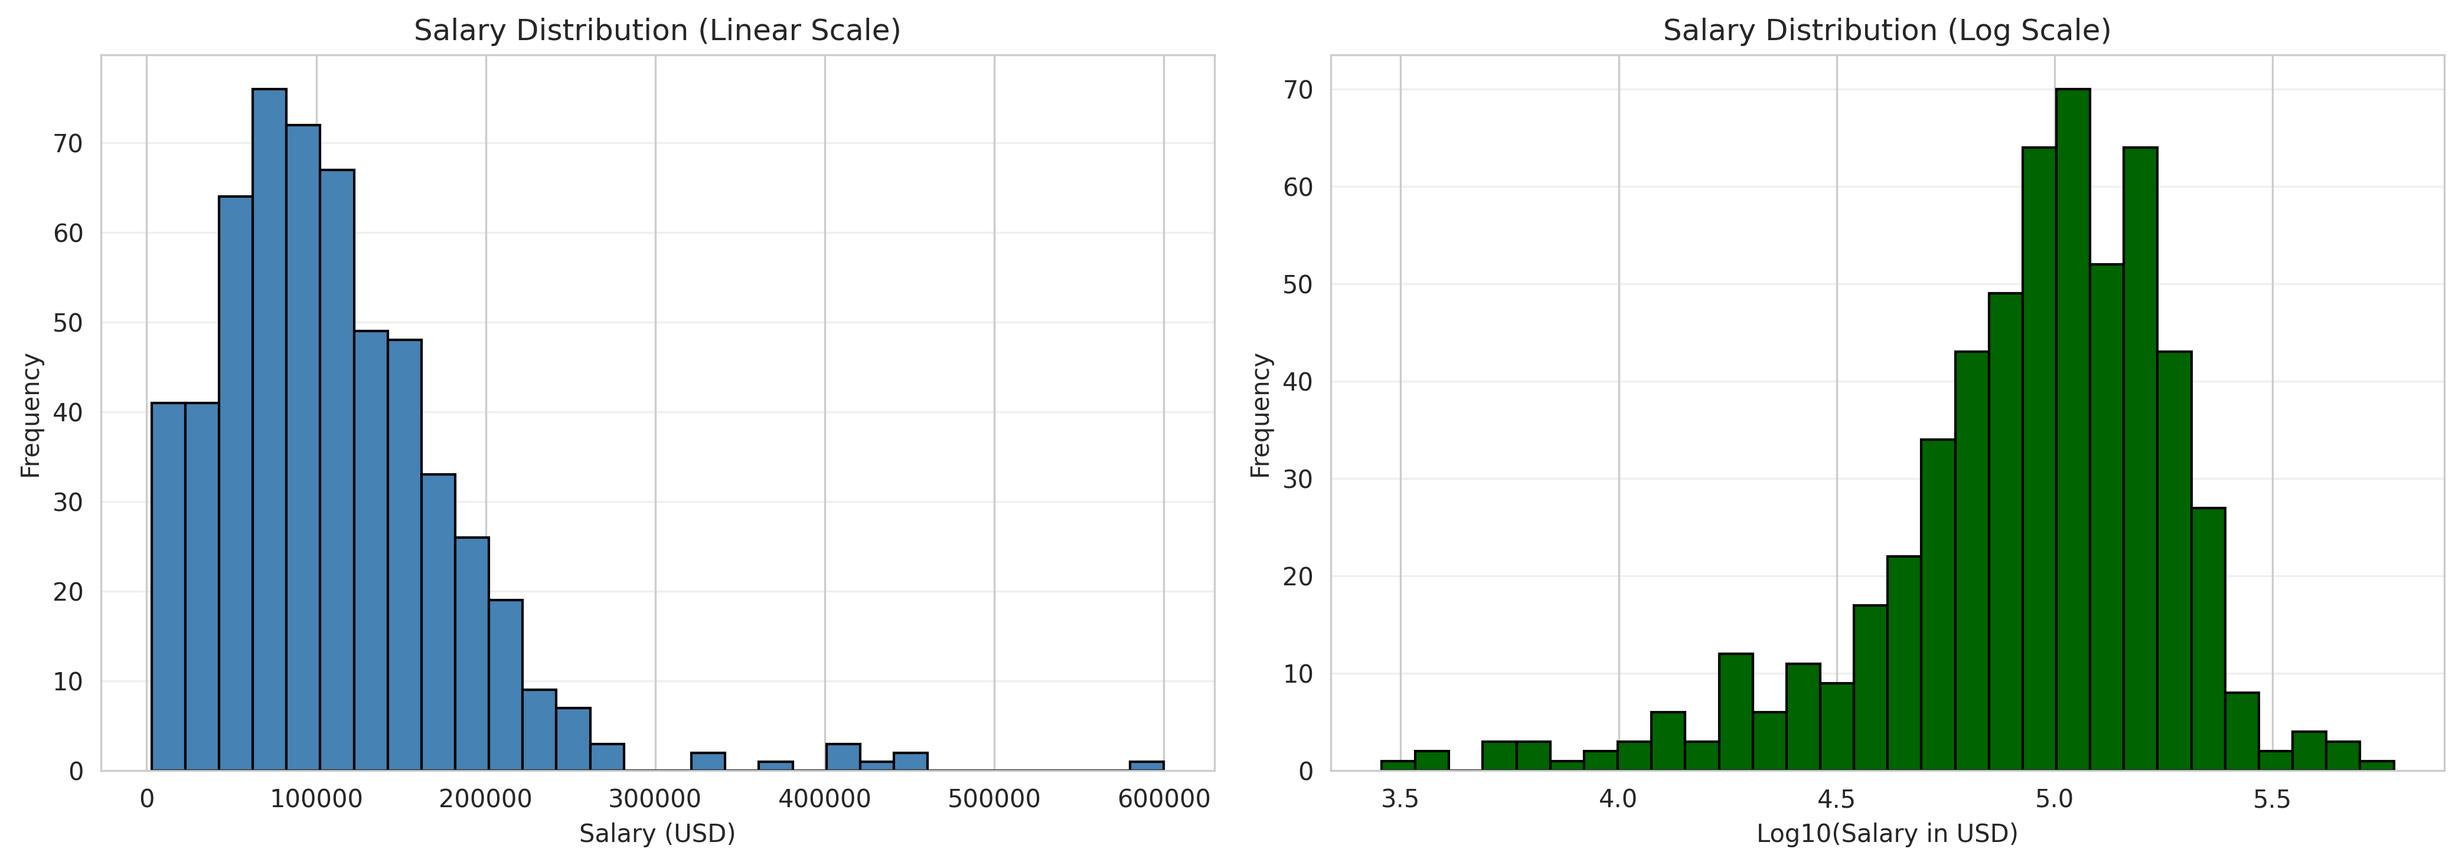
Exploratory Data Analysis
Key Findings
Mean: $112,297
Median: $101,570
Right-skewed distribution with outliers above $300K
42 duplicates removed during cleaning

Slide 5
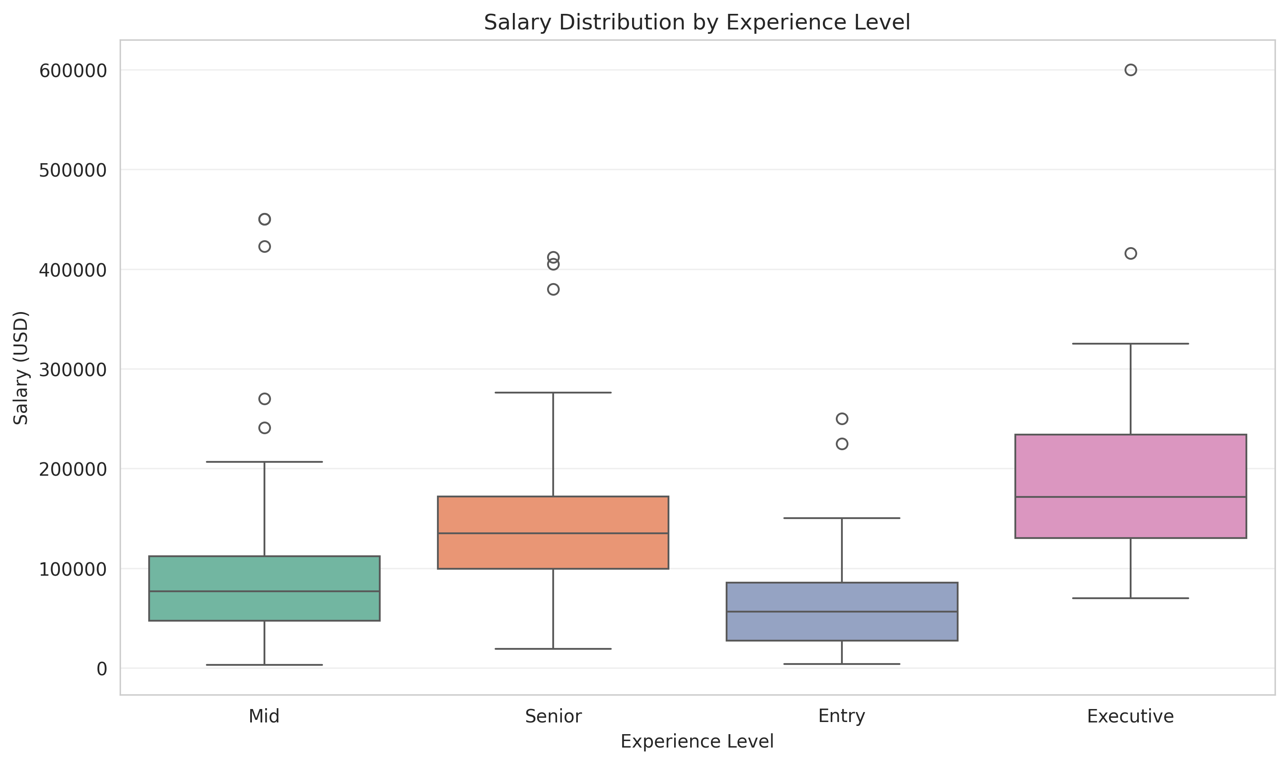
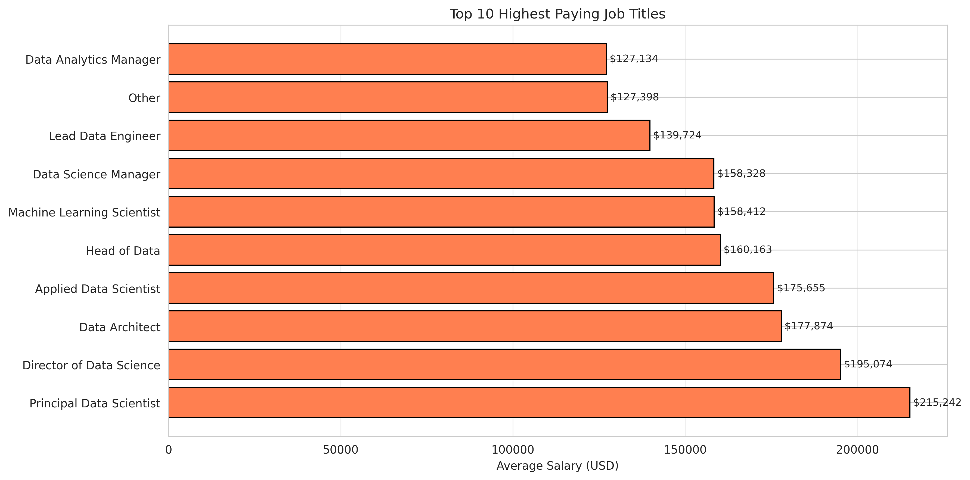
Salary by Experience & Top-Paying Roles
Experience level is the strongest single predictor — Executive roles earn 2-3x Entry-level salaries

Slide 6
Feature Engineering
Ordinal Encoding
Job Title Grouping
experience_level mapped to 1-4 (EN, MI, SE, EX) to preserve natural ordering
Titles with < 5 occurrences grouped as "Other" to reduce cardinality (50 → ~15)
Geographic Features
Label Encoding
Extracted continent from country code + binary is_us flag for US vs international
Remaining categoricals (employment_type, company_size, etc.) label-encoded for tree models

Slide 7
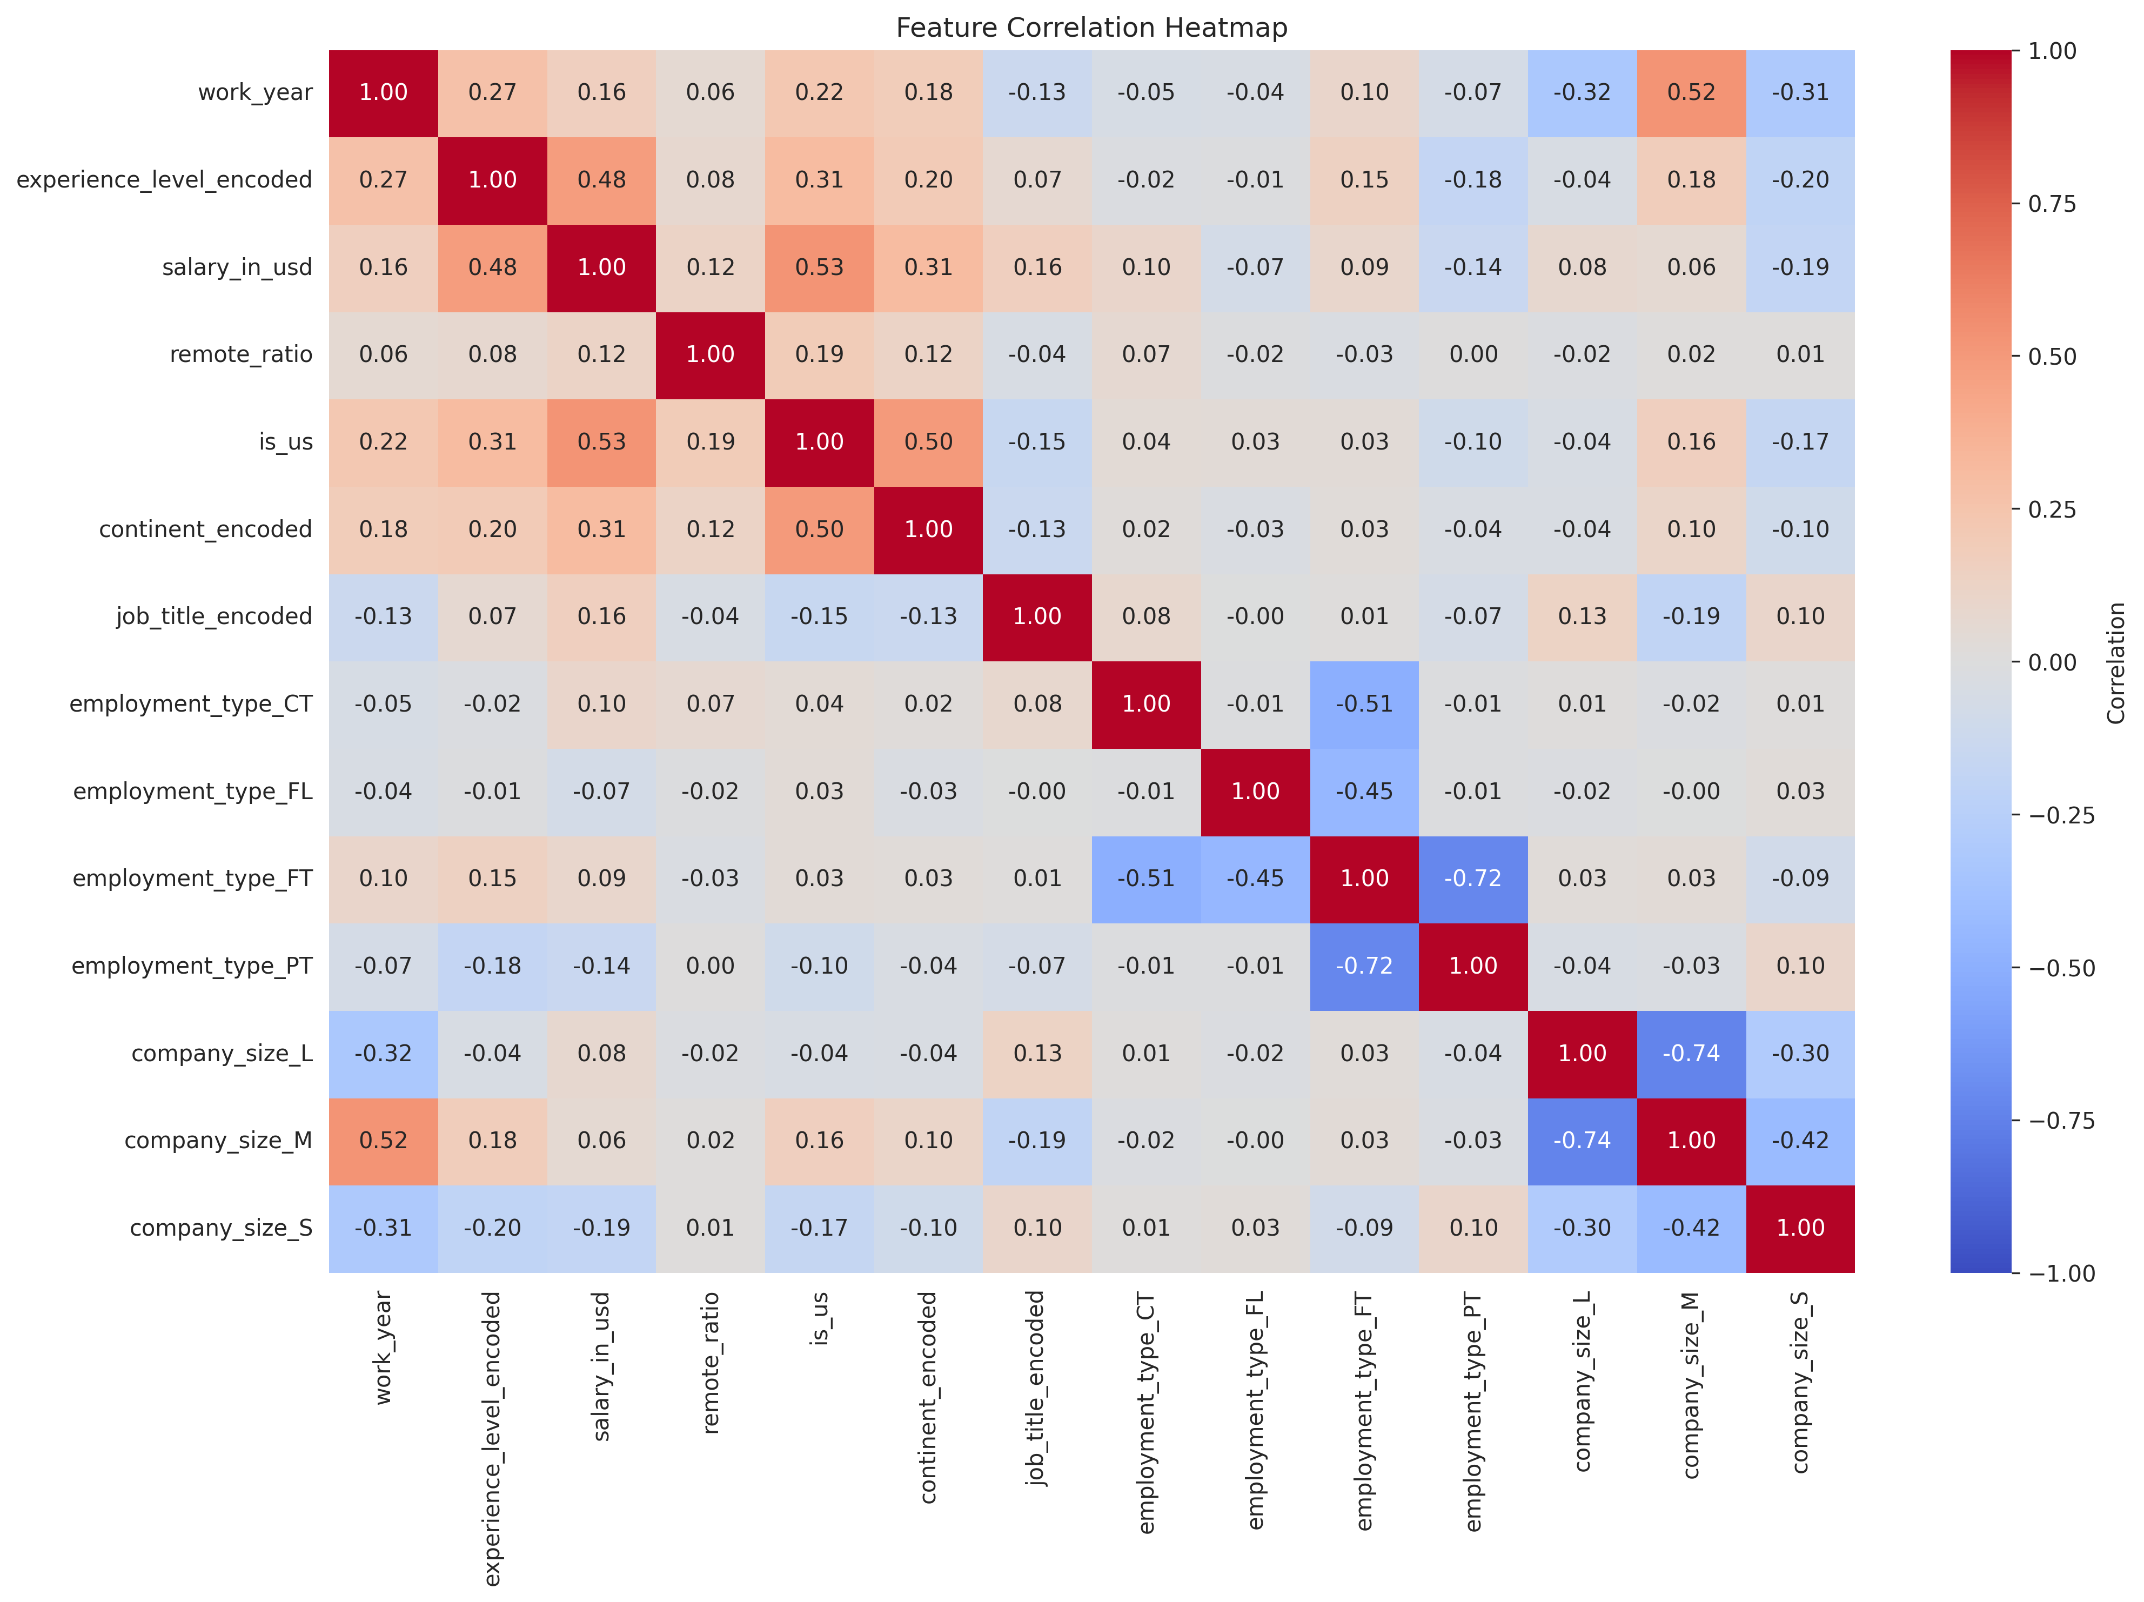
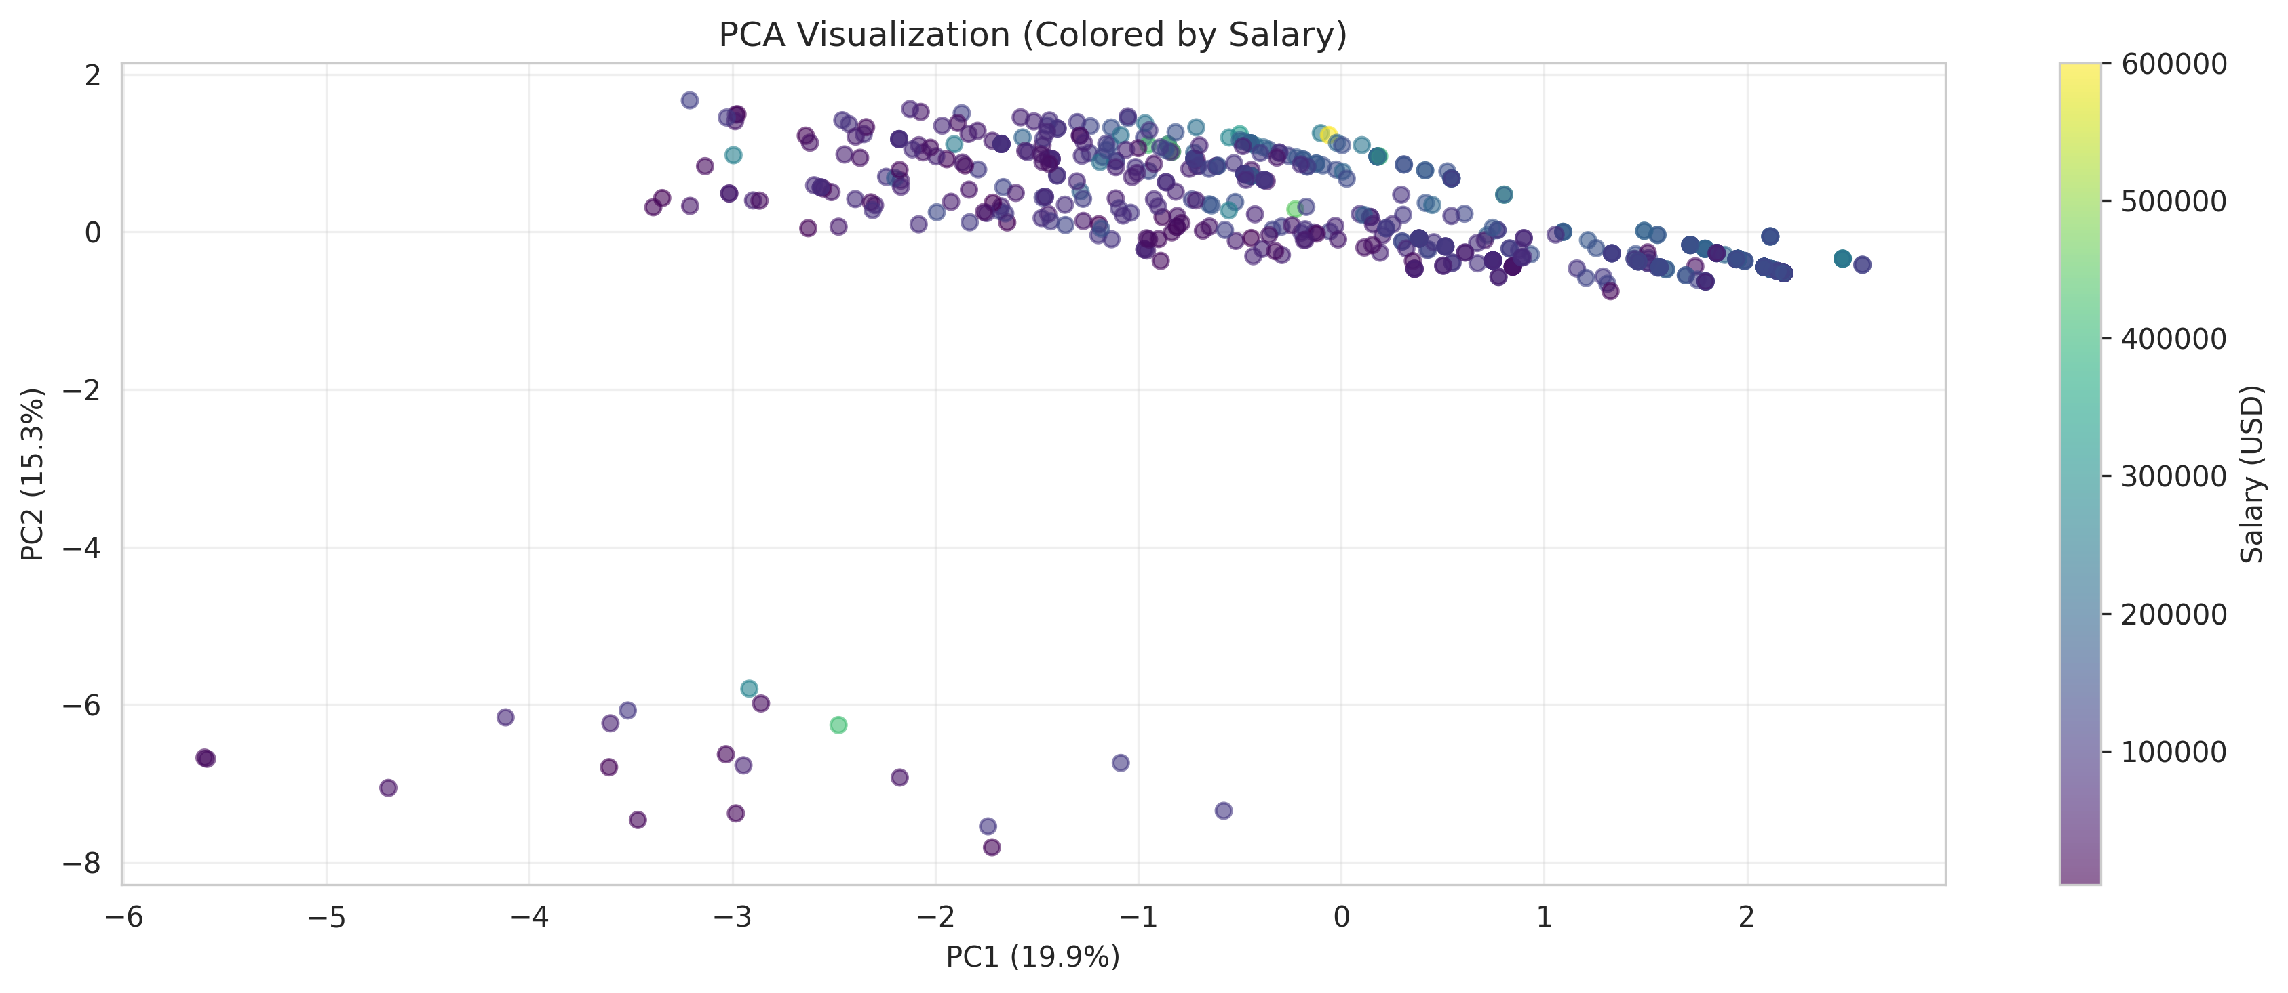
Correlation & Dimensionality Reduction
Left: Feature correlations — experience_level_ord shows strongest positive correlation with salary. Right: PCA 2D projection colored by experience level.

Slide 8
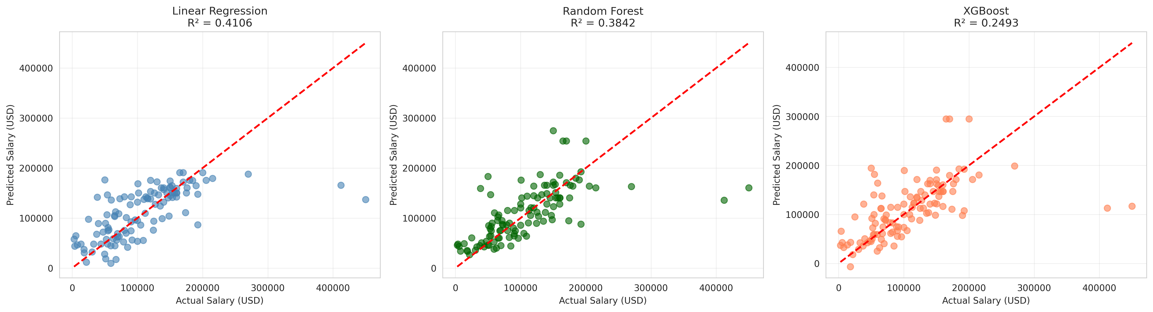
Model Implementation & Results
Model | RMSE | MAE | R²
Linear Regression | $53,248 | $33,731 | 0.41
Random Forest | $53,436 | $32,189 | 0.41
XGBoost | $53,813 | $32,574 | 0.40
Linear Regression achieves the best test R² = 0.41 — modest but realistic for 565 rows with limited features

Slide 9
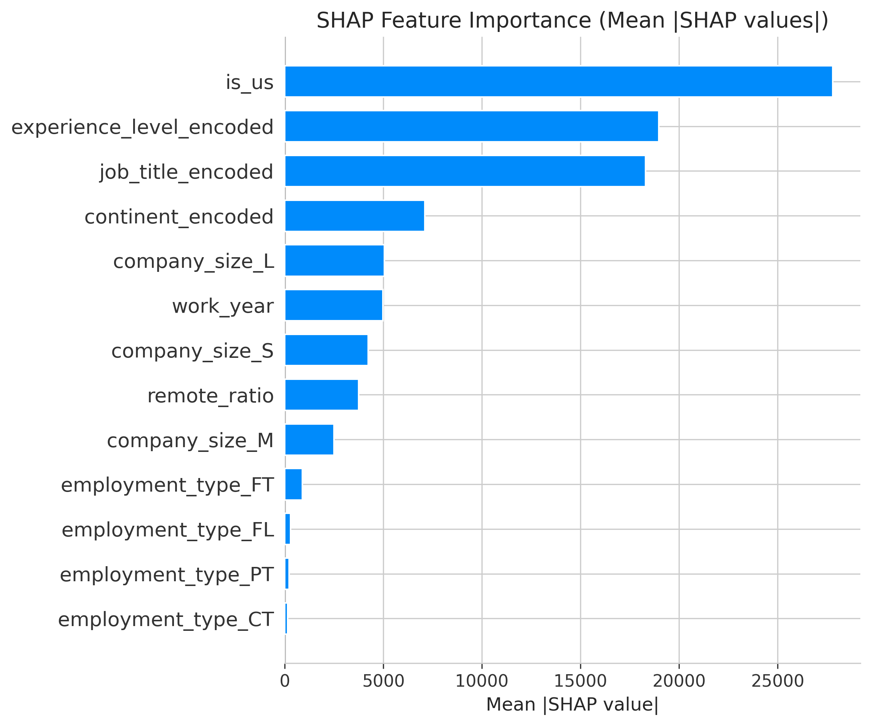
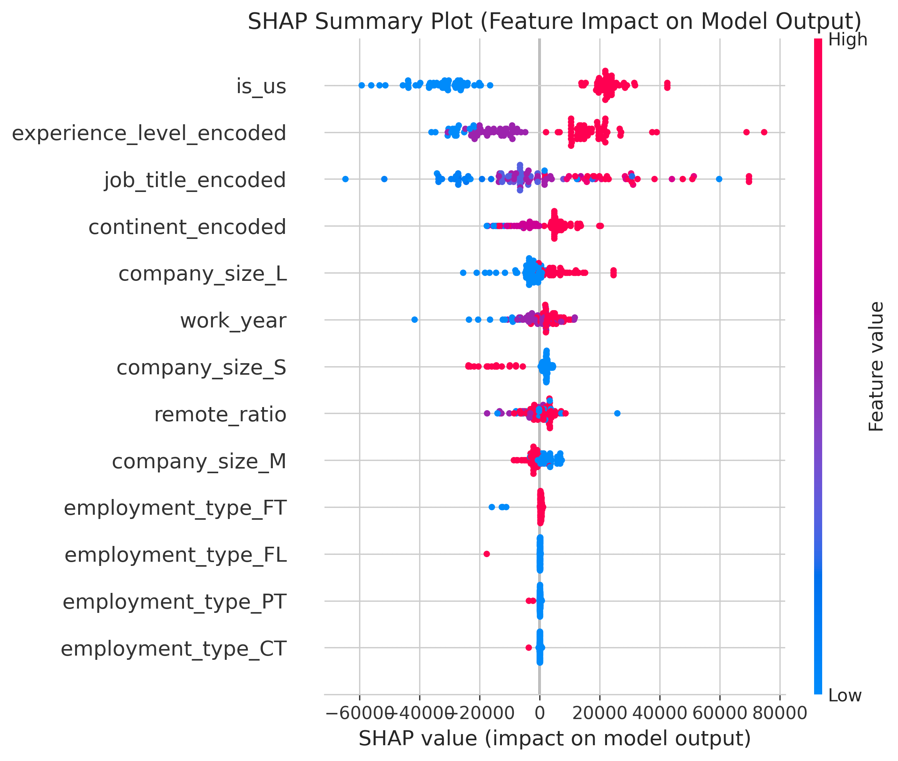
SHAP Explainability Analysis
SHAP values reveal experience_level_ord as the dominant salary predictor, followed by job_title_encoded and company_size_encoded

Slide 10
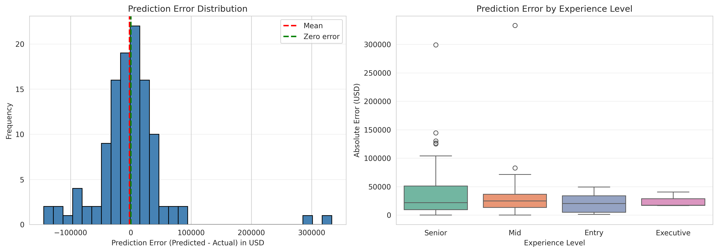
Bias & Error Analysis
Bias Observations
Geographic: US-based roles dominate the dataset (~75%), creating prediction bias for non-US salaries
Experience: Senior/Executive levels have fewer samples, wider error margins
Company Size: Large companies over-represented; small company predictions less reliable
Outliers: A few extreme salaries ($400K+) disproportionately affect RMSE

Slide 11
Key Takeaways
Best Model
Linear Regression (R²=0.41, MAE=$33,731) achieved the best test performance
Top Predictor
Experience level is the single strongest salary driver, confirmed by SHAP analysis
Data Limitations
Small dataset (565 rows) and limited feature set constrain model performance
Next Steps
Larger datasets, NLP on job descriptions, time-series analysis for salary trend forecasting
Jerel Velarde — AI/ML Capstone Project — March 2026

