Slide 1
How to Implement the Lambda Calculus, Quickly
Stephanie Weirich
University of Pennsylvania
IFL
September 3, 2021
https://github.com/sweirich/lambda-n-ways/

Slide 2
Key lambda-calculus operation
Capture-avoiding substitution
a { b / x }
(z (λy.z)) { y / z }
⟾
y (λw. y)

Slide 3
Haskell implementation
data Exp = Var Var -- x
| Lam (Bind Exp) -- λx.a
| App Exp Exp -- (a b)
type Var -- some way to represent variables
type Bind t -- some way to represent binding/scope
subst :: Var -> Exp -> Exp -> Exp -- a { b / x }

Slide 4
Too many answers
Names: simple renaming
Names: nominal
de Bruijn indices
de Bruijn levels
co-de-Bruijn representation
HOAS
Weak HOAS / PHOAS
Locally Nameless
Locally Named
Canonically Named
…
These implementations differ in
the representation of variables and binders
the implementation of alpha-equivalence, capture-avoiding substitution functions
what you need to do to implement other operations

Slide 5
Why so many?
Different goals: compiler vs. type checker vs. didactic explanation vs. proofs
Subtle bugs are common, some designed to be "easier to implement"
Subtle bugs are common, some designed to be "easier to use"
Proofs are important, some designed to be "easier to reason about"
Performance is important, some designed to be "faster"
But … which should you use if you care about all of these?

Slide 6
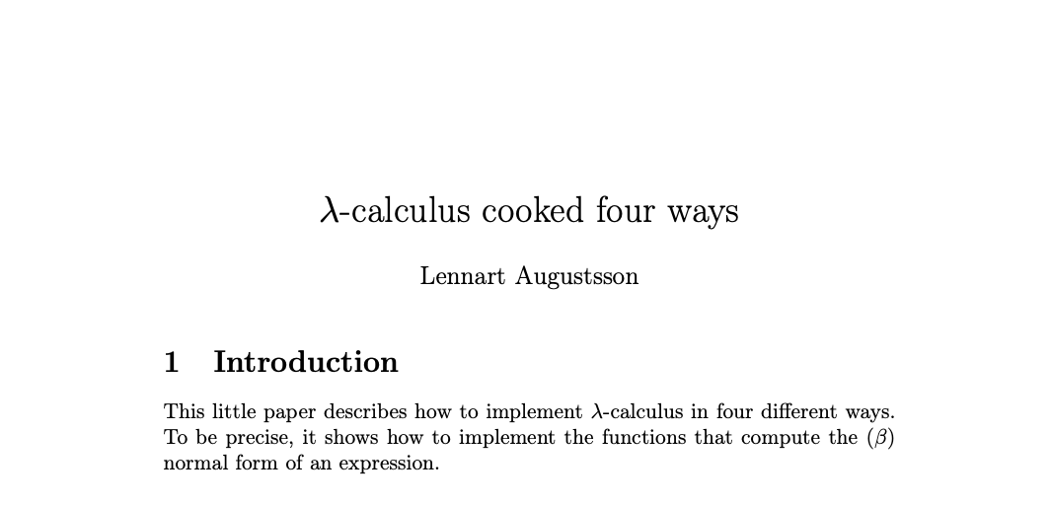
Inspiration
2005-2006, https://github.com/steshaw/lennart-lambda
Notes:
a "little paper"
really a literate Haskell implementation
Stand on the shoulders of giants
focusses on capture-avoiding substitution
we'll make sure that we can also calculate alpha-equiavalence

Slide 7
Today
Three common approaches
Names
de Bruijn indices
Locally nameless representation
Compare implementations of normalization, which uses capture-avoiding substitution
Can make implementation faster by caching information at binders
Can make implementation easier by generic programming
Considerable overlap in performance

Slide 8
Example: Computing normal form with names
λw. λx. (λy. w y (λx. w y (λy. w y))) (x x x)
λw. λx. w (x x x) (λz. w (x x x) (λy. w y))
substitute (x x x) for y
rename x to avoid capture
stop when y not free

Slide 9
Example: with de Bruijn indices
λw. λx. (λy. w y (λx. w y (λy. w y))) (x x x)
λ. λ. (λ. 2 0 (λ. 3 1 (λ. 4 0))) (0 0 0)
λ. λ. 1 (0 0 0) (λ. 2 (1 1 1) (λ. 3 0))
substitute (0 0 0) for 0
decrement other variables
after reduction
increment (0 0 0) under binders

Slide 10
Example: with Locally nameless
λw. λx. (λy. w y (λx. w y (λy. w y))) (x x x)
λ. λ. (λ. 2 0 (λ. 3 1 (λ. 4 0))) (0 0 0)
(λ. w 0 (λ. w 1 (λ. w 0))) (x x x)
w (x x x) (λ. w (x x x) (λ. w 0))
λ. λ. 1 (0 0 0) (λ. 2 (1 1 1) (λ. 3 0))
name outermost
variables to expose
beta-reduction
substitute (x x x) for 0
replace names with
indices when finished

Slide 11
Bookkeeping during b {a/x}
Names: rename bound variables to avoid capture
calculate free variables of a
rename bound variables in b with a "fresh" name
calculate all variables in b, avoid names that have been used
de Bruijn: adjust indices
shift free indices in a depending on binding depth
decrement indices of b b/c we lose a binder
Locally nameless: exchange names/indices
invariant: a has no "free" indices, only free names
exchange happens during every traversal, not just substitution
need to choose "fresh" names

Slide 12
What does reduction look like?
data Exp =
Var Var
| Lam (Bind Exp)
| App Exp Exp
https://github.com/sweirich/lambda-n-ways/
Lennart.Simple: named implementation from "Lambda Calculus Cooked Four Ways"
Lennart.DeBruijn: index implementation from "Lambda Calculus Cooked Four Ways"
LocallyNameless.Ott: Implementation generated by Ott tool, translated to Haskell

Slide 13
Normal-order full reduction w/ names
nf :: Exp -> Exp
nf (Var x) = Var x
nf (Lam (Bind x e)) =
-- recurse under binder
Lam (Bind x (nf e))
nf (App a b) =
case whnf a of
Lam (Bind x a0) ->
nf (subst x b a0)
a' -> App (nf a') (nf b)
whnf :: Exp -> Exp
whnf (Var x) = Var x
whnf (Lam b) =
-- don't recurse
Lam b
whnf (App a b) =
case whnf a of
Lam (Bind x a0) ->
whnf (subst x b a0)
a' -> App a' b
-- normalize head only

Slide 14
Normal-order full reduction w/ indices
nf :: Exp -> Exp
nf (Var x) = Var x -- x is an Int (index)
nf (Lam (Bind e)) = -- no Var stored at binder
-- recurse under binder
Lam (Bind (nf e))
nf (App a b) =
case whnf a of
Lam (Bind a0) ->
nf (subst 0 b a0) -- adjust indices during subst
a' -> App (nf a') (nf b)

Slide 15
Reduction w/ locally nameless terms
nf :: Exp -> N Exp -- "freshness monad"
nf (Var x) = return (Var x) -- x is a name or index
nf (Lam b) = do -- no Var at binder
x <- fresh
b' <- nf (open b (Var x)) -- open: convert index to name
Lam <$> close x b' -- close: convert name to index
nf (App a b) = do
a' <- whnf a
case a' of
Lam a0 -> nf (open a0 b) -- open is substitution
_ -> App <$> nf a' <*> nf b

Slide 16
But which is faster?
https://github.com/sweirich/lambda-n-ways/
Lennart.Simple: named implementation from "λ-Calculus Cooked Four Ways", with bugfix
Lennart.DeBruijn: index implementation from "λ-Calculus Cooked Four Ways"
LocallyNameless.Ott: Implementation generated by Ott tool, then translated to Haskell

Slide 17
Lennart's benchmark
Normal-order reduction of the Church encoding of 6! == sum [1 .. 37] + 17
i.e. 720 == 719
Benchmark statistics
Number of substitutions required for normalization: 119,697
AST depth: 53, binding depth: 25
Average # of variable occurrences during each beta-reduction: 1.15
Notes:
NOTE: We aren't trying to make normalization fast, just create a lot of repeated calls to substitution.

Slide 18
Benchmark results: head-to-head
MacBook pro, 2.4 GHz 8-Core Intel Core i9, 64 GB, measured using criterion

Slide 19
Strictness annotations
data Exp =
Var Var
| Lam (Bind Exp)
| App Exp Exp
data Exp =
Var {-# UNPACK #-} !Var
| Lam !(Bind Exp)
| App !Exp !Exp

Slide 20
Benchmark results: strictness annotations

Slide 21
Can we do better? Yes!
In all three versions, bookkeeping leads to multiple traversals
General Idea: generalize traversals and cache info at binders
subst :: Sub Exp -> Exp -> Exp
For Names
Multi-substitution type Sub a = Map Var a
Cache free vars data Bind a = Bind VarSet Var a
Benefits
Can cut off substitution early if domain doesn't affect free variables
Fuse renaming substitutions with normal substitutions
Find fresh variables quickly

Slide 22
Can we do better? Yes!
In all three versions, bookkeeping leads to multiple traversals
General Idea: generalize traversals and cache info at binders
subst :: Sub Exp -> Exp -> Exp
For de Bruijn indices
Multi-substitution data Sub a = Inc Int | Cons a (Sub a) | Compose (Sub a) (Sub a)
Cache substitution data Bind a = Bind (Sub a) Var a
Benefits
Fewer traversals: multiple indices replaced simultaneously
Compose substitutions using smart constructors

Slide 23
Can we do better? Yes!
In all three versions, bookkeeping leads to multiple traversals
General Idea: generalize traversals and cache info at binders
subst :: Sub Exp -> Exp -> Exp
For Locally Nameless
Multi-subst/close type Sub a = (Int, [Exp])
Cache last traversal data Bind a = Bind (Info a) Var a data Info a = NoInfo | Subst Int [a] | Close Int [IdInt]
Benefits
Fewer traversals: multiple indices/names replaced simultaneously

Slide 24
Comparison: Strict vs. Optimized

Slide 25
Can we implement substitution more quickly?

Slide 26
Binding libraries
Idea: isolate the tricky code into a library
Interface of the library depends on the approach
Example: Name-based binding library
newtype Var = V IdInt -- concrete type Bind a -- abstract, hides cached var set type Sub a -- abstract
plus functions to create & destruct Bind/Sub types

Slide 27
Name-based library operations
class VarC a where
var :: Var -> a -- needed for renaming
class FreeVarsC a where
freeVars :: a -> VarSet
class FreeVarsC a => SubstC b a where
subst :: Sub b -> a -> a -- freeVars needed to -- avoid capture
Instances for Var and Bind types provided by library

Slide 28
Straightforward client instances
instance VarC Exp where
var = Var instance FreeVarsC Exp where
freeVars (Var v) = freeVars v -- uses Var instance
freeVars (Lam b) = freeVars b -- uses Bind instance
freeVars (App f a) = freeVars f `union` freeVars a
instance SubstC Exp Exp where
subst s (Var v) = substVar s v -- library function
subst s (Lam b) = Lam (subst s b) -- uses Bind instance
subst s (App f a) = App (subst s f) (subst s a)

Slide 29
Overloaded and Generic operations
class VarC a where
var :: Var -> a
isvar :: a -> Maybe Var -- a little more info about vars
isvar _ = Nothing
class FreeVarsC a where
freeVars :: a -> VarSet
freeVars x = … -- default definition using GHC.Generics
-- and isvar

Slide 30
Generic client instances, virtually no code
instance VarC Exp where
var = Var
isvar (Var v) = Just v
isvar _ = Nothing
instance FreeVarsC Exp where
instance SubstC Exp Exp where

Slide 31
Generic client instances, virtually no code
instance VarC Exp where
{-# SPECIALIZE instance VarC Exp #-}
var = Var
isvar (Var v) = Just v
isvar _ = Nothing
instance FreeVarsC Exp where
{-# SPECIALIZE instance FreeVarsC Exp #-}
instance SubstC Exp Exp where
{-# SPECIALIZE instance SubstC Exp Exp #-}

Slide 32
Comparison: Optimized vs. Generic

Slide 33
Benchmark summary

Slide 34
Use binding libraries, people
Libraries for optimized named, locally nameless and de Bruijn representations available on github https://github.com/sweirich/lambda-n-ways
Other binding libraries available on Hackage & provide more
Unbound (Weirich & Yorgey), GHC version <= 8.8.3
unbound-generics (Kliger)
bound (Kmett)
nominal (Selinger)
nom (Gabbay)

Slide 35
Conclusions
This is one benchmark, so don't read too much into it
Optimizations more significant than representation
Class-based library and generic programming worth it (caveat: compilation time)
More implementations and benchmarks available in repository: https://github.com/sweirich/lambda-n-ways Contributions welcome!

Slide 37
This work (in progress)
https://github.com/sweirich/lambda-n-ways/
Inspired by Lennart Augustsson's "Lambda Calculus Cooked Four Ways"
Collection of implementations & variations for comparison
lib/DeBruijn
lib/LocallyNameless
lib/Named
others…
Common test suite
Benchmarks
Used for differing purposes, so no "typical" workload
Language is impoverished, but don't want to over-emphasize Church encodings
Notes:
Warning: Some implementations "in the wild" have bugs!
Project opportunity: use mutation testing to evaluate QC properties and shrink the unit test suite

Slide 38

de Bruijn indices
and variations

Slide 39

de Bruijn indices
and variations

Slide 40
de Bruijn implementations
data Exp = Var Var
| Lam (Bind Exp)
| App Exp Exp
deriving (Eq)
type Var = Int -- variables are indices type Bind t = t -- no info at binders
\x -> x (\y -> x y)
Lam (App (Var 0) (Lam (App (Var 1) (Var 0))))

Slide 41
TAPL definition of substitution
subst :: Var -> Exp -> Int -> Exp -> Exp
subst j b = walk
where
walk c (Var x) = if x == j + c then shift c 0 b else Var x
walk c (Lam t2) = Lam (walk (c + 1) t2)
walk c (App t1 t2) = App (walk c t1) (walk c t2)
shift :: Int -> Int -> Exp -> Exp
shift d = walk
where
walk c (Var x) = if x >= c then Var (x + d) else Var x
walk c (Lam t2) = Lam (walk (c + 1) t2)
walk c (App t1 t2) = App (walk c t1) (walk c t2)
Notes:
Find and apply the leftmost beta-redex

Slide 42
Capture-avoiding substitution (TAPL)
tmap :: (Int -> Var -> Exp) -> Int -> Exp -> Exp
tmap f = walk 0 where
walk c (Var x) = f c x
walk c (Lam t2) = Lam (walk (c + 1) t2)
walk c (App t1 t2) = App (walk c t1) (walk c t2)
shift d = tmap f where
f c x = if x >= c then Var (x + d) else Var x
subst j b = tmap f where
f c x = if x == j + c then shift c b else Var x
lib/DeBruijn/TAPL.hs
Notes:
Here we can see that there is commonality. And the general idea of "walk over the term and do something special at variables and binders"

Slide 43
TAPL definition of substitution
instantiate :: Exp -> Bind Exp -> Bind Exp
instantiate a b =
shift (-1) (subst 0 (shift 1 b) a)
Instantiation used for beta reduction, i.e. (λx.a)b ⟾ a {b/x}
substitute variable at index 0 in a with "b"
the rest of "a" loses a binder, so decrement the output
but first increment free variables in "b" because they can appear in the output
Running time is O(|a|*|b|) i.e. proportional to size of output term
Notes:
Find and apply the leftmost beta-redex

Slide 44
Variations – Single substitution
Lennart: incorporate shifting into substitution operation
Cornell lecture notes: shift b when going under each binder, instead of at every variable occurrence
Lift (Lennart+Cornell): incorporate post shifting into substitution & shift at binders
subst j b = tmMap f where
f c x
| x == j + c = shift c 0 b -- arg shift
| x > j + c = Var (x - 1) -- post shift
| otherwise = Var x instantiate a b = subst 0 b a
Notes:
Lennart: "Lambda Calculus Cooked Four Ways"

Slide 45
Variations - Parallel Substitution
subst :: [Exp] -> Exp -> Exp
N.G. de Bruijn. Lambda calculus notation with nameless dummies, a tool for automatic formula manipulation, with application to the Church-Rosser theorem. Indagationes Mathematicae (Proceedings), Volume 75, Issue 5, 1972, Pages 381-392.
A substitution is an infinite list, mapping every variable index to an expression.
[Var 0, Var 1, ..] is the identity substitution
[b, Var 0, Var 1, ..] replaces 0 by b, decrements rest
[Var 1, Var 2, ..] shifts all free variables by 1
All free variables in the output come from this input, so no post shifting.

Slide 46
Variations - Parallel Substitutions
subst :: [Exp] -> Exp -> Exp
subst bs = walk where
walk (Var i) = bs !! i
walk (Lam e) = Lam (subst (lift bs) e)
walk (App f a) = App (walk f) (walk a)
lift :: [Exp] -> [Exp]
lift bs = (Var 0 : bs') -- leave 0 alone
bs' = map (subst ([Var 1, Var 2, ..])) bs -- incr vars in bs
Notes:
map subst is
compose bs with incr substitution

Slide 47
Variations - Parallel substitutions
DeBruijn.Par.L.hs – represent substitutions by infinite lists (ala de Bruijn)
DeBruin.Par.Fun.hs – represent substitutions by functions (Nat -> Exp)
DeBruijn.Par.P.hs – defunctionalized version of Fun
data Sub = Inc Int -- "id/shift" [Var i, Var i+1, …]
| Cons Exp Sub -- "cons" e : s
| Sub :<> Sub -- "composition" map (subst s2) s1
DeBruijn.Par.B.hs – delay substitutions at binders to optimize composition
DeBruijn.Par.GB.hs – and then use generic programming to make it easy to define

Slide 48
Are de Bruijn variants easy to define?
Lambda Calculus Implementation
Binding library (for B variant)
data Exp = Var Var
| Lam (Bind Exp)
| App Exp Exp
deriving (Eq, Generic)
instance VarC Exp where
var = Var
instance SubstC Exp where
subst s(Var i) = applySub s i
subst s (Lam b) = Lam (subst s b)
subst s (App f a) =
App (subst s f) (subst s a)
type Var = Int
data Bind a = Bind (Sub a) a
data Sub a = …
class VarC a where
var :: Var -> a
class SubstC a where
subst :: Sub a -> a -> a
applySub :: (SubstC a, VarC a)
=> Sub a -> Var -> a
…
lib/DeBruijn/Par/B.hs
lib/Support/Subst.hs
Notes:
They can be, with the right library support

Slide 49
Are de Bruijn variants easy to define?
Lambda Calculus Implementation
Binding library (w / Generics)
data Exp = Var Var
| Lam (Bind Exp)
| App Exp Exp
deriving (Eq, Generic)
instance VarC Exp where
var = Var
isvar (Var i) = Just i
isvar _ = Nothing
instance SubstC Exp Exp where
type Var = Int
data Bind a = Bind (Sub a) a
data Sub a = …
class VarC a where
var :: Var -> a
isvar :: a -> Maybe Var
class SubstC b a where
subst :: Sub b -> a -> a
default subst :: (VarC a, …)
subst s x = …
lib/DeBruijn/Par/GB.hs
lib/Support/Subst.hs
Notes:
They can be, with the right library support

Slide 50
Stop implementing de Bruijn substitution!
All variations can be automated
Alpha-equivalence already for free (derive Eq)
Users need only implement "tmMap" or something similar
GHC.Generics/TemplateHaskell can automate even that
Example: lib/Support/Subst.hs in repo
Another example: Haskell's "bound" library
parameterize exp by type for variables, uses DeriveFunctor
(limitation: only a single variable sort)
Common in Coq: Dblib, Autosubst, Needle & Knot, Tealeaves

Slide 51
Are de Bruijn indices easy to use?
Not really. Need to remember to shift!
Solution(?): use well-scoped expressions, track scopes in types
Nested – Bird and Patterson
Bound – Kmett's take on Bird and Patterson
CPDT – From Chlipala's Coq textbook
Kit – From Allias, Atkey, Chapman, McBride, McKinna's Agda version (Fun)
Scoped – well-scoped version of "B"
In Haskell, well-scoped expressions can be difficult to work with, but they help eliminate bugs

Slide 52
Summary – de Bruijn indices – 14 variations
 | Simply-typed expressions | Well-scoped expressions
Single substitutions | TAPL, Lennart, Cornell, Lift | Nested, Bound*+, CPDT
Parallel substitutions | L, Fun, P, B*, GB*+ | Kit, Scoped*
Orange – adapted from elsewhere Black – new variants
*optimized, +generic

Slide 53
Benchmarks
for de Bruijn implementations

Slide 54
Benchmarks
for de Bruijn variations
results/sixteen.local/*.html

Slide 55
So, which is fastest?
Benchmark using criterion tool
This laptop (MacBook Pro 2019) MacOS Catalina 2.4 GHz 8-Core Intel Core i9, 64 GB 2667 MHz DDR4
Use normal-order full reduction to generate successive calls to the substitution function
Random terms
Lennart's term ("Lambda calculus cooked four ways")
Constructed term
In Haskell, need to be super careful about evaluation order

Slide 56
Benchmark: Random terms
Generate 100 random terms, keeping those that need at least 15 substitutions during normalization
lams/random15.lam
\x0.\x1.\x2.\x3.\x4.x0 ((\x1.\x2.\x3.x3) x4 x0 x1) ((\x1.\x2.\x3.x1 (\x4.(\x5.\x6.\x7.\x8.(\x9.\x10.\x11.\x12.x12) x1 x2 x3) x4 x2 x1)) (\x1.(\x2.\x3.\x4.(\x5.\x6.x5 x6) x2 x3) x1 x2 x0) (x0 x0) (x1 x2))
Statistics about these terms
Num substitutions required for full normalization: 15 – 158
AST tree depth: 19 – 95
Binding depth: 12-52
Average # of variable occurrences in each substitution: 1.4

Slide 57
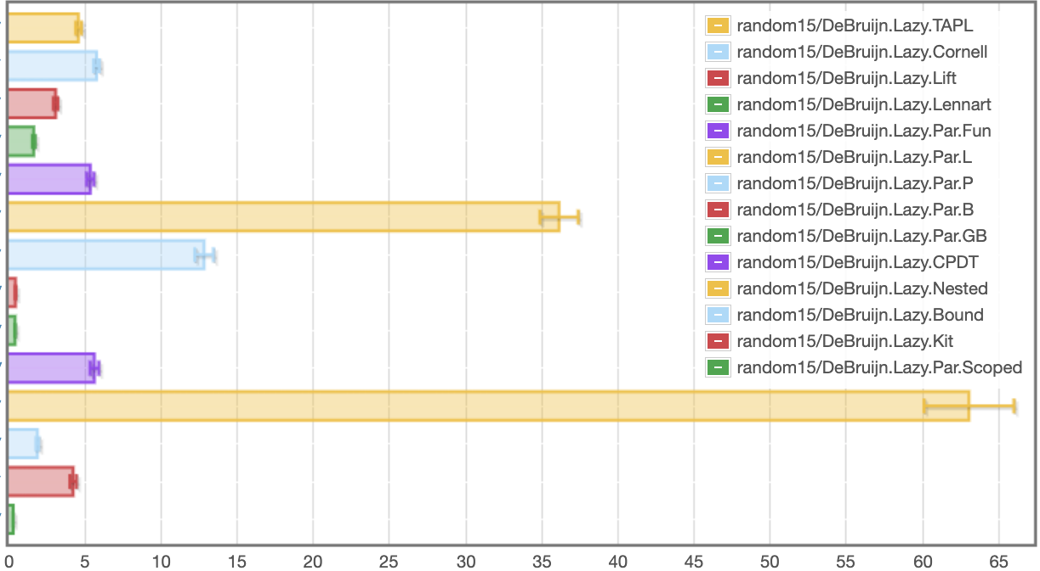
de Bruijn: random, lazy
results/sixteen.local/db_lazy_random15_bench.html
Single substitutions
Parallel substitutions
Scoped single
Scoped parallel
milliseconds
Fastest: Scoped (288 microseconds), Slowest: Nested (63.1s)
Notes:
Note scale change. Slowest is now under a second.

Slide 58
Laziness affects execution
AST definition is "lazy" in Haskell data Exp = Var Var
| Lam (Bind Exp)
| App Exp Exp
What if we make it "strict" ?
data Exp = Var {-# unpack #-} !Var
| Lam !(Bind Exp)
| App !Exp !Exp

Slide 59
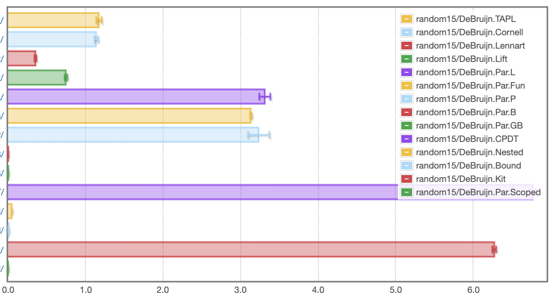
de Bruijn: random, strict
results/sixteen.local/db_random15_bench.html
Single substitutions
Parallel substitutions
Scoped single
Scoped parallel
seconds
Fastest: Scoped (969 microseconds), Slowest: CPDT (6.77s)
Notes:
Most implementations are slower, some significantly so. (cf Kit/CPDT)
BUT: Nested went from 63 to 47 miliseconds

Slide 60
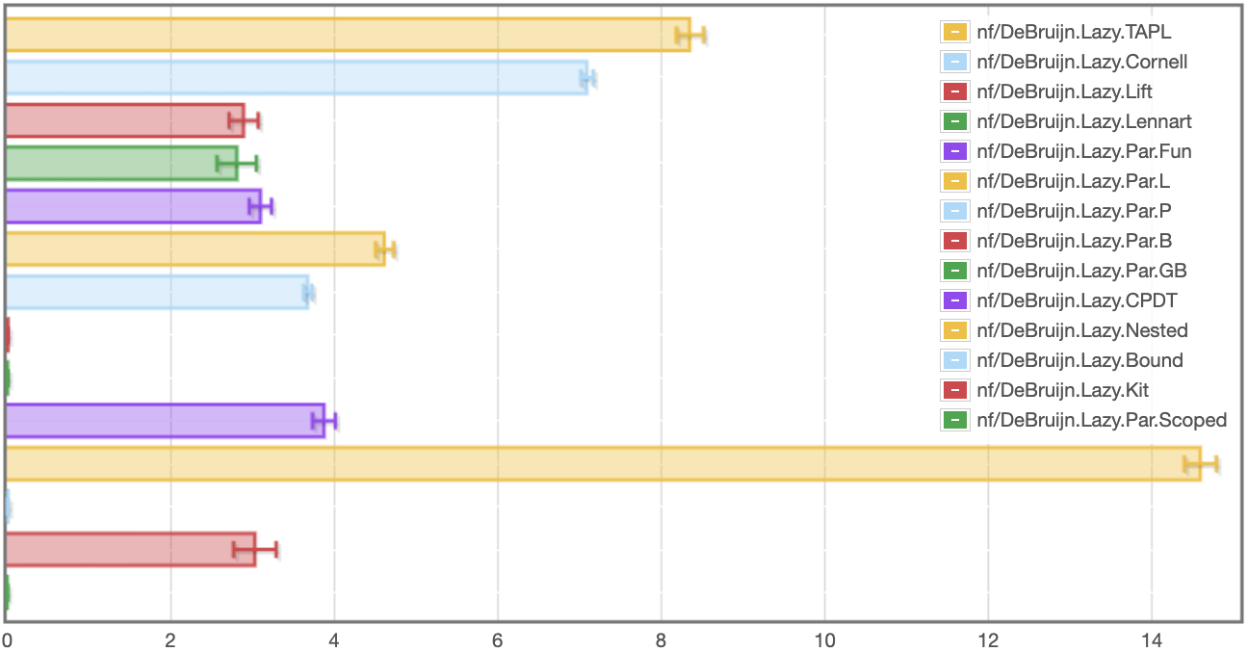
de Bruijn: Lennart, lazy
Single substitutions
Parallel substitutions
Scoped single
Scoped parallel
Fastest: Scoped (5.59ms), Slowest: Nested (14.6s)
seconds

Slide 61
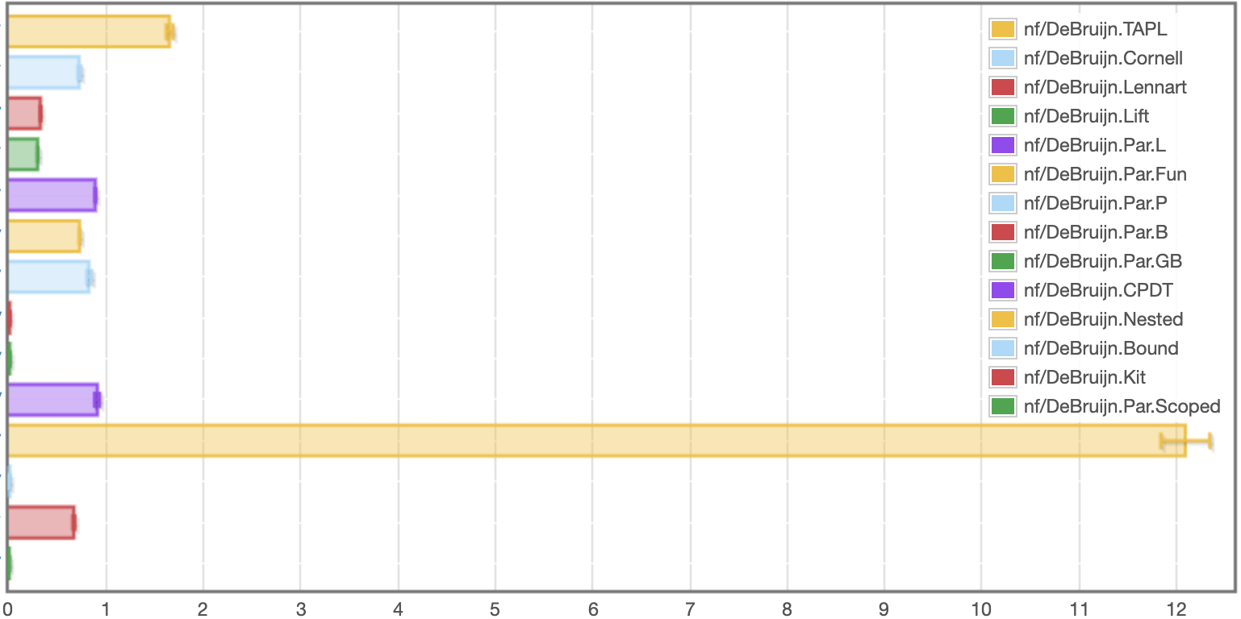
de Bruijn: Lennart, strict
Single substitutions
Parallel substitutions
Scoped single
Scoped parallel
Fastest: Scoped (3.2ms), Slowest: Nested (12.1s)
seconds
Notes:
Different runs lead to differences of .5 seconds.
Strictness helps this time

Slide 62
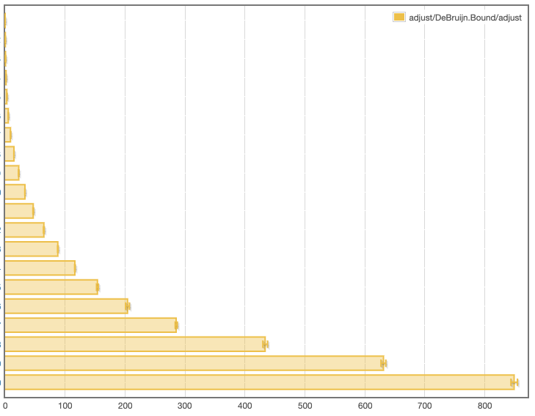
Takeaways from de Bruijn benchmarks
Orders of magnitude difference between fastest and slowest versions
Well-scoped implementations generally do not slow down terms
Sometimes laziness helps significantly, sometimes it doesn't
"bound" library comes out very well
No implementation provides linear performance in worst case
\x0.(\x1.x1) x0
\x0.(\x1.x1 (\x2.x1)) (x0 x0)
\x0.(\x1.x1 (\x2.x1 (\x3.x1))) (x0 x0 x0)
…

Slide 63
Comparison

Slide 64
Comparison

Slide 65
We can do similar things with LocallyNameless & Named representations
General idea of library interface / generic code applies broadly
Scrap Your Nameplate [Cheney, ICFP 2005]
Unbound library [Weirich, Yorgey, Sheard, ICFP 2011]
more versions in repo
General idea of delaying work at binders applies broadly
Locally nameless: aggregate open and close operations
Named: multi-substitutions & cache free variables
Are these easier to use? Opinions vary
Are they faster/slower?

Slide 66
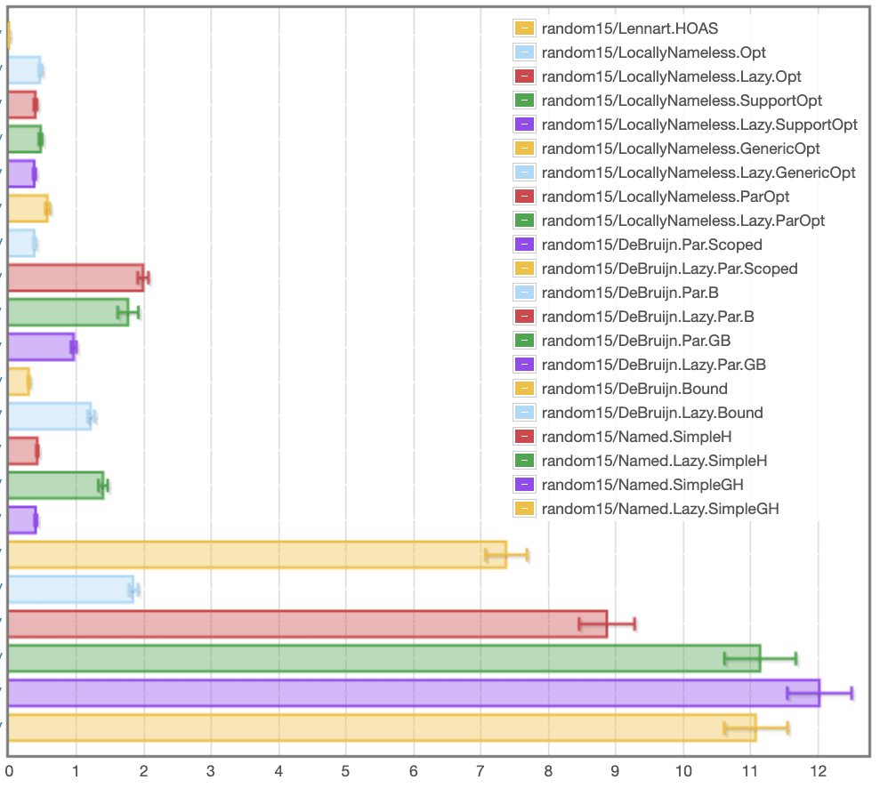
Random15
(fastest variants)
HOAS
Locally Nameless
Fastest: 375 μs
de Bruijn
Fastest: 293 μs
Named
results/sixteen.local/fast_random15_bench.html
milliseconds
Notes:
This is only the fastest versions, both strict and lazy

Slide 67
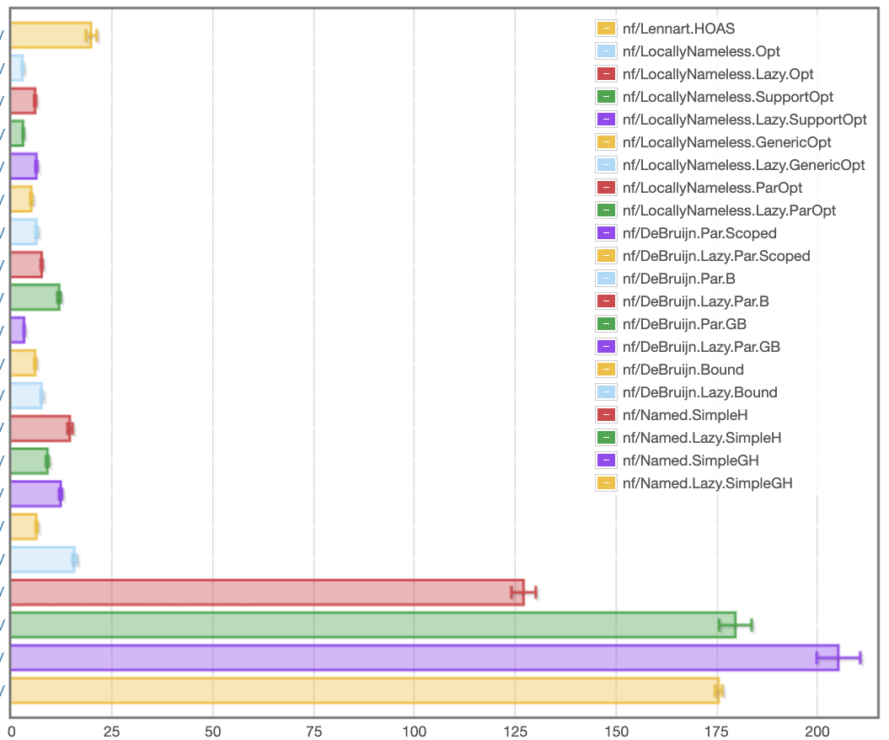
Lennart
(fastest variants)
HOAS
Locally Nameless
Fastest: 2.74 ms
de Bruijn
Fastest: 3.13ms
Named
results/sixteen.local/fast_nf_bench.html
milliseconds
Notes:
This is only the fastest versions, both strict and lazy

Slide 68
Conclusion

Slide 69
Conclusion
There is a lot more to learn here and I can't explore it all on my own
https://github.com/sweirich/lambda-n-ways
More implementations…
More benchmarks…
Opportunities for new Haskell libraries, too

Slide 71
Extra slides, probably wont have time for them

Slide 72
Locally Nameless
and variations

Slide 73
Locally Nameless implementations
data Exp = Var Var
| Lam (Bind Exp)
| App Exp Exp
deriving (Eq)
type Var = B Int | F Id -- distinguish bound/free type Bind t = t -- no info at binders
\x -> x (\y -> x z)
Lam (App (Var (B 0)) (Lam (App (Var (B 1)) (Var (F "z")))))

Slide 74
LN definition of (bound var) substitution
open :: Int -> Exp -> Int -> Exp -> Exp
open j b = walk j
where
walk c (Var (B x))
| x == c = b | x < c = Var (B x) | otherwise = Var (B (x – 1))
walk c (Var (F x)) = Var (F x)
walk c (Lam t2) = Lam (walk (c + 1) t2)
walk c (App t1 t2) = App (walk c t1) (walk c t2)
instantiate :: Bind Exp -> Exp -> Exp
instantiate a b = open 0 b a
No free indices means no need to shift
lib/DeBruijn/TAPL.hs
Notes:
Find and apply the leftmost beta-redex

Slide 75
Locally Nameless Normalization
nf' :: Exp -> N Exp
nf' e@(Var _) = return e
nf' (Abs e) =
scope $ \x -> do
b' <- nf' (instantiate e (Var (F x))
return $ Abs (close x b')
nf' (App a b) = do
a' <- whnf a
case a' of
Abs a0 -> nf' (instantiate a0 b)
_ -> App <$> nf' a' <*> nf' b
Work in Reader or State monad
Need to generate a fresh variable name for the binder.
Replace bound variable with fresh name
Replace fresh name with a bound variable,
inverse of open

Slide 76
Locally Nameless variations
Ott – generated by Ott tool, translated to Haskell
TypedOtt – well-scoped version of Ott
ParOpt – well-scoped version with parallel substitutions (cf. DeBruijn.Scoped)
Opt – optimized Ott version, delays open & close at binders
GenericOpt – optimized Ott version, with Generic Programming=
UnboundRep – generic programming (RepLib) (Yorgey, Sheard, Weirich)
UnboundGenerics – unbound ported to GHC.Generics (Alexey Klieger)
UGEBind – opt ported to UG
UGSubstBind – substbind
UGSubstBind – opt + substbind

Slide 77
Well scoped LN
de Bruijn index usage is "hidden" by the library so clients don't need to think about indices
Clients only work with "locally-closed" expressions
If expression types track bound variables, this is type "Exp 'Z".
As a tradeoff, clients need to make sure that all binders are opened with sufficiently fresh "free" variables.
Monads are good for this, and types can ensure clients don't forget

Slide 78
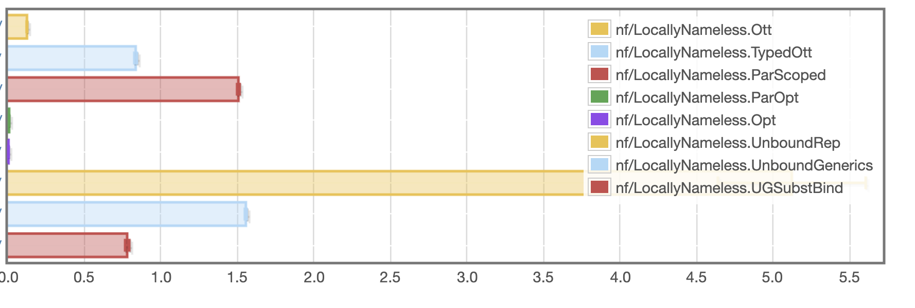
LN: lennart
seconds
Fastest Opt: 2.96 ms, Slowest: Unbound 5.12s

Slide 79
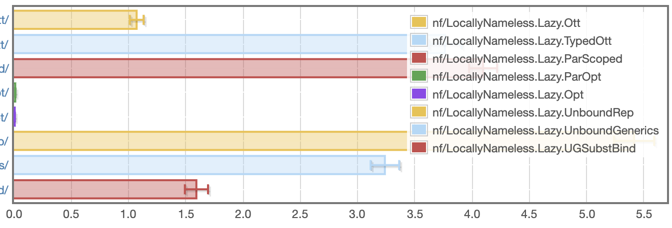
LN: lennart, lazy
seconds
Fastest Opt: 6.02 ms, Slowest: Unbound 5.41s

Slide 80
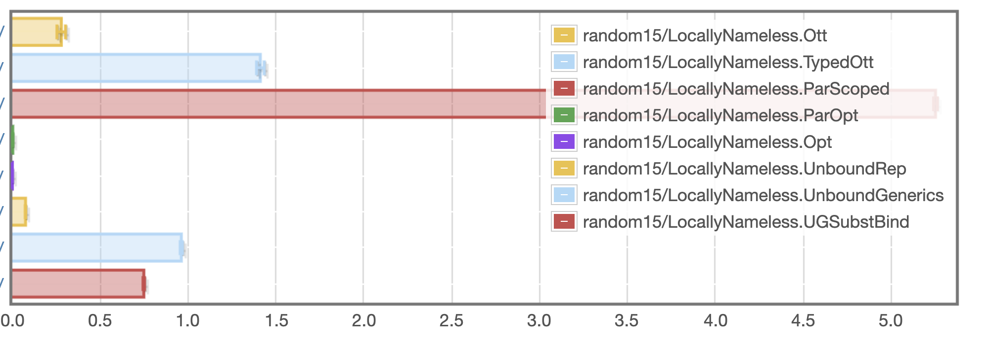
LN: random
seconds
Fastest Opt: 444 microseconds, Slowest: ParScoped 5.25s

Slide 81
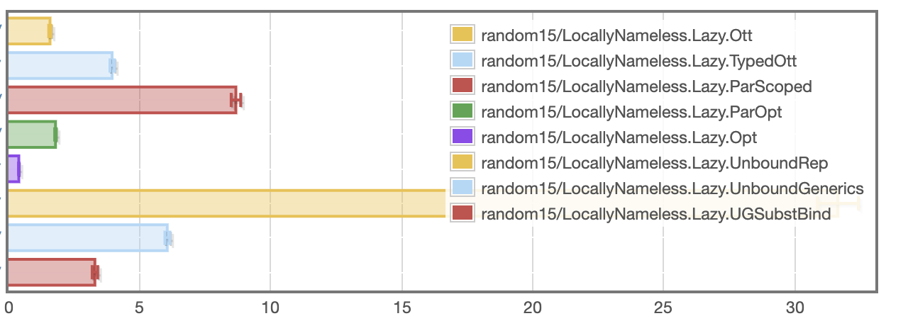
LN: random, lazy
milliseconds
Fastest Opt: 393 microseconds, Slowest: Unbound 31.7 ms

Slide 82
Named / Nominal
and variations

Slide 83
What makes a good implementation?
Quick implementation of key operations, with high confidence
No matter what language, because we are probably not actually implementing the untyped lambda calculus
i.e. could have multiple binders, patterns, etc
Minimal invariants to keep track of
Or at least help with them
example invariants: BVC, shifting indices when changing scopes,
Reasonably fast runtime execution
Very easy to end up with quadratic execution times
Opportunity for early cut-off (\x.a) {b/x}
Constant factors dominate

