Slide 1
How to Implement the Lambda Calculus, Quickly
Stephanie Weirich
University of Pennsylvania
Haskell Love
September 10, 2021
https://github.com/sweirich/lambda-n-ways/

Slide 2
Key lambda-calculus operation
Capture-avoiding substitution
a { b / x }
(z (λy.z)) { y / z }
⟾
y (λw. y)

Slide 3
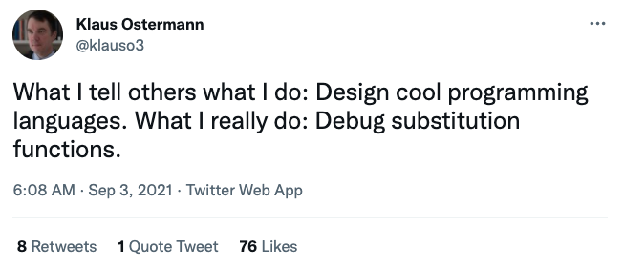

Slide 4
Magic Haskell Implementation?
data Exp = Var Var -- x
| Lam (Bind Exp) -- λx.a
| App Exp Exp -- (a b)
deriving (Substitution)
-- definition of substitution "for free"
-- subst :: Var -> Exp -> Exp -> Exp -- a { b / x }

Slide 5
Binding Library (unbound-generics)
import LocallyNameless.UnboundGenerics
data Exp = Var (Name Exp) -- x
| Lam (Bind (Name Exp) Exp) -- λx.a
| App Exp Exp -- (a b)
deriving (Show, Generic)
instance Subst Exp Exp where
isvar (Var x) = Just (SubstName x)
isvar _ = Nothing
-- generic definition of substitution

Slide 6
Multiple libraries available on hackage!
Unbound (GHC version <= 8.8.3)
unbound-generics
bound
nominal
nom
GHC 8.8.3, MacBook pro, 2.4 GHz 8-Core Intel Core i9, 64 GB, measured using criterion

Slide 7
Why the difference?
Different developers?
Reimplement uniformly
Extra features? (pattern binding, annotations, etc.)
Only reimplement "core" mechanism
Magic GHC pragma? {-# SUMMON SPJ #-}
Study GHC manual
Different generic programming?
Compare with and without
Different optimizations?
Cross-fertilize ideas
Different binding representations?
nom/nominal Name-based binding
bound de Bruijn indices
Unbound/unbound-generics Locally nameless (mixed)

Slide 8
This talk
Overview of three common approaches
Names and simple renaming
de Bruijn indices
Locally nameless (mix of names and indices)
Compare their use in a small application
Benchmark their implementations
Considerable overlap in performance
Can optimize by caching information at binders

Slide 9
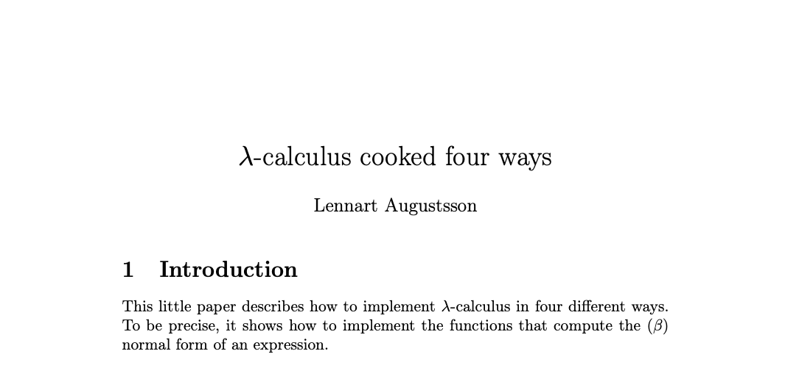
Inspiration
2005-2006, https://github.com/steshaw/lennart-lambda
Notes:
a "little paper"
really a literate Haskell implementation
Stand on the shoulders of giants
focusses on capture-avoiding substitution

Slide 10
Example: Computing normal form with names
λw. λx. (λy. w y (λx. w y (λy. w y))) (x x x)
λw. λx. w (x x x) (λz. w (x x x) (λy. w y))
substitute (x x x) for y
rename x to avoid capture
stop when y not free

Slide 11
Example: with de Bruijn indices
λw. λx. (λy. w y (λx. w y (λy. w y))) (x x x)
λ. λ. (λ. 2 0 (λ. 3 1 (λ. 4 0))) (0 0 0)
λ. λ. 1 (0 0 0) (λ. 2 (1 1 1) (λ. 3 0))
substitute (0 0 0) for 0
decrement other variables
after reduction
increment (0 0 0) under binders

Slide 12
Example: with Locally nameless
λw. λx. (λy. w y (λx. w y (λy. w y))) (x x x)
λ. λ. (λ. 2 0 (λ. 3 1 (λ. 4 0))) (0 0 0)
(λ. w 0 (λ. w 1 (λ. w 0))) (x x x)
w (x x x) (λ. w (x x x) (λ. w 0))
λ. λ. 1 (0 0 0) (λ. 2 (1 1 1) (λ. 3 0))
name outermost
variables to expose
beta-reduction
substitute (x x x) for 0
replace names with
indices when finished

Slide 13
Bookkeeping during b {a/x}
Names: rename bound variables to avoid capture
calculate free variables of a
rename bound variables in b with a "fresh" name
de Bruijn: adjust indices
shift free indices in a depending on binding depth
decrement indices of b because we lost a binder
Locally nameless: exchange names/indices
invariant: a has no "free" indices, only free names
exchange happens during traversal, not substitution
need to choose "fresh" names

Slide 14
Binding library example
data Exp =
Var Var
| Lam (Bind Exp)
| App Exp Exp
deriving (Generic)

Slide 15
Binding libraries isolate tricky code
Interface of the library depends on the approach
Example: Name-based binding library
newtype Var = V IdInt -- concrete type Bind a -- abstract, hides cached var set type Sub a -- abstract
plus functions to create & destruct Bind/Sub types

Slide 16
Name-based library operations
class VarC a where
var :: Var -> a -- needed for renaming isvar :: a -> Maybe Var
class FreeVarsC a where
freeVars :: a -> VarSet
class FreeVarsC a => SubstC b a where
subst :: Sub b -> a -> a -- freeVars needed to -- avoid capture
Instances for Var and Bind types provided by library

Slide 17
Straightforward instances without Generics
instance VarC Exp where
var = Var instance FreeVarsC Exp where
freeVars (Var v) = freeVars v -- uses Var instance
freeVars (Lam b) = freeVars b -- uses Bind instance
freeVars (App f a) = freeVars f `union` freeVars a
instance SubstC Exp Exp where
subst s (Var v) = substVar s v -- library function
subst s (Lam b) = Lam (subst s b) -- uses Bind instance
subst s (App f a) = App (subst s f) (subst s a)

Slide 18
Generic client instances, virtually no code
instance VarC Exp where
var = Var
isvar (Var v) = Just v
isvar _ = Nothing
instance FreeVarsC Exp where
instance SubstC Exp Exp where

Slide 19
Generic client instances, virtually no code
instance VarC Exp where
{-# SPECIALIZE instance VarC Exp #-}
var = Var
isvar (Var v) = Just v
isvar _ = Nothing
instance FreeVarsC Exp where
{-# SPECIALIZE instance FreeVarsC Exp #-}
instance SubstC Exp Exp where
{-# SPECIALIZE instance SubstC Exp Exp #-}

Slide 20
How to implement reduction?
data Exp =
Var Var
| Lam (Bind Exp)
| App Exp Exp
How difficult is it to use these three approaches?
Notes:
https://github.com/sweirich/lambda-n-ways/
Lennart.Simple: named implementation from "Lambda Calculus Cooked Four Ways"
Lennart.DeBruijn: index implementation from "Lambda Calculus Cooked Four Ways"
LocallyNameless.Ott: Implementation generated by Ott tool, translated to Haskell

Slide 21
Normal-order full reduction w/ names
nf :: Exp -> Exp
nf (Var x) = Var x
nf (Lam (Bind x e)) =
-- recurse under binder
Lam (Bind x (nf e))
nf (App a b) =
case whnf a of
Lam (Bind x a0) ->
nf (subst x b a0)
a' -> App (nf a') (nf b)
whnf :: Exp -> Exp
whnf (Var x) = Var x
whnf (Lam b) =
-- don't recurse
Lam b
whnf (App a b) =
case whnf a of
Lam (Bind x a0) ->
whnf (subst x b a0)
a' -> App a' b
-- normalize head only

Slide 22
Normal-order full reduction w/ indices
nf :: Exp -> Exp
nf (Var x) = Var x -- x is an Int (index)
nf (Lam (Bind e)) = -- no Var stored at binder
-- recurse under binder
Lam (Bind (nf e))
nf (App a b) =
case whnf a of
Lam (Bind a0) ->
nf (subst 0 b a0) -- shift indices during subst
a' -> App (nf a') (nf b)

Slide 23
Reduction w/ locally nameless terms
nf :: Exp -> Exp
nf (Var x) = (Var x) -- invariant, no free indices
nf (Lam (Bind b)) = -- no Var at binder
let x = fresh b -- find var not free in b
b' = nf (subst 0 (Var x) b) -- cvt index to name
in Lam (Bind (close x b')) -- cvt name to index
nf (App a b) =
case whnf a of
Lam (Bind a0) ->
nf (subst 0 b a0) -- no shifting (from invariant)
a' -> App (nf a') (nf b)

Slide 24
But which is faster?
Lennart.Simple – adapted from "Lambda-calculus cooked four ways", bugfix
Lennart.DeBruijn – adapted from "Lambda-calculus cooked four ways"
LocallyNameless.Ott – generated by Ott tool
https://github.com/sweirich/lambda-n-ways

Slide 25
Lennart's benchmark
Normal-order reduction of the Church encoding of 6! == sum [1 .. 37] + 17
i.e. 720 == 719
Benchmark statistics
Number of substitutions required for normalization: 119,697
AST depth: 53, binding depth: 25
Average # of variable occurrences during each beta-reduction: 1.15
Notes:
NOTE: We aren't trying to make normalization fast, just create a lot of repeated calls to substitution.

Slide 26
Benchmark results: head-to-head

Slide 27
Can we do better? Yes!
In all three versions, bookkeeping leads to multiple traversals
General Idea: generalize traversals and cache info at binders
subst :: Sub Exp -> Exp -> Exp
For Names
Multi-substitution type Sub a = Map Var a
Cache free vars data Bind a = Bind VarSet Var a
Benefits
Find fresh variables quickly
Can cut off substitution early if domain doesn't affect free variables
Fewer traversals: fuse renaming and normal substitutions

Slide 28
Can we do better? Yes!
In all three versions, bookkeeping leads to multiple traversals
General Idea: generalize traversals and cache info at binders
subst :: Sub Exp -> Exp -> Exp
For de Bruijn indices
Multi-substitution data Sub a = Inc Int | Cons a (Sub a) | Compose (Sub a) (Sub a)
Cache substitution data Bind a = Bind (Sub a) Var a
Benefits
Compose substitutions using smart constructors
Fewer traversals: multiple indices replaced simultaneously

Slide 29
Can we do better? Yes!
In all three versions, bookkeeping leads to multiple traversals
General Idea: generalize traversals and cache info at binders
subst :: Sub Exp -> Exp -> Exp
For Locally Nameless
Multi-subst/close type Sub a = (Int, [Exp])
Cache last traversal data Bind a = Bind (Info a) Var a data Info a = NoInfo | Subst Int [a] | Close Int [IdInt]
Benefits
Fewer traversals: multiple indices/names replaced simultaneously

Slide 30
Comparison: Original vs. optimized

Slide 31
Comparison: Optimized vs. Generic

Slide 32
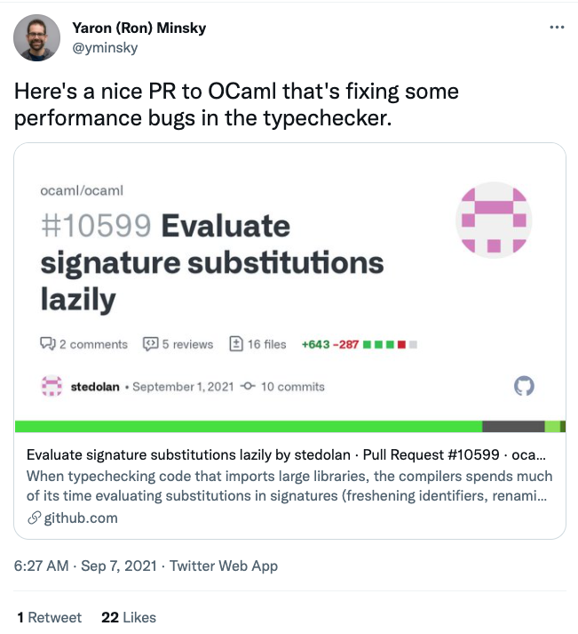

Slide 33
Strictness annotations
data Exp =
Var Var
| Lam (Bind Exp)
| App Exp Exp
data Exp =
Var {-# UNPACK #-} !Var
| Lam !(Bind Exp)
| App !Exp !Exp

Slide 34
Benchmark results: strictness annotations

Slide 35
Strictness annotations and optimization

Slide 36
Benchmark summary

Slide 37
Conclusions
This is one benchmark, so don't read too much into it
Optimizations more significant than representation
Class-based library and generic programming worth it (caveat: compilation time)
More implementations and benchmarks available in repository: https://github.com/sweirich/lambda-n-ways Contributions welcome!

Slide 39
Too many approaches
Names: simple renaming
Names: nominal
de Bruijn indices
de Bruijn levels
co-de-Bruijn representation
HOAS
Weak HOAS / PHOAS
Locally Nameless
Locally Named
Canonically Named
…
These implementations differ in
the representation of variables and binders
the implementation of alpha-equivalence, capture-avoiding substitution functions
what you need to do to implement other operations

Slide 40
Use binding libraries, people
Libraries for optimized named, locally nameless and de Bruijn representations available on github
Other binding libraries available on Hackage & provide more
Unbound (Weirich & Yorgey), GHC version <= 8.8.3
unbound-generics (Kliger)
bound (Kmett)
nominal (Selinger)
nom (Gabbay)

Slide 41
type Var -- some way to represent variables
type Bind t -- some way to represent binding/scope
type Sub t -- some way to represent substitutions
substVar :: Sub a -> Var -> a
substBind :: Sub a -> Bind a -> Bind a
data Exp = Var Var -- x
| Lam (Bind Exp) -- λx.a
| App Exp Exp -- (a b)
subst :: Sub Exp -> Exp -> Exp
subst s (Var v) = substVar s v
subst s (Lam b) = Lam (substBind s b)
subst s (App a b) = App (subst s a) (subst s b)

Slide 42
Why so many?
Different goals: compiler vs. type checker vs. didactic explanation vs. proofs
Proofs are important, some designed to be "easier to reason about"
Subtle bugs are common, some designed to be "easier to implement"
Subtle bugs are common, some designed to be "easier to use"
Performance is important, some designed to be "faster"
But … which should you use if you care about all of these things?

Slide 43
Comparison: Optimized-strict vs. Generic-strict

Slide 44
Comparison: Strict vs. Optimized-strict

Slide 45
Benchmark summary

Slide 46
Overloaded and Generic operations
class VarC a where
var :: Var -> a
isvar :: a -> Maybe Var -- a little more info about vars
isvar _ = Nothing
class FreeVarsC a where
freeVars :: a -> VarSet
freeVars x = … -- default definition using GHC.Generics
-- and isvar

