Slide 1
How to Implement the Lambda Calculus, Quickly
Stephanie Weirich
University of Pennsylvania
Haskell Love
September 10, 2021
https://github.com/sweirich/lambda-n-ways/

Slide 2
Key lambda-calculus operation
Capture-avoiding substitution
a { b / x }
(z (λy.z)) { y / z }
⟾
y (λw. y)

Slide 3
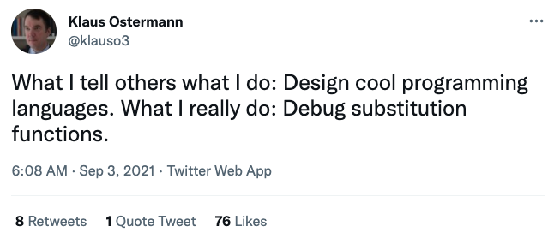

Slide 4
Magic implementation?
data Exp = Var Var -- x
| Lam (Bind Exp) -- λx.a
| App Exp Exp -- (a b)
deriving (Substitution)
-- definition of substitution "for free"
-- subst :: Var -> Exp -> Exp -> Exp -- a { b / x }

Slide 5
Binding Library (unbound-generics)
import LocallyNameless.UnboundGenerics
data Exp = Var (Name Exp) -- x
| Lam (Bind (Name Exp) Exp) -- λx.a
| App Exp Exp -- (a b)
deriving (Show, Generic)
instance Subst Exp Exp where
isvar (Var x) = Just (SubstName x)
isvar _ = Nothing
-- quick definition of substitution
Notes:
There, we have implemented substitution quickly. But you probably thought I meant something else!

Slide 6
Multiple libraries available on hackage!
Unbound (GHC version <= 8.8.3)
unbound-generics
bound
nominal
nom
GHC 8.8.3, MacBook pro, 2.4 GHz 8-Core Intel Core i9, 64 GB, measured using criterion

Slide 7
Why the difference?
Different developers?
Reimplement uniformly
Extra features? (pattern binding, annotations, etc.)
Only reimplement "core" mechanism
Magic GHC pragma? {-# SUMMON SPJ #-}
Study GHC manual
Different generic programming?
Compare with and without
Different optimizations?
Cross-fertilize ideas
Different binding representations?
nom/nominal Name-based binding
bound de Bruijn indices
Unbound/unbound-generics Locally nameless (mixed)

Slide 8
This work
Start with three basic implementations
Names and simple renaming
de Bruijn indices
Locally nameless representation
Create optimized versions
Use type classes and generics to define a library interface
Benchmark

Slide 9
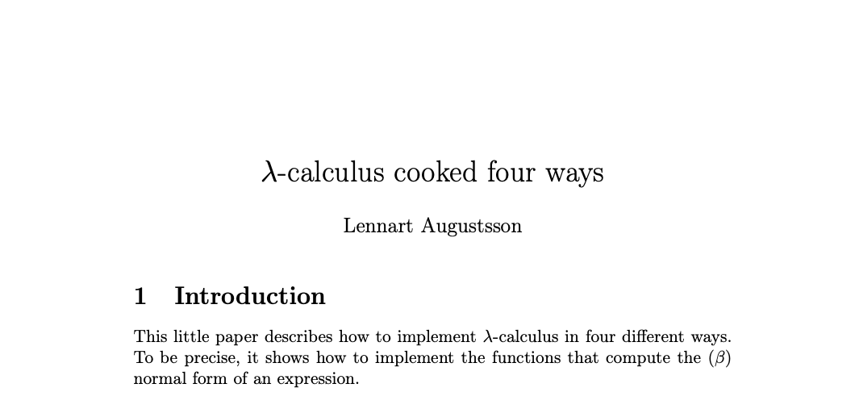
Inspiration
2005-2006, https://github.com/steshaw/lennart-lambda
Notes:
a "little paper"
really a literate Haskell implementation
Stand on the shoulders of giants
focusses on capture-avoiding substitution

Slide 10
Lennart's benchmark
Normal-order reduction of the Church encoding of 6! == sum [1 .. 37] + 17
i.e. 720 == 719
Benchmark statistics
Number of substitutions required for normalization: 119,697
AST depth: 53, binding depth: 25
Average # of variable occurrences during each beta-reduction: 1.15
Notes:
NOTE: We aren't trying to make normalization fast, just create a lot of repeated calls to substitution.

Slide 11
Example: Computing normal form with names
λw. λx. (λy. w y (λx. w y (λy. w y))) (x x x)
λw. λx. w (x x x) (λz. w (x x x) (λy. w y))
substitute (x x x) for y
rename x to avoid capture
stop when y not free

Slide 12
Example: with de Bruijn indices
λw. λx. (λy. w y (λx. w y (λy. w y))) (x x x)
λ. λ. (λ. 2 0 (λ. 3 1 (λ. 4 0))) (0 0 0)
λ. λ. 1 (0 0 0) (λ. 2 (1 1 1) (λ. 3 0))
substitute (0 0 0) for 0
decrement other variables
after reduction
increment (0 0 0) under binders

Slide 13
Example: with Locally nameless
λw. λx. (λy. w y (λx. w y (λy. w y))) (x x x)
λ. λ. (λ. 2 0 (λ. 3 1 (λ. 4 0))) (0 0 0)
(λ. w 0 (λ. w 1 (λ. w 0))) (x x x)
w (x x x) (λ. w (x x x) (λ. w 0))
λ. λ. 1 (0 0 0) (λ. 2 (1 1 1) (λ. 3 0))
name outermost
variables to expose
beta-reduction
substitute (x x x) for 0
replace names with
indices when finished

Slide 14
Bookkeeping during b {a/x}
Names: rename bound variables to avoid capture
calculate free variables of a
rename bound variables in b with a "fresh" name
de Bruijn: adjust indices
shift free indices in a depending on binding depth
decrement indices of b because we lost a binder
Locally nameless: exchange names/indices
invariant: a has no "free" indices, only free names
exchange happens during traversal, not substitution
need to choose "fresh" names

Slide 15
What does it look like to use these three approaches?
data Exp =
Var Var
| Lam (Bind Exp)
| App Exp Exp
Let's implement normal-order reduction
Notes:
https://github.com/sweirich/lambda-n-ways/
Lennart.Simple: named implementation from "Lambda Calculus Cooked Four Ways"
Lennart.DeBruijn: index implementation from "Lambda Calculus Cooked Four Ways"
LocallyNameless.Ott: Implementation generated by Ott tool, translated to Haskell
Goal, understand benchmark and also understand LN representation

Slide 16
Normal-order full reduction w/ names
nf :: Exp -> Exp
nf (Var x) = Var x
nf (Lam (Bind x e)) =
-- recurse under binder
Lam (Bind x (nf e))
nf (App a b) =
case whnf a of
Lam (Bind x a0) ->
nf (subst x b a0)
a' -> App (nf a') (nf b)
whnf :: Exp -> Exp
whnf (Var x) = Var x
whnf (Lam b) =
-- don't recurse
Lam b
whnf (App a b) =
case whnf a of
Lam (Bind x a0) ->
whnf (subst x b a0)
a' -> App a' b
-- normalize head only

Slide 17
Normal-order full reduction w/ indices
nf :: Exp -> Exp
nf (Var x) = Var x -- x is an Int (index)
nf (Lam (Bind e)) = -- no Var stored at binder
-- recurse under binder
Lam (Bind (nf e))
nf (App a b) =
case whnf a of
Lam (Bind a0) ->
nf (subst 0 b a0) -- shift indices during subst
a' -> App (nf a') (nf b)

Slide 18
Reduction w/ locally nameless terms
nf :: Exp -> Exp
nf (Var x) = (Var x) -- invariant, no free indices
nf (Lam (Bind b)) = -- no Var at binder
let x = fresh b -- find var not free in b
b' = nf (subst 0 (Var x) b) -- cvt index to name
in Lam (Bind (close x b')) -- cvt name to index
nf (App a b) =
case whnf a of
Lam (Bind a0) ->
nf (subst 0 b a0) -- no shifting (from invariant)
a' -> App (nf a') (nf b)

Slide 19
But which is faster?
https://github.com/sweirich/lambda-n-ways
Lennart.Simple – adapted from "Lambda-calculus cooked four ways", with bugfix
Lennart.DeBruijn – adapted from "Lambda-calculus cooked four ways"
LocallyNameless.Ott – generated by Ott tool

Slide 20
Benchmark results: basic versions head-to-head

Slide 21
Optimize!
Named.Lazy.SimpleH
DeBruijn.Lazy.Par.B
LocallyNameless.Lazy.Opt

Slide 22
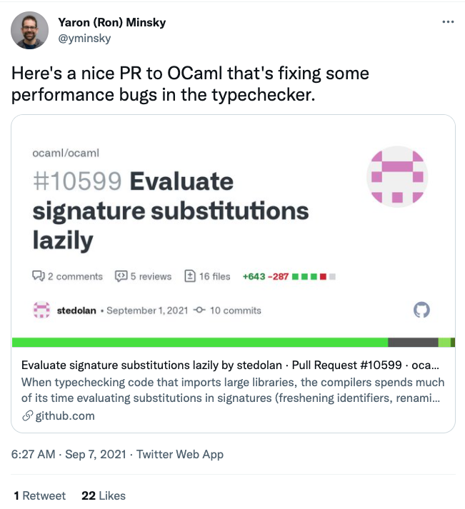

Slide 23
Can we do better? Yes!
In all three versions, bookkeeping leads to multiple traversals
General Idea: generalize traversals and cache info at binders
subst :: Sub Exp -> Exp -> Exp
For Names
Multi-substitution type Sub a = Map Var a
Cache free vars data Bind a = Bind VarSet Var a
Benefits
Find fresh variables quickly
Can cut off substitution early if domain doesn't affect free variables
Fewer traversals: fuse renaming and normal substitutions

Slide 24
Can we do better? Yes!
In all three versions, bookkeeping leads to multiple traversals
General Idea: generalize traversals and cache info at binders
subst :: Sub Exp -> Exp -> Exp
For de Bruijn indices
Multi-substitution data Sub a = Inc Int | Cons a (Sub a) | Compose (Sub a) (Sub a)
Delay substitution data Bind a = Bind (Sub a) Var a
Benefits
Compose substitutions using smart constructors
Fewer traversals: multiple indices replaced simultaneously

Slide 25
Can we do better? Yes!
In all three versions, bookkeeping leads to multiple traversals
General Idea: generalize traversals and cache info at binders
subst :: Sub Exp -> Exp -> Exp
For Locally Nameless
Multi-subst/close type Sub a = (Int, [Exp])
Delay last traversal data Bind a = Bind (Info a) Var a data Info a = NoInfo | Subst Int [a] | Close Int [IdInt]
Benefits
Fewer traversals: multiple indices/names replaced simultaneously

Slide 26
Comparison: Original vs. optimized

Slide 27
Make it generic!
data Exp =
Var Var
| Lam (Bind Exp)
| App Exp Exp
Named.Lazy.SimpleGH
DeBruijn.Lazy.Par.GB
LocallyNameless.Lazy.GenericInstOpt

Slide 28
Named Client: virtually no code
instance VarC Exp where
var = Var
isvar (Var v) = Just v
isvar _ = Nothing
instance FreeVarsC Exp where
instance SubstC Exp Exp where

Slide 29
Named Client: virtually no code
instance VarC Exp where
{-# SPECIALIZE instance VarC Exp #-}
var = Var
isvar (Var v) = Just v
isvar _ = Nothing
instance FreeVarsC Exp where
{-# SPECIALIZE instance FreeVarsC Exp #-}
instance SubstC Exp Exp where
{-# SPECIALIZE instance SubstC Exp Exp #-}

Slide 30
Benchmark: Optimized vs. Generic

Slide 31
Coda: strictness?
data Exp =
Var Var
| Lam (Bind Exp)
| App Exp Exp
data Exp =
Var {-# UNPACK #-} !Var
| Lam !(Bind Exp)
| App !Exp !Exp

Slide 32
Benchmark results: strictness annotations

Slide 33
Strictness annotations and optimization

Slide 34
Benchmark summary

Slide 35
Conclusions
This is one benchmark, so don't read too much into it, but
Optimization more significant than representation
Generic programming is relatively low runtime cost
More to do even, in this context
de Bruijn optimizations not the same as "bound"
locally nameless optimizations not the same as "unbound"
Many other alternatives
Contributions welcome! https://github.com/sweirich/lambda-n-ways

Slide 37
Binding library example
data Exp =
Var Var
| Lam (Bind Exp)
| App Exp Exp
deriving (Generic)

Slide 38
Binding libraries isolate tricky code
Interface of the library depends on the approach
Example: Name-based binding library
newtype Var = V IdInt -- concrete type Bind a -- abstract, hides cached var set type Sub a -- abstract
plus functions to create & destruct Bind/Sub types

Slide 39
Name-based library operations
class VarC a where
var :: Var -> a -- needed for renaming isvar :: a -> Maybe Var
class FreeVarsC a where
freeVars :: a -> VarSet
class FreeVarsC a => SubstC b a where
subst :: Sub b -> a -> a -- freeVars needed to -- avoid capture
Instances for Var and Bind types provided by library

Slide 40
Straightforward instances without Generics
instance VarC Exp where
var = Var instance FreeVarsC Exp where
freeVars (Var v) = freeVars v -- uses Var instance
freeVars (Lam b) = freeVars b -- uses Bind instance
freeVars (App f a) = freeVars f `union` freeVars a
instance SubstC Exp Exp where
subst s (Var v) = substVar s v -- library function
subst s (Lam b) = Lam (subst s b) -- uses Bind instance
subst s (App f a) = App (subst s f) (subst s a)

Slide 41
Too many approaches
Names: simple renaming
Names: nominal
de Bruijn indices
de Bruijn levels
co-de-Bruijn representation
HOAS
Weak HOAS / PHOAS
Locally Nameless
Locally Named
Canonically Named
…
These implementations differ in
the representation of variables and binders
the implementation of alpha-equivalence, capture-avoiding substitution functions
what you need to do to implement other operations

Slide 42
Use binding libraries, people
Libraries for optimized named, locally nameless and de Bruijn representations available on github
Other binding libraries available on Hackage & provide more
Unbound (Weirich & Yorgey), GHC version <= 8.8.3
unbound-generics (Kliger)
bound (Kmett)
nominal (Selinger)
nom (Gabbay)

Slide 43
type Var -- some way to represent variables
type Bind t -- some way to represent binding/scope
type Sub t -- some way to represent substitutions
substVar :: Sub a -> Var -> a
substBind :: Sub a -> Bind a -> Bind a
data Exp = Var Var -- x
| Lam (Bind Exp) -- λx.a
| App Exp Exp -- (a b)
subst :: Sub Exp -> Exp -> Exp
subst s (Var v) = substVar s v
subst s (Lam b) = Lam (substBind s b)
subst s (App a b) = App (subst s a) (subst s b)

Slide 44
Why so many?
Different goals: compiler vs. type checker vs. didactic explanation vs. proofs
Proofs are important, some designed to be "easier to reason about"
Subtle bugs are common, some designed to be "easier to implement"
Subtle bugs are common, some designed to be "easier to use"
Performance is important, some designed to be "faster"
But … which should you use if you care about all of these things?

Slide 45
Comparison: Optimized-strict vs. Generic-strict

Slide 46
Comparison: Strict vs. Optimized-strict

Slide 47
Benchmark summary

Slide 48
Overloaded and Generic operations
class VarC a where
var :: Var -> a
isvar :: a -> Maybe Var -- a little more info about vars
isvar _ = Nothing
class FreeVarsC a where
freeVars :: a -> VarSet
freeVars x = … -- default definition using GHC.Generics
-- and isvar

