Slide 1
How to Implement the Lambda Calculus, Quickly
Stephanie Weirich
University of Pennsylvania
IFL
September 3, 2021
https://github.com/sweirich/lambda-n-ways/

Slide 2
Key lambda-calculus operation
Capture-avoiding substitution
a { b / x }
(z (λy.z)) { y / z }
⟾
y (λw. y)

Slide 3
Haskell implementation
data Exp = Var Var -- x
| Lam (Bind Exp) -- λx.a
| App Exp Exp -- (a b)
type Var -- some way to represent variables
type Bind t -- some way to represent binding/scope
subst :: Var -> Exp -> Exp -> Exp -- a { b / x }

Slide 4
Too many answers
Names: simple renaming
Names: nominal
de Bruijn indices
de Bruijn levels
co-de-Bruijn representation
HOAS
Weak HOAS / PHOAS
Locally Nameless
Locally Named
Canonically Named
…
These implementations differ in
the representation of variables and binders
the implementation of alpha-equivalence, capture-avoiding substitution functions
what you need to do to implement other operations

Slide 5
Why so many?
Different goals: compiler vs. type checker vs. didactic explanation vs. proofs
Subtle bugs are common, some designed to be "easier to implement"
Subtle bugs are common, some designed to be "easier to use"
Proofs are important, some designed to be "easier to reason about"
Performance is important, some designed to be "faster"
But … which should you use if you care about all of these?

Slide 6
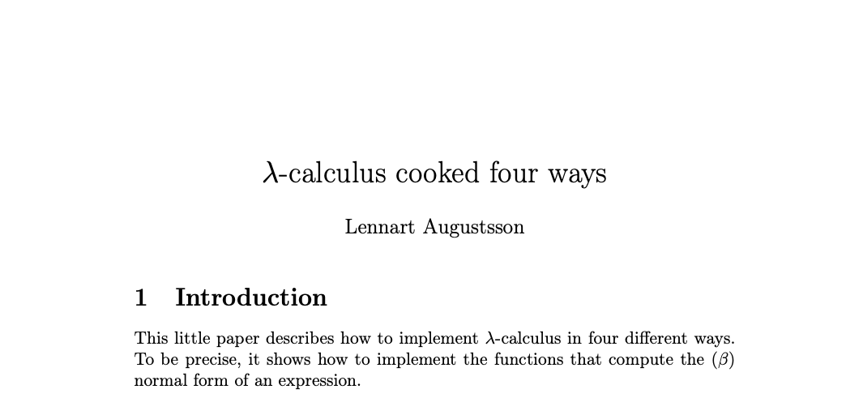
Inspiration
2005-2006, https://github.com/steshaw/lennart-lambda
Notes:
a "little paper"
really a literate Haskell implementation
Stand on the shoulders of giants
focusses on capture-avoiding substitution
we'll make sure that we can also calculate alpha-equiavalence

Slide 7
Today
Three common approaches
Names
de Bruijn indices
Locally nameless representation
Compare implementations of normalization, which uses capture-avoiding substitution
Can make implementation faster by caching information at binders
Can make implementation easier by generic programming
Considerable overlap in performance

Slide 8
Example: Computing normal form with names
λw. λx. (λy. w y (λx. w y (λy. w y))) (x x x)
λw. λx. w (x x x) (λz. w (x x x) (λy. w y))
substitute (x x x) for y
rename x to avoid capture
stop when y not free

Slide 9
Example: with de Bruijn indices
λw. λx. (λy. w y (λx. w y (λy. w y))) (x x x)
λ. λ. (λ. 2 0 (λ. 3 1 (λ. 4 0))) (0 0 0)
λ. λ. 1 (0 0 0) (λ. 2 (1 1 1) (λ. 3 0))
substitute (0 0 0) for 0
decrement other variables
after reduction
increment (0 0 0) under binders

Slide 10
Example: with Locally nameless
λw. λx. (λy. w y (λx. w y (λy. w y))) (x x x)
λ. λ. (λ. 2 0 (λ. 3 1 (λ. 4 0))) (0 0 0)
(λ. w 0 (λ. w 1 (λ. w 0))) (x x x)
w (x x x) (λ. w (x x x) (λ. w 0))
λ. λ. 1 (0 0 0) (λ. 2 (1 1 1) (λ. 3 0))
name outermost
variables to expose
beta-reduction
substitute (x x x) for 0
replace names with
indices when finished

Slide 11
Bookkeeping during b {a/x}
Names: rename bound variables to avoid capture
calculate free variables of a
rename bound variables in b with a "fresh" name
calculate all variables in b, avoid names that have been used
de Bruijn: adjust indices
shift free indices in a depending on binding depth
decrement indices of b b/c we lose a binder
Locally nameless: exchange names/indices
invariant: a has no "free" indices, only free names
exchange happens during every traversal, not just substitution
need to choose "fresh" names

Slide 12
What does reduction look like?
data Exp =
Var Var
| Lam (Bind Exp)
| App Exp Exp
https://github.com/sweirich/lambda-n-ways/
Lennart.Simple: named implementation from "Lambda Calculus Cooked Four Ways"
Lennart.DeBruijn: index implementation from "Lambda Calculus Cooked Four Ways"
LocallyNameless.Ott: Implementation generated by Ott tool, translated to Haskell
Notes:
Are these representations easy to use?

Slide 13
Normal-order full reduction w/ names
nf :: Exp -> Exp
nf (Var x) = Var x
nf (Lam (Bind x e)) =
-- recurse under binder
Lam (Bind x (nf e))
nf (App a b) =
case whnf a of
Lam (Bind x a0) ->
nf (subst x b a0)
a' -> App (nf a') (nf b)
whnf :: Exp -> Exp
whnf (Var x) = Var x
whnf (Lam b) =
-- don't recurse
Lam b
whnf (App a b) =
case whnf a of
Lam (Bind x a0) ->
whnf (subst x b a0)
a' -> App a' b
-- normalize head only

Slide 14
Normal-order full reduction w/ indices
nf :: Exp -> Exp
nf (Var x) = Var x -- x is an Int (index)
nf (Lam (Bind e)) = -- no Var stored at binder
-- recurse under binder
Lam (Bind (nf e))
nf (App a b) =
case whnf a of
Lam (Bind a0) ->
nf (subst 0 b a0) -- adjust indices during subst
a' -> App (nf a') (nf b)

Slide 15
Reduction w/ locally nameless terms
nf :: Exp -> N Exp -- "freshness monad"
nf (Var x) = return (Var x) -- x is a name or index
nf (Lam b) = do -- no Var at binder
x <- fresh
b' <- nf (open b (Var x)) -- open: convert index to name
Lam <$> close x b' -- close: convert name to index
nf (App a b) = do
a' <- whnf a
case a' of
Lam a0 -> nf (open a0 b) -- open is substitution
_ -> App <$> nf a' <*> nf b

Slide 16
But which is faster?
https://github.com/sweirich/lambda-n-ways/
Lennart.Simple: named implementation from "λ-Calculus Cooked Four Ways", with bugfix
Lennart.DeBruijn: index implementation from "λ-Calculus Cooked Four Ways"
LocallyNameless.Ott: Implementation generated by Ott tool, then translated to Haskell

Slide 17
Lennart's benchmark
Normal-order reduction of the Church encoding of 6! == sum [1 .. 37] + 17
i.e. 720 == 719
Benchmark statistics
Number of substitutions required for normalization: 119,697
AST depth: 53, binding depth: 25
Average # of variable occurrences during each beta-reduction: 1.15
Notes:
NOTE: We aren't trying to make normalization fast, just create a lot of repeated calls to substitution.

Slide 18
Benchmark results: head-to-head
MacBook pro, 2.4 GHz 8-Core Intel Core i9, 64 GB, measured using criterion

Slide 19
Strictness annotations
data Exp =
Var Var
| Lam (Bind Exp)
| App Exp Exp
data Exp =
Var {-# UNPACK #-} !Var
| Lam !(Bind Exp)
| App !Exp !Exp

Slide 20
Benchmark results: strictness annotations

Slide 21
Can we do better? Yes!
In all three versions, bookkeeping leads to multiple traversals
General Idea: generalize traversals and cache info at binders
subst :: Sub Exp -> Exp -> Exp
For Names
Multi-substitution type Sub a = Map Var a
Cache free vars data Bind a = Bind VarSet Var a
Benefits
Can cut off substitution early if domain doesn't affect free variables
Fuse renaming substitutions with normal substitutions
Find fresh variables quickly

Slide 22
Can we do better? Yes!
In all three versions, bookkeeping leads to multiple traversals
General Idea: generalize traversals and cache info at binders
subst :: Sub Exp -> Exp -> Exp
For de Bruijn indices
Multi-substitution data Sub a = Inc Int | Cons a (Sub a) | Compose (Sub a) (Sub a)
Cache substitution data Bind a = Bind (Sub a) Var a
Benefits
Fewer traversals: multiple indices replaced simultaneously
Compose substitutions using smart constructors

Slide 23
Can we do better? Yes!
In all three versions, bookkeeping leads to multiple traversals
General Idea: generalize traversals and cache info at binders
subst :: Sub Exp -> Exp -> Exp
For Locally Nameless
Multi-subst/close type Sub a = (Int, [Exp])
Cache last traversal data Bind a = Bind (Info a) Var a data Info a = NoInfo | Subst Int [a] | Close Int [IdInt]
Benefits
Fewer traversals: multiple indices/names replaced simultaneously

Slide 24
Comparison: Strict vs. Optimized

Slide 25
Can we implement substitution more quickly?

Slide 26
Binding libraries
Idea: isolate the tricky code into a library
Interface of the library depends on the approach
Example: Name-based binding library
newtype Var = V IdInt -- concrete type Bind a -- abstract, hides cached var set type Sub a -- abstract
plus functions to create & destruct Bind/Sub types

Slide 27
Name-based library operations
class VarC a where
var :: Var -> a -- needed for renaming
class FreeVarsC a where
freeVars :: a -> VarSet
class FreeVarsC a => SubstC b a where
subst :: Sub b -> a -> a -- freeVars needed to -- avoid capture
Instances for Var and Bind types provided by library

Slide 28
Straightforward client instances
instance VarC Exp where
var = Var instance FreeVarsC Exp where
freeVars (Var v) = freeVars v -- uses Var instance
freeVars (Lam b) = freeVars b -- uses Bind instance
freeVars (App f a) = freeVars f `union` freeVars a
instance SubstC Exp Exp where
subst s (Var v) = substVar s v -- library function
subst s (Lam b) = Lam (subst s b) -- uses Bind instance
subst s (App f a) = App (subst s f) (subst s a)

Slide 29
Overloaded and Generic operations
class VarC a where
var :: Var -> a
isvar :: a -> Maybe Var -- a little more info about vars
isvar _ = Nothing
class FreeVarsC a where
freeVars :: a -> VarSet
freeVars x = … -- default definition using GHC.Generics
-- and isvar

Slide 30
Generic client instances, virtually no code
instance VarC Exp where
var = Var
isvar (Var v) = Just v
isvar _ = Nothing
instance FreeVarsC Exp where
instance SubstC Exp Exp where

Slide 31
Generic client instances, virtually no code
instance VarC Exp where
{-# SPECIALIZE instance VarC Exp #-}
var = Var
isvar (Var v) = Just v
isvar _ = Nothing
instance FreeVarsC Exp where
{-# SPECIALIZE instance FreeVarsC Exp #-}
instance SubstC Exp Exp where
{-# SPECIALIZE instance SubstC Exp Exp #-}

Slide 32
Comparison: Optimized vs. Generic

Slide 33
Benchmark summary

Slide 34
Use binding libraries, people
Libraries for optimized named, locally nameless and de Bruijn representations available on github https://github.com/sweirich/lambda-n-ways
Other binding libraries available on Hackage & provide more
Unbound (Weirich & Yorgey), GHC version <= 8.8.3
unbound-generics (Kliger)
bound (Kmett)
nominal (Selinger)
nom (Gabbay)

Slide 35
Conclusions
This is one benchmark, so don't read too much into it
Optimizations more significant than representation
Class-based library and generic programming worth it (caveat: compilation time)
More implementations and benchmarks available in repository: https://github.com/sweirich/lambda-n-ways Contributions welcome!

