Slide 1
Talk context
This is an early practice talk for IFL keynote in early September
Overall talk goals: part new results, part tutorial, part invitation for collaboration
Stop me with questions
… I'm assuming you did your homework

Slide 2
How to Implement the Lambda Calculus, Quickly
Stephanie Weirich
University of Pennsylvania
Penn PLCLUB
August 6, 2021
https://github.com/sweirich/lambda-n-ways/

Slide 3
Two Key Operations
Alpha-equivalence
a ≡_{𝛼} b
Example
λx.x ≡_{𝛼} λy.y
⟾
True
Capture-avoiding substitution
a { b / x }
Example
(λy.z) { y / z }
⟾
λw. y

Slide 4
Many implementations
Names: simple renaming, BVC
Names: nominal
de Bruijn indices
de Bruijn levels
co-de Bruijn representation
HOAS
Weak HOAS / PHOAS
Locally Nameless
Locally Named
Canonically Named
…
These implementations differ in
Representation of syntax, esp. variables and binders
Implementation of alpha-equivalence, capture-avoiding substitution functions
What you need to do to implement other operations

Slide 5
Why so many?
Different goals: compiler vs. type checker vs. didactic explanation vs. proofs
Subtle bugs are common, some designed to be "easier to implement"
Subtle bugs are common, some designed to be "easier to use"
Proofs are important, some designed to be "easier to reason about"
Performance is important, some designed to be "faster"
But …
Which should you use?
(caveat: of the "pure" implementations)

Slide 6
"Pure" implementation (Haskell)
data Exp = Var Var
| Lam (Bind Exp)
| App Exp Exp
type Var -- some way to represent variables
type Bind t -- some way to represent binding/scope
aeq :: Exp -> Exp -> Bool
subst :: Var -> Exp -> Exp -> Exp

Slide 7
This talk
Overview of 3 most common approaches (de Bruijn, Locally Nameless, Named)
Are they easy to define?
Are they easy to use?
Are they fast?
Spoilers
Can make them all easy to define (generic programming library)
Trade-offs in ease of use, but I'm not going to talk much about that
Can make them all fast (suspend work at binders)
Considerable overlap in performance

Slide 8
This work (in progress)
Gather implementations & variations for comparison
de Bruijn (~14 variations)
named/nominal representations (5)
locally nameless (8)
other (2)
Common test suite
Benchmarks
Challenge: implementations used for differing purposes, so no "typical" workload
Language is impoverished, but don't want to favor Church encodings
Notes:
Warning: Some implementations "in the wild" have bugs!
Project opportunity: use mutation testing to evaluate QC properties and shrink the unit test suite

Slide 9

de Bruijn indices
and variations

Slide 10
de Bruijn implementations
data Exp = Var Var
| Lam (Bind Exp)
| App Exp Exp
deriving (Eq)
type Var = Int -- variables are indices type Bind t = t -- no info at binders
\x -> x (\y -> x y)
Lam (App (Var 0) (Lam (App (Var 1) (Var 0))))

Slide 11
TAPL definition of substitution (Homework)
subst :: Var -> Exp -> Int -> Exp -> Exp
subst j b = walk
where
walk c (Var x) = if x == j + c then shift c 0 b else Var x
walk c (Lam t2) = Lam (walk (c + 1) t2)
walk c (App t1 t2) = App (walk c t1) (walk c t2)
shift :: Int -> Int -> Exp -> Exp
shift d = walk
where
walk c (Var x) = if x >= c then Var (x + d) else Var x
walk c (Lam t2) = Lam (walk (c + 1) t2)
walk c (App t1 t2) = App (walk c t1) (walk c t2)
lib/DeBruijn/TAPL.hs
Notes:
Find and apply the leftmost beta-redex

Slide 12
TAPL definition of substitution
tmMap :: (Int -> Var -> Exp) -> Int -> Exp -> Exp
tmMap onvar = walk
where
walk c (Var x) = onvar c x
walk c (Lam t2) = Lam (walk (c + 1) t2)
walk c (App t1 t2) = App (walk c t1) (walk c t2)
shift d = tmMap f where
f c x = if x >= c then Var (x + d) else Var x
subst j b = tmMap f where
f c x = if x == j + c then shift c 0 b else Var x
lib/DeBruijn/TAPL.hs

Slide 13
TAPL definition of substitution
instantiate :: Exp -> Bind Exp -> Bind Exp
instantiate a b =
shift (-1) (subst 0 (shift 1 b) a)
Instantiation used for beta reduction, i.e. (λx.a)b ⟾ a {b/x}
substitute variable at index 0 in a with "b"
the rest of "a" loses a binder, so decrement the output
but first increment free variables in "b" because they can appear in the output
Running time is O(|a|*|b|) i.e. proportional to size of output term
Notes:
Find and apply the leftmost beta-redex

Slide 14
Variations – Single substitution
Lennart: incorporate arg/post shifting into substitution operation
Cornell lecture notes: shift b when going under each binder, instead of at each variable occurrence
Lift (Lennart+Cornell): incorporate post shifting into substitution & shift at binders
subst j b = tmMap f where
f c x
| x == j + c = shift c 0 b -- arg shift
| x > j + c = Var (x - 1) -- post shift
| otherwise = Var x instantiate a b = subst 0 b a

Slide 15
Variations - Parallel Substitutions
subst :: [Exp] -> Exp -> Exp
N.G. de Bruijn. Lambda calculus notation with nameless dummies, a tool for automatic formula manipulation, with application to the Church-Rosser theorem. Indagationes Mathematicae (Proceedings), Volume 75, Issue 5, 1972, Pages 381-392.
A substitution is an infinite list, mapping every index to an expression.
[Var 0, Var 1, ..] is the identity substitution
[a, Var 0, Var 1, ..] replaces 0 by a, decrements rest
[Var 1, Var 2, ..] shifts all free variables by 1
All free variables in the output come from this substitution

Slide 16
Variations - Parallel Substitutions
subst :: [Exp] -> Exp -> Exp
subst bs = walk where
walk (Var i) = bs !! i
walk (Lam e) = Lam (subst (lift bs) e)
walk (App f a) = App (walk f) (walk a)
lift :: [Exp] -> [Exp]
lift bs = (Var 0 : bs') -- leave 0 alone
bs' = map (subst ([Var 1, Var 2, ..])) bs -- incr vars in bs
Notes:
map subst is
compose bs with incr substitution

Slide 17
Variations - Parallel substitutions
DeBruijn.Par.L.hs – represent substitutions by infinite lists (ala de Bruijn)
DeBruin.Par.Fun.hs – represent substitutions by functions (Nat -> Exp)
DeBruijn.Par.P.hs – defunctionalized version of Fun
data Sub = Inc Int -- "id/shift" [Var i, Var i+1, …]
| Cons Exp Sub -- "cons" e : s
| Sub :<> Sub -- "composition" map (subst s2) s1
DeBruijn.Par.B.hs – delay substitutions at binders to optimize composition
DeBruijn.Par.GB.hs – and then use generic programming to make it easy to define

Slide 18
Are de Bruijn variants easy to define?
Lambda Calculus Implementation
Binding library
data Exp = Var Var
| Lam (Bind Exp)
| App Exp Exp
deriving (Eq, Generic)
instance VarC Exp where
var = Var
instance SubstC Exp Exp where
subst s(Var i) = applySub s i
subst s (Lam b) = Lam (subst s b)
subst s (App f a) =
App (subst s f) (subst s a)
type Var = Int
data Bind a = Bind (Sub a) a
data Sub a = …
class VarC a where
var :: Var -> a
class SubstC b a where
subst :: Sub b -> a -> a
lib/DeBruijn/Par/B.hs
lib/Support/Subst.hs
Notes:
They can be, with the right library support

Slide 19
Are de Bruijn variants easy to define?
Lambda Calculus Implementation
Binding library (w / Generics)
data Exp = Var Var
| Lam (Bind Exp)
| App Exp Exp
deriving (Eq, Generic)
instance VarC Exp where
var = Var
isvar (Var i) = Just i
isvar _ = Nothing
instance SubstC Exp Exp where
type Var = Int
data Bind a = Bind (Sub a) a
data Sub a = …
class VarC a where
var :: Var -> a
isvar :: a -> Maybe Var
class SubstC b a where
subst :: Sub b -> a -> a
default subst :: (VarC a, …)
subst s x = …
lib/DeBruijn/Par/GB.hs
lib/Support/Subst.hs
Notes:
They can be, with the right library support

Slide 20
Stop implementing de Bruijn substitution!
All variations can be automated
Alpha-equivalence already for free
Users need only implement "tmMap" or something similar
GHC.Generics/TemplateHaskell can automate even that
Example in the wild: Haskell "bound" library
parameterize exp by type for variables, uses DeriveFunctor
cost: only a single variable sort
Common in Coq: Dblib, Autosubst, Needle & Knot, Tealeaves

Slide 21
Are de Bruijn indices easy to use?
Not really. Need to shift!
Solution: use well-scoped expressions, track scopes in types
Nested – Bird and Patterson
Bound – Kmett's take on Bird and Patterson
CPDT – From Chlipala's Coq textbook
Kit – From Allias, Atkey, Chapman, McBride, McKinna's Agda version (Fun)
Scoped – Strongly-typed version of "B"
In Haskell, these can be difficult to work with, but if you get it to type check, you can be confident of correctness

Slide 22
Summary – de Bruijn indices – 14 variations
 | Simply-typed expressions | Well-scoped expressions
Single substitutions | TAPL, Lennart, Cornell, Lift | Nested, Bound*+, CPDT
Parallel substitutions | L, Fun, P, B*, GB*+ | Kit, Scoped*
Orange – adapted from elsewhere Black -- new variants
*optimized, +generic

Slide 23
Benchmarks
for de Bruijn variations

Slide 24
So, which is fastest?
Benchmark using criterion tool
This laptop (MacBook Pro 2019) MacOS Catalina 2.4 GHz 8-Core Intel Core i9, 64 GB 2667 MHz DDR4
Use normal-order full reduction of terms to generate calls to the substitution function
Random terms (careful with generation)
Lennart's term ("Lambda calculus cooked four ways")
Constructed terms (observe quadratic behavior)
Be super careful about when things are evaluated

Slide 25
Normal-order full-reduction
Reduce everywhere, including under binders
Arguments are substituted into the body of a binder before they are reduced (i.e. leftmost, outermost reduction)
If an expression has a normal form, then normal order evaluation will always find it.
Example: (λx. y) ((λx. x x) (λx. x x))
NOTE: We aren't trying to make reduction fast, just create a lot of calls to substitution. "Optimal reduction" is a separate problem.

Slide 26
Normal order full reduction
nf :: Exp -> Exp
nf a@(Var _) = a
nf (Lam b) = Lam (nfb b)
nf (App a b) =
case whnf a of
Lam a0 ->
nf (instantiate a0 b)
a' -> App (nf a') (nf b)
nfb = bind . nf . unbind
whnf :: Exp -> Exp
whnf a@(Var _) = a
whnf a@(Lam _) = a
whnf (App a b) =
case whnf a of
Lam a0 ->
whnf (instantiate a0 b)
a' -> App a' b

Slide 27
Benchmark: Random terms
Generate 100 random terms, keeping those that need at least 15 substitutions during normalization
Statistics about these terms
num substitutions required for full normalization: 15 – 158
depth: 19 – 95
binding depth: 12-52
average # of variable occurrences in each substitution: 1.4 (median)

Slide 28
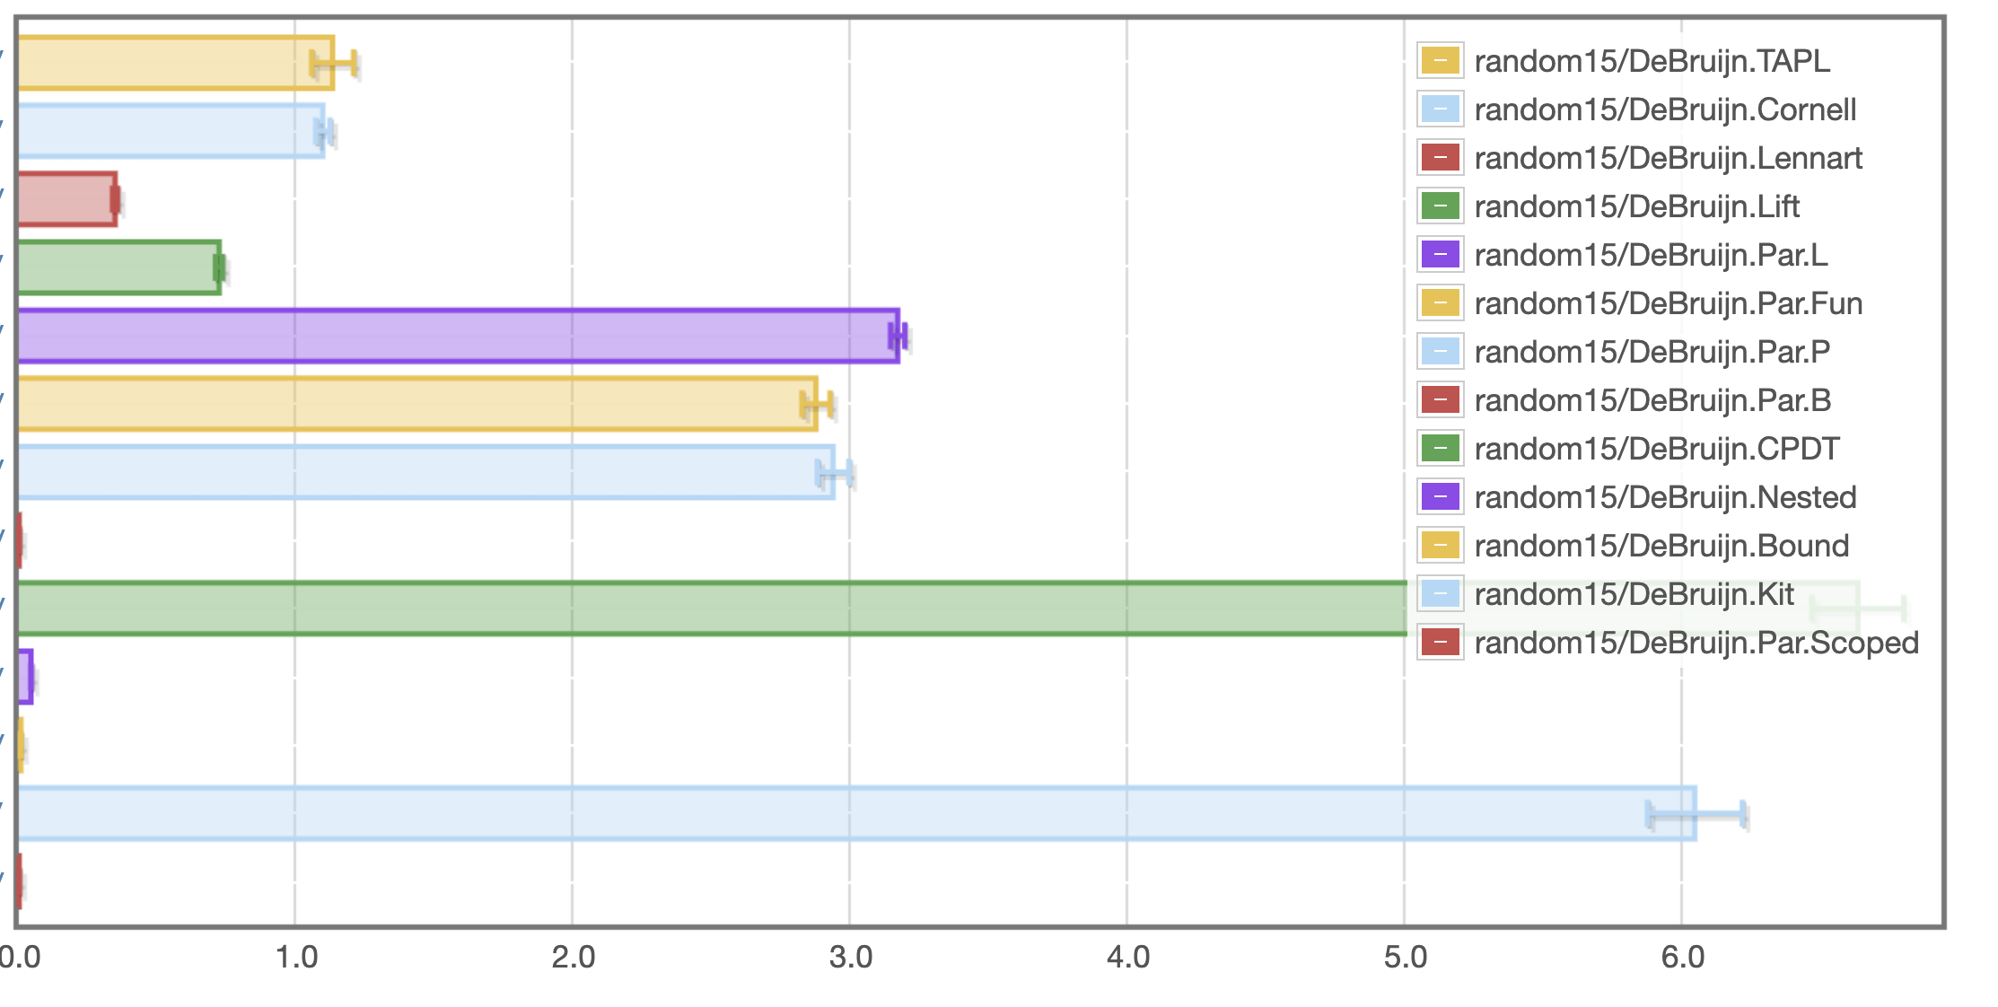
de Bruijn: random
Single substitutions
Parallel substitutions
Scoped single
Scoped parallel
seconds
Fastest: Scoped (914 microseconds), Slowest: Kit (6.63s)

Slide 29
Laziness is an optimization
Previous results for "strict" version of datatype
data Exp = Var {-# unpack #-} !Var
| Lam !(Bind Exp)
| App !Exp !Exp
What about the more standard "lazy" version? data Exp = Var Var
| Lam (Bind Exp)
| App Exp Exp

Slide 30
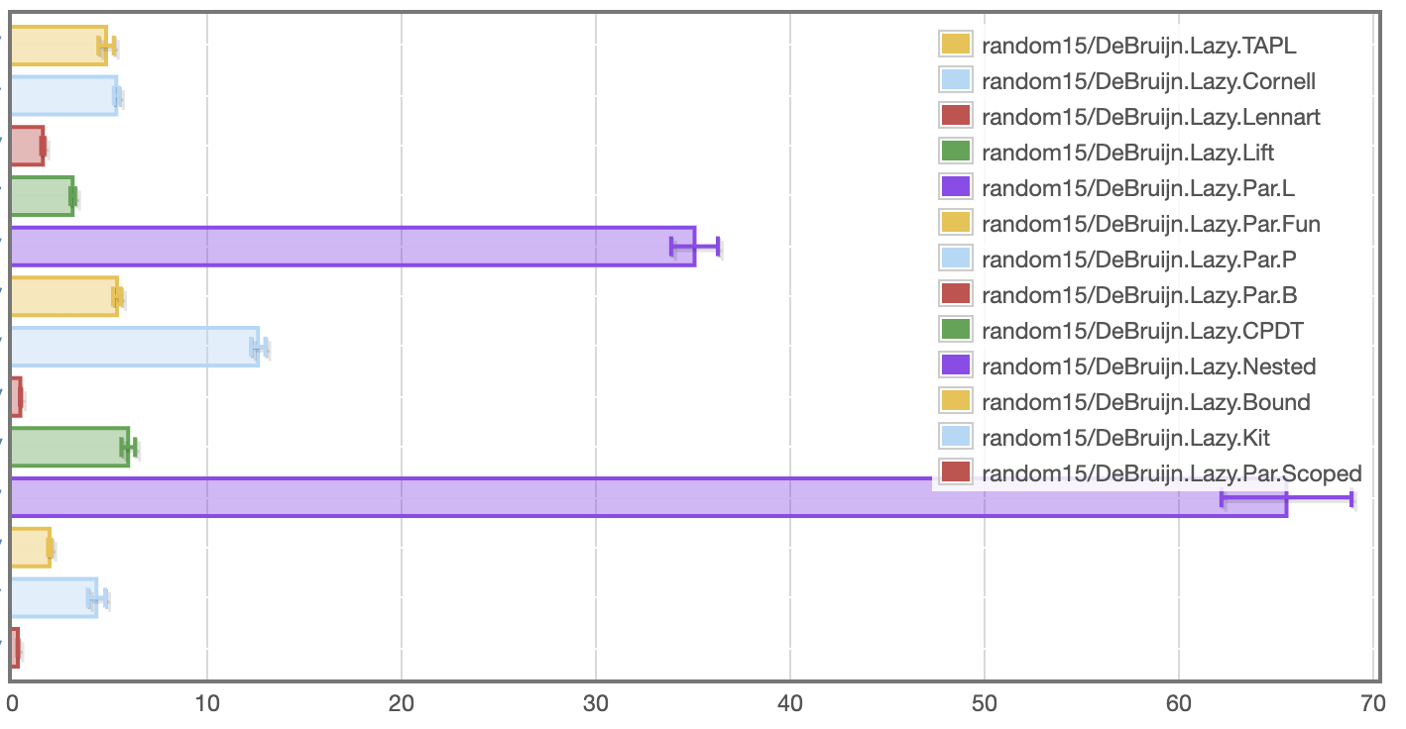
de Bruijn: random, lazy
Single substitutions
Parallel substitutions
Scoped single
Scoped parallel
milliseconds
Fastest: Scoped (307 microseconds), Slowest: Nested (65.5s)
Notes:
Note scale change. Slowest is now under a second.

Slide 31
Lennart's term
Benchmark term from "Lambda Calculus Cooked Four Ways"
Church encoding of:
6! == sum [1 .. 37] + 17
i.e. 720 == 719
i.e. False
Statistics
number of substitutions required for normalization: 119,697
depth: 53
binding depth: 25
average # of variable occurrences in each substitution: 1.15

Slide 32
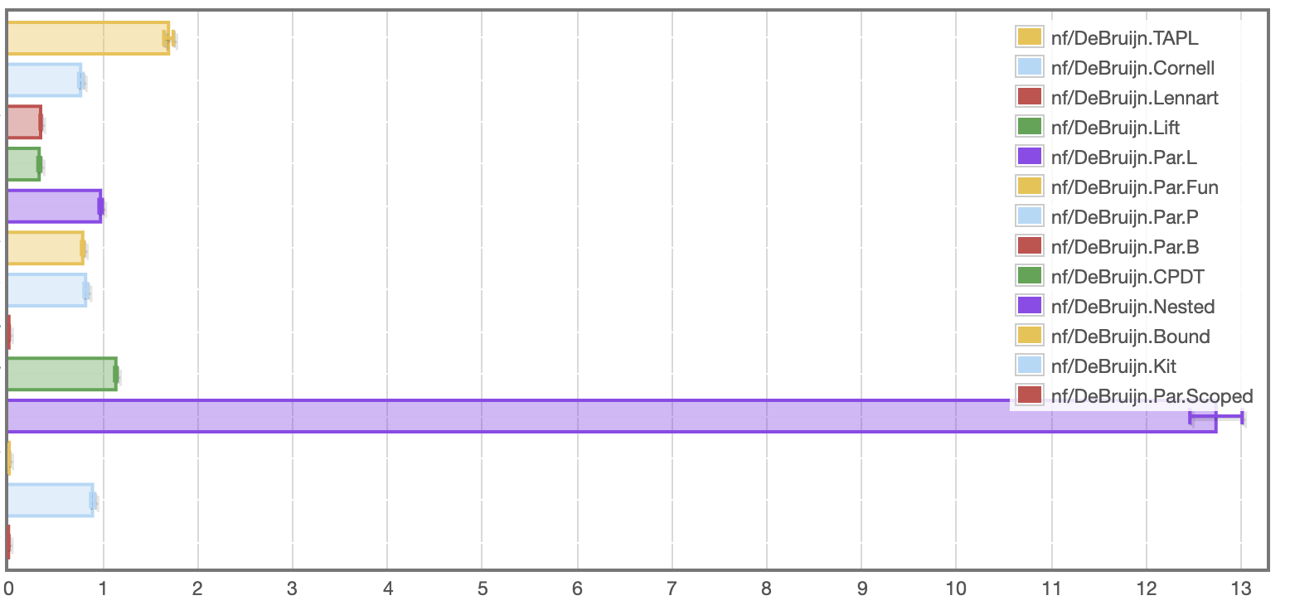
de Bruijn: Lennart
Single substitutions
Parallel substitutions
Scoped single
Scoped parallel
Fastest: Scoped (3.09ms), Slowest: Nested (12.7s)
seconds

Slide 33
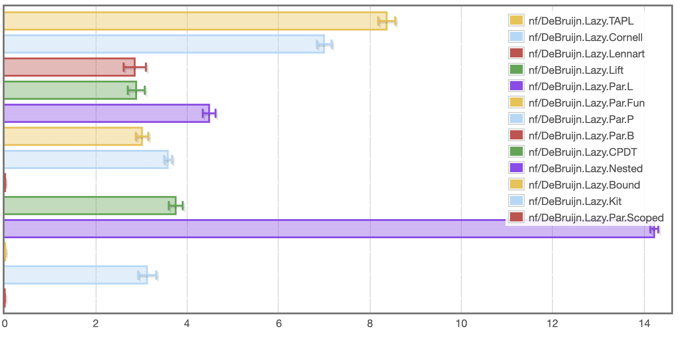
de Bruijn: Lennart, lazy
This time laziness slightly degrades performance
Single substitutions
Parallel substitutions
Scoped single
Scoped parallel
Fastest: Scoped (5.91ms), Slowest: Nested (14.2s)
seconds

Slide 34
Takeaways
Orders of magnitude difference between fastest and slowest versions
Well-scoped implementations generally do not slow down terms
Sometimes laziness helps significantly, sometimes it doesn't
"bound" library comes out very well
No implementation provides (observed) linear performance in worst case

Slide 35
Comparison

Slide 36
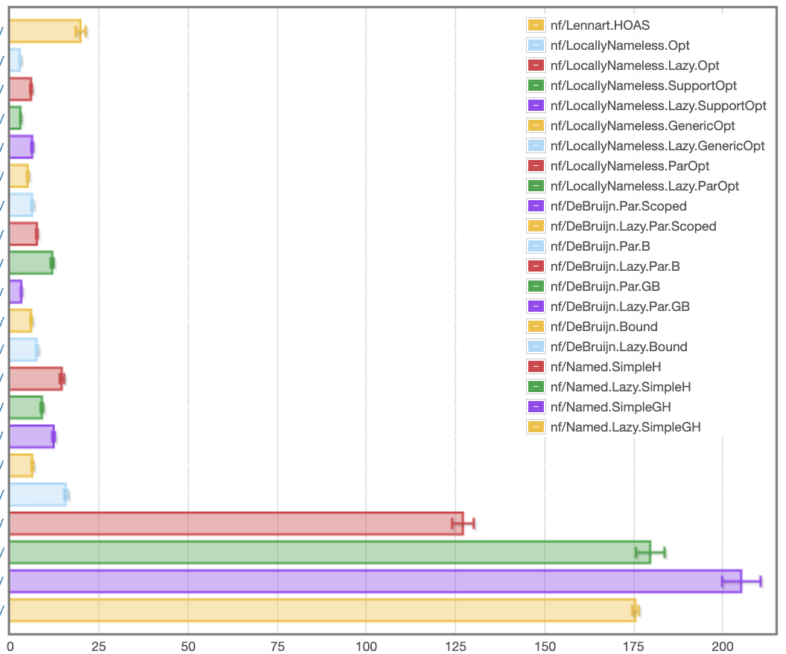
Lennart
HOAS
Locally Nameless
Fastest: 2.74 ms
de Bruijn
Fastest: 3.13ms
Named
results/sixteen.local/fast_nf_bench.html
milliseconds

Slide 37
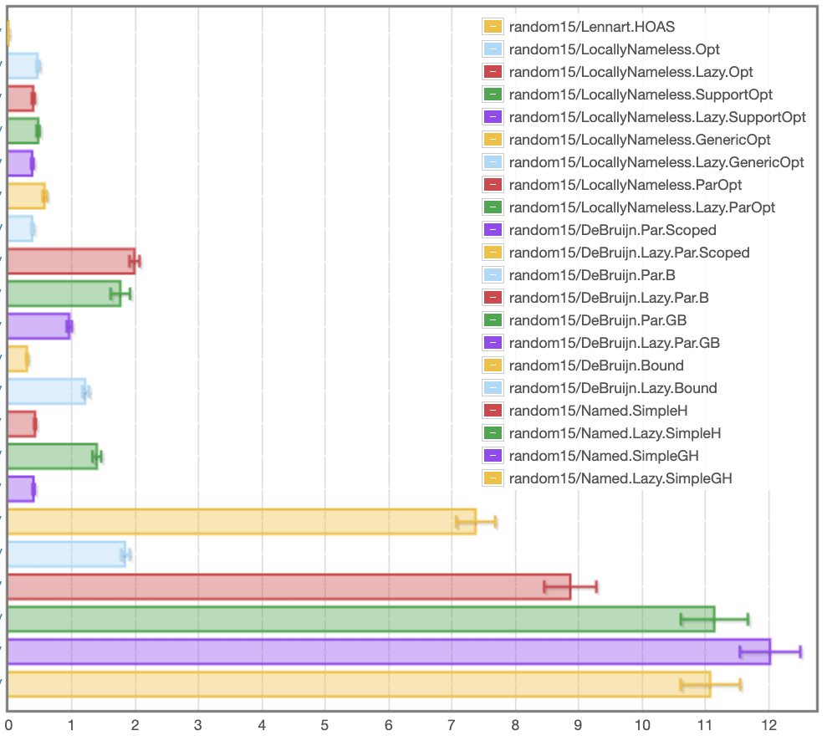
Random
HOAS
Locally Nameless
Fastest: 375 μs
de Bruijn
Fastest: 293 μs
Named
results/sixteen.local/fast_random15_bench.html
milliseconds

Slide 38
Locally Nameless
and variations

Slide 39
Locally Nameless implementations
data Exp = Var Var
| Lam (Bind Exp)
| App Exp Exp
deriving (Eq)
type Var = B Int | F Id -- distinguish bound/free type Bind t = t -- no info at binders
\x -> x (\y -> x z)
Lam (App (Var (B 0)) (Lam (App (Var (B 1)) (Var (F "z")))))

Slide 40
LN definition of (bound var) substitution
open :: Int -> Exp -> Int -> Exp -> Exp
open j b = walk j
where
walk c (Var (B x))
| x == c = b | x < c = Var (B x) | otherwise = Var (B (x – 1))
walk c (Var (F x)) = Var (F x)
walk c (Lam t2) = Lam (walk (c + 1) t2)
walk c (App t1 t2) = App (walk c t1) (walk c t2)
instantiate :: Bind Exp -> Exp -> Exp
instantiate a b = open 0 b a
No free indices means no need to shift
lib/DeBruijn/TAPL.hs
Notes:
Find and apply the leftmost beta-redex

Slide 41
Locally Nameless Normalization
nf' :: Exp -> N Exp
nf' e@(Var _) = return e
nf' (Abs e) =
scope $ \x -> do
b' <- nf' (instantiate e (Var (F x))
return $ Abs (close x b')
nf' (App a b) = do
a' <- whnf a
case a' of
Abs a0 -> nf' (instantiate a0 b)
_ -> App <$> nf' a' <*> nf' b
Work in "Reader" monad, i.e. IdInt -> Exp
Need to generate a fresh variable name for the binder.
Replace bound variable with fresh name
Replace fresh name with a bound variable,
inverse of open

Slide 42
Locally Nameless variations
Ott – generated by Ott tool, translated to Haskell
TypedOtt – well-scoped version of Ott
ParOpt – well-scoped version with parallel substitutions (cf. DeBruijn.Scoped)
Opt – optimized Ott version, delays open & close at binders
GenericOpt – optimized Ott version, with Generic Programming=
UnboundRep – generic programming (RepLib) (Yorgey, Sheard, Weirich)
UnboundGenerics – unbound ported to GHC.Generics (Alexey Klieger)
UGEBind – opt ported to UG
UGSubstBind – substbind
UGSubstBind – opt + substbind

Slide 43
Well scoped LN
de Bruijn index usage is "hidden" by the library so clients don't need to think about indices
Clients only work with "locally-closed" expressions
If expression types track bound variables, this is type "Exp 'Z".
As a tradeoff, clients need to make sure that all binders are opened with sufficiently fresh "free" variables.
Monads are good for this, and types can ensure clients don't forget

Slide 44
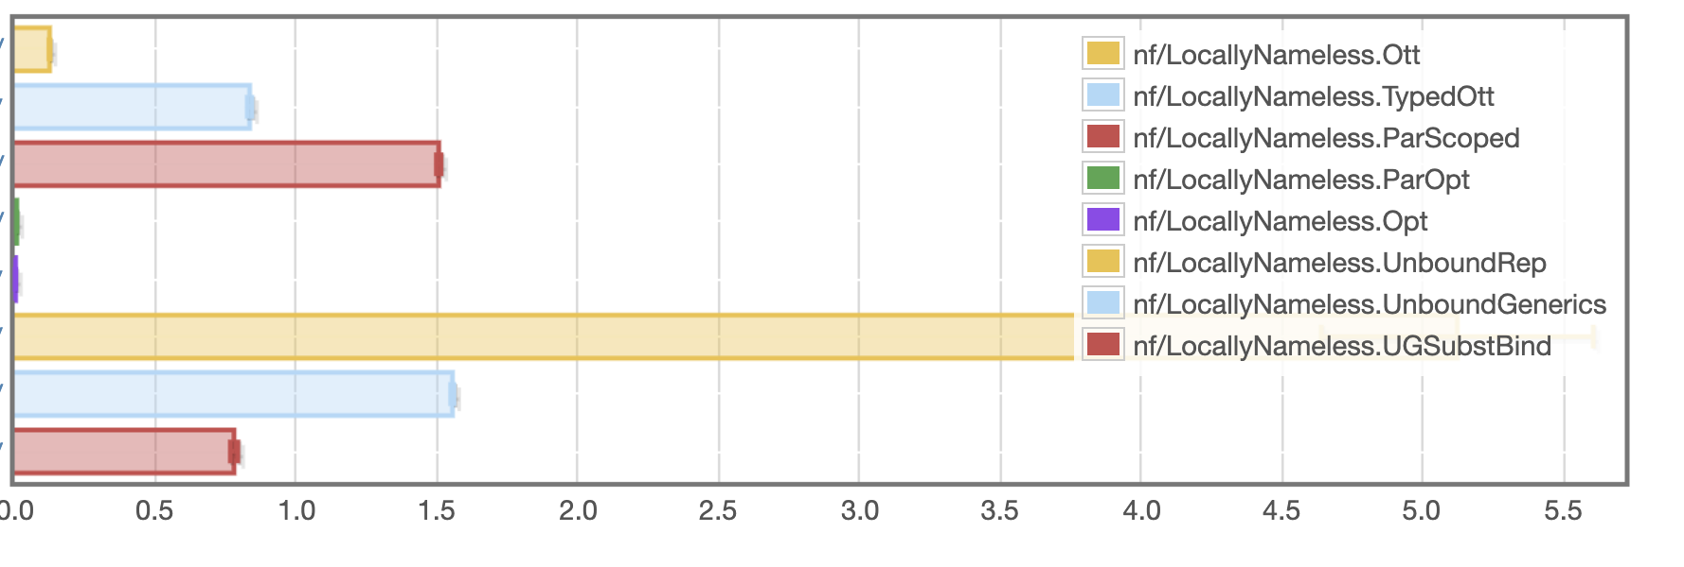
LN: lennart
seconds
Fastest Opt: 2.96 ms, Slowest: Unbound 5.12s

Slide 45
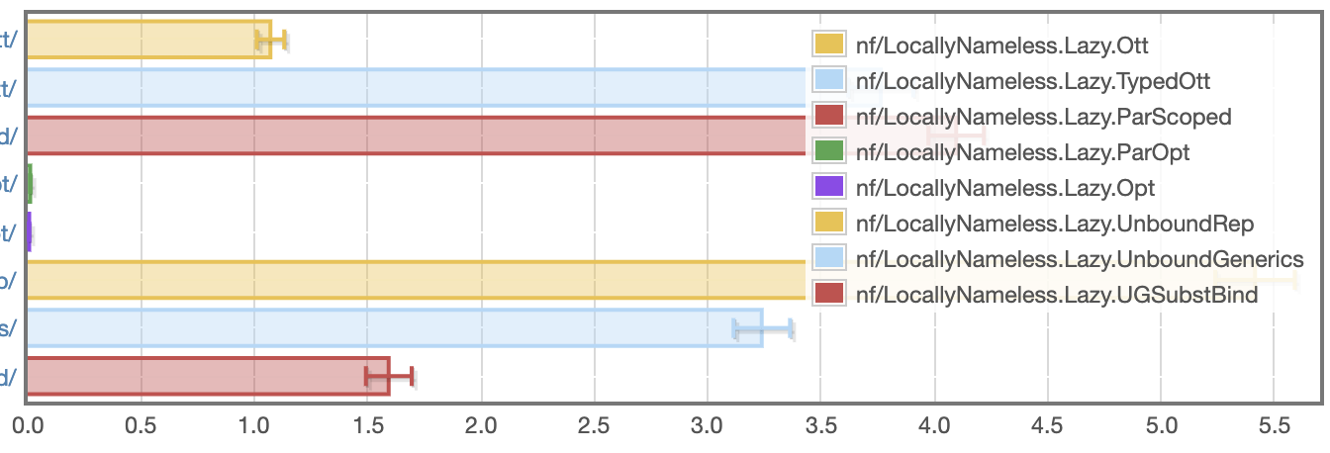
LN: lennart, lazy
seconds
Fastest Opt: 6.02 ms, Slowest: Unbound 5.41s

Slide 46
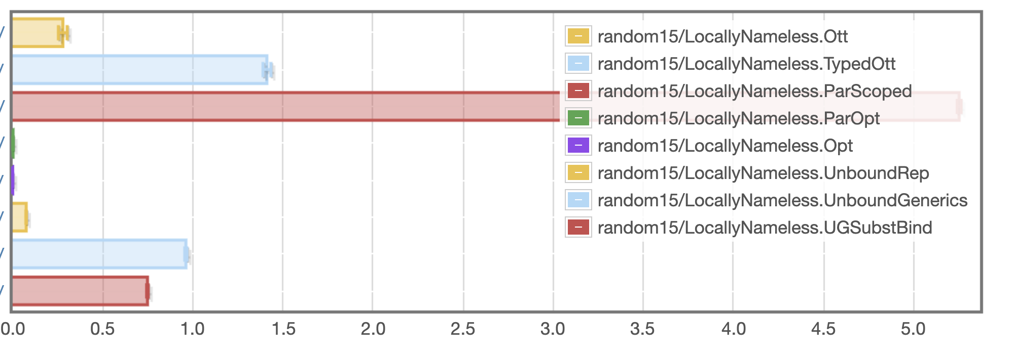
LN: random
seconds
Fastest Opt: 444 microseconds, Slowest: ParScoped 5.25s

Slide 47
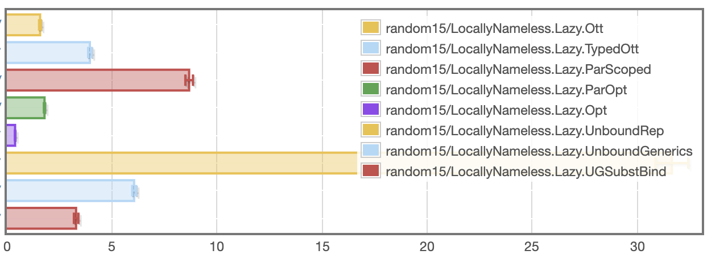
LN: random, lazy
milliseconds
Fastest Opt: 393 microseconds, Slowest: Unbound 31.7 ms

Slide 48
Named / Nominal
and variations

Slide 49
What makes a good implementation?
Quick implementation of key operations, with high confidence
No matter what language, because we are probably not actually implementing the untyped lambda calculus
i.e. could have multiple binders, patterns, etc
Minimal invariants to keep track of
Or at least help with them
example invariants: BVC, shifting indices when changing scopes,
Reasonably fast runtime execution
Very easy to end up with quadratic execution times
Opportunity for early cut-off (\x.a) {b/x}
Constant factors dominate

Slide 50
Substitution w/ de Bruijn indices
stepApp (LamE t e1) e2 = ???? -- substitute e2 into e1
Simple case: no lambdas in e1
… replace occurrences of "Var 0" with e2
… if e1 is not closed, decrement all other variables (we've removed a binder)
Towards generality: what if we need to traverse under a binder?
…replace occurrences of "Var 1" under the binder with e2
…if e1 is not closed, decrement variables >= 2 in e1, but leave 0 alone
…if e2 is not closed, increment free variables in e2 by 1

Slide 51

Substitution w/ de Bruijn indices
stepApp (LamE t e1) e2 = ???? -- substitute e2 into e1
Simple case: no lambdas in e1
… replace occurrences of "Var 0" with e2
… if e1 is not closed, decrement all other variables (we've removed a binder)
Towards generality: what if we need to traverse under n binders?
…replace occurrences of "Var n" under the binder with e2
…if e1 is not closed, decrement variables >= n+1 in e1, but leave 0..n-1 alone
…if e2 is not closed, increment free variables in e2 by n
Notes:
When things get scary, let's just close our eyes. We can ignore the details.

Slide 52
Big-step evaluation, closed terms
data Val = IntV Int | LamV Exp
eval :: Exp -> Val
eval (IntE x) = IntV x
eval (VarE _) = error "Unbound variable"
eval (LamE e) = LamV e
eval (AppE e1 e2) =
case eval e1 of
(IntV _) -> error "Type error"
(LamV e1') -> eval ??? -- substitute e2 in e1'
Simple.hs
Notes:
Find and apply the leftmost beta-redex

Slide 53
Substitution w/ de Bruijn indices
(LamE e1) -> eval ??? -- substitute e2 into e1
Simple case: no lambdas in e1
… replace occurrences of "Var 0" with e2
… if e1 is not closed, decrement all other variables (we've removed a binder)
Towards generality: what if we need to traverse under a binder?
…replace occurrences of "Var 1" under the binder with e2
…if e1 is not closed, decrement variables >= 2 in e1, but leave 0 alone
…if e2 is not closed, increment free variables in e2 by 1

Slide 54
Substitution w/ de Bruijn indices
(LamE e1) -> eval ??? -- substitute e2 into e1
Simple case: no lambdas in e1
… replace occurrences of "Var 0" with e2
… if e1 is not closed, decrement all other variables (we've removed a binder)
Towards generality: what if we need to traverse under n binders?
…replace occurrences of "Var n" under the binder with e2
…if e1 is not closed, decrement variables >= n+1 in e1, but leave 0..n-1 alone
…if e2 is not closed, increment free variables in e2 by n
Notes:
When things get scary, let's just close our eyes. We can ignore the details.

Slide 55
Substitution library
type Sub -- abstract type
singleSub :: Exp -> Sub -- replace 0 with exp
applySub :: Sub -> Idx -> Exp -- lookup index
lift :: Sub -> Sub -- go under binder
subst :: Sub -> Exp -> Exp
subst s (IntE x) = IntE x
subst s (VarE x) = applySub s x
subst s (LamE e) = LamE (subst (lift s) e)
subst s (AppE e1 e2) = AppE (subst s e1) (subst s e2)
Simple.hs
Notes:
Substitution affects multiple indices, so view as a function from indices to expressions
What do you want -→ what to do for variables, and what to do at binders.
applySub needs to replace "0", but also decrement free variables
lift needs to shift the free variables in the range of the substitution

Slide 56
Substitution library
type Sub a -- abstract type
singleSub :: a -> Sub a -- replace 0 with exp
applySub :: SubstDB a => Sub a -> Idx -> a
lift :: SubstDB a => Sub a -> Sub a
class SubstDB a where
var :: Idx -> a -- "var" constructor
subst :: Sub a -> a -> a -- AST traversal
Subst.hs

Slide 57
Using the library
import Subst
instance SubstDB Exp where
var = VarE
subst s (IntE x) = IntE x
subst s (VarE x) = applySub s x
subst s (LamE e) = LamE (subst (lift s) e)
subst s (AppE e1 e2) = AppE (subst s e1) (subst s e2)
Simple.hs
Notes:
I've gotten my wish...

Slide 58
Small-step reduction, closed terms
step :: Exp -> Maybe Exp
step (IntE x) = Nothing
step (VarE n) = error "Unbound variable"
step (LamE t e) = Nothing
step (AppE e1 e2) = Just $ stepApp e1 e2 where
stepApp :: Exp -> Exp -> Exp
stepApp (IntE x) e2 = error "Type error"
stepApp (VarE n) e2 = error "Unbound variable"
stepApp (LamE t e1) e2 = subst (singleSub e2) e1
stepApp (AppE e1' e2') e2 = AppE (stepApp e1' e2') e2
Simple.hs

Slide 59
Big-step evaluation, closed terms
data Val = IntV Int | LamV Ty Exp
eval :: Exp -> Val
eval (IntE x) = IntV x
eval (VarE _) = error "Unbound variable"
eval (LamE e) = LamV e
eval (AppE e1 e2) =
case eval e1 of
(IntV _) -> error "Type error"
(LamV e1') -> eval (subst (singleSub e2) e1)
Simple.hs
Notes:
Find and apply the leftmost beta-redex

Slide 60
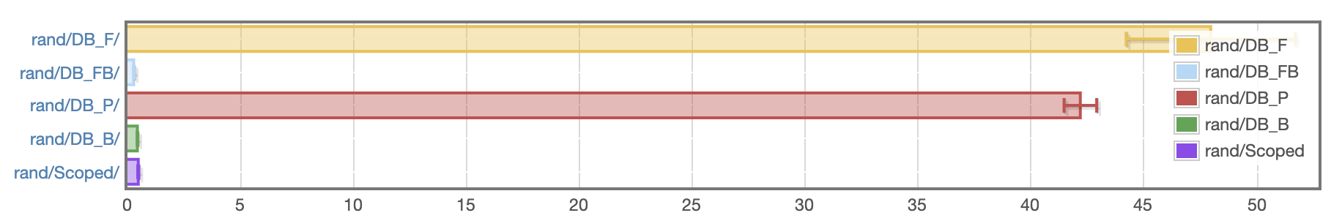
Benchmark – Random terms
Full normalization of 25 randomly generated, closed lambda terms (26-36 subst each)
time in ms
DB_F: represent substitutions with functions, as in Benton et al.
DB_FB: above, but delay substitutions at binders
DB_P: defunctionalize substitutions
DB_B: defunctionalize, delay at binders, & "smart" composition
Scoped: same as DB_B, but types ensure well-scoped terms
https://github.com/sweirich/lennart-lambda

Slide 61
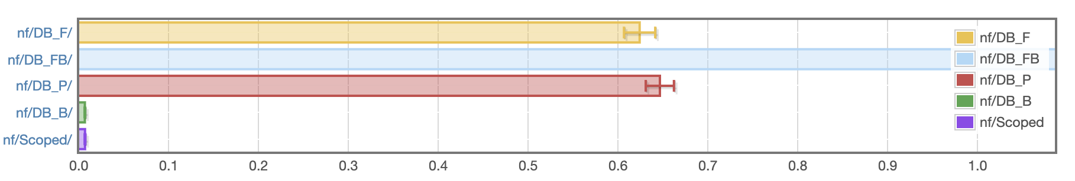
Benchmark – Pathological term
Full normalization of `factorial 6 == sum [1..37] + 17`, Church encoded (119,697 substs)
14 secs!!
time in seconds
DB_F: represent substitutions with functions, as in Benton et al.
DB_FB: above, but delay substitutions at binders
DB_P: defunctionalize substitutions
DB_B: defunctionalize, delay at binders, & "smart" composition
Scoped: same as DB_B, but types ensure well-scoped terms
https://github.com/sweirich/lennart-lambda

