Slide 1

HOW TO
PREVENT WOMEN JOINING CYBER
(and keep other
under-represented
identities out too)
KEIRA PATERSON

Slide 2
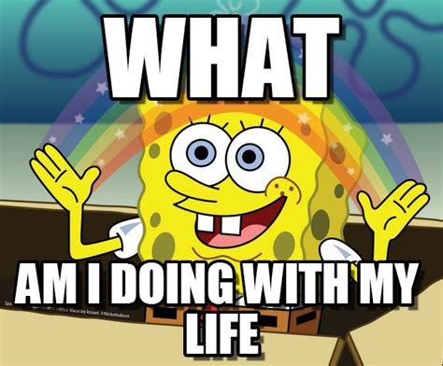
Notes:
33
Hi, I’m Keira, my pronouns are she/her. I’m a web developer. I work on energy reporting and citizen science software, I maintain an open source project and run a SASS platform for activist groups.
Working in tiny teams and not-for-profits, it means I handle back and front end development, testing, ops, and security – this is the reality of small budgets. This is the world no security team, no managed services.
So I read about, take courses in, and have attended a LOT of events about cyber security over the past 8 years.
I didn’t formally study computer science, instead my degree is in Gender, Sexuality and Culture, the other side of this talk.
That’s more about myself than I’d usually share in a talk, but, perhaps ironically, researching the myriad terrible opinions about women in cyber got to me over time, so I need to remind myself, more than you all, that I’m “allowed” to talk about this issue.
I care deeply about cyber security not because I love computers – I really don’t – but because I love people. And because I care about security, I care about diversity in security. It makes everyone safer.

Slide 3
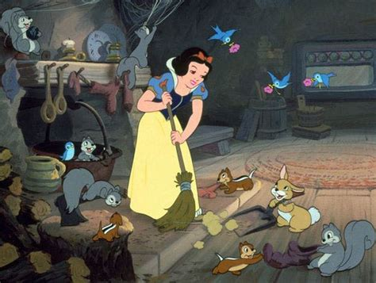
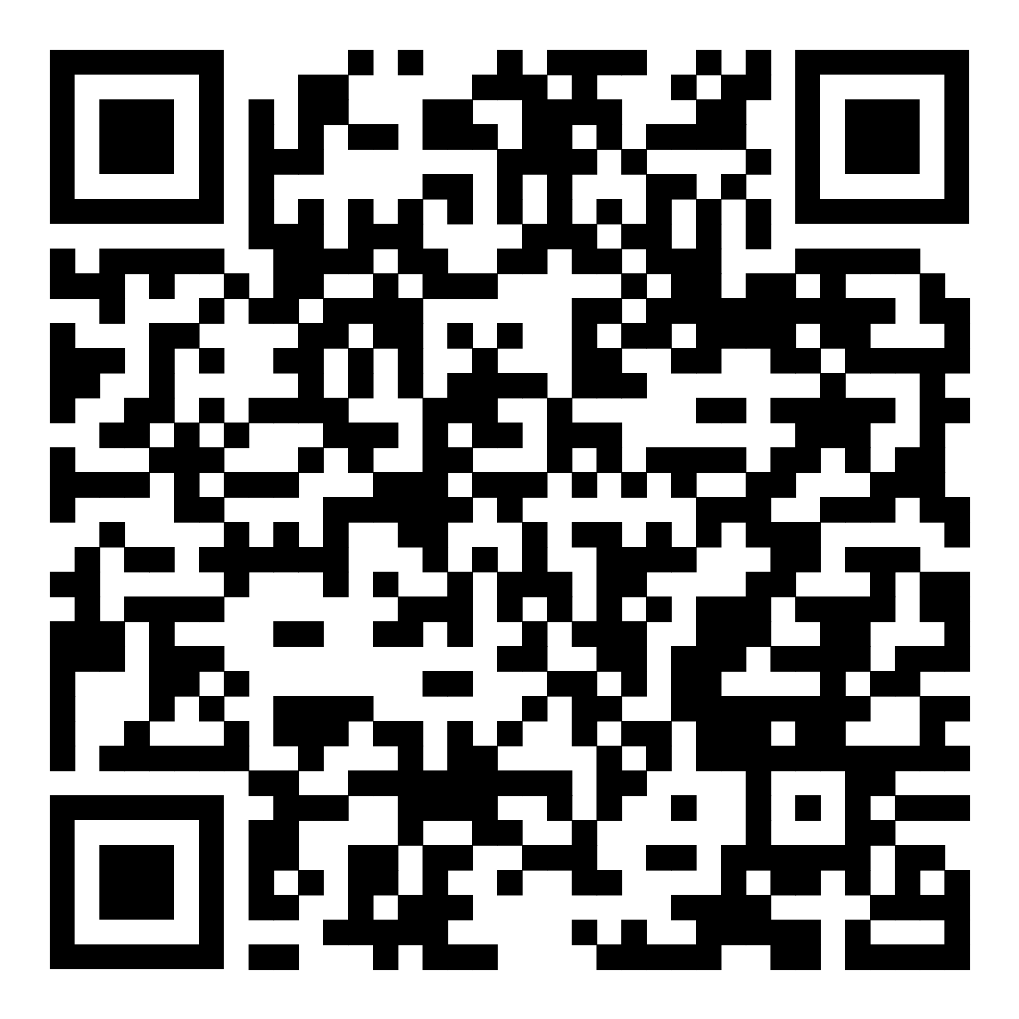
https://github.com/GeneralStrike/slides_and_things/tree/master/CyberCon2023
Notes:
33
A little housekeeping before the satire starts: I've put the slides, the full text of this talk on my github, so if you're hard of hearing or you'd like to catch up later, you can follow along there. It’s OK to take photos, but please keep questions to the end.
This is satire. I don't want anyone to think for a second that I or the organisers of CyberCon want to prevent women joining cyber security. This talk is a way to have a laugh while engaging with some deeper material, and hopefully leaving you with some ideas of how NOT to be the problem.
Second, where examples are given they are real and have happened to me or people I trust, within the last 8 years. This isn't ancient history.
Gender is my wheelhouse, but know there are many other diversity issues and marginalised identities. Not all women will have the same concerns, and you can assume that these examples are definitely NOT the worst things anyone has experienced.
Researches have repeatedly found that the lack of gender diversity in tech is due to systemic gender bias. I’m willing to to bet that applies cyber security, and my talk is about what that looks like, day to day.
Last, I know this isn't a problem caused by all men, or exclusively caused by men. If the shoe doesn't fit, don't wear it.

Slide 4
<satire>
or, in English:
This is where the satire starts.
Notes:
33

Slide 5
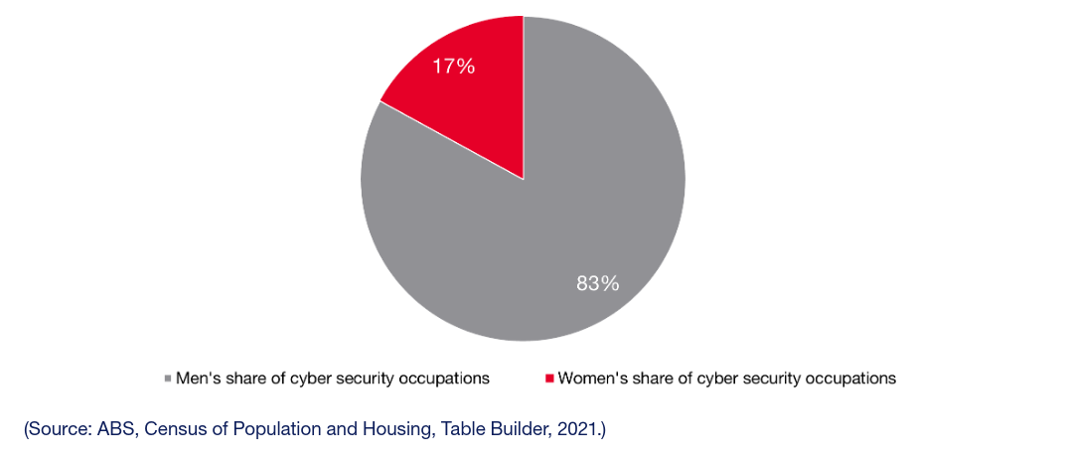
WOMEN IN CYBER SECURITY
Notes:
So here we are. 2023, and women have been joining cyber at an alarming rate. In the US women’s participation rose from 11% to 24% over just a few years. In Australia women now make up 17% of the industry.
I don’t have numbers for non-binary people, but I am sure they are just as concerning.
Gone are the days when we could rely on laws to prevent women from working outside their rightful roles.
But thanks to some lingering structural inequalities, a slow-changing media culture, and the realities of capitalism, we've got a fighting chance.
33

Slide 6
#NOTALLMEN
Notes:
Some of us in the industry have been working hard to keep women from settling in.
Of course, of course, #NotAllMen.
33

Slide 7
#NOTALLMEN
#WHYNOT?
Notes:
And I ask you, why not?!
There are plenty of things we can all do to contribute to the discomfort and exclusion of women and non-binary people, whether you're a colleague, manager, conference organiser, founder, tutor or colourful community identity.
33

Slide 8
IN EDUCATION AND TRAINING
Notes:
Obviously the best bet is to prevent people getting in the door in the first place. So how can we keep our places of learning suitably masculine?
Make sure teachers say things like “you don’t look like a nerd”, or “I’m surprised you want to hang out with the geeks” when girls show interest in STEM subjects.
Don’t ask pronouns, don’t give yours. Ask someone if they are “sure” that their pronopuns really are they/them. If possible, discourage the use of pronouns in email signatures as "divisive".
Make sure the toilet situation is binary, causing discomfort and risk for many people. Only have two gender fields on any given form. And, if you can, make sure your systems have no way to handle non-anglo names, and no way to handle name changes.
Never have women professors or guest lecturers, ensure any reading is of male authors, and assign only male mentors.
33

Slide 9
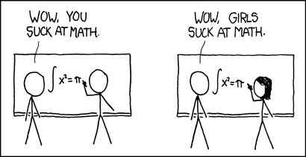
Notes:
Make sure group discussions are combative. Make people compete, and belittle those who don't know something - take back the jock culture of shaming and one-upping which you may have been the victim of in high school. This is likely to keep out all sorts of undesirables, as well as women.
If a woman gets the wrong answer, assume it is because she is a woman, not an individual. You can apply this tactic to any minority!
In formal training, mark down for a lack of public contribution, ignoring the reasons why minorities, who are aware they're judged differently, might not speak up.
33

Slide 10

Notes:
Advertise your courses and meetups with images like this. Make it all about technology, systems, and combat, and never about people, community or caring.
If mature women, and those from other industries join a course, make sure they know how out-of-place they are.
Ask women, or anyone not wearing the uniform hoody, if they are lost.
Ignore harassment. She needs to know what it will be like in the industry.
33

Slide 11
DURING RECRUITMENT
Notes:
Never train your recruitment staff in unconscious bias, or take steps to prevent such bias from entering your hiring decisions.
Never advertise the pay. Ask interviewees what they'd expect to be paid. If a woman's answer seems to low to you, take it as a win. Ignore the literal centuries of history which affect how men and women assess their value and assume that's all she's worth.
For bonus points, tell her she can't discuss her pay with her colleagues.
Ask women if they have children, if they plan to, and if they plan to have more. Never ask men the same thing. Express disbelief if she says she doesn’t plan to.
80% of women will have children, but 20% won’t, so make sure to judge them as a poor fit either way.
33

Slide 12

Notes:
33
Recruit primarily at pizza-and-beer type meetups or via introductions from your guys. This keeps 'outsiders' out, and holds mothers back in particular, as many can't regularly attend weeknight events.
Hire mainly on culture fit. Where by culture fit, you mean same gender, same colour, same vibe, and willing to work very long hours.
Never hire someone who has had "dramas" at a previous workplace, even if the drama was them being the victim of bullying, harassment or abuse.
In the interview, ask women if they are comfortable working in an all male team. Make sure they know they may need a tough skin. Say this as though you are helping.

Slide 13
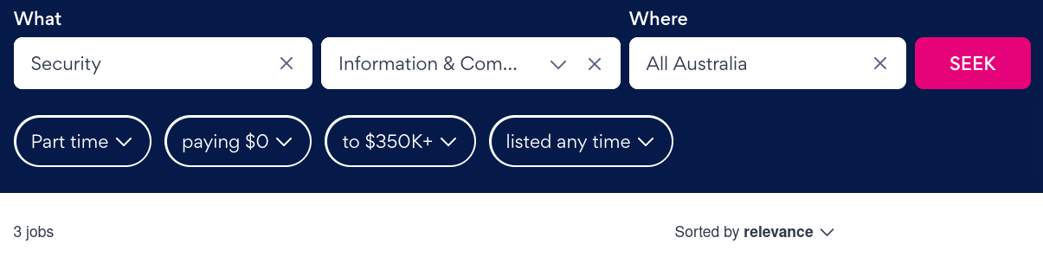
!!!
Notes:
Never have any part time or job share roles. If you are open to part time, don't mention it in the ad.
With this search result we are screaming from the screen: we don't want you. Right into someone's phone or home, and with no risk to our brands. (The full time search listed more than 2500 roles).
If you feel you must have part time options, make sure they are tokenistic, like a 9 day fortnight, to make it clear they are meant to be for the benefit of men with hobbies, not people with significant caring responsibilities or health issues.
Insist the role requires extensive travel, weekend hours and unplanned overtime.
Never hire enough people to comfortably cover your service window, just insist your staff sacrifice their home lives instead.
These have the added bonus of helping to prevent any men who are sympathetic to gender equality from taking on an equal role at home too, making life difficult for their partners and setting a poor example for their children. Propping up the patriarchy on all fronts,
33

Slide 14
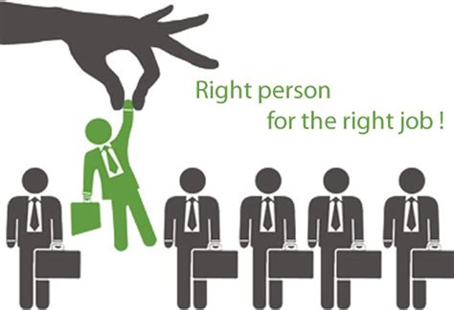
Notes:
Use phrases in your ads that convey domination, individualism, and exceptionalism like "rock star", "hero", "10x", "alpha". List every criteria you can imagine, not just your must-haves.
Act as though teaching hands on cyber skills is significantly harder than teaching strategic thinking, communication skills, and the like. So cyber experience is required, but management experience is not, even for management roles.
Never consider the benefits of hiring people with backgrounds in other fields. What benefit could you possibly get from hiring someone with 10 years of experience in working directly with the public, or managing contracts, or writing policy documents?
Outsource cyber as much as possible, to start ups without the capacity to take on juniors, and centralise public service cyber capacity into defence and policing.
33

Slide 15
IN THE WORKPLACE
Notes:
It’s not good enough to look only at the pipeline though. 38% of women in the broader tech landscape are reportedly planning to leave within the next two years. That’s a good start, but what can we do to speed up the exodus?
Avoid difficult conversations with staff or colleagues about bullying or harassment. To "resolve" bullying complaints, suggest staff just avoid that person who is treating them badly.
Whatever your company approach to neurodiversity in the workplace, make absolutely sure you don't consider how it may show up in women differently to men. Also, never look into the stats around gender non-conformity and neurodiversity, or consider how this might be affecting your assumptions about non-binary or trans people. Surely a gender is enough, you cannot also have a disability or be neurospicy.
Expect women staff to meet aesthetic, deportment and interaction standards you'd never require of male staff.
33
.

Slide 16
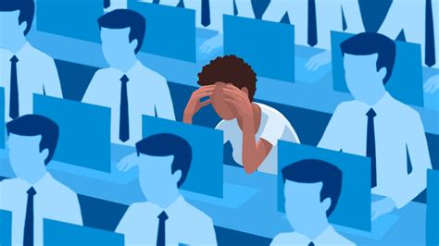
Notes:
Only put one woman in each team, max. Never let women support each other in mostly-male teams by working together and developing solidarity.
If you give a woman a challenging project, make sure it's under-resourced and likely to fail. The rest of the time, give her boring work below her capacity, that no one else wants.
Don't let her attend client meetings or present her own work. Where possible, take credit for her work and ideas.
Get women team members to take minutes, get coffee or bring snacks.
Make no one responsible for workplace dishes or cleanliness. Sooner or later a woman will "choose" to clean up after everyone.
Don’t have any onboarding process for new team members. "It's sink or swim here, bro. This is how the big boys roll!"
33
.

Slide 17
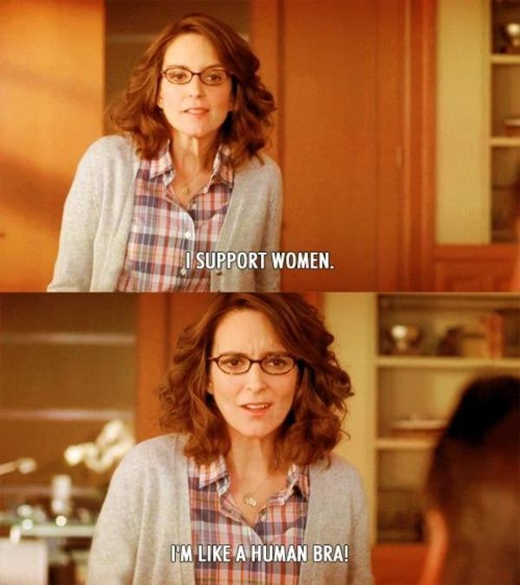
Notes:
Wait until asked before making your spaces more accessible. Use the women's or accessible toilets as storage.
Don’t have sanitary bins in all toilet stalls. This is an issue for anyone with a shedding uterus or bladder problems, so you can cause problems for women, non-binary people, trans men and disabled people with just one thoughtless gesture.
You can make mothers and trans and non-binary parents unwelcome by making leave difficult to access, ensure there are no private spaces for breast-milk pumping, and talk about the importance of doing industry or learning activities in their "spare time".
While we're talking about icky body things, it's a good idea to make sure your managers don't know anything about, and aren't safe people to talk to about, fertility treatments, pregnancy, menstruation, menopause or transition. These things can all require leave or adjustment at work, and you can make people's work lives extremely uncomfortable by refusing to acknowledge this.
33

Slide 18
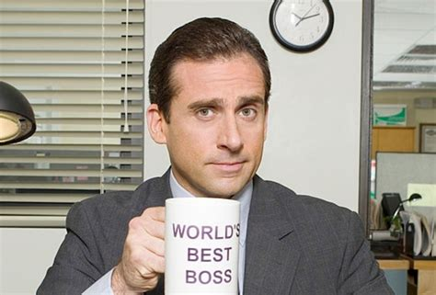
Notes:
Give women feedback that they are too aggressive, or too lacking in confidence. Allow no middle ground.
Champion "facts over feelings". Do not consider that women are usually not in quantitative studies and therefore there are often no "objective" figures to back up what women are experiencing. Tell her her concerns aren't relevant to "normal" or “most” people.
Talk about emotions vs rationality, but be careful to only consider crying or feminine reactions "emotional". Men's rage, frustration or anger are exempt, because they only express such feeling over serious, rational issues, like tabs versus spaces, or which actors should be allowed to play the character Doctor Who.
Men, famously, have neither bodies nor emotions - much better workers!
33

Slide 19
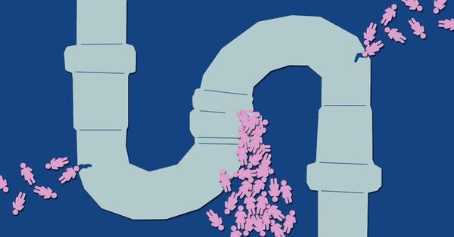
Notes:
Make sure *all* your senior people are promoted from technical roles. Don't split technical leadership and managerial roles along skill lines.
Don't hire for people skills, and don't train your technical seniors in people management.
Don’t require managers, or anyone else, to undergo any diversity or bias training.
If you must have diversity training for some reason, make sure everyone knows it’s because of your token hire.
If you believe it's a pipeline problem, and that a lack of diversity in senior roles keeps outsiders away, then promoting only on the basis of a long technical career will seriously slow the invasion.
33

Slide 20
COMMUNITIES AND CONFERENCES
Notes:
Maybe you're a conference organiser or community wrangler? There’s a lot you can do too.
Make sure there very few women speakers in your conference line ups. Or go for gold and try for no women speakers at all!
Make sure that minorities speakers are scheduled at the same time as a keynote, and/or in the smallest room, and/or early on the morning after the party.
Never offer childcare, and don't stream or record your talks.
Keep the focus at 'women in cyber' events on fixing women so they are more like the men. Never hold talks about bias at “mainstream” events attended by men.
Never do nameless reviews of talk proposals.
Hold your event in a country or region that isn't safe for women, LGBTIQ people, or other groups, or where their identities are illegal.
Make your decision based on your own gut - never ask person with lived experience for their views.
33

Slide 21
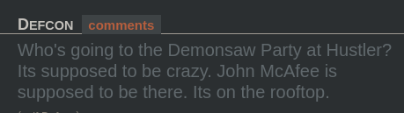
Notes:
If you're sponsoring an event at DEFCON or the like, have it at a strip club. This will put lots of women (and others) off attending.
Strip clubs are also a great venue for holding project kick-off talks and client meetings.
Have booth babes.
Keep inviting and accepting speakers who are known to have harassed, assaulted or stalked people, or who express views of women's general inferiority or who are publicly "skeptical" of the humanity and rights of trans and non-binary people.
Never have a code of conduct, or never enforce it. Don't moderate discussion in online spaces.
Create or support "code of conduct free-zones" at events which do have a code of conduct.
Refer to anyone seeking change as feminists. Talk about them like they are not *also* hackers or colleagues, but outsiders trying to force their values onto *your* community. Don't worry, no one will notice your assumption of natural exclusion.
33

Slide 22
AS A (MALE) COLLEAGUE
Notes:
Even if you have no structural power, you’re just an average Joe, we can all play a role.
Complain that any featuring of marginalised genders in the field is pandering, politics, or reverse discrimination.
Assume that a woman at a conference is looking to date.
Have you considered simply groping women at networking events? Simple but effective.
If a woman encountered groping or other assault, blame her or tell her she's lying.
Assume women have attended events with a male partner. If they say they work in cyber, assume they mean in marketing or sales.
Assume general incompetence in women and post your thoughts online as truth telling.
Ask women at a conference if they will give you an invitation to the 'secret women's only party'. Try to lie your way in if you don’t get an invite.
33

Slide 23
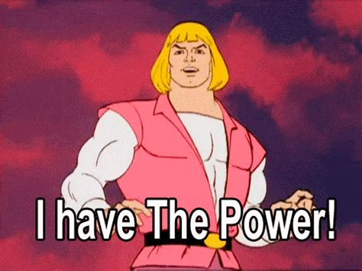
Notes:
Refer to lying, hitting on, or manipulating women (outside of a contract or contest) as "social engineering".
Never attend talks by or about women. Never read anything about gender, culture, or race, from a writer who has lived experience of these things.
Assume that men who are confident talking about these issues and are smart at other things must know what they're talking about on this issue too.
Assume that because you are smart at other things your opinions on things like gender equality, affirmative action, and merit are also well-informed and sensible.
Refer to hypothetical senior professionals as "grey beards". Refer to hypothetical people who don't know anything about tech as a "grandmas".
If you don't know the gender of the person you're looking for, ask the woman you see. "Hey hon, I'm looking for the threat analyst, is he nearby?"
Don't follow any women or non binary people on social media.
33

Slide 24
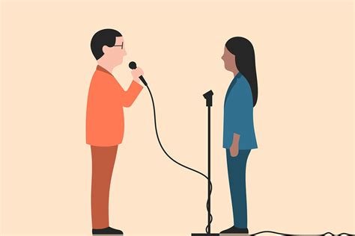
Notes:
Constantly remind women that they are out of place.
Use the language of protest and liberation movements to explain your own lack of desire to change. Pretend "bringing your whole self to work" means never having to keep a racist comment or rape joke to yourself.
Use the term "technical" as though it means "intelligent". Use it to refer to people, not roles, and make it clear that "non-technical" people are below your notice.
As a colleague, make sure women know where they stand by using feminine terms to describe things and people you don't like. Pussy, princess, little girl, and bitch are a good start. This tip will probably also work for ensuring gay men feel unwelcome in your team. Extra points for rape used as an analogy for workplace successes or failures.
Make endless excuses for men who say or do sexist things. "He didn't mean it". Or "he's just a bit socially awkward". Do not make excuses for women, especially transwomen, if they are assertive or prickly in their own defence.
33

Slide 25
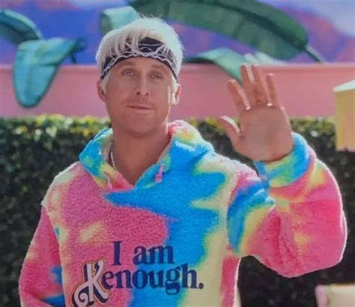
Notes:
Make the very important point that concerns about diversity are political and do not belong in such an apolitical space (unlike discussion of famously neutral topics like free speech, promotion of either surveillance OR anti-surveillance tools, or calling nation state actors 'the baddies').
Talk about harassers as men who are "maladjusted, basement dwellers who don't know how to talk to women". This approach belittles autistic and/or nerdy men, lets jock-type predators off the hook, pretends there no autistic or nerdy women, and suggests women can't tell the difference between awkward and predatory. Wins all round!
Wax lyrical about the contributions of arsehole geniuses that we would lose if we held them to a basic standard of decency. Ignore entirely the contributions we continue to lose by the women and minorities those arsehole geniuses pushed out.
Talk about the "pipeline problem" and "teaching girls to code" but don't step up for your adult women colleagues. Little girls are a lot more palatable than women - they're not angry yet
33

Slide 26
BUT I’M A WOMAN
Notes:
Women can contribute in most of the ways I've already suggested, but there are some extra things you can do. Pull that ladder up behind you.
Compare neurodiverse women and non-binary people with a neurotypical feminine norms, and express “concern” or disdain if they don’t measure up.
If you are less femme, express disdain for women who are more femme. Girly girls, probably aren’t right for this industry.
In either case, down-talk them to their male colleagues or managers behind their backs.
33

Slide 27
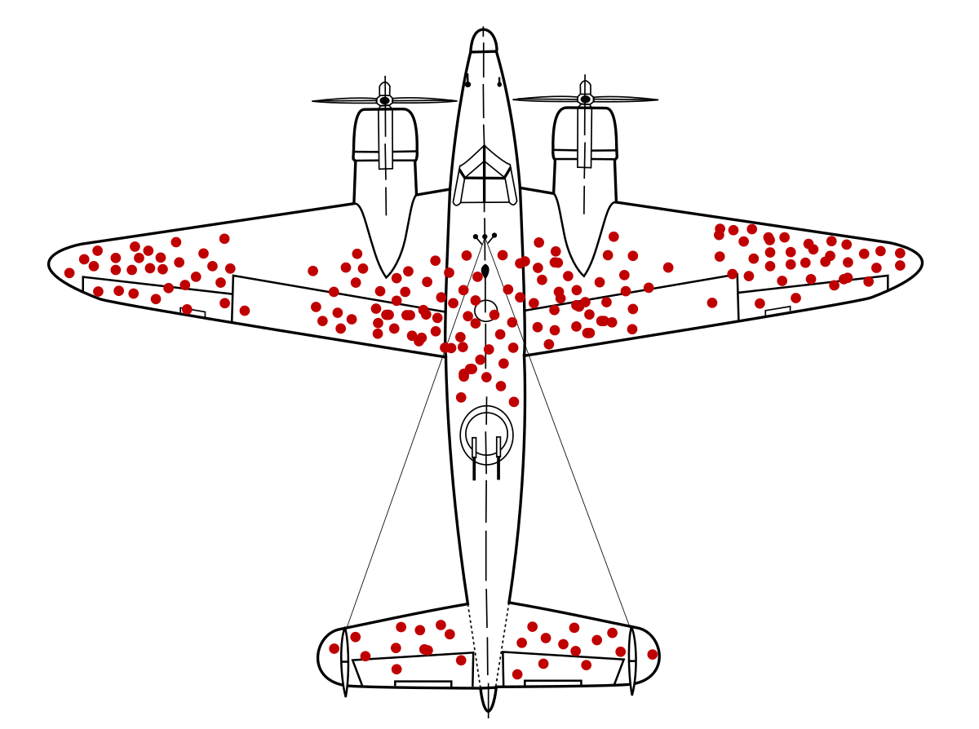
Notes:
If you don’t recognisie this image, keep it that way. Definitely don't read anything about survivorship bias.
If you haven't encountered anything you recognise as sexism in the workplace, assume that other women are making it up, complaining, are not tough enough, or just need to be more like you.
If you have experienced worse treatment in another industry, use that to justify the status quo or prove that cyber "isn't so bad". I mean, if it's not the very worst, it must be fine!
Never consider how your experience might be different if you were a parent, came in via a different pathway, looked different, were more or less traditionally feminine or had visibly aged a little more.
If possible, proclaim publicly that you'd be embarrassed to receive any benefit as the result of affirmative action measures.
33

Slide 28
WE ALL HAVE A ROLE TO PLAY
Notes:
But what’s the most important thing we can all do?
33

Slide 29

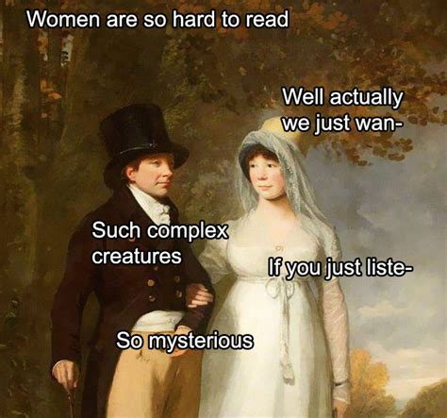
Notes:
The most important thing we can all do is guess!
You've met women. You are a person in a cyber job. That makes you just as qualified as an academic social sciences research team to figure out these issues.
Wondering why fewer girls are graduating? Just guess! Perhaps it’s because they’re just not interested?
Wondering why women leave in mid career? Guess! Maybe we need another International Women's’ Day morning tea?
You don't need to read research that says job share and part time roles are actually more productive. Just go with your gut.
Then act on your guesses and pretend to be stumped when your actions don't work.
What makes women happy anyway?
33

Slide 30

Notes:
I’m pretty sure it’s cupcakes.
And non-binary people?
33

Slide 31
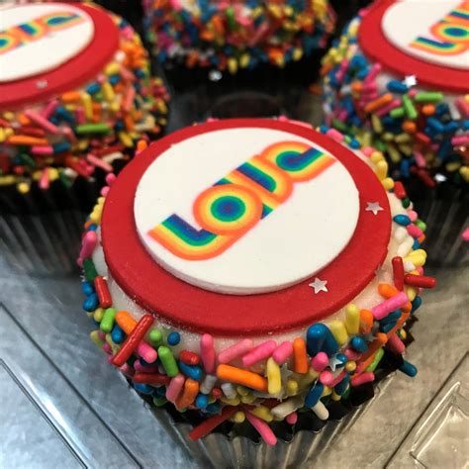
Notes:
Rainbow cupcakes!
So that's a long, but not exhaustive, list of how we could keep women out of cyber, and make it an unwelcoming place for people of other genders too.
I've put a list of resources on making workplaces more welcoming up on my github, in case you'd like to add them to your workplace blocklist. (I'll show the link in a minute).
33

Slide 32
</satire>
or, in English:
This is where the satire ends.
Notes:
Back out of the satire now, back to just being me.
I hope no one here does ALL these things, but if you did see yourself, or your corner of the industry in these things, that's OK. This is your invitation to learn and grow.
<number>

Slide 33
THANK YOU
SOCIALS: @keira_reckons
GITHUB: GeneralStrike/slides_and_things
Notes:
My twitter, bluesky and mastodon are both @keira_reckons, although I am mostly on mastodon now.
Any questions?

