Slide 1


Judy AI – AI-Powered E-Signature POC
Handoff Session | October 28, 2026
2026 | nClouds.com

Slide 2

Agenda
Project Overview
Architecture and System Flow
What We Delivered and Live Walkthrough
Results and Running the System
Deliverables and Handover
POC Decisions and Phase 2 Recommendations
Questions

Slide 3
Project Overview
Current Challenges
Manual contract review: Approvals rely on people reading every contract, which slows the cycle and risks missing critical terms or compliance issues.
Time-consuming document preparation: Staff identify signature blocks, form fields and signers by hand for every contract packet.
No obligation tracking: Renewal dates, milestones and vendor commitments are tracked manually, which leads to missed deadlines.
Hard-to-review supplier agreements: Long, complex agreements take decision-makers time and need legal review that delays the business.

Slide 4
Project Overview
POC Goal
Flag risks before signing: AI reviews supplier contracts for unusual terms, missing clauses, date mismatches and compliance gaps, with suggested wording from Judy's playbook.
Prepare documents automatically: AI identifies signature blocks, form fields and signers for MSA, purchase agreement and SOW templates.
Track obligations: After signing, AI extracts commitments, renewal dates and milestones where the contract states them.
Summarize in plain language: Short overviews of long supplier agreements for faster decisions.
Modernize the signing workflow: Upload, review, approval chains, batch signing and a signed copy, all in Judy's own AWS account.
Amazon Bedrock reviews, prepares and tracks contracts; people stay in charge of every decision.
POC Focus
Prove AI-assisted contract review and e-signature on Judy's sample contracts in a single AWS environment. Not a production rollout.

Slide 5
Architecture and System Flow
What happens
AWS services
Upload
A PDF or Word contract is uploaded in the Judy web app
CloudFront, Cognito, API Gateway, S3
↓
Extract
Bedrock Data Automation reads the text and page layout
SNS, SQS, Lambda, Bedrock Data Automation
↓
Analyze
Three AI agents check risks, find signature fields, write a summary
Lambda agents, Amazon Bedrock (Nova Pro)
↓
Review
Reviewer sees risks, playbook wording and summary before sending
Analysis API, Aurora PostgreSQL
↓
Route & sign
Approval chain sends it to signers, in order or in parallel
Signature workflow (Lambda), Amazon SES
↓
Signed copy
Signatures, names, titles and dates stamped, plus an audit page
Lambda, Amazon S3
↓
Obligations
After the last signature, AI lists deadlines, renewals and commitments
Lambda agent, Amazon Bedrock

Slide 6
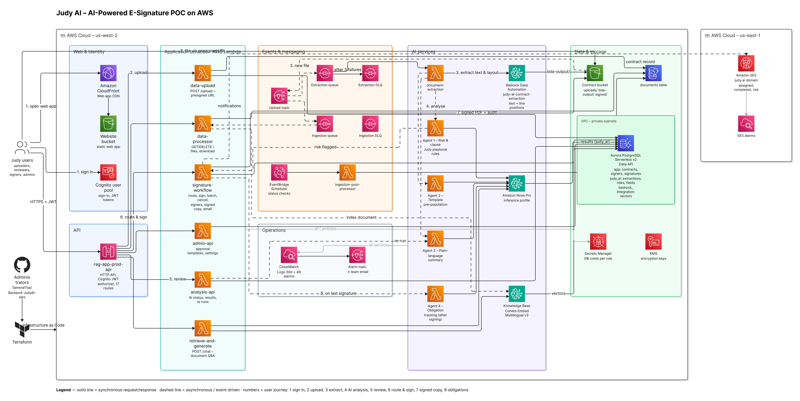
Solution Architecture on AWS

Slide 7
What We Delivered
Key design principle
AI advises, people decide. Suggested wording comes word for word from Judy's playbook.
Judy Web App
Upload, review, route, sign and download, with secure sign-in, served through CloudFront.
Document Extraction
Bedrock Data Automation reads PDF and Word: the text plus where each line sits on the page.
Four AI Agents
Risk & clause (Judy playbook), signature fields, summary and obligations, on Amazon Nova Pro.
Approval & Signing
Sequential or parallel chains, batch signing, name, title and initials, email notifications.
Signed Copy & Audit
Stamped signed PDF with an audit page listing every signer; one-click download.
Admin & Operations
Admin panel for templates and settings, AI API, CloudWatch alarms, all infrastructure in Terraform.

Slide 8
Results in Numbers
How the POC performed
Measured on the 8-contract test set built from Judy's own templates, and on the live system.
4
AI agents live: risk, fields, summary, obligations
11/11
playbook rules found on the test set
98%
of summary key points traced to a contract sentence
0
invented dates in extracted obligations
~45 s
from upload to full AI analysis
~$0.13
AI and extraction cost per contract (list prices)

Slide 9
Running the System
Day-to-day operations
Everything runs in Judy's AWS account; the admin reference document has step-by-step detail.
Health Checks
CloudWatch alarms email the admins on errors; a failed upload waits in a dead-letter queue.
Re-run Analysis
One API call re-runs any AI agent for a contract, for example after a playbook change.
Update the Playbook
Edit the Word playbook, regenerate the rules, run the checks, deploy. Guide included.
Change the AI Model
Switch to another Bedrock model with one setting; evaluation scripts compare results.
Deploy Changes
Terraform for AWS infrastructure and functions; web app via S3 upload and CloudFront refresh.
Users & Access
Admins create users in Amazon Cognito; each user sees only their own and assigned contracts.

Slide 10
Deliverables & Handover
Delivered to Judy
Handover actions
Live system in Judy's AWS account (us-west-2)
Source code and Terraform in Judy's GitHub repository
Administrator reference document
System architecture diagram
Playbook update guide (PDF)
AI API reference
This handoff session (recorded)
Send alarm emails to Judy's team
Give Judy's admins their own AWS access and retire the delivery team's access keys
Confirm Judy's admin rights on the GitHub repository
Resolve the paused related AWS account so AWS approves production email (SES)

Slide 11
Phase 2 Recommendations
1. Product features (raised by Eean during the POC)
Receiver sign-in and account creation, so signers have their own login and inbox
Email the signed copy to all parties when the last person signs
Sender pre-fill and click-to-fill: the sender fills in the fields the AI found before sending, and signers can click a field on the document to fill it
Message box for the sender to add a note to the signers
Integration with the main Judy app, so contracts flow in and out of the existing platform
2. AI improvements
Check for unfilled blanks and leftover placeholders (for example "[COMPANY NAME]") before a contract is sent
Validate purchase agreements and SOWs with real samples (untested in the POC because no samples came). Add more contract types (for example vendor agreements) if needed.
Let senders adjust or add signature boxes where the AI can't place one (for example extra signer blocks on consent forms)
Feedback loop: users mark AI findings as useful or not, so accuracy can be measured and improved over time
Grow the playbook beyond the current 11 sections, with your legal partner reviewing the wording
Support scanned documents (OCR) if needed. The POC reads text-based PDF and Word files only.
3. Production readiness
Security: multi-factor sign-in, Judy's own web address with HTTPS, and a web firewall (AWS WAF)
Data protection: longer database backups, deletion protection and point-in-time recovery, plus a data retention policy (how long contracts are kept and how they're deleted)
Email to any address: resolve the paused related AWS account so AWS approves production email
Compliance: an AWS BAA and HIPAA-eligible services before real patient or research data is used
Legal strength of e-signatures: signer identity check (email one-time code), consent to sign electronically, and a tamper-evident signed PDF
Environments and deployments: a staging environment, a dedicated AWS account for production, and automated deployments (CI/CD)
Cost and scale: remove idle resources from the POC, set cost alerts, and request Bedrock limit increases ahead of larger volumes

Slide 12

Thank you!

