Slide 1
Cloud Solutions Architecture IT Tallaght
Onsite Panel Presentation
07 January 2020
X00159409 Alan Duffin

Slide 2
Workflow is a common pattern for solving use cases across a broad range of sectors. These use cases require maintaining state and coordinating operations across sometimes heterogeneous / distributed participants over extended time periods. Examples of common problem areas include loan/insurance origination, order management, billing systems and logistics fulfilment.
The use case selected for my project is Loan Origination. This is the process by which a borrower applies for a new loan, and a lender processes that application. Origination includes all the steps from taking a loan application up to drawdown of funds or refusal of the application. The loan origination process has many long running steps, including human decision points.
The cental objective of this project is to build a Serverless solution for long – running mortgage processing that require human interaction / approval. The specific problem domain is the mortgage application / approval process. The implementation platform chosen as suitable for this type of application, after the technical evaluation stage is the AWS Serverless Application Model using AWS Step Functions and AWS Lambda.

Slide 3
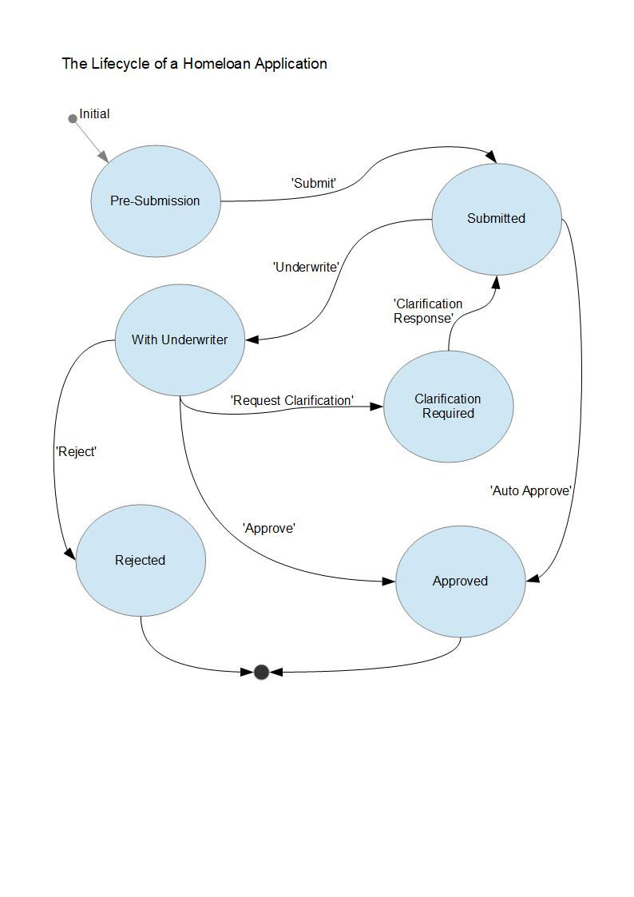
Homeloan - Lifecycle

Slide 4
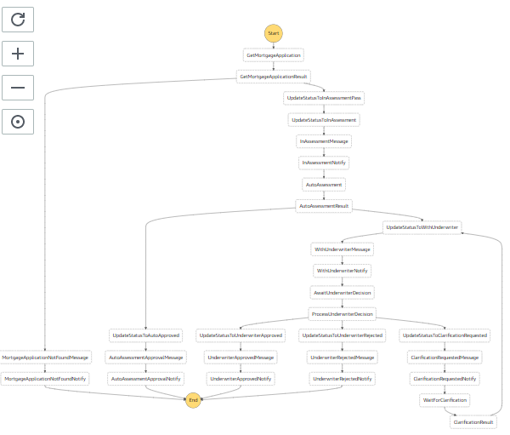
AWS Step Function – State Machine
The diagram opposite outlines the final version of the State Machine that I have built to model the Mortgage approval process.

Slide 5
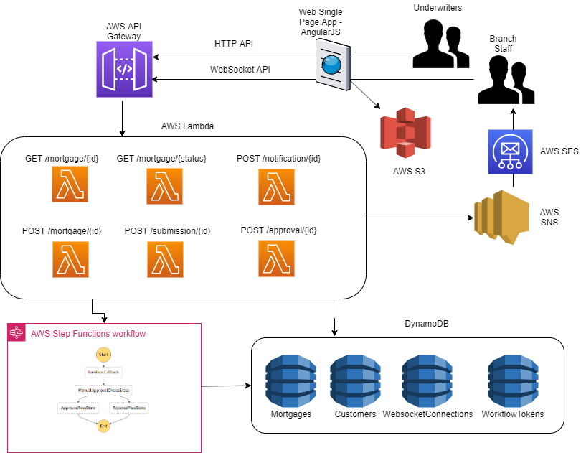

Slide 6
Technologies Used
AWS Services Used
1 CloudFormation
2 Serverless Application Model templates
3 IAM
4 S3
5 DynamoDB
6 Lambda
6 SNS
7 API Gateway Rest API
8 API Gateway Websocket API
9 Step Functions
Open Source Technologies
1 Git
2 Javascript / NodeJS / NPM
3 Angular / Typescript
4 Docker
5 Websockets NPM
Project Metrics
Lambda Functions 31
Lines of Code 6160
S3 Buckets 2
SNS Topics 2
DynamoDB Tables 6
API Gateway HTTP Endpoints 14
Step Function States 29

Slide 7
Demonstration Video
https://s3-eu-west-1.amazonaws.com/appd.cloud.project/IT-Tallaght-Mortgage-Workflow-WebApp-2019-12-08.mp4

