Slide 1


Implementation Presentation
on
Topic Smart Vitality Tracker with AI
Submitted by
Aditya Raj Singh Tomar EN22CS301062
Akash Ghosh EN22CS301082
Akash Ravi Jaisinghani EN22CS301084
Under the supervision of
Prof. Jyotsana Goyal
Department of Computer Science & Engineering
Faculty of Engineering
Medi-Caps University, Indore
Smart Vitality Tracker with AI
Notes:
Sample slide

Slide 2
Implementation of Smart Vitality Tracker with AI
Smart Vitality Tracker with AI
Notes:
Sample slide

Slide 3
Technologies
Pandas : Pandas is used for handling data in .csv format as DataFrames.
NumPy : NumPy provides an array object of arbitrary homogeneous items, fast mathematical operations over arrays.
SkLearn : SkLearn is a Python module integrating classical machine learning algorithms in the tightly-knit world of scientific Python packages (numpy, scipy, matplotlib).
Metrics(mean_squared_error), Model selection(train_test_split), Pipeline(Pipeline, make_pipeline), Impute(SimpleImputer), Preprocessing (StandardScaler), Linear Model (LinearRegression).
Seaborn/MatPlotLib : Seaborn/MatPlotLib are libraries used for plotting of data.
PyQt5 : A package developed for easy UI designing and event handling connections (signals/slots).
SciPy : Fundamental algorithms for optimization, Extends NumPy, Provides Specialized data structures.
JobLib : Joblib enables multiprocessing across several machines or cores on a single machine, which enables programmers to parallelize jobs across numerous machines. Saves and Loads ML Models.
Smart Vitality Tracker with AI
Notes:
Sample slide

Slide 4
Dataset Sample (Sleep Efficiency)
1 | ID | Age | Gender | Bedtime | Wakeup time | Sleep duration | Sleep efficiency | REM sleep percentage | Deep sleep percentage | Light sleep percentage | Awakenings | Caffeine consumption | Alcohol consumption | Smoking status | Exercise frequency
2 | 1 | 65 | Female | 2021-03-06 01:00:00 | 2021-03-06 07:00:00 | 6.0 | 0.88 | 18 | 70 | 10 | 0.0 | 0.0 | 0.0 | Yes | 3.0
3 | 2 | 69 | Male | 2021-12-05 02:00:00 | 2021-12-05 09:00:00 | 7.0 | 0.66 | 24 | 28 | 53 | 3.0 | 0.0 | 3.0 | Yes | 3.0
4 | 3 | 40 | Female | 2021-05-25 21:30:00 | 2021-05-25 05:30:00 | 8.0 | 0.89 | 20 | 70 | 10 | 1.0 | 0.0 | 0.0 | No | 3.0
5 | 4 | 40 | Female | 2021-11-03 02:30:00 | 2021-11-03 08:30:00 | 6.0 | 0.51 | 28 | 25 | 52 | 3.0 | 50.0 | 5.0 | Yes | 1.0
6 | 5 | 57 | Male | 2021-03-13 01:00:00 | 2021-03-13 09:00:00 | 8.0 | 0.76 | 27 | 55 | 18 | 3.0 | 0.0 | 3.0 | No | 3.0
7 | 6 | 36 | Female | 2021-07-01 21:00:00 | 2021-07-01 04:30:00 | 7.5 | 0.9 | 28 | 60 | 17 | 0.0 | Na | 0.0 | No | 1.0
Smart Vitality Tracker with AI
Notes:
Sample slide

Slide 5
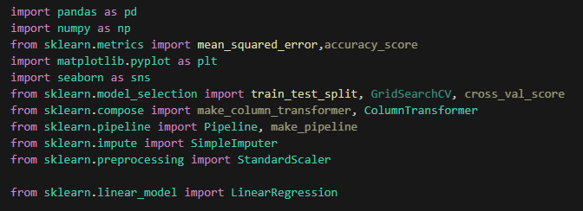
Code: Sleep Analysis Model (Overview)
Smart Vitality Tracker with AI
Notes:
Sample slide

Slide 6
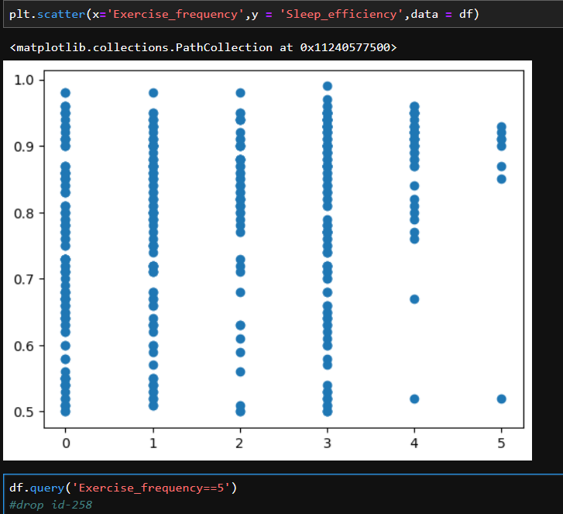
Finding Outliers: Sleep Analysis Model (Overview)
This Scatter-plot shows us the relation between “Exercise Frequency” and “Sleep Efficiency”.
The graph can be interpreted as higher the exercise frequency, higher the sleep efficiency.
The data-point that shows otherwise, needs to be dropped.
Smart Vitality Tracker with AI
Notes:
Sample slide

Slide 7
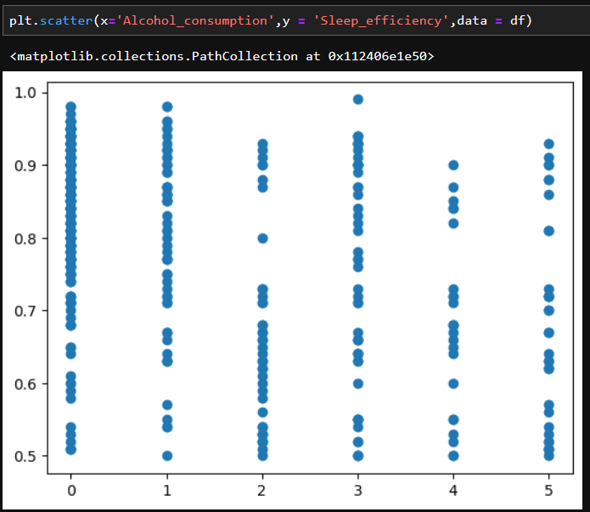
Finding Outliers: Sleep Analysis Model (Overview)
This Scatter-plot shows us the relation between “Alcohol Consumption” and “Sleep Efficiency”.
Smart Vitality Tracker with AI
Notes:
Sample slide

Slide 8
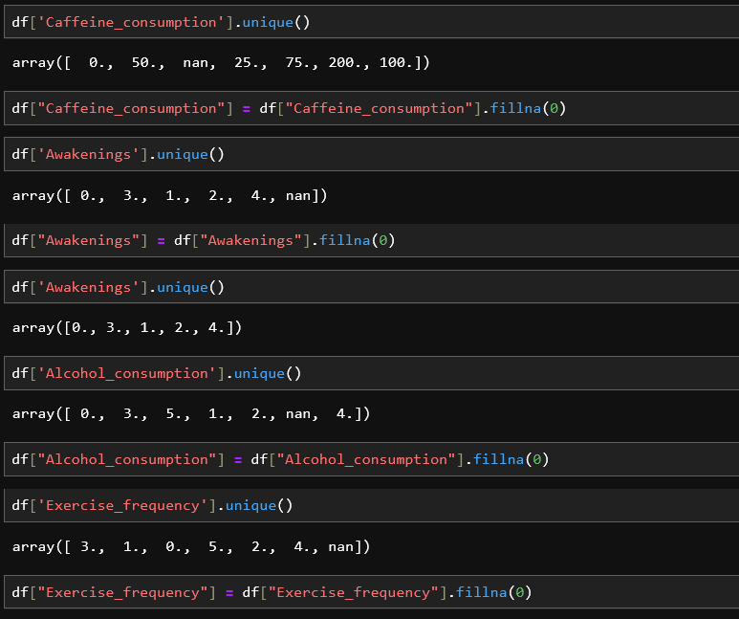
Data Cleaning: Handling the missing Values
The next step is to remove any missing Values and filling them with a default value.
Smart Vitality Tracker with AI
Notes:
Sample slide

Slide 9
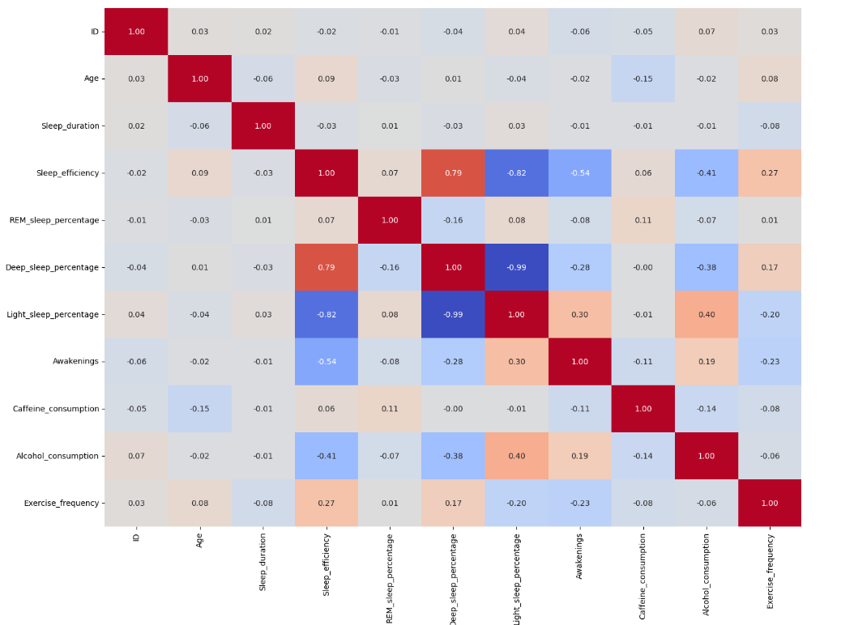
Feature Engineering: HeatMap
The HeatMap shows that the correlation coefficient between “light sleep %” and “Deep Sleep %” is 0.99, and thus one needs to be dropped.
Smart Vitality Tracker with AI
Notes:
Sample slide

Slide 10
Feature Engineering: HeatMap
The HeatMap shows that the correlation coefficient between “light sleep %” and “Deep Sleep %” is 0.99, and thus one needs to be dropped.
Smart Vitality Tracker with AI
Notes:
Sample slide

Slide 11
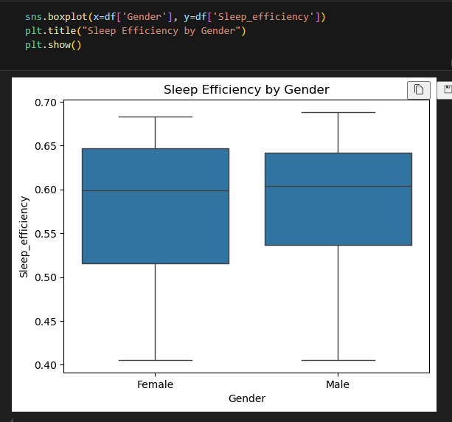
Feature Engineering: impact of gender on sleep efficiency
The box plot shows that gender does not significantly affect sleep efficiency and can therefore be dropped as a variable.
Smart Vitality Tracker with AI
Notes:
Sample slide

Slide 12
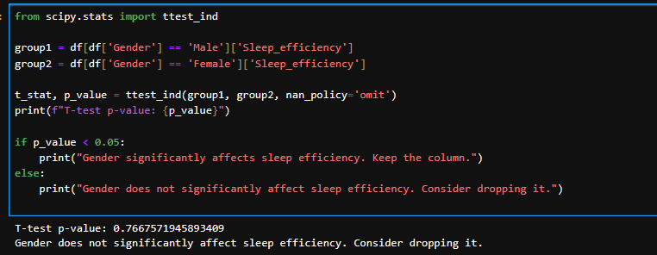
Feature Engineering: impact of gender on sleep efficiency.
This can also be verified by conducting a T- test , the p-value is high and therefore, gender doesn’t affect Sleep Efficiency.
Smart Vitality Tracker with AI
Notes:
Sample slide

Slide 13
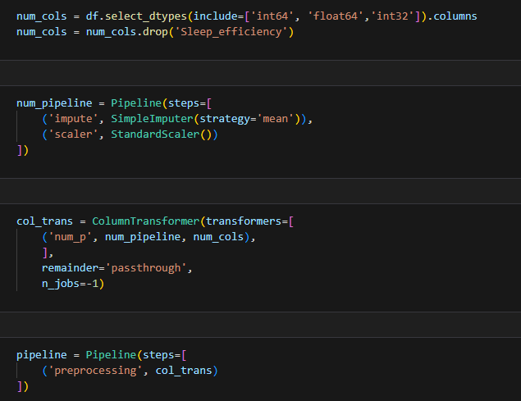
Preparing Pipeline: Sleep Analysis Model (Overview)
Smart Vitality Tracker with AI
Notes:
Sample slide

Slide 14
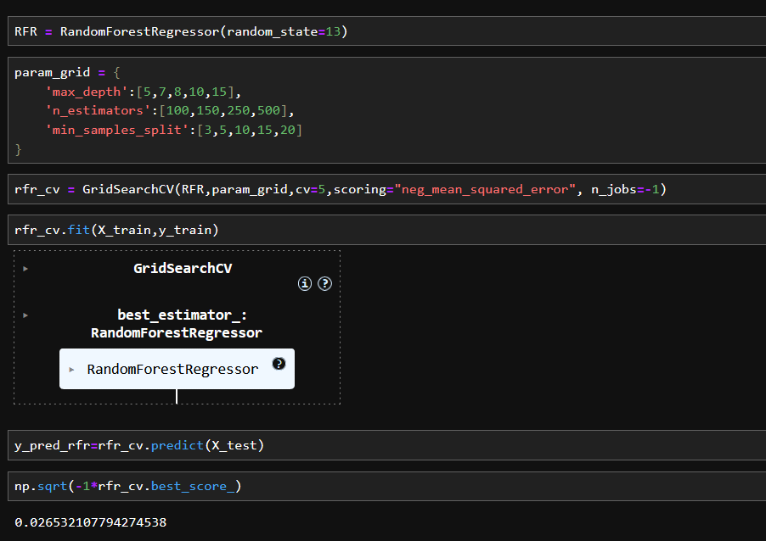
Splitting and training: Sleep Analysis Model (Overview)
Using RandomForestRegressor and GridSearchCV , the MSE value is 0.0265.
Smart Vitality Tracker with AI
Notes:
Sample slide

Slide 15
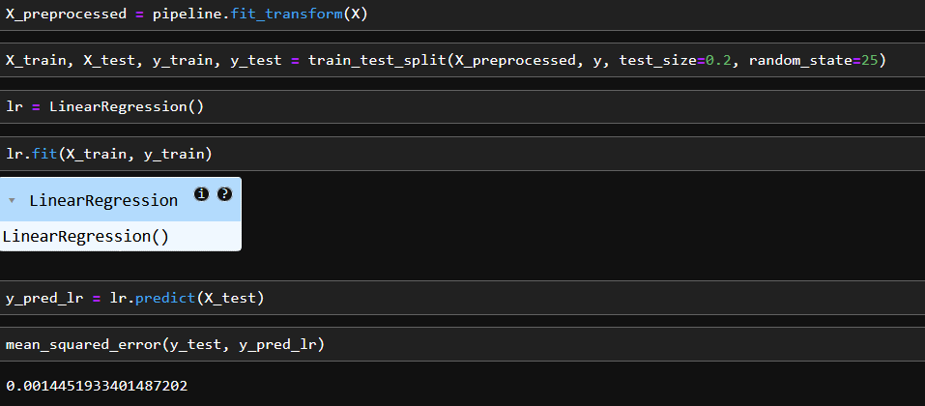
Splitting and training: Sleep Analysis Model (Overview)
Using Linear Regression Model, the lower MSE value implies that LR is a better fit for our Model.
Smart Vitality Tracker with AI
Notes:
Sample slide

Slide 16
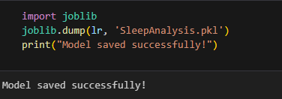
Using Joblib: Sleep Analysis Model (Overview)
Using joblib to save our Trained Sleep Analysis Model.
Smart Vitality Tracker with AI
Notes:
Sample slide

Slide 17
UI Design using React + Vite
Smart Vitality Tracker with AI
Notes:
Sample slide

Slide 18
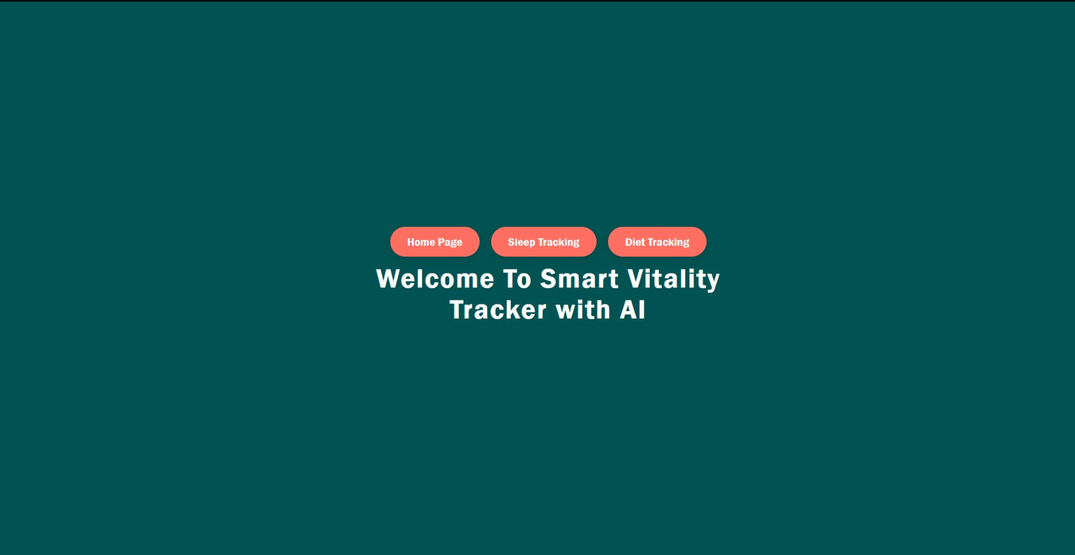
Code: UI Design by React + Vite (Overview)
Smart Vitality Tracker with AI
Notes:
Sample slide

Slide 19
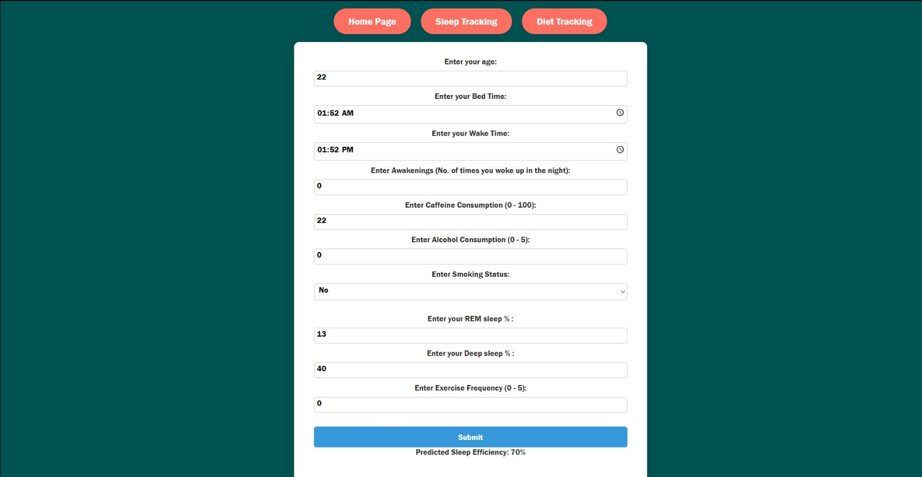
Code: UI Design by React + Vite (Overview)
Smart Vitality Tracker with AI
Notes:
Sample slide

Slide 20
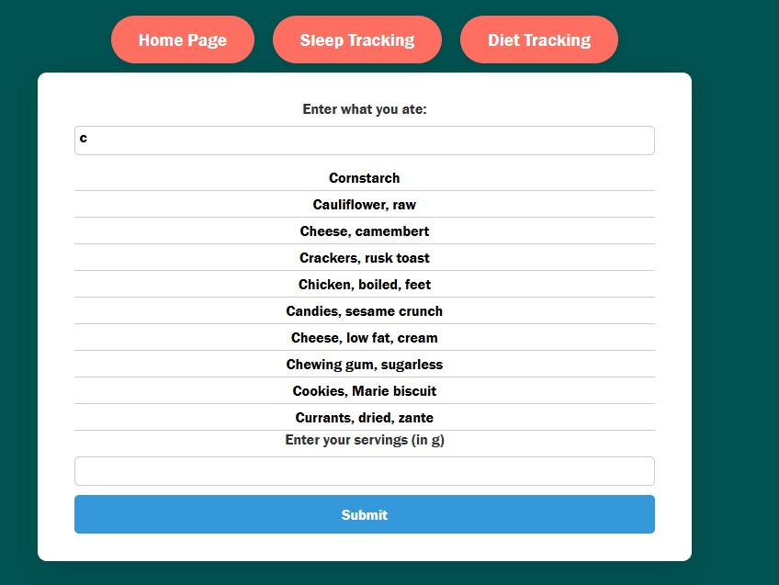
Code: UI Design by React + Vite (Overview)
Smart Vitality Tracker with AI
Notes:
Sample slide

Slide 21
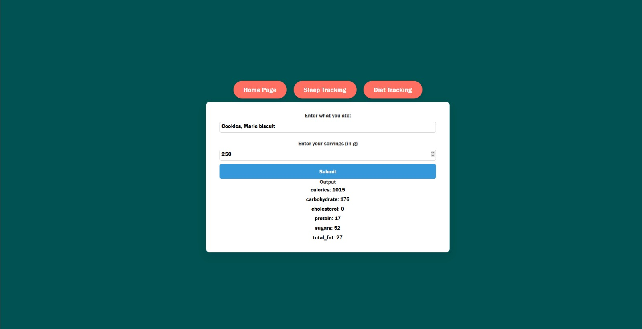
Code: UI Design by React + Vite (Overview)
Smart Vitality Tracker with AI
Notes:
Sample slide

Slide 22
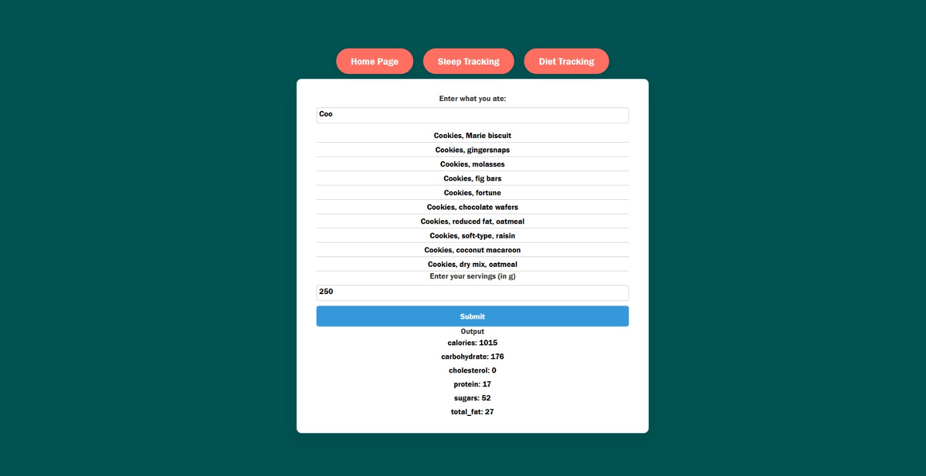
Code: UI Design by React + Vite (Overview)
Smart Vitality Tracker with AI
Notes:
Sample slide

