Slide 1
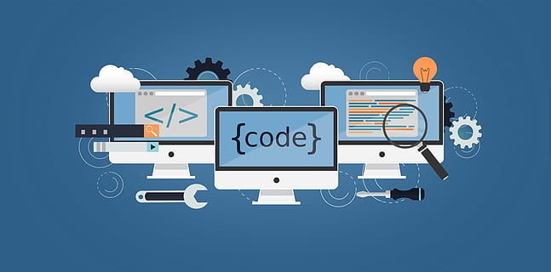
Mini-Project
CS3PC04
By:
Aditya Raj Singh Tomar EN22CS301062
Akash Ghosh EN22CS301082
Akash Ravi Jaisinghani EN22CS301084
Of Batch B1
To:
Prof. Jyotsana Goyal

Slide 2
Domain: Machine Learning
Machine Learning is a sub-topic of Artificial Intelligence where the development and study of statistical algorithms arise that can learn from data and experience.
As per Arthur Samuel’s definition of ML: Without being explicitly programmed, ML enables a machine to automatically learn from data, improve performance from experience & can predict things.
Instead of being explicitly programmed to perform specific tasks, ML algorithms analyze data, identify patterns, and improve their performance over time.
Key features include: Learning from data and experience using dataset to train and develop models, To perform well on unseen data(not just the training dataset), & improvements through more data and better algorithms.

Slide 3
Domain: Machine Learning
Why Machine Learning?
Machine Learning can automate decision-making processes that are too complex to code explicitly.
Machine Learning algorithms can process and analyze massive datasets that are infeasible to handle manually.
Machine Learning models can learn and adapt to new data without requiring significant reprogramming.
Machine Learning reduces human effort by automating repetitive tasks and scaling efficiently with increased data.
Machine Learning algorithms can uncover insights and patterns in data, and is used in a wide range of fields, from healthcare and finance to gaming and autonomous systems.

Slide 4
Domain: Machine Learning
Applications:
Healthcare: Disease prediction and diagnosis, Medical imaging, drug discovery, personalized treatment.
Finance: Fraud detection, credit scoring, algorithmic trading, risk management.
Retail and E-commerce: Personalized recommendations, dynamic pricing, inventory management, customer sentiment analysis.
Transportation and Logistics: Autonomous Vehicles, Route Optimization, Predictive maintenance, Traffic management.
Education: Adaptive Learning systems, Automated Grading, Student retention, Content recommendation.

Slide 5
Topic: Smart Vitality Tracker With AI
Machine Learning is an exceptionally great way of handling time-series datasets, thanks to which it is implemented in fields like Healthcare.
And so we can use ML as a Healthcare Assistant.
Creating a personal health assistant through machine learning (ML) involves the application of various techniques to analyze and predict an individual’s health status and help manage health-related tasks.
And since it’s done through Machine Learning, we can use publicly available APIs to train the model for it, which will keep track of patient’s health and recommend treatment according to the live dataset provided.

Slide 6
Topic: Smart Vitality Tracker With AI
Why Choose this topic?
Relevance and Growth of the Health Tech Industry: The global health tech market is booming, with an increasing demand for personalized health solutions. Wearables and health apps are becoming a standard part of modern lifestyles.
Personal Relevance: Health and well-being are universal concerns. Many people struggle with tracking or maintaining their health goals. “We wanted to create a tool that empowers users to take control of their health.”
Intersection of Machine Learning and Real-Life Impact: The project applies cutting-edge ML techniques (time-series forecasting, recommendation systems) to solve real-world problems. Demonstrates the power of data science in driving positive change.
Future Potential: The system can be expanded to integrate mental health, gamification, and real-time alerts. Scalable to industries like insurance, fitness, and nutrition.

Slide 7
Topic: Smart Vitality Tracker With AI
Technology to be used in the project:
APIs: Google Fit API, Fitbit API.
Database: MySQL.
Why?
APIs allow integration with existing health platforms to collect real-time data.
Relational Databases ensure organized storage and efficient queries for structured data.
Data Processing and Analysis Technologies: Pandas, NumPy, SciPy Python Libraries.
Why?
Pandas and NumPy simplify data cleaning, transformation, and analysis.
Machine Learning Models Frameworks: TensorFlow(deep learning for time-series and recommendations). Scikit-learn (traditional machine learning algorithms).

Slide 8
Topic: Smart Vitality Tracker With AI
Why?
TensorFlow are industry-standard frameworks with flexibility and scalability for deep learning models.
Scikit-learn offers a simple interface for implementing traditional ML algorithms.
Visualization and Reporting Libraries: Matplotlib, Seaborn(interactive dashboards).
Why?
Matplotlib and Seaborn are great for creating basic graphs and reports.

