Slide 1



Slide 2

Presentation on Design of the Project
Topic
Smart Vitality Tracker with AI
Submitted by
Aditya Raj Singh Tomar EN22CS301062
Akash Ghosh EN22CS301082
Akash Ravi Jaisinghani EN22CS301084
Under the supervision of
Prof. Jyotsana Goyal
Department of Computer Science & Engineering
Faculty of Engineering
Medi-Caps University, Indore
Smart Vitality Tracker with AI
Notes:
Sample slide

Slide 3
Smart Vitality Tracker with AI: Overview
The Objective of our project is to track certain health aspects of the user(like sleep analysis, diet tracking) for the user so that they can take recommendations for improving these health aspects.
We will achieve our goal through Python language & its libraries(such as Seaborn, scikit-learn, tensorflow), a Database system(MySQL or MongoDB), and build an interface using either combination of Flask API & ReactJs, or Python’s tkinter library.
This vitality tracker will be developed by training the model on datasets found throughout the web, and any applicable API (such as Google Fit API) would be connected for real-time data.
The User is also expected to give their own inputs(such as what they have eaten within the past 24 hours.)

Slide 4
Smart Vitality Tracker with AI: Overview
Technology to be used in the project:
APIs: Google Fit API, Fitbit API.
Database: MySQL.
Why?
APIs allow integration with existing health platforms to collect real-time data.
Relational Databases ensure organized storage and efficient queries for structured data.
Data Processing and Analysis Technologies: Pandas, NumPy, SciPy Python Libraries.
Why?
Pandas and NumPy simplify data cleaning, transformation, and analysis.
Machine Learning Models Frameworks: TensorFlow(deep learning for time-series and recommendations). Scikit-learn (traditional machine learning algorithms).

Slide 5
Smart Vitality Tracker with AI: Overview
Why?
TensorFlow are industry-standard frameworks with flexibility and scalability for deep learning models.
Scikit-learn offers a simple interface for implementing traditional ML algorithms.
Visualization and Reporting Libraries: Matplotlib, Seaborn(interactive dashboards).
Why?
Matplotlib and Seaborn are great for creating basic graphs and reports.

Slide 6
Smart Vitality Tracker with AI: Use Case Diagram
A Use Case Diagram in Unified Modelling Language (UML) is a visual representation that illustrates the interactions between users (actors) and a system.
It captures the functional requirements of a system, showing how different users engage with various use cases, or specific functionalities, within the system.
Use case diagrams provide a high-level overview of a system’s behavior, making them useful for stakeholders, developers, and analysts to understand how a system is intended to operate from the user’s perspective, and how different processes relate to one another. They are crucial for defining system scope and requirements.

Slide 7
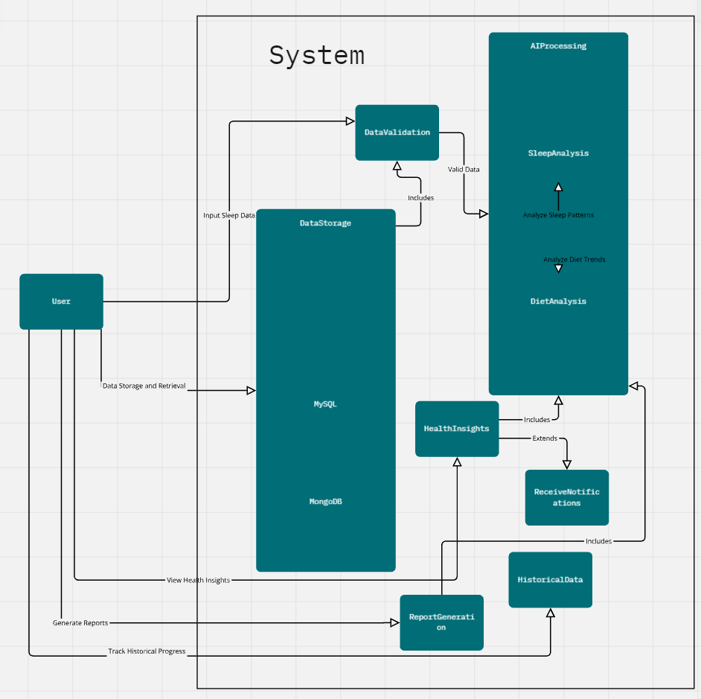
Smart Vitality Tracker with AI: Use Case Diagram

Slide 8
Smart Vitality Tracker with AI: Use Case Diagram

Slide 9
Smart Vitality Tracker with AI: Activity Diagram
Activity diagrams are an essential part of the Unified Modeling Language that help visualize workflows, processes, or activities within a system.
They depict how different actions are connected and how a system moves from one state to another.
By offering a clear picture of both simple and complex workflows, activity diagrams make it easier for developers and stakeholders to understand how various elements interact in a system.

Slide 10
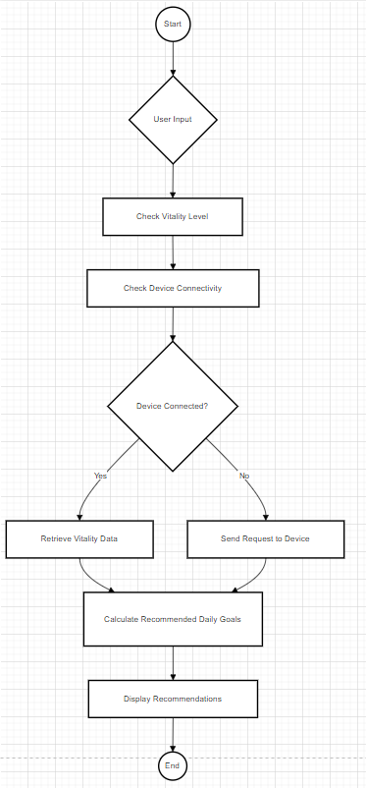
Smart Vitality Tracker with AI: Activity Diagram

Slide 11
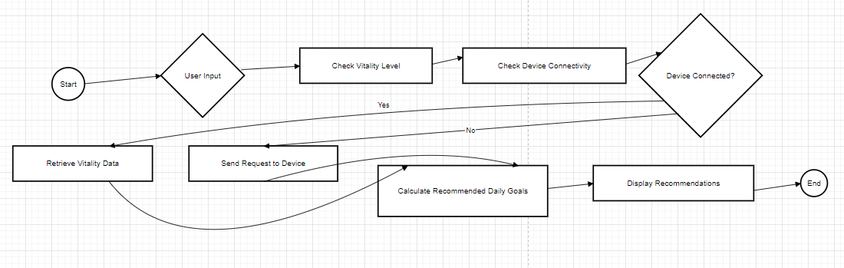
Smart Vitality Tracker with AI: Activity Diagram

Slide 12
Smart Vitality Tracker with AI: Data Flow Diagram
DFD is the abbreviation for Data Flow Diagram. The flow of data in a system or process is represented by a Data Flow Diagram (DFD).
It also gives insight into the inputs and outputs of each entity and the process itself. Data Flow Diagram (DFD) does not have a control flow and no loops or decision rules are present.
Specific operations, depending on the type of data, can be explained by a flowchart.
It is a graphical tool, useful for communicating with users, managers and other personnel. it is useful for analyzing existing as well as proposed systems.

Slide 13
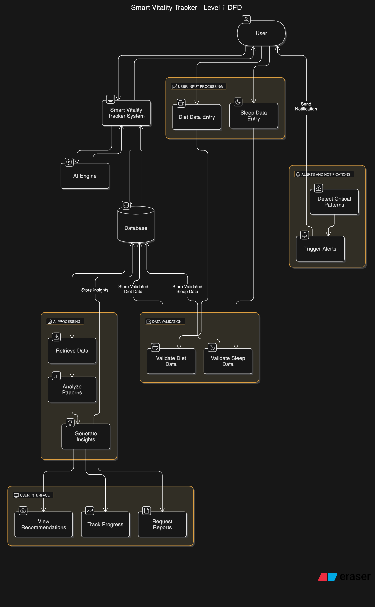
Smart Vitality Tracker with AI: Data Flow Diagram

Slide 14
Smart Vitality Tracker with AI: Data Flow Diagram

Slide 15
Smart Vitality Tracker with AI: State Chart
State chart diagram is one of the five UML diagrams used to model the dynamic nature of a system.
They define different states of an object during its lifetime and these states are changed by events.
State chart diagrams are useful to model the reactive systems. Reactive systems can be defined as a system that responds to external or internal events.

Slide 16
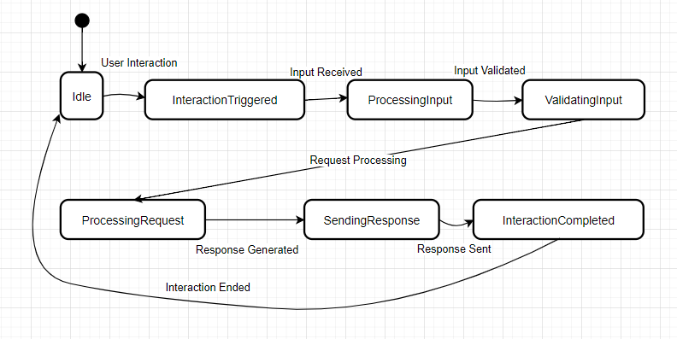
Smart Vitality Tracker with AI: State Chart

Slide 17
Smart Vitality Tracker with AI: State Chart

Slide 18
Smart Vitality Tracker with AI: E-R Diagram
The Entity Relationship Model is a model for identifying entities (like student, car or company) to be represented in the database and representation of how those entities are related.
The ER data model specifies enterprise schema that represents the overall logical structure of a database graphically.
ER Model is used to model the logical view of the system from a data perspective which consists of these symbols:
Rectangles: Rectangles represent Entities in the ER Model.
Ellipses: Ellipses represent Attributes in the ER Model.
Diamond: Diamonds represent Relationships among Entities.
Lines: Lines represent attributes to entities and entity sets with other relationship types.
Double Ellipse: Double Ellipses represent Multi-Valued Attributes.
Double Rectangle: Double Rectangle represents a Weak Entity.

Slide 19
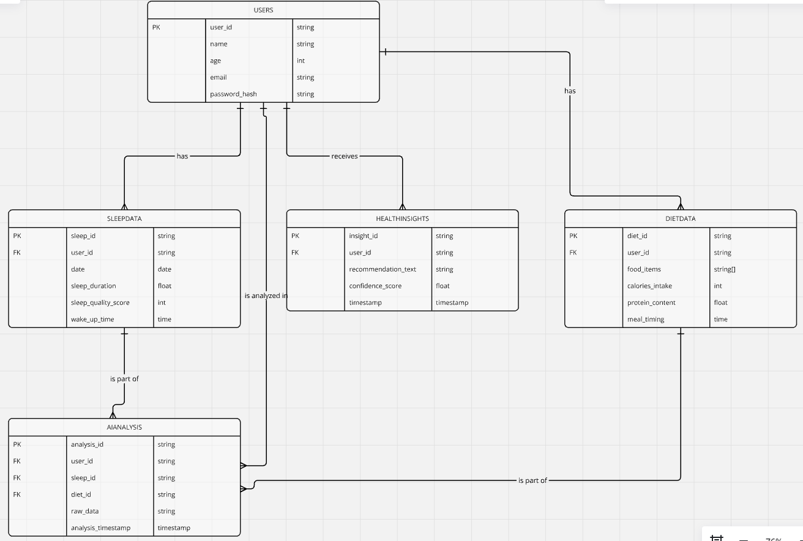
Smart Vitality Tracker with AI: E-R Diagram

Slide 20
Smart Vitality Tracker with AI: E-R Diagram

Slide 21
Smart Vitality Tracker with AI: Class Diagram
Class diagrams are a type of UML (Unified Modeling Language) diagram used in software engineering to visually represent the structure and relationships of classes within a system i.e. used to construct and visualize object-oriented systems.
A UML Class Diagram is a visual tool that represents the structure of a system by showing its classes, attributes, methods, and the relationships between them. It helps everyone involved in a project—like developers and designers—understand how the system is organized and how its components interact.
Class diagrams provide a high-level overview of a system’s design, helping to communicate and document the structure of the software. They are a fundamental tool in object-oriented design and play a crucial role in the software development lifecycle.

Slide 22
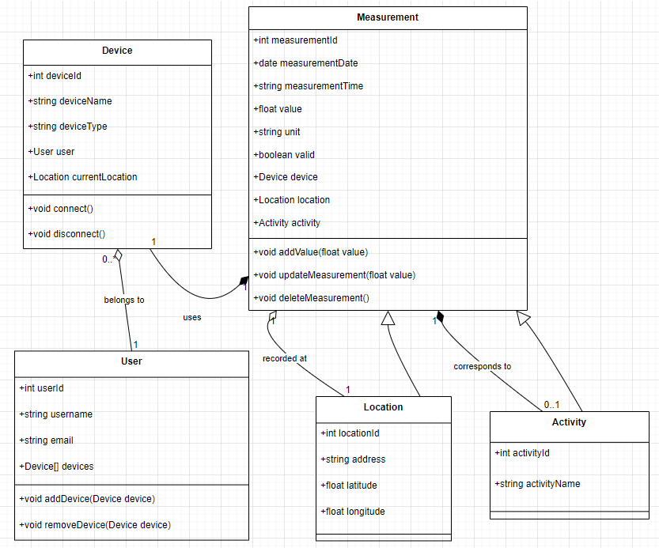
Smart Vitality Tracker with AI: Class Diagram

Slide 23
Smart Vitality Tracker with AI: Class Diagram

Slide 24
Smart Vitality Tracker with AI: Sequence Diagram
Sequence diagrams are a type of UML (Unified Modeling Language) diagram that visually represent the interactions between objects or components in a system over time.
They focus on the order and timing of messages or events exchanged between different system elements. A Sequence Diagram is a key component of Unified Modeling Language (UML) used to visualize the interaction between objects in a sequential order. It focuses on how objects communicate with each other over time, making it an essential tool for modeling dynamic behavior in a system.
The diagram captures how objects communicate with each other through a series of messages, providing a clear view of the sequence of operations or processes.

Slide 25
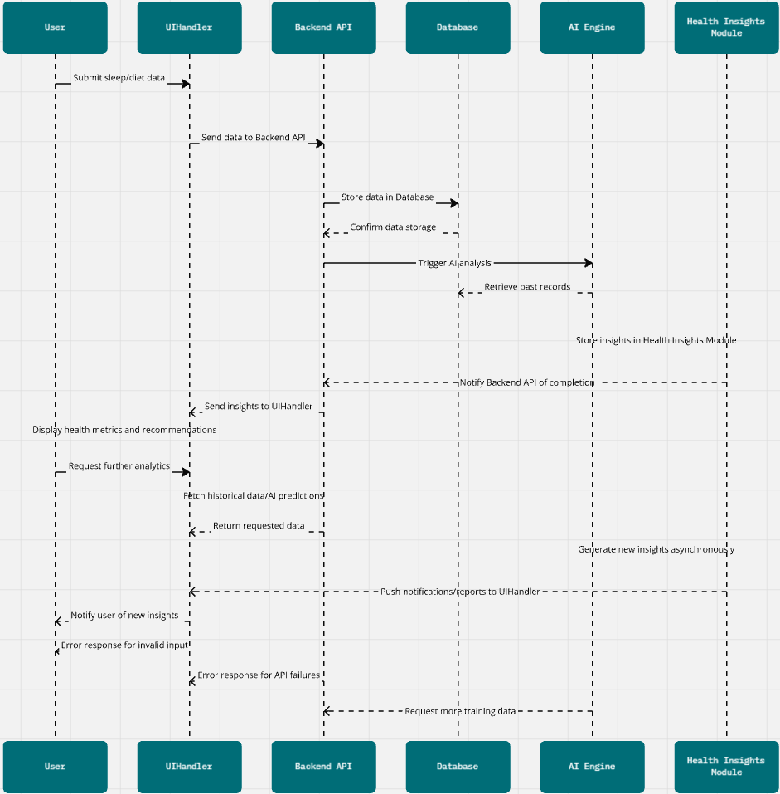
Smart Vitality Tracker with AI: Sequence Diagram

Slide 26
Smart Vitality Tracker with AI: Sequence Diagram

