Slide 1
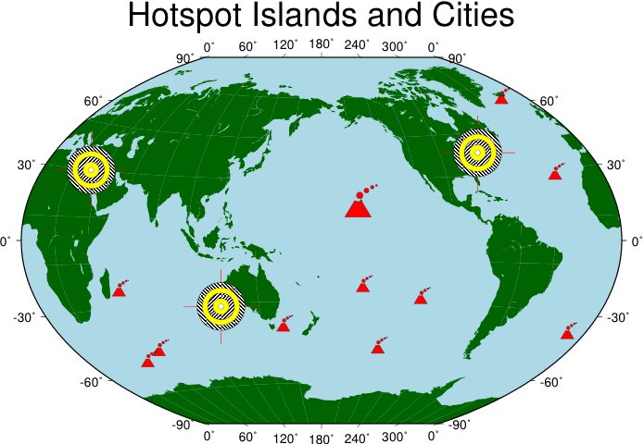
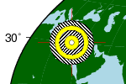
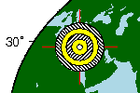
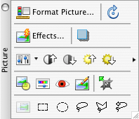
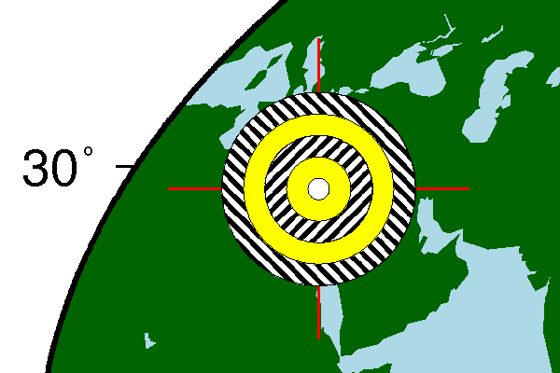
Examples of Rendered Images
75 dpi with
anti-aliasing (scaled 120%)
Click to
change scaling
and rotation
75 dpi without anti-aliasing (scaled 120%)
300 dpi without anti-aliasing (scaled 30%)
Click to select
transparent
color
Embedded PDF (scaled 100%)

