Slide 1
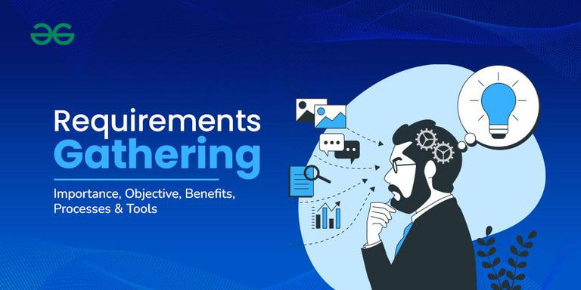
GROUP 2
Presented by Group2
Design and Implementation of a
Mobile App for Collection of
User Experience Data from Mobile Network Subscribers.
Task 2: Requirement Gathering

Slide 2
Introduction
What is Requirement Gathering?
Methods Used
The critical phase that defines what a system must achieve and how it should function before development begins.
1. Structured Survey
Project Goal
2. In-depth Interviews
Design a mobile application that passively and actively collects user experience data from mobile network subscribers.
3. Brainstorming Sessions
Why It Matters
Bridges the gap between user perception and raw technical metrics, ensuring the system is both user-centred and data-driven.
4. Reverse Engineering
133 responses collected via Google Forms

Slide 3
Stakeholder Identification
PRIMARY STAKEHOLDER
SECONDARY STAKEHOLDERS
Mobile Network Subscribers
Mobile Network Operators
Direct users of the app and primary source of data
MTN, Orange, Camtel
Leverage collected data to optimise resource allocation, detect faults, improve coverage, and reduce customer churn.
Provide active feedback: call quality, internet speed, satisfaction ratings
Passively supply objective data: signal strength, network type, latency, location
Their participation volume determines data reliability and app scalability
App must be user-friendly, non-intrusive, and secure to maximise engagement
System Developers
Design, Build & Maintain
Translate requirements into a functional, efficient, secure, and scalable mobile application.
Regulatory Authorities
Oversight & Compliance
Ensure user data is collected with proper consent, stored securely, and processed in line with data protection laws.

Slide 4
Requirement Gathering Techniques
Surveys
Interviews
Google Forms distributed to 133 respondents
Close-ended questions for statistical analysis
Covered demographics, OS, network ratings, call drops
Selected students, professionals and business users
Informal conversations on frustrations and expectations
Explored switching behaviour, call drop patterns, app interest
Outcome: Quantitative baseline on network performance and user demographics
Outcome: Qualitative insights revealing churn behaviour and unmet user expectations
Brainstorming
Reverse Engineering
Group ideation among potential users and developers
Ideas scored by feasibility, relevance and impact
Produced the full feature list for the proposed application
Analysed Speedtest, OpenSignal and nPerf applications
Examined UI patterns, data collection methods, architecture
Identified strengths and gaps in existing solutions
Outcome: Real-time monitoring, background logging, alert system, dashboard
Outcome: Best practices and innovation opportunities for the new system

Slide 5
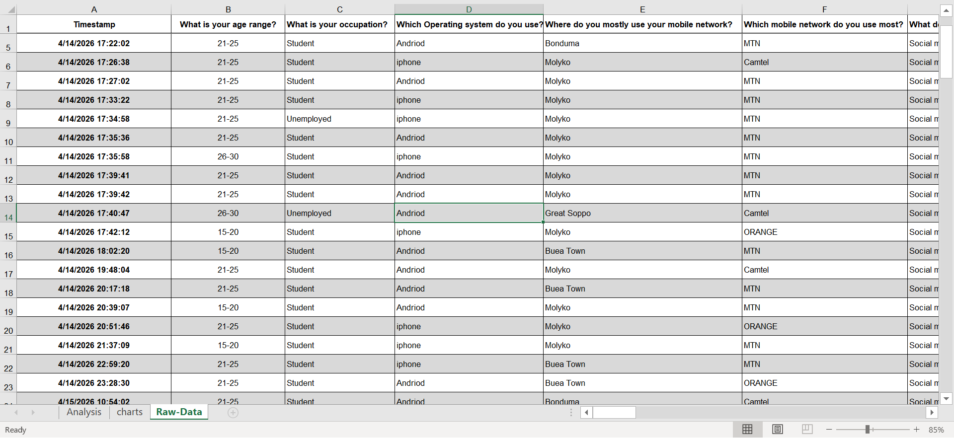
Data Gathering
133 Responses
Subjective Data
Objective Data
Device OS, network provider, age group and location identifies measurable usage patterns.
Collected via Google Forms from mobile network subscribers across the region.
Network ratings, call drop experiences, overall satisfaction — captures Quality of Experience (QoE).
1
2
3
4

Slide 6
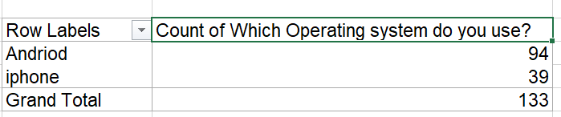
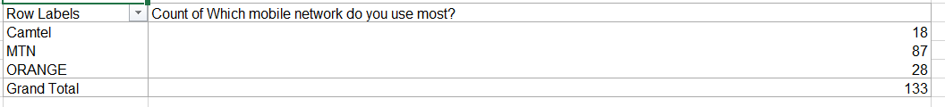
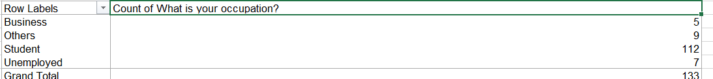
Data Cleaning
1
Remove Invalid Rows
Correct Spelling Errors
Standardise Text Values
2
a
3
4
Handle Missing Values
1 all-Unknown response eliminated from the dataset
"Andriod" corrected to "Android"; "iphone to "iPhone"
"mtm" and "mtn" unified to "MTN"; all operator names normalised
All blank fields replaced with the placeholder "Unknown"
1
2
3
4

Slide 7
Survey – Key Findings (Part 1)
133 total respondents | 21–25 age group dominates (71.4%) | Android leads at 70.7%

Slide 8
Survey – Key Findings (Part 2)
112 out of 133 respondents (84.2%) experience call drops — a critical pain point that directly drives core app requirements.

Slide 9
User Concerns – Reluctance Assessment
73% data consumption | 51% privacy | 39% battery usage
56.4% Yes | 40.6% Maybe | 3% No

Slide 10
Feedback & Location Preferences
Key insight: 69.9% of users would allow location sharing — yet 48.9% prefer only occasional feedback. The app should limit prompts to a maximum of 3 per day.

Slide 11
User Reluctance – Mitigation Strategies
1
4
Data Privacy & Security
Clear User Benefits
End-to-end encryption, opt-in consent flow, visible privacy policy, compliance with data protection regulations.
Show personalised network insights, alert users to poor signal zones, demonstrate community impact.
2
5
Battery Optimisation
User-Friendly Interface
Energy-efficient background algorithms, reduce collection frequency when the device is idle.
Minimal interaction required, smooth UX, maximum 3 feedback prompts per day aligned with survey preference.
3
Reduce Data Consumption
Sync only on Wi-Fi (driven by 73% concern), compress payloads, transmit only essential metrics.
Addressing these concerns systematically is essential to drive adoption and ensure high-quality, sustained data collection.

Slide 12
From Requirements to App Features
Survey Finding
App Feature / Design Decision
70.7% use Android (94 / 133)
Build native Android application first; iOS to follow in a later phase
112 / 133 experience call drops (84.2%)
Automatically log call state, signal strength and drop events in the background
48.9% prefer occasional feedback
Cap in-app prompts at a maximum of 3 per day; use unobtrusive notification style
69.9% would allow location sharing
Enable coarse GPS for network geo-mapping; provide granular opt-out control
73% concerned about data consumption
Compress data payloads and restrict synchronisation to Wi-Fi networks only
61 report internet is often slow (45.9%)
Continuous background monitoring of download speed and latency
51% concerned about privacy
End-to-end encryption, visible privacy policy, user-controlled data sharing

Slide 13
Conclusion & Next Steps
“Requirement gathering transformed real user data into a clear, evidence‑based blueprint — prioritizing Android native development, Wi‑Fi‑only syncing, background call‑drop logging, and sparse feedback prompts — ensuring the app is both technically sound and genuinely wanted by subscribers.”
App Features Defined
Data Analysis Structure
System Architecture
Real-time network performance monitoring
Automatic background data collection
Feedback prompts capped at 3 per day
Privacy controls and opt-in consent flow
Structured tables and pivot tables
Charts and visualisations for patterns
QoE mapped against objective metrics
Meaningful trend identification
Mobile app to backend communication
Scalable data collection pipeline
Processing and storage components
Real-time capable system design
"Requirements are user-centred and data-driven — ensuring successful implementation and adoption."

