Slide 1

UNIVERSITY OF BUEA · CEF440 · 2025–2026
QoETRACK
Database Design
& Implementation
TASK 6 · Two-tier Room/SQLite + MySQL cloud architecture for mobile QoE data collection
27 Data Attributes
4 Entities
5 API Endpoints
Railway Cloud

Slide 2










System Overview
Two-tier offline-first architecture for real-time QoE data collection
Android Device
Railway Cloud
TelephonyManager / ConnectivityManager
Express.js Backend (Node.js v22)
Passive metric collection every 15 min
REST API — 5 endpoints
Room / SQLite (qoetrack_local_db)
MySQL 8.0 — qoetrack_db
Offline-first local storage
3 tables: users, network_metrics, feedback
Retrofit
HTTPS
WorkManager SyncWorker
Sequelize ORM 6.x
Background sync with retry logic
Auto-sync schema on deploy
FeedbackFragment (User Input)
SSL + ENV variable secrets
Star ratings, sliders, free-text comments
Secure Railway internal hostname

Slide 3




Data Elements
27 attributes across 4 entities — passive collection + active user input
User
NetworkMetric
▸ user_id (PK)
▸ metric_id (PK)
▸ device_id (UNIQUE)
▸ network_type, signal_strength
▸ created_at
▸ latency, jitter, bandwidth
▸ latitude, longitude
▸ recorded_at, synced
One registration per device
Passive — every 15 min
Feedback
AppSettings*
▸ feedback_id (PK)
▸ id = 1 (singleton)
▸ overall_satisfaction (1–5)
▸ dark_mode_enabled
▸ speed_rating, usability_rating
▸ bg_collection_enabled
▸ comments (free text)
▸ prompt_frequency_hrs
▸ submitted_at, synced
Active — user submitted
Local only — not synced

Slide 4
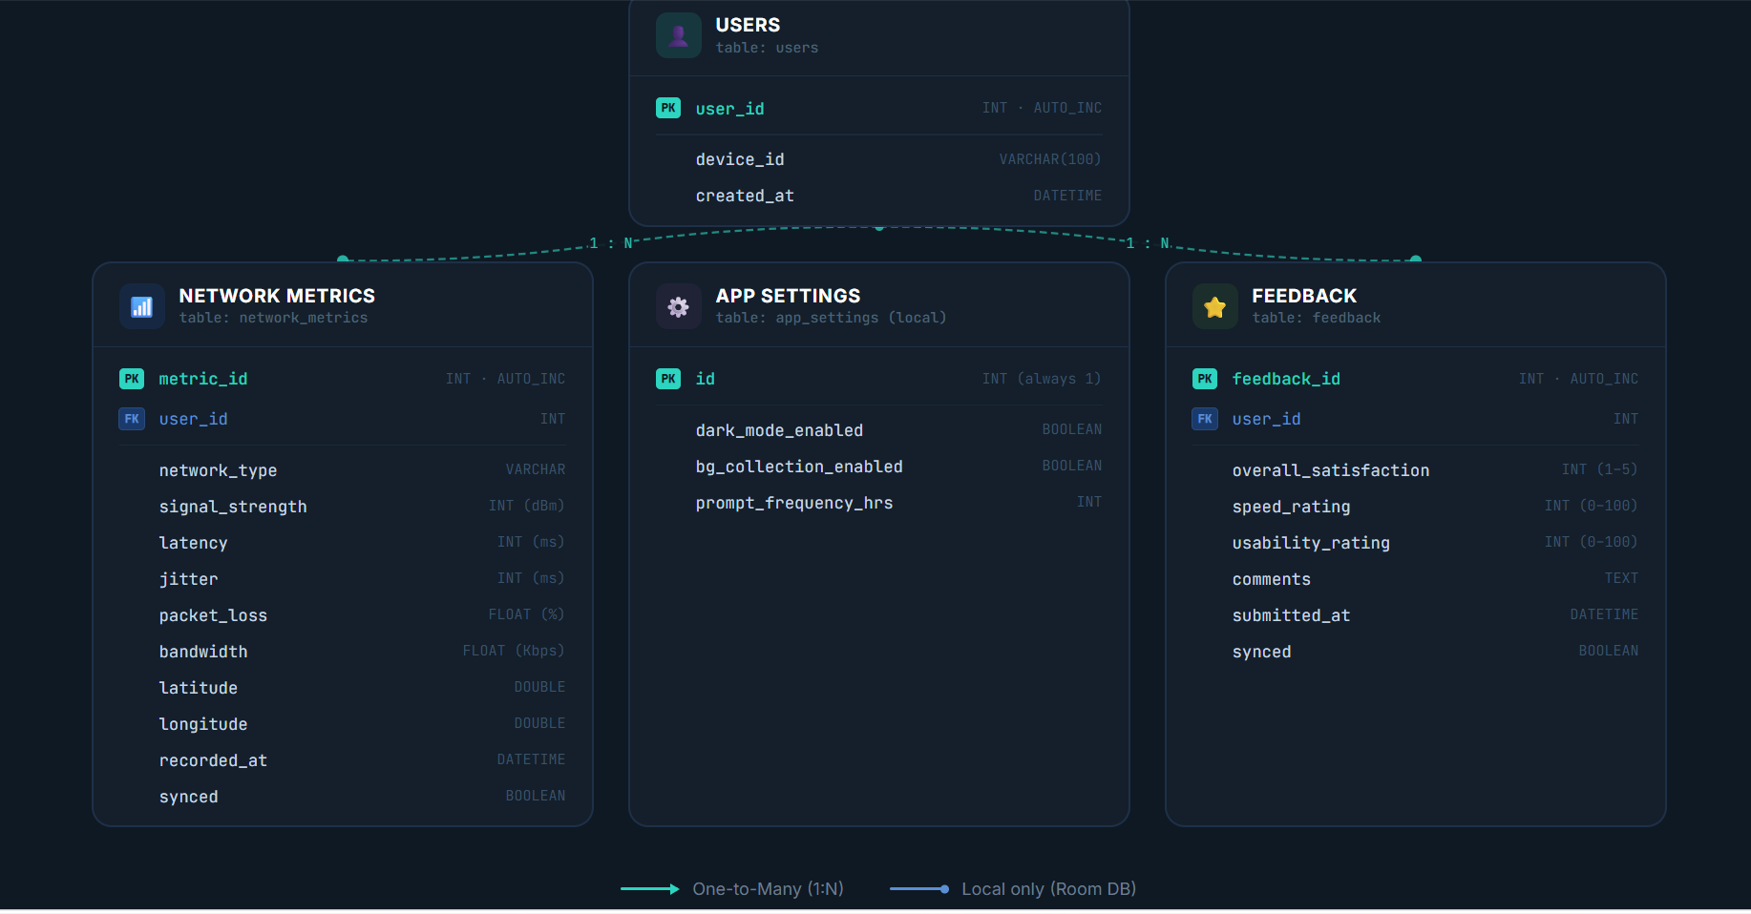
Conceptual Design & ER Model
Entities, relationships, and key design decisions
NETWORK_METRIC

Slide 5



Local Database — Android Room
SQLite embedded in the Android app for offline-first data persistence
@Entity Classes
DAO Interfaces
RoomDatabase Class
NetworkMetricEntity.kt
NetworkMetricDao.kt
QoETrackDatabase.kt
@PrimaryKey(autoGenerate=true)
▸
insert() — save new row
▸
version = 2
▸
Fields: networkType, signal,
▸
getUnsynced() — query pending
▸
Entities: NetworkMetric,
▸
latency, jitter, bandwidth,
▸
markSynced(id) — after upload
▸
Feedback, AppSettings
▸
lat/lon, recordedAt, synced
▸
observeLatest() — Flow for UI
▸
Singleton getInstance()
▸
✅ 50+ real rows collected from Buea, Cameroon · GPS lat ≈ 4.1556 · Verified in Android Studio Database Inspector

Slide 6
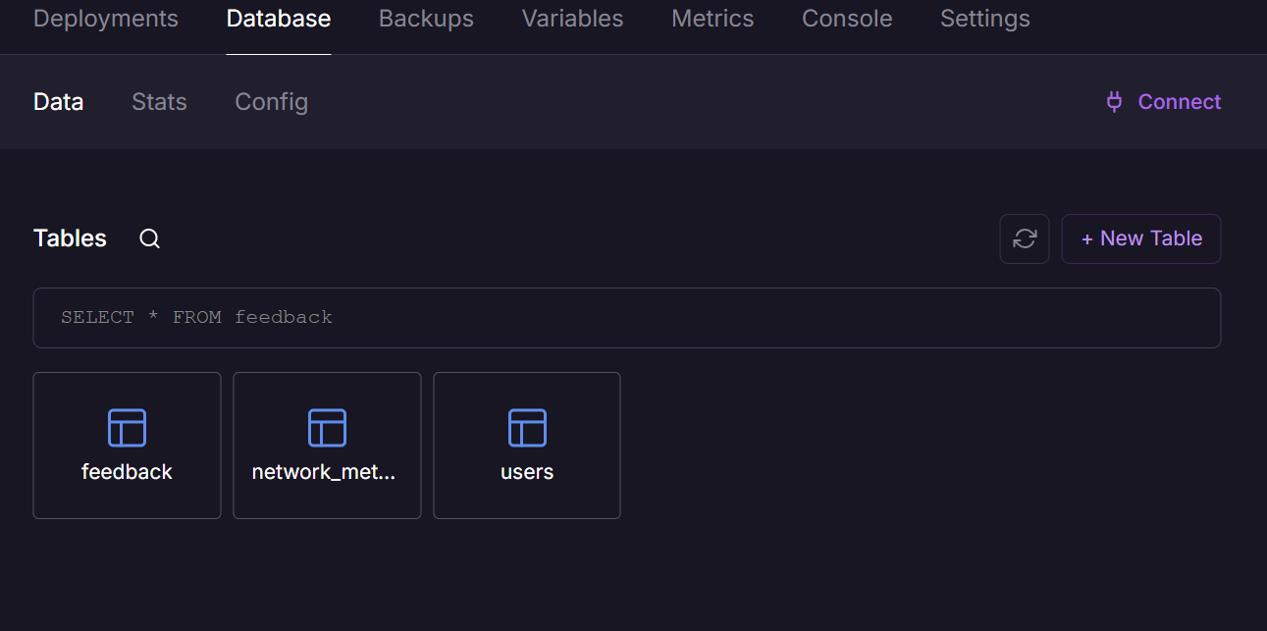
Remote Database MySQL on Railway
MySQL 8.0 cloud schema —3 tables with full referential integrity
Core Identity: The users table tracks unique hardware "device_id" and registration timestamps.
Performance Telemetry: The "network_metrics" table logs signal, latency, bandwidth, and GPS coordinates.
User Sentiment: The feedback table captures star ratings, usability scores, and open comments.
Relational Integrity: Both child tables link via "user_id" using "ON DELETE CASCADE" for clean deletion.
Offline-Ready: A synced boolean flag tracks pending local database updates for future sync.
Clean Separation: The 3-table schema in image_3d5e3d.png clearly isolates identity, network metrics, and feedback.

Slide 7
Backend API Express.js on Railway
Node.js v22 · Express.js 4.x · Sequelize ORM · MySQL2 driver
Node.js v22
Express.js 4.x
Sequelize 6.x
MySQL2
Railway.app
Method
Endpoint
Status
Description
GET
/
200 OK
Health check server status
POST
/api/metrics
201 Created
Batch network metrics from Android
GET
/api/metrics/user/:userId
200 OK
Last 50 metric readings for a user
POST
/api/feedback
201 Created
Feedback submission from Android
GET
/api/feedback/user/:userId
200 OK
Last 50 feedback entries for a user
🌐 https://qoetrack-backend-production.up.railway.app

Slide 8



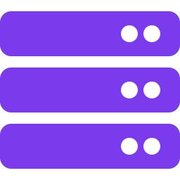

End-to-End Sync Pipeline
From device sensor to Railway MySQL — the complete data flow
1
2
3
4
5
▶
▶
▶
▶
Sensor Collection
Local Room Write
SyncWorker Runs
Retrofit POST
MySQL Stored
TelephonyManager
ConnectivityManager
FusedLocationProvider
NetworkMetricEntity
inserted with synced=false
LiveData updates UI
Every 15 minutes
Queries unsynced rows
Builds JSON payload
HTTPS to Railway
POST /api/metrics
201 Created response
Sequelize model saves
Row in network_metrics
Cloud dashboard ready
✅ On 201 OK: markSynced(id) updates Room — synced = 1 · WorkManager retries automatically on failure

Slide 9

Results & Summary
All 6 sub-tasks completed · Real data from Buea, Cameroon · Cloud-deployed
27
4
50+
5
Data Attributes
Documented
Database
Entities
Real Rows
Collected
REST API
Endpoints
Data Elements
27 attributes across 4 entities documented
Conceptual Design
Entities, attributes, relationships, design decisions
ER Diagram
Interactive diagram with crow's foot notation
DB Implementation
Room (local) + MySQL Railway cloud — 3 tables live
Backend Implementation
Express.js API deployed, 5 endpoints active
DB ↔ Backend Connection
End-to-end sync verified: Room → Retrofit → MySQL

Slide 10

Thank You
QoETRACK Mobile Application
Task 6: Database Design and Implementation
CEF440 — Internet & Mobile Programming · University of Buea · 2025–2026

