Slide 1
QoET
QoETRACK
Rate It. Report It. Improve It.
CEF440 — Task 5: UI Design and Implementation
Group 2 | University of Buea | Dr. Valery Nkemeni
Notes:
Welcome. This is QoETRACK — a mobile app for collecting Quality of Experience data from network subscribers. Task 5 covers our UI design and implementation work.

Slide 2
PROJECT OVERVIEW
What is QoETRACK?
Task 5 Scope
A native Android application built to collect, measure, and report mobile network Quality of Experience data from subscribers.
It captures signal strength, latency, GPS location, and user satisfaction ratings — forwarding anonymised data to network operators to help improve mobile coverage.
App Identity
Brand name, colour palette, typography, logo
Visual Design
Figma mockups for all 7 screens
Frontend Implementation
7 Kotlin activities + XML layouts
Full navigation flow
Notes:
QoETRACK stands for Quality of Experience Tracking. Task 5 had three main deliverables: app identity, visual design in Figma, and frontend implementation in Android/Kotlin.

Slide 3
APP IDENTITY
Colour Palette
QoET
Primary
#1A3A6B
Accent
#00C9A7
Background
#F4F8FC
Surface
#FFFFFF
Danger
#E53935
QoETRACK
Typography
Rate It. Report It. Improve It.
Poppins Bold / SemiBold / Regular
Headings, app name, button labels, metric values, card titles
Inter Regular
Body text, captions, timestamps, supporting labels
Notes:
Our brand is built around navy and teal — professional, readable, and distinctive. Poppins gives modern headings, Inter is optimised for small-screen legibility.

Slide 4
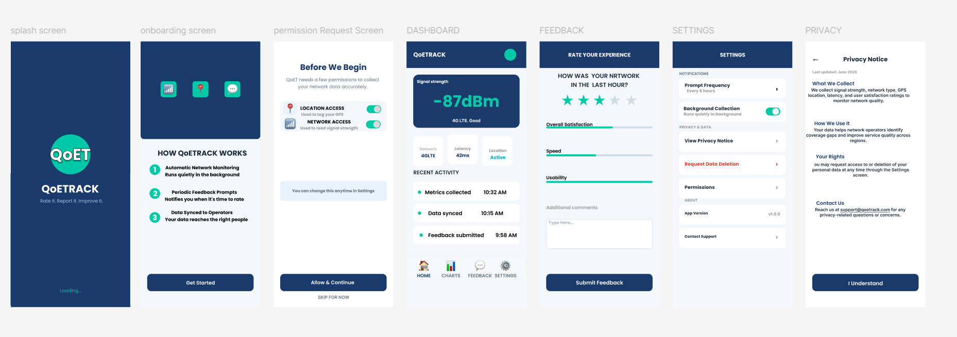
SCREEN FLOW & NAVIGATION
First Launch
From Dashboard
Dashboard → Feedback
Bottom Nav
Dashboard → Settings
Bottom Nav
Settings → Privacy Notice
Privacy row
Settings → Permission
Permissions row
Notes:
Splash and Onboarding use android:noHistory='true' so users cannot navigate back to them. The onboarding_complete flag in SharedPreferences controls which flow fires on launch.

Slide 5
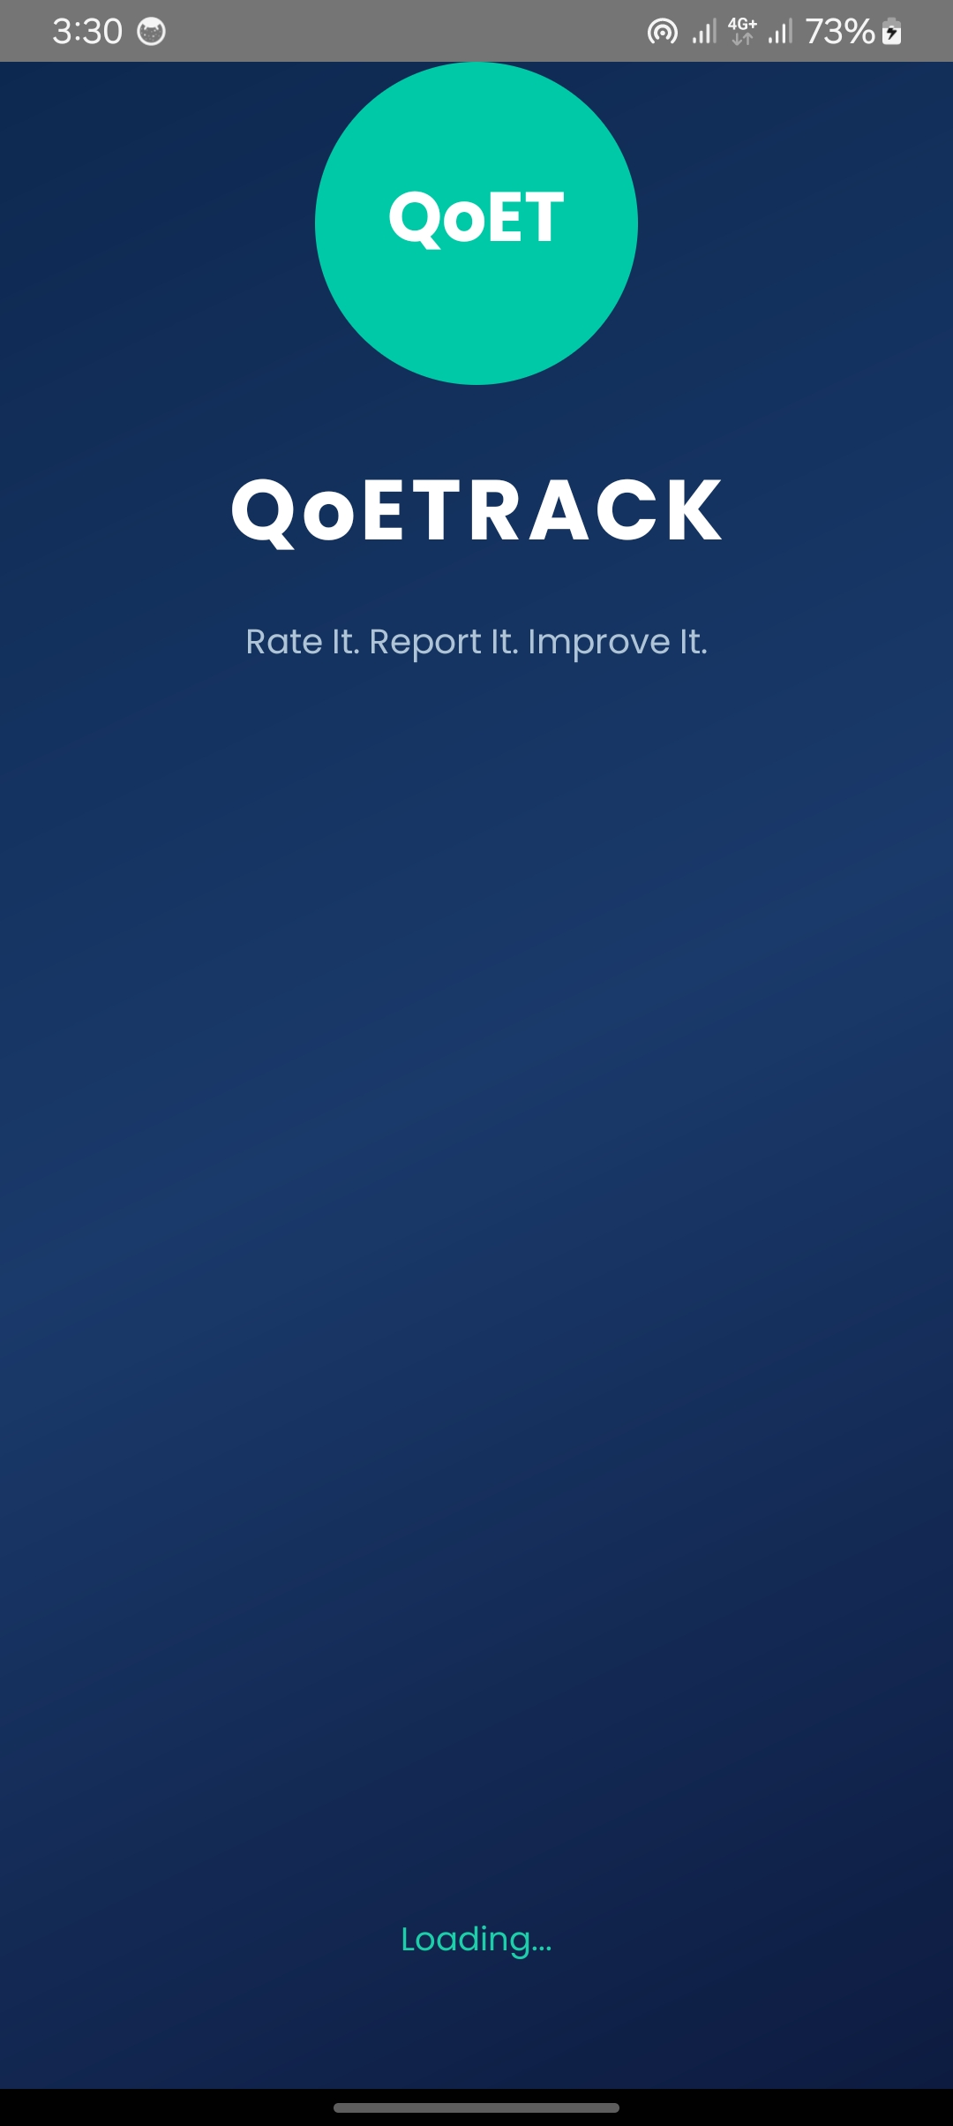
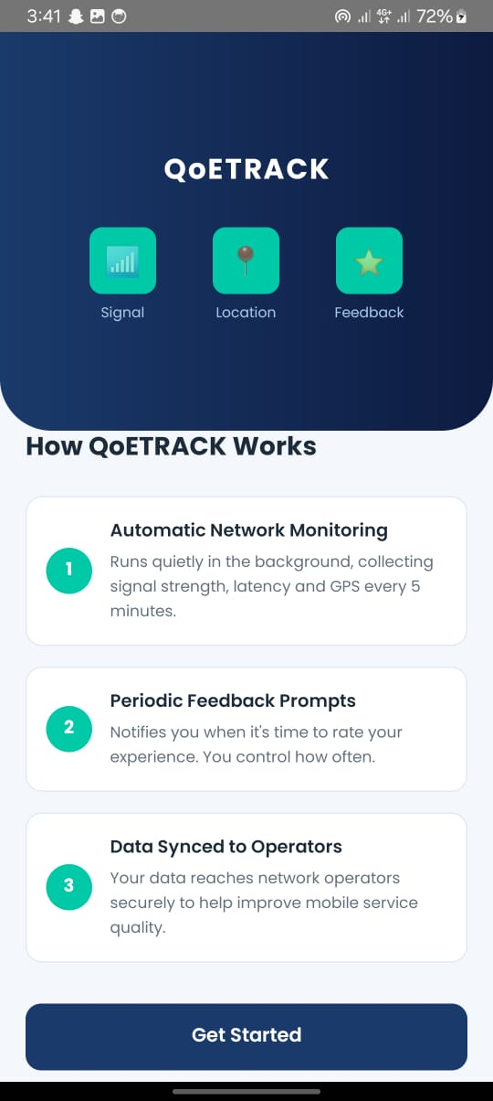
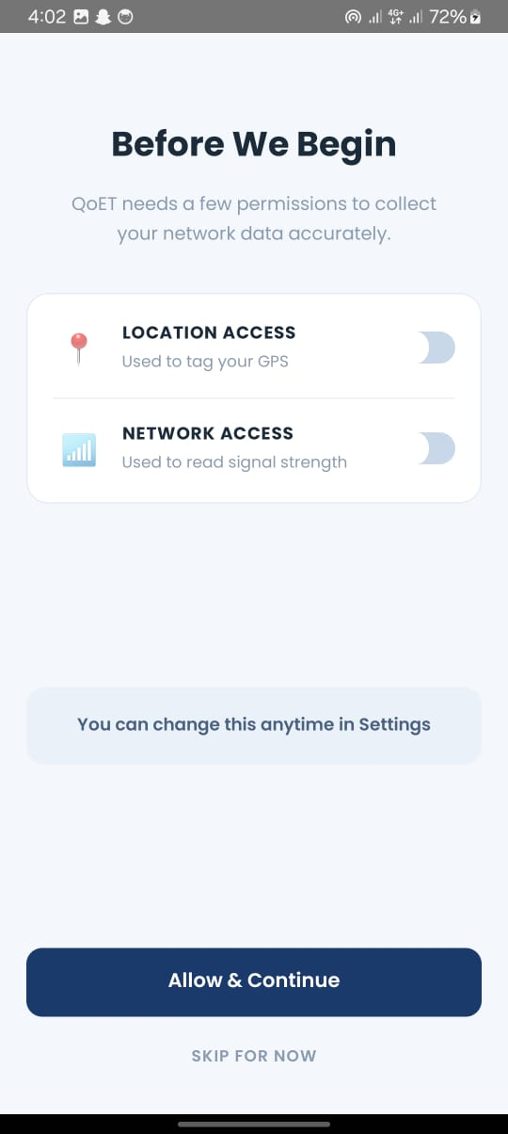
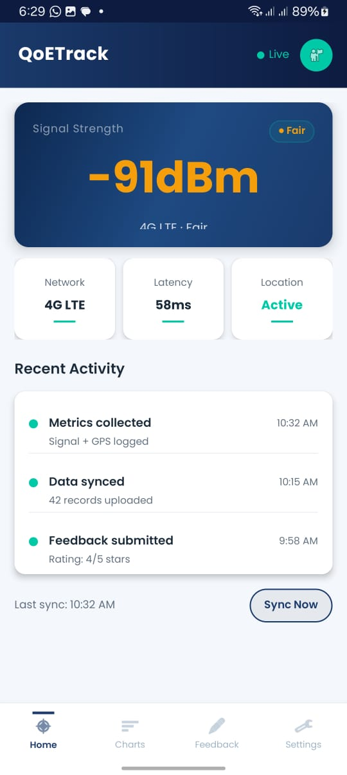
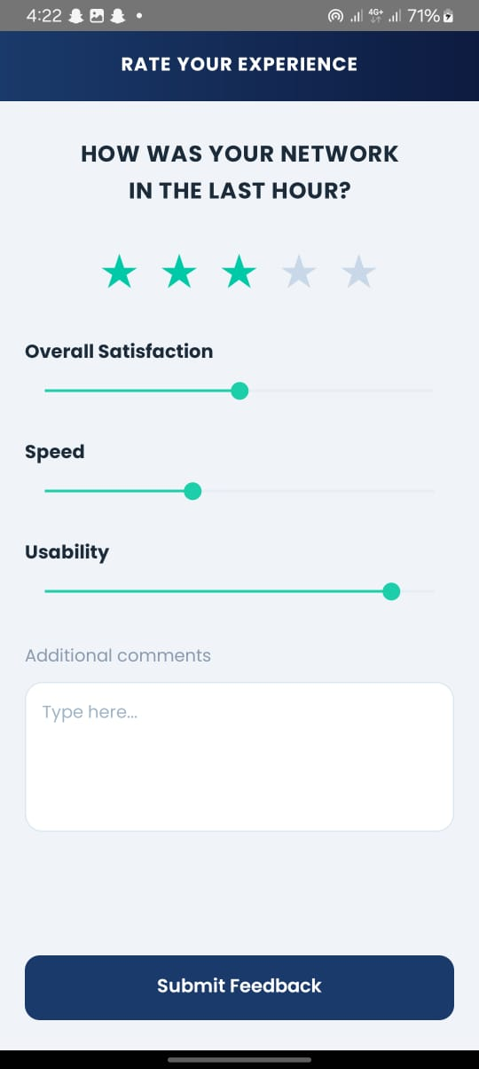
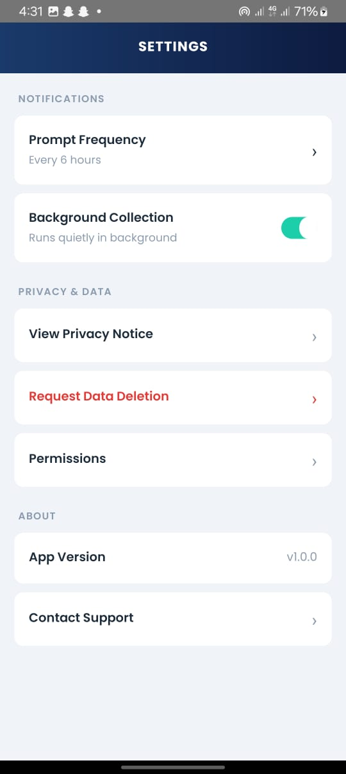
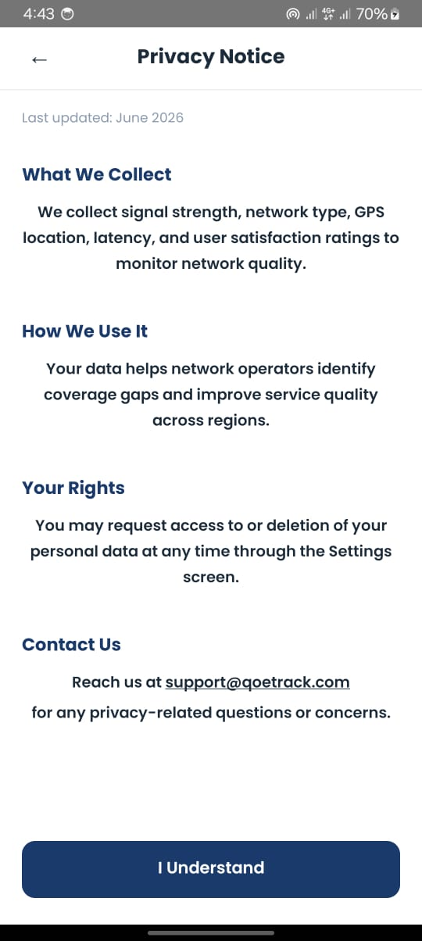
IMPLEMENTED SCREENS
Notes:
All 7 screens are fully implemented and tested on a physical Android device. Each screen has a dedicated Kotlin activity controller and XML layout file.

Slide 6
TECH STACK & KEY CHALLENGES
Technology Stack
Key Challenges Resolved
Language:
Kotlin
Gradle Kotlin DSL syntax errors → fixed dependency format
Layouts:
ConstraintLayout + LinearLayout
compileSdk block syntax → replaced with compileSdk = 35
Min SDK:
API 24 (Android 7.0)
AAR compatibility → bumped targetSdk to 35
Target SDK:
API 35
android:hintTextColor invalid in XML → moved to Kotlin code
Theme:
AppCompat.Light.NoActionBar
android:paintFlags invalid in XML → applied via paintFlags flag
Signal Data:
TelephonyManager / TelephonyCallback
Onboarding skipped silently → cleared SharedPreferences via reinstall
Persistence:
SharedPreferences
Wrong navigation in withEndAction → called navigateToPermission()
Notes:
The main technical hurdles were around Gradle DSL, invalid XML attributes, and SharedPreferences state. Each was diagnosed systematically and resolved.

Slide 7
CONCLUSION
7
100%
11
Screens
Implemented
Navigation
Functional
Challenges
Resolved
All designed, coded
& tested on device
Full flow from Splash
to Privacy Notice
Gradle, SDK, XML attrs,
& layout issues fixed
QoETRACK is a complete frontend implementation of the Task 4 architecture — a functional, visually branded Android application ready for backend integration.
Thank you
Notes:
To summarise: all 7 screens implemented and tested, full navigation flow working, 11 technical challenges resolved. QoETRACK is ready for Task 6 backend integration.

