Slide 1


Software engineering fundamentals
Harry Sanderson

Slide 2
Follow along: https://github.com/GenesisCoast/Whey-Code-Man

Slide 3
Session outcomes
By the end of this session, you will:
Use variables, conditionals, and loops in PowerShell
Load and parse CSV ticket data
Build a simple analysis script
Understand how script pre-processing can reduce AI token usage

Slide 4
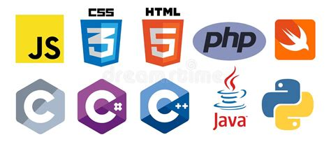
Languages
Language | Type (how it runs) | Pros | Cons
C# | Compiled → JIT / AOT | Fast, great tooling, strong for APIs | More boilerplate
Java | Compiled → JIT | Portable, huge ecosystem | Verbose, JVM tuning
Python | Interpreted (bytecode VM) | Very easy, rapid dev, big libs | Slower for CPU-heavy work
PHP | Interpreted (with optional JIT) | Simple web dev, widely hosted | Web-centric, JIT often small wins for typical apps
PowerShell | Interpreted | Excellent Windows/Azure automation | Not for high-perf apps/loops
JavaScript | Interpreted + JIT (engine optimizes hot paths) | Ubiquitous (browser + Node), great for I/O + realtime | Async complexity; performance can vary due to browsers

Slide 5
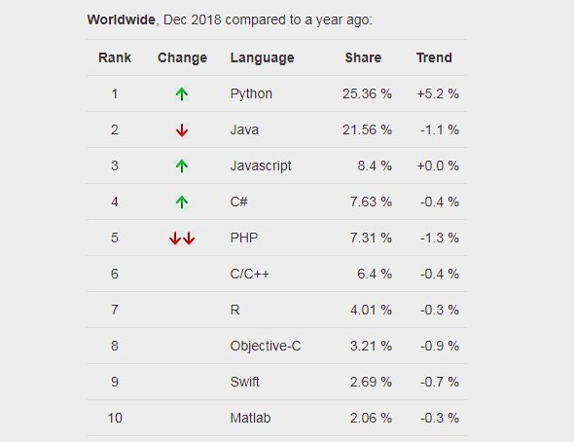
Market share

Slide 6

Service desk AI agent
Thanks Dean!

