Slide 1



Project
View in Power BI
Last data refresh:
11/11/2024 4:46:41 PM UTC
Downloaded at:
11/11/2024 6:06:48 PM UTC

Slide 2
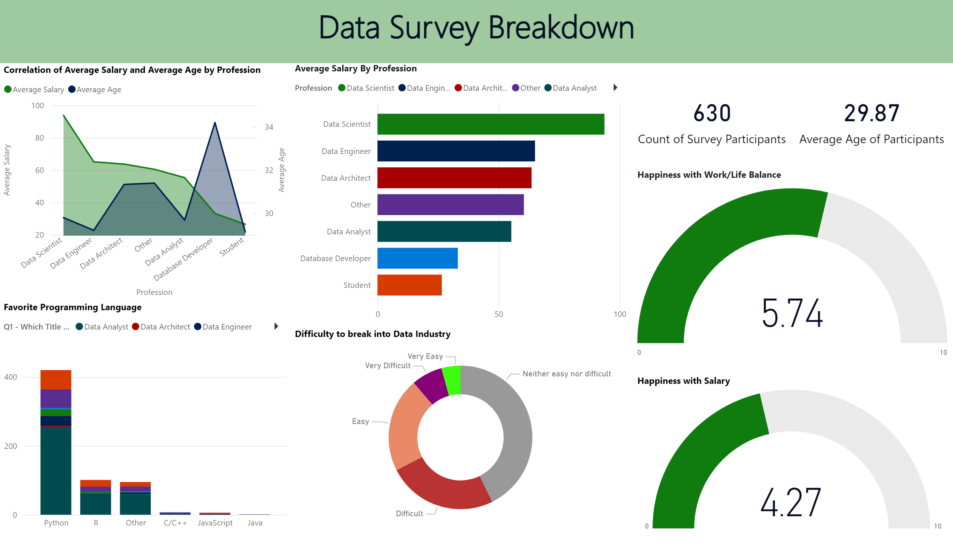
Page 1
Notes:
textbox
No alt text provided
card
No alt text provided
card
No alt text provided
Average Salary By Profession
No alt text provided
Favorite Programming Language
No alt text provided
Happiness with Work/Life Balance
No alt text provided
Happiness with Salary
No alt text provided
Difficulty to break into Data Industry
No alt text provided
Correlation of Average Salary and Average Age by Profession
No alt text provided

