Slide 1
The Basics of Genetic Analysis

Slide 2
Time | Session Details | Speakers and Moderator
8:00 am | Welcome/Intro | Tavia Evans
8:10 am | How to design your genetics experiment | Natalia Vilor-Tejedor
8:20 am | How to get data, QC, and imputation | Natalia Vilor-Tejedor
9:00 am | Single nucleotide polymorphisms (SNP) analysis | Yuetiva Robles
9:40 am | Break
9:50 am | Genome Wide Association Studies (GWAS) | Yuetiva Robles
10:40 am | Polygenic risk score (PRS) calculation with PRSice | Emma Luckett
11:35 am | PostGWAS analysis. Understanding biological pathways | Krishna Rani Kalari &. Karunya Kandimalla
11:55 am | End/Review | Tavia Evans/Natalia Vilor-Tejedor/Jun Hao Wen

Slide 3

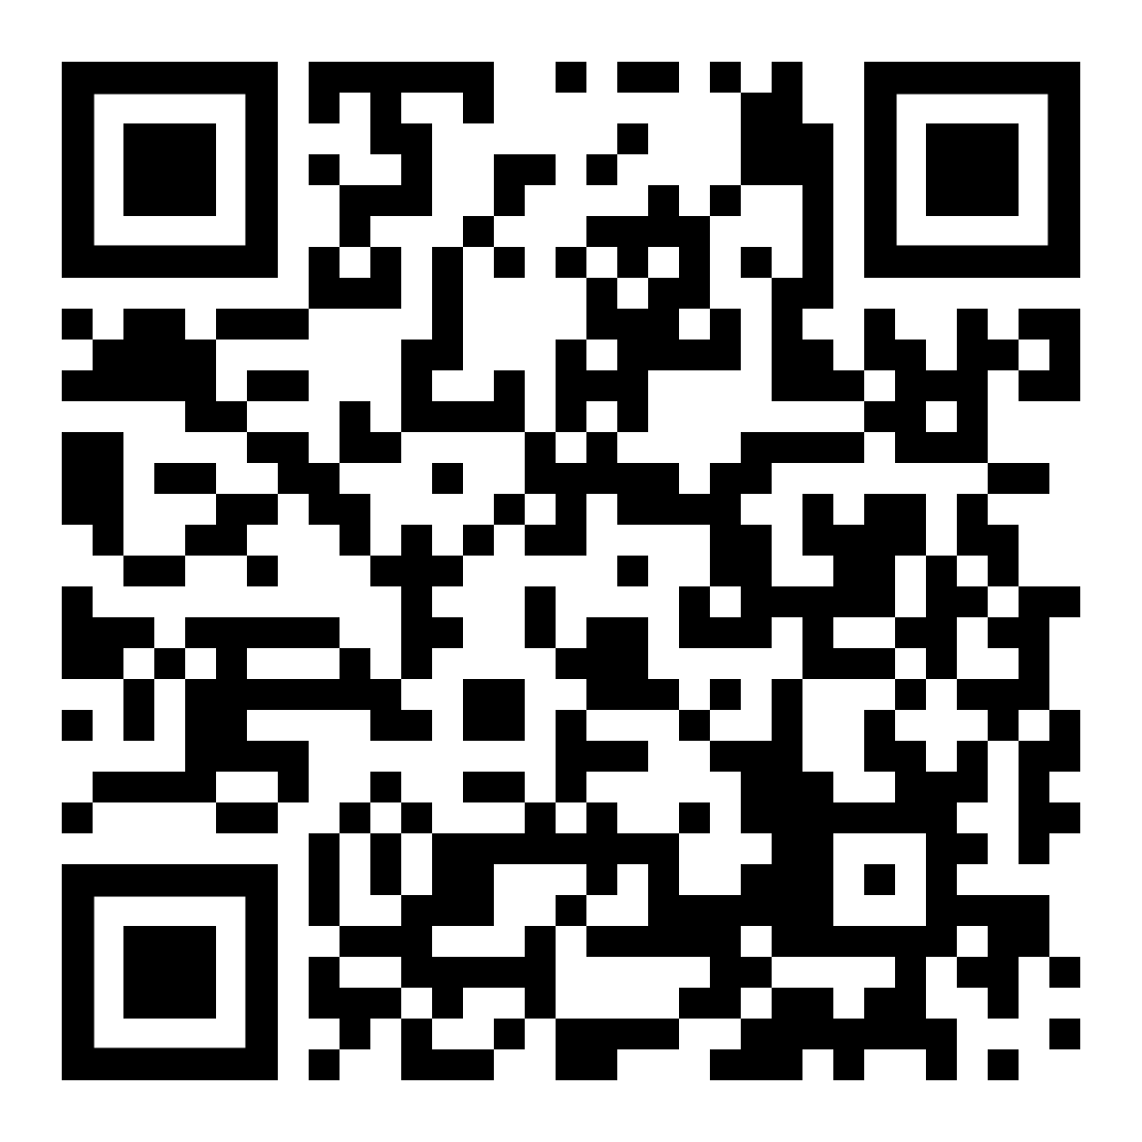

ADNI access Virtual machine access

Slide 4
Enjoy!
Any questions?

