Slide 1
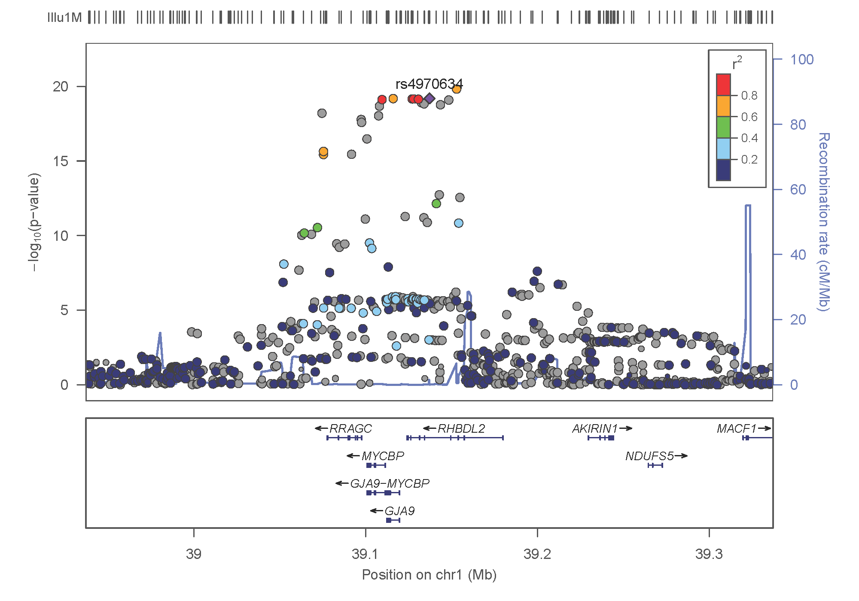
FM-pipeline
A FineMapping pipeline using GWAS summary statistics

Slide 2
Methods
Finemapping uses additional steps to identify causal variants underpinning GWAS signals, which can be furnished with individual level data or GWAS summary statistics (.sumstats), the focus of this work and involving
Extraction of region-specific .sumstats,
Extraction of correlation (r) from the reference panel among overlapped SNPs from 1 and the reference panel containing individual level data,
Information from 1 and 2 above is then used as input for finemapping.
The measure of evidence is typically (log10) Bayes factor (BF) and associate SNP probability in the causal set.

Slide 3
Why it is necessary
A primary rationale is to put together information to facilitate analysis esp. alignment of the direction of effect with the reference but this is not always straightforward leading to prolonged program debugging.
The development has been relatively recent, reflecting our incremental approach nevertheless it is really handy to enable them.
The regional association (LocusZoom) plots would also facilitate our analysis and can be streamlined.
HRC format have variants sharing the same position so it is necessary to use SNPID but alleles in the GEN format do not always have right order.
GTOOL can convert GEN to PED/MAP in a way better than PLINK as the allele labels are kept in the MAP file but it does not allow for specification of reference allele so we pre-order them before the conversion.

Slide 4
Software included in the pipeline
Name | Function | Input | Output | Reference
CAVIAR | finemapping | z, correlation matrix | causal sets and probabilities | Hormozdiari, et al. (2014)
CAVIARBF | finemapping | z, correlation matrix | BF and probabilities for all configurations | Chen, et al. (2015)
GCTA | joint/conditional analysis | .sumstats, reference data | association results | Yang, et al. (2012)
FM-summary | finemapping | .sumstats association results | updated results | Huang, et al. (2017)
JAM | finemapping | beta, individual reference data | Bayes Factor of being causal | Newcombe, et al. (2016)
LocusZoom | regional plot | partial .sumstats | .pdf/.png plots | Pruim, et al. (2010)
fgwas | functional GWAS |  |  | Pickrell (2014)
finemap | finemapping | z, correlation matrix | causal SNPs and configuration | Benner, et al. (2016)

Slide 5
USAGE
INPUT
GWAS summary statistics (repro.txt), e.g.,
SNP A1 A2 freqA1 beta se P N chr pos
rs4970634 a g 0.6730 -0.1970 0.0216 6.433e-20 70423 1 39364617
Region-specific data, list of SNPs (e.g., GIANT data) or the following (st.bed)
chrom, Start, End, pos, rsid SN
1 39114617 39614617 39364617 rs4970634 1
.GEN (chr1_39114617-39614617.gen)
1:39114626_A_T 1:39114626_A_T 39114626 A T 1 0 0 …
SYNTAX. pmp.sh repro.txt
OUTPUT. One can choose software, e.g., GCTA, finemap, JAM.

Slide 6
Issues for finemap/JAM (or all software)
Index SNPID SNP_prob snp_log10bf z
733 9:32932194_C_T 1.0 13.0829 4.841630
1231 9:33069181_C_T 1.0 13.0829 -4.766990
873 9:32987594_G_T 1.0 13.0805 0.223041
1130 9:33037350_A_C 1.0 9.8589 -5.813400
1193 9:33058705_A_C 0.5 3.0832 -2.305340
1191 9:33058461_C_T 0.5 3.0832 2.305340
> ld[index, index]
V733 V1231 V873 V1130 V1193 V1191
733 1.0000000 -0.8247300 -0.1326670 0.893704 -0.0626968 0.0626968
1231 -0.8247300 1.0000000 -0.0775275 -0.898488 -0.2290370 0.2290370
873 -0.1326670 -0.0775275 1.0000000 -0.126591 0.0172165 -0.0172165
1130 0.8937040 -0.8984880 -0.1265910 1.000000 -0.1451790 0.1451790
1193 -0.0626968 -0.2290370 0.0172165 -0.145179 1.0000000 -1.0000000
1191 0.0626968 0.2290370 -0.0172165 0.145179 -1.0000000 1.0000000

Slide 7
Interpretation and additional work
Due to limitation of GWAS marginal association statistics, joint association results holds the key for finemapping but is it necessarily the way we know (e.g., from GCTA)?
We are yet to lash out a strategy that actually works!
We need to refine the modular implementations.
We need inputs from users inside (/genetics/bin/FM-pipeline) and outside (GitHub).

Slide 8
References
Hormozdiari F, Kostem E, Kang EY, Pasaniuc B, Eskin E. Identifying Causal Variants at Loci with Multiple Signals of Association. Genetics 44, 725–731, 2014
Chen W, et al. (2015). Fine Mapping Causal Variants with an Approximate Bayesian Method Using Marginal Test Statistics. Genetics 200:719-736.
Benner C. et al. FINEMAP: Efficient variable selection using summary data from genome-wide association studies. Bioinformatics 32, 1493-1501, 2016
Newcombe PJ, Conti DV, Richardson. JAM: A Scalable Bayesian Framework for Joint Analysis of Marginal SNP Effects. Genet Epidemiol 40:188–201, 2016
Pickrell JK. Joint analysis of functional genomic data and genome-wide association studies of 18 human traits. bioRxiv 10.1101/000752, 2014

Slide 9
One more example
Here we extracted results on the first region (largely because of the setup on HPC while our Unit’s Linux clusters was done) with rsid, chr, position as follows,
rs4970634 1 39,364,617
and +/- 250kb region chr1:39114617-39614617. The GWAS .sumstat is as follows,
chr | pos | A1 | A2 | AF1 | beta | se | p | n
1 | 39364617 | A | G | 0.6730 | -0.1970 | 0.0216 | 6.433e-20 | 70423

Slide 10
Regional association plot (locusZoom)

Slide 11
Results from finemap
In the pruned set (509 SNPs) only two SNPs were of interest,
snp snp_prob snp_log10bf rsid
1:39364617_A_G 0.8829 3.5831 rs4970634
1:39302020_C_T 0.1167 1.8270 rs7548054
Again the lead SNP was flagged with high probability and large log10(BF).

Slide 12
Three causal loci
For the pruning set,
snp snp_prob snp_log10bf rsid
1:39382803_C_T 1.0000 12.5294 rs9726587
1:39378739_C_T 1.0000 12.5294 rs12116890
1:39364617_A_G 1.0000 12.5294 rs4970634
And the configuration containing all three variants has the highest log10(BF) =543.07. It seems quite reassuring that our lead SNP is among the top candidates

