Slide 1
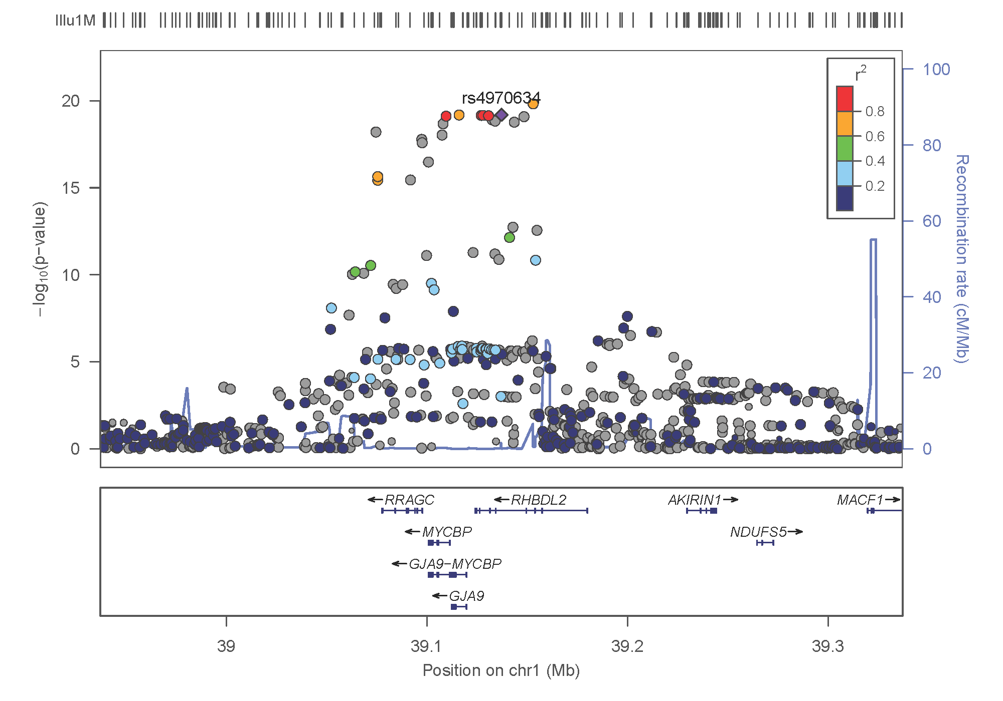
FM-pipeline
A FineMapping pipeline using GWAS summary statistics

Slide 2
Methods
Finemapping uses additional steps to identify causal variants underpinning GWAS signals, which can be furnished with individual level data or GWAS summary statistics (.sumstats), the focus of this work and involving
Extraction of region-specific .sumstats,
Extraction of correlation (r) from the reference panel among overlapped SNPs from 1 and the reference panel containing individual level data,
Information from 1 and 2 above is then used as input for finemapping.
The measure of evidence is typically (log10) Bayes factor (BF) and associate SNP probability in the causal set.

Slide 3
Why it is necessary
A primary rationale is to put together information to facilitate analysis esp. alignment of the direction of effect with the reference but this is not always straightforward leading to prolonged program debugging.
The development has been relatively recent, reflecting our incremental approach nevertheless it is really handy to enable them.
The regional association (LocusZoom) plots would also facilitate our analysis and can be streamlined.
HRC format have variants sharing the same position so it is necessary to use SNPID but alleles in the GEN format do not always have right order.
GTOOL can convert GEN to PED/MAP in a way better than PLINK as the allele labels are kept in the MAP file but it does not allow for specification of reference allele so we pre-order them before the conversion. We turn to qctool, however, since conversion fails with UK10K+1KG data.

Slide 4
Software included in the pipeline
Name | Function | Input | Output | Reference
CAVIAR | finemapping | z, correlation matrix | causal sets and probabilities | Hormozdiari, et al. (2014)
CAVIARBF | finemapping | z, correlation matrix | BF and probabilities for all configurations | Chen, et al. (2015)
GCTA | joint/conditional analysis | .sumstats, reference data | association results | Yang, et al. (2012)
FM-summary | finemapping | .sumstats association results | updated results | Huang, et al. (2017)
JAM | finemapping | beta, individual reference data | Bayes Factor of being causal | Newcombe, et al. (2016)
LocusZoom | regional plot | partial .sumstats | .pdf/.png plots | Pruim, et al. (2010)
fgwas | functional GWAS |  |  | Pickrell (2014)
finemap | finemapping | z, correlation matrix | causal SNPs and configuration | Benner, et al. (2016)

Slide 5
References
Hormozdiari F, Kostem E, Kang EY, Pasaniuc B, Eskin E. Identifying Causal Variants at Loci with Multiple Signals of Association. Genetics 44, 725–731, 2014
Chen W, et al. (2015). Fine Mapping Causal Variants with an Approximate Bayesian Method Using Marginal Test Statistics. Genetics 200:719-736.
Benner C. et al. FINEMAP: Efficient variable selection using summary data from genome-wide association studies. Bioinformatics 32, 1493-1501, 2016
Newcombe PJ, Conti DV, Richardson. JAM: A Scalable Bayesian Framework for Joint Analysis of Marginal SNP Effects. Genet Epidemiol 40:188–201, 2016
Pickrell JK. Joint analysis of functional genomic data and genome-wide association studies of 18 human traits. bioRxiv 10.1101/000752, 2014

Slide 6
USAGE
INPUT
GWAS summary statistics (repro.txt), e.g.,
SNP A1 A2 freqA1 beta se P N chr pos
rs4970634 a g 0.6730 -0.1970 0.0216 6.433e-20 70423 1 39364617
Region-specific data (st.bed)
chrom, Start, End, pos, rsid SN
1 39114617 39614617 39364617 rs4970634 1
.GEN (chr1_39114617_39614617.gen.gz)
1:39114626_A_T 1:39114626_A_T 39114626 A T 1 0 0 …
SYNTAX. pmp.sh repro.txt
OUTPUT. One can choose software, e.g., GCTA, finemap, JAM.

Slide 7
Reference panels tested
EPIC-Omics GWAS and its own individual level data
1KG phase III as with FUSION/LDREF
EPIC-Omics UK10K+1KG imputed data
EPIC-Omics HRC imputed data

Slide 8
The front-page example
Here we extracted results on the first region (largely because of the setup on HPC while our Unit’s Linux clusters was done) with rsid, chr, position as follows,
rs4970634 1 39,364,617
and +/- 250kb region chr1:39114617-39614617. The GWAS .sumstat is as follows,
chr | pos | A1 | A2 | AF1 | beta | se | p | n
1 | 39364617 | A | G | 0.6730 | -0.1970 | 0.0216 | 6.433e-20 | 70423

Slide 9
Regional association plot (locusZoom)

Slide 10
GCTA –cojo-slct results
Whole-genome
Chr | SNP | bp | refA | freq | b | se | p | n | freq_geno | bJ | bJ_se | pJ | LD_r
1 | 1:39355351_G_T | 39355351 | T | 0.6721 | -0.1946 | 0.0213 | 6.64E-20 | 87018.7 | 0.671757 | -0.19157 | 0.021316 | 2.53E-19 | 0.023461
-/+ 250kb region surrounding rs4970634
Chr | SNP | bp | refA | freq | b | se | p | n | freq_geno | bJ | bJ_se | pJ | LD_r
1 | 1:39355351_G_T | 39355351 | T | 0.6721 | -0.1946 | 0.0213 | 6.64E-20 | 88098.7 | 0.671757 | -0.1946 | 0.02131 | 6.73E-20 | 0

Slide 11
JAM results
It is based on pruned set containing 191 out of 1,565 SNPs including the lead SNP, but is further cut down to those with complete data.
The configuration that the top models involve 20 SNPs the first of which only rs7548892 is causal with posterior probability of 0.3798 with Bayes Factor 240.37.

Slide 12
SNPs with snp_prob>0.01 (finemap)
index | snp | snp_prob | snp_log10bf | order | rsid
815 | 1:39380385_C_T | 0.3147 | 2.6581 | 1 | rs4246511
697 | 1:39343467_C_T | 0.0882 | 1.9815 | 2 | rs9438972
742 | 1:39355351_G_T | 0.0815 | 1.9442 | 3 | rs9438979
737 | 1:39354517_C_T | 0.0779 | 1.9229 | 4 | rs4414011
752 | 1:39358143_A_C | 0.0778 | 1.9226 | 5 | rs9438982
776 | 1:39364617_A_G | 0.0704 | 1.8753 | 6 | rs4970634
806 | 1:39375844_A_G | 0.0702 | 1.8739 | 7 | rs7540233
677 | 1:39336991_G_T | 0.0599 | 1.8003 | 8 | rs9439079
756 | 1:39360035_A_G | 0.043 | 1.6485 | 9 | rs4970564
764 | 1:39361425_G_T | 0.0413 | 1.6306 | 10 | rs4532801
796 | 1:39370992_C_T | 0.0294 | 1.4774 | 11 | rs61780052
674 | 1:39335493_G_T | 0.0229 | 1.3665 | 12 | rs9439078
1472 | 1:39573975_G_T | 0.0107 | 1.0322 | 13 | rs76351144

Slide 13
Configurations with config_prob>0.01 (finemap)
rank | config | config_prob | config_log10bf
1 | 1:39380385_C_T | 0.243985 | 17.49907
2 | 1:39343467_C_T | 0.066351 | 16.93355
3 | 1:39355351_G_T | 0.060923 | 16.89648
4 | 1:39354517_C_T | 0.058382 | 16.87798
5 | 1:39358143_A_C | 0.058382 | 16.87798
6 | 1:39364617_A_G | 0.052792 | 16.83427
7 | 1:39375844_A_G | 0.052792 | 16.83427
8 | 1:39336991_G_T | 0.045022 | 16.76513
9 | 1:39360035_A_G | 0.03212 | 16.61848
10 | 1:39361425_G_T | 0.030874 | 16.60129
11 | 1:39370992_C_T | 0.021983 | 16.45380
12 | 1:39335493_G_T | 0.017120 | 16.34520

Slide 14
Z-score/LD consistence (finemap)
snp | z | index | snp_prob | snp_log10bf | V815 | V697 | V742 | V737 | V752 | V776 | V806 | V677 | V756 | V764 | V796 | V674 | V1472
1:39380385_C_T | 9.28761 | 815 | 0.3147 | 2.6581 | 1 | 0.915285 | -0.91536 | 0.915399 | -0.91541 | -0.91428 | -0.91750 | -0.91230 | -0.91396 | 0.914023 | -0.91436 | -0.91215 | 0.041220
1:39343467_C_T | 9.14554 | 697 | 0.0882 | 1.9815 | 0.915285 | 1 | -0.99975 | 0.999807 | -0.99966 | -0.99805 | -0.99417 | -0.99625 | -0.99811 | 0.997919 | -0.99752 | -0.99569 | 0.050917
1:39355351_G_T | -9.13615 | 742 | 0.0815 | 1.9442 | -0.91536 | -0.99975 | 1 | -0.99994 | 0.999715 | 0.998108 | 0.994185 | 0.996023 | 0.998165 | -0.99798 | 0.99754 | 0.995707 | -0.05089
1:39354517_C_T | 9.13146 | 737 | 0.0779 | 1.9229 | 0.915399 | 0.999807 | -0.99994 | 1 | -0.99977 | -0.99817 | -0.99424 | -0.99608 | -0.99822 | 0.998034 | -0.9976 | -0.99577 | 0.050898
1:39358143_A_C | -9.13146 | 752 | 0.0778 | 1.9226 | -0.91541 | -0.99966 | 0.999715 | -0.99977 | 1 | 0.998393 | 0.994551 | 0.995933 | 0.998449 | -0.99794 | 0.997668 | 0.995617 | -0.05087
1:39364617_A_G | -9.12037 | 776 | 0.0704 | 1.8753 | -0.91428 | -0.99805 | 0.998108 | -0.99817 | 0.998393 | 1 | 0.996122 | 0.994408 | 0.999707 | -0.99920 | 0.999224 | 0.99409 | -0.05065
1:39375844_A_G | -9.12037 | 806 | 0.0702 | 1.8739 | -0.91750 | -0.99417 | 0.994185 | -0.99424 | 0.994551 | 0.996122 | 1 | 0.990499 | 0.995877 | -0.99537 | 0.995812 | 0.990183 | -0.05092
1:39336991_G_T | -9.10280 | 677 | 0.0599 | 1.8003 | -0.91230 | -0.99625 | 0.996023 | -0.99608 | 0.995933 | 0.994408 | 0.990499 | 1 | 0.994462 | -0.99427 | 0.993878 | 0.999226 | -0.05116
1:39360035_A_G | -9.06542 | 756 | 0.0430 | 1.6485 | -0.91396 | -0.99811 | 0.998165 | -0.99822 | 0.998449 | 0.999707 | 0.995877 | 0.994462 | 1 | -0.99926 | 0.998982 | 0.994145 | -0.05069
1:39361425_G_T | 9.06103 | 764 | 0.0413 | 1.6306 | 0.914023 | 0.997919 | -0.99798 | 0.998034 | -0.99794 | -0.99920 | -0.99537 | -0.99427 | -0.99926 | 1 | -0.99962 | -0.99478 | 0.050646
1:39370992_C_T | -9.02326 | 796 | 0.0294 | 1.4774 | -0.91436 | -0.99752 | 0.99754 | -0.9976 | 0.997668 | 0.999224 | 0.995812 | 0.993878 | 0.998982 | -0.99962 | 1 | 0.994386 | -0.05060
1:39335493_G_T | -8.99535 | 674 | 0.0229 | 1.3665 | -0.91215 | -0.99569 | 0.995707 | -0.99577 | 0.995617 | 0.99409 | 0.990183 | 0.999226 | 0.994145 | -0.99478 | 0.994386 | 1 | -0.05108
1:39573975_G_T | -2.89602 | 1472 | 0.0107 | 1.0322 | 0.041220 | 0.050917 | -0.05089 | 0.050898 | -0.05087 | -0.05065 | -0.05092 | -0.05116 | -0.05069 | 0.050646 | -0.05060 | -0.05108 | 1

Slide 15
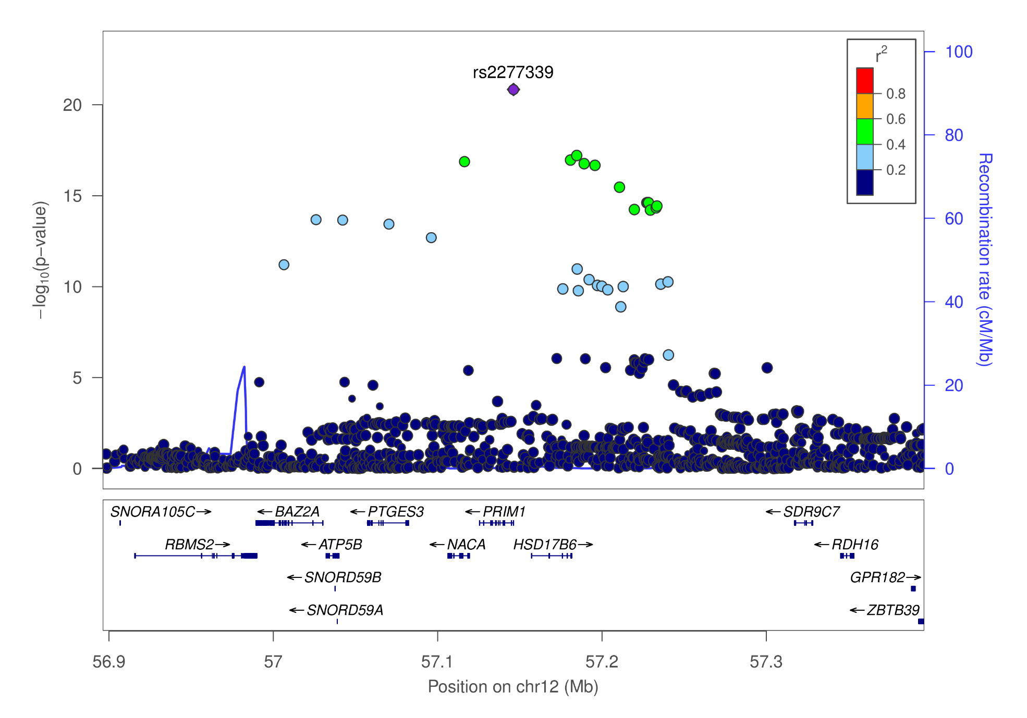
chr12_56896069_57396069 (rs2277339)

Slide 16
12:57146069_G_T is rs2277339!!!
Results from HRC panel are promising but 1KG phase III reference panel is sufficient.
GCTA
Chr | SNP | bp | refA | freq | b | se | p | n | freq_geno | bJ | bJ_se | pJ | LD_r
12 | 12:57146069_G_T | 57146069 | T | 0.8889 | 0.3242 | 0.034 | 1.42E-21 | 66329 | 0.886503 | 0.3242 | 0.034023 | 1.59E-21 | 0
JAM
BF=29391.4444, top model has posterior probability=0.8486.
finemap
snp_prob=1, snp_log10bf=8.4214, config_prob=0.8672335, config_log10bf=18.50581.

