Slide 1

The Environmental & Economical Impact of USA’s Airlines
Geneva, ashruti, Tsamaija, Saweena, yolanta, zsoka

Slide 2
This project explores the original idea of comparing the environmental and economic impact of the USA’s main airlines, including the ten airlines which have almost a 90% share of the domestic flight market in the USA: American, Southwest, Delta, United, Spirit, Alaska, JetBlue, SkyWest, Frontier and Hawaiian Airlines. We explore different factors which may affect the levels of CO2 produced by each airline, such as fleet size, ticket prices and revenue, altogether not only investigating the way in which airlines can affect the environment but also its impact on aspects of the economy.
- Summary

Slide 3
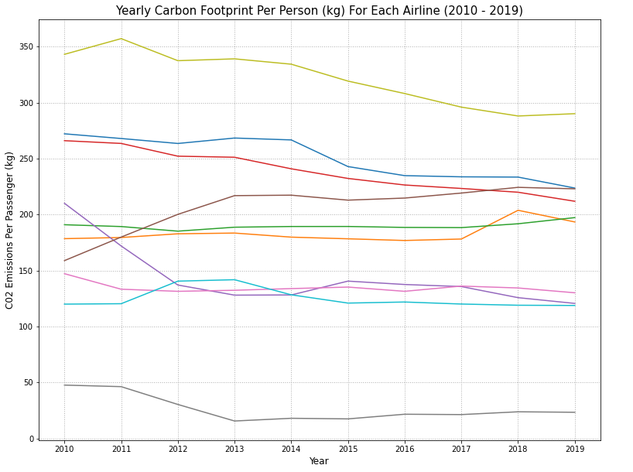
Emissions & Passenger Analysis
BTS data for both fuel consumption and passengers transported was used to produce a yearly picture of the carbon footprint per passenger travelling with each airline. The data was processed to ensure that it could be combined with other datasets.
The carbon footprint per passenger for most airlines has reduced over time. Surprisingly, some lower emission airlines have a very high carbon footprint per passenger. This may be due to the composition of their fleet, but too many other factors need to be considered to be certain .

Slide 4
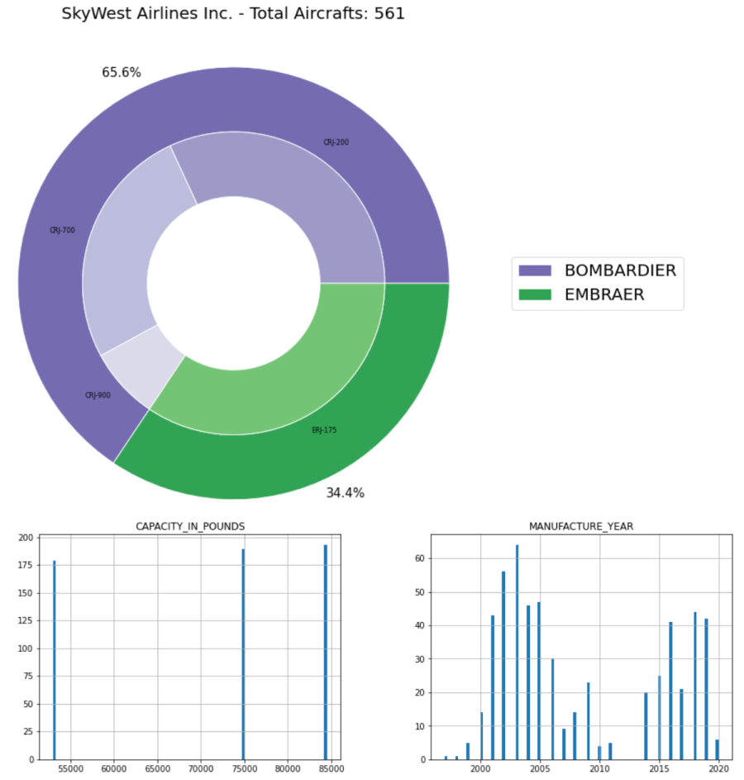
Fleet Data Analysis
Inventory data was used for each airline which included every individual airline owned. The data was imported into a pandas data frame and only the useful data was retained. The data was further reformatted to allow the qualitative data to be represented in nested pie charts and histograms.
Fleet age, model distribution, and size all appear to play a role in airline annual emissions, however it is likely a greater role is played by how the fleet is utilised.

Slide 5
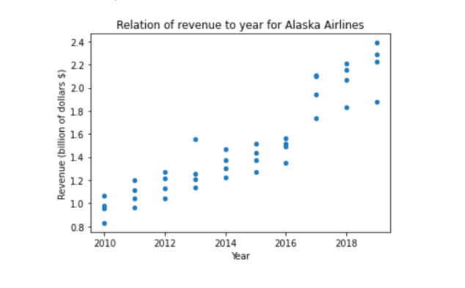
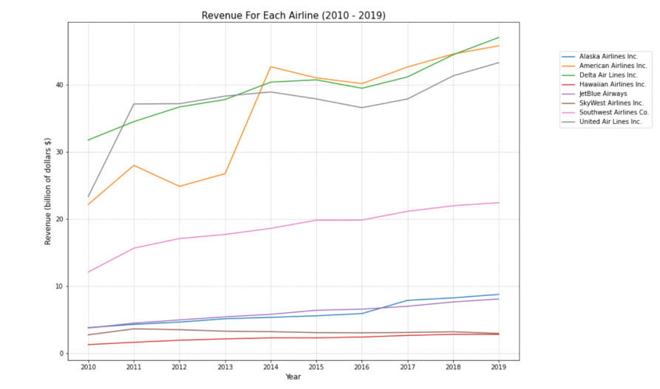
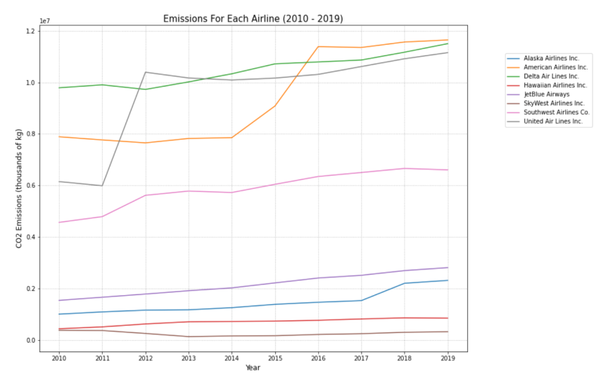
Revenue & Emissions Analysis
The csv was constructed by averaging the emissions quarterly. The data from revenue was used to plot graphs for emissions and revenue for each year for the Airlines. Scatter plot was used to illustrate trends in revenue per year for the Airlines.
There is a direct correlation between emissions and revenue of airlines.

Slide 6
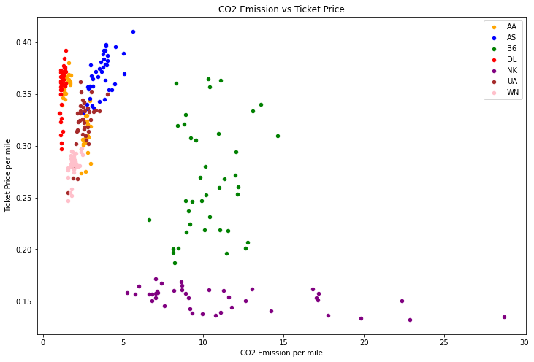
Ticket Price Analysis
The ticket price data of domestic flights has been analysed
The aim is to investigate a possible relationship between prices and CO2 emissions of flights
Weak negative correlation (-0.65) was found between Average price per mile and CO2 emission thousand kg per mile
The result is possibly due to different business strategies of different airlines, rather than within individual companies

