Slide 1

The Environmental & Economical Impact of USA’s Airlines
Geneva, ashruti, Tsamaija, Saweena, yolanta, zsoka

Slide 2
This project explores the original idea of comparing the environmental and economic impact of the USA’s main airlines, including the ten airlines which have almost a 90% share of the domestic flight market in the USA: American, Southwest, Delta, United, Spirit, Alaska, JetBlue, SkyWest, Frontier and Hawaiian Airlines. We explore different factors which may affect the levels of CO2 produced by each airline, such as fleet size, ticket prices and revenue, altogether not only investigating the way in which airlines can affect the environment but also its impact on aspects of the economy.
- Summary

Slide 3
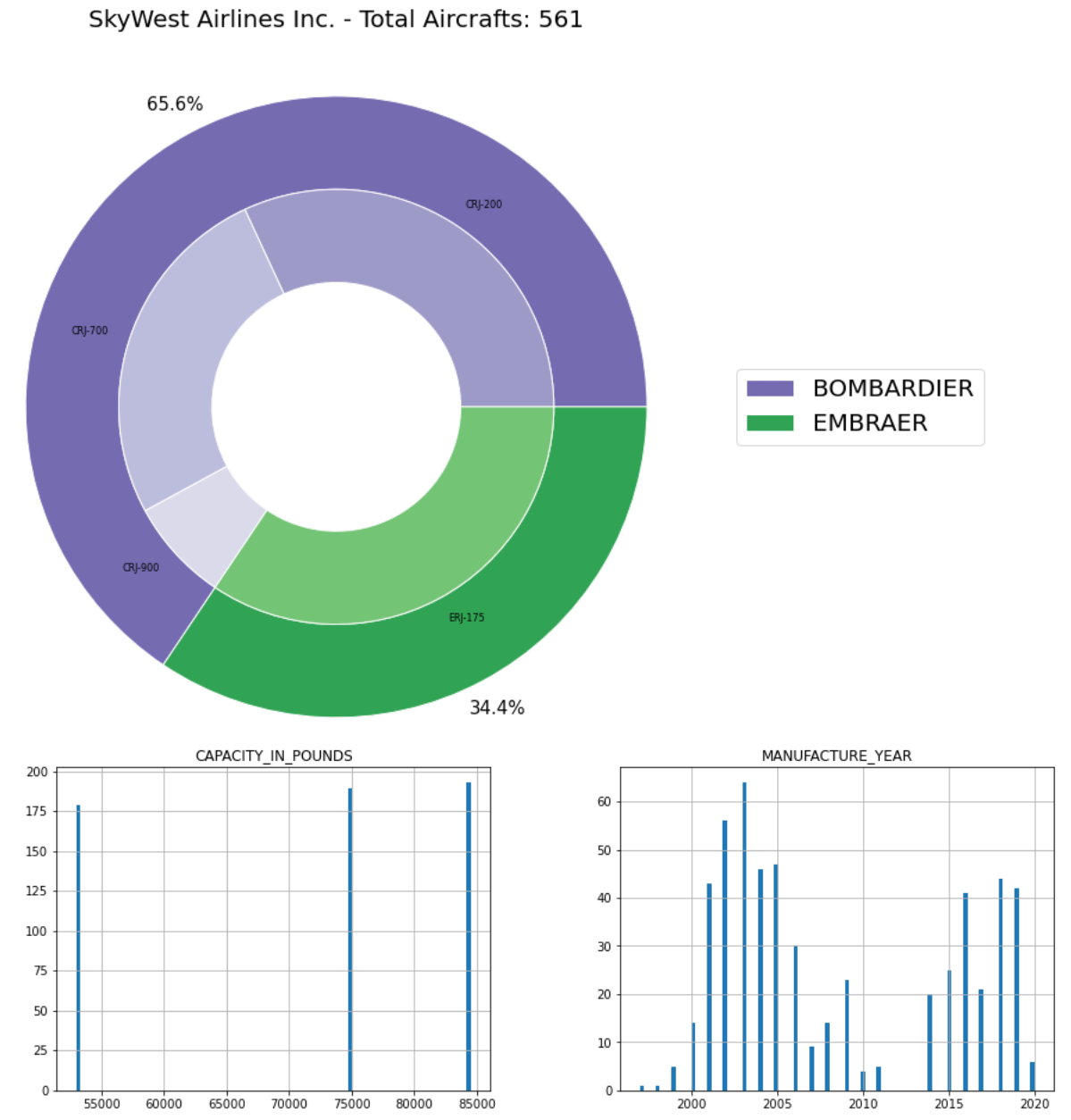
Fleet Data Analysis
Inventory data was used for each airline which included every individual airline owned. The data was imported into a pandas data frame and only the useful data was retained. The data was further reformatted to allow the qualitative data to be represented in nested pie charts and histograms.
Fleet age, model distribution, and size all appear to play a role in airline annual emissions, however it is likely a greater role is played by how the fleet is utilised.

Slide 4
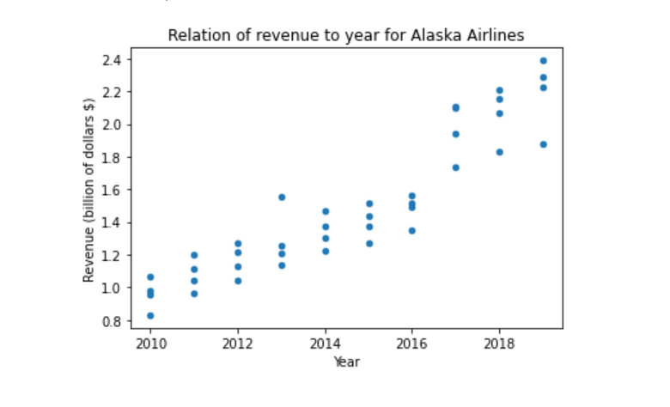
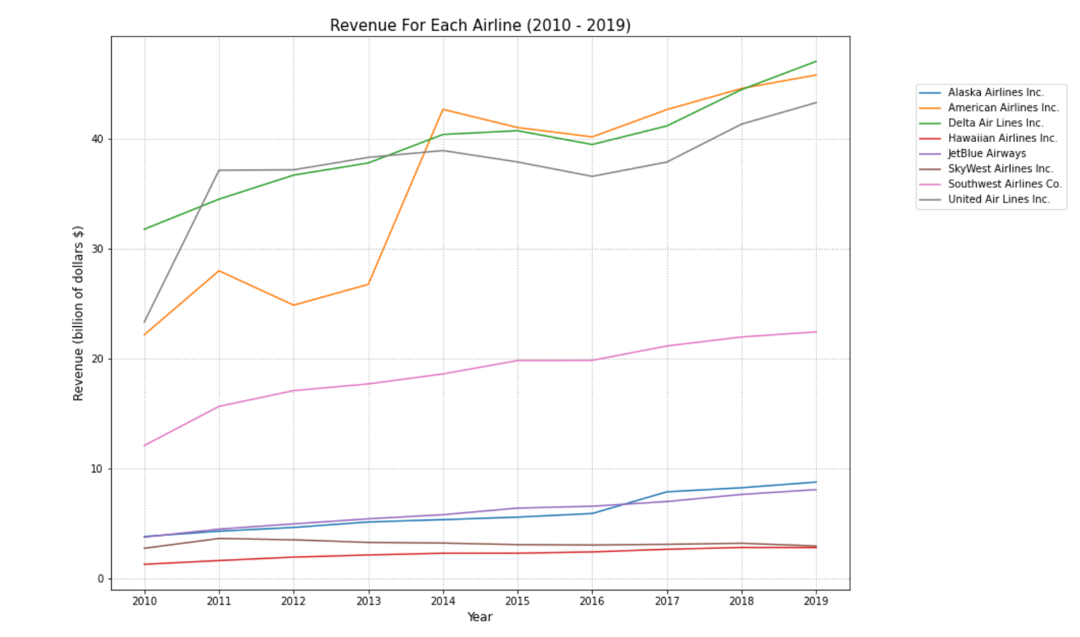
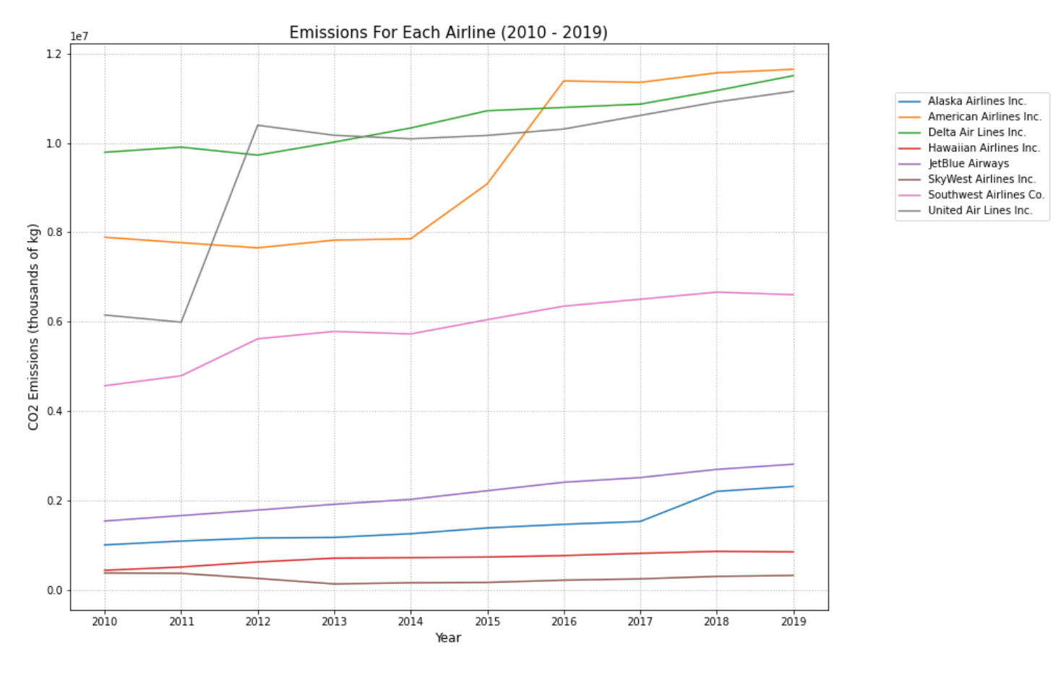
Revenue & Emissions Analysis
The csv was constructed by averaging the emissions quarterly. The data from revenue was used to plot graphs for emissions and revenue for each year for the Airlines. Scatter plot was used to illustrate trends in revenue per year for the Airlines.
There is a direct correlation between emissions and revenue of airlines.

