Slide 1
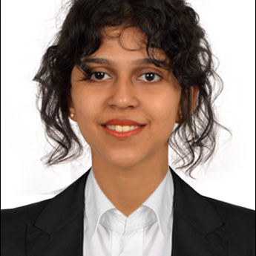
Genevive Gloria Mendonca
Analyst/Software Engineer
Bachelor of Technology, Computer Science : 2016 - 2021
Skills
Java | Java Basics, OOPS, Generics, Collections, java8 features
J2EE | Servlets
Database | PostgreSQL, MySQL
Web Technology | HTML & CSS and JavaScript, Typescript, Bootstrap, Angular.
Tools | Git, Postman, Swagger, Visual Studio Code Sonarqube, Jenkins
Add On skills | Adaptability, Communication Skills, Team management, work ethic persuasion
Frameworks | Hibernate & spring
Bangalore
genevive.gloria-mendonca@capgemini.com
+91 8660824580
A4
Electronic Voting System Application
Created Electronic Voting System application to automate the process of planning and managing the voting system, as well as the actual voting activity.
We Used HTML,CSS, Boostrap and TypeScript for the UI designing. And with PostgreSQL as backend and java and Spring Boot as middleware.
Trained on JEE Full Stack with Angular
Core java, java8 features(stream API , Lambda Expressions, java date time API, Optional class)
J2EE
Git and GitHub
SQL and RDBMS
Hibernate and Spring Frameworks
HTML, CSS , JavaScript , Typescript
Proficient in creating Single page Web Application in Angular with Authentication with routing.

