Slide 1
Mobile Programing Term ProJECt
201635806 김정민
201635841 이채현
201635848 장휘준
201835848 서동익

Slide 2
Contents
1
2
3
4
Introduction
Needs
Other things
Schedule & Roles
Deep Learning
Modules
Built-in function
What App?
WHY?
Other Functions
Schedule & Roles

Slide 3
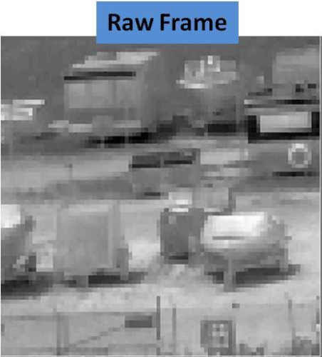
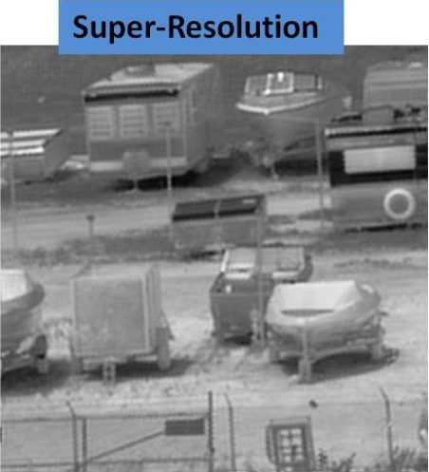


Super Resolution

Slide 4
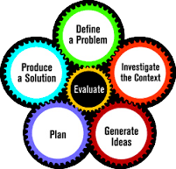
What need to implement?
Deep Learning
Android Module
Basic function
Extract PT File
Pytorch Android
Image Process, UI

Slide 5

Deep learning
SR GAN
Super Resolution Model
Extract .PT File
Saved Pretrained Weight
with Pytorch

Slide 6
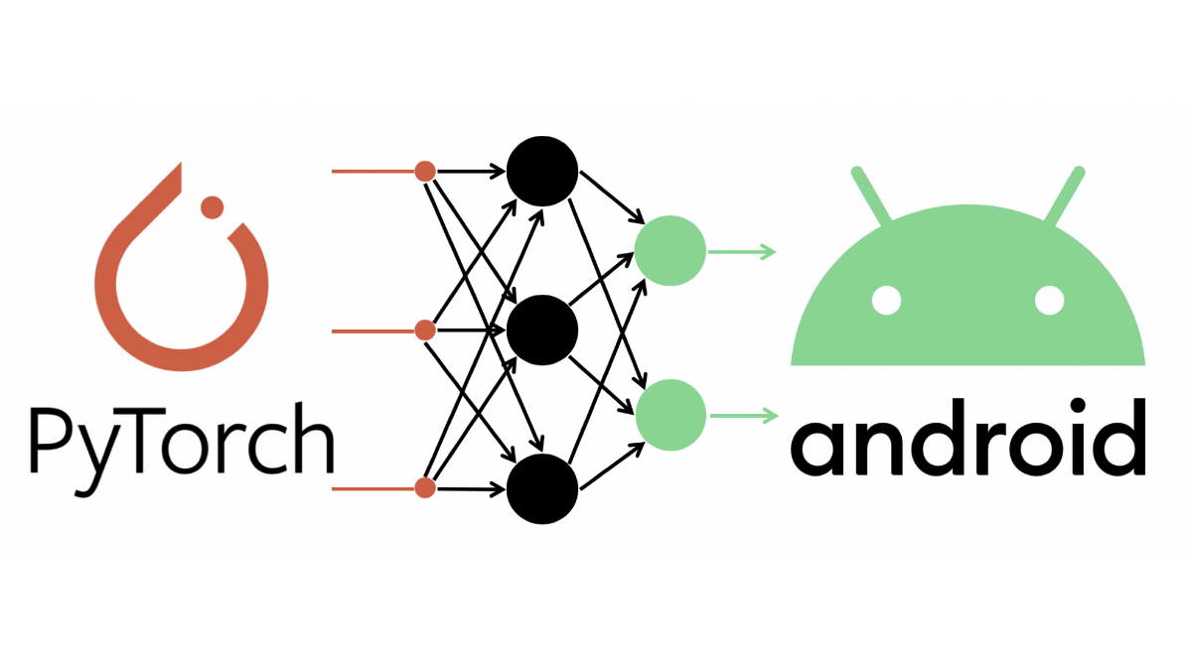
Android module
Pytorch Android
Support Android Studio
Run Pretrained Model in Android

Slide 7




scalability on development
Size Control
Sharing In SNS
Virtualization
New Transformation

Slide 8
Schedule
Final presentation:
7/3
Planning & role sharing
Prototype
Part Implementation
Edit wiki
Debugging
~ 4/22
~5/21
~6/18
~7/2

Slide 9




roles
Kim Jeongmin
Lee Chaehyeon
Deep Learning
Manage Modules
Manage Github
Apply Modules
Jang Hwijun
Seo Dongik
Control a function
Mobile UI

Slide 10
Q&A?

