Slide 1
Python Exceptions
Yinuo Guo
2.24

Slide 2
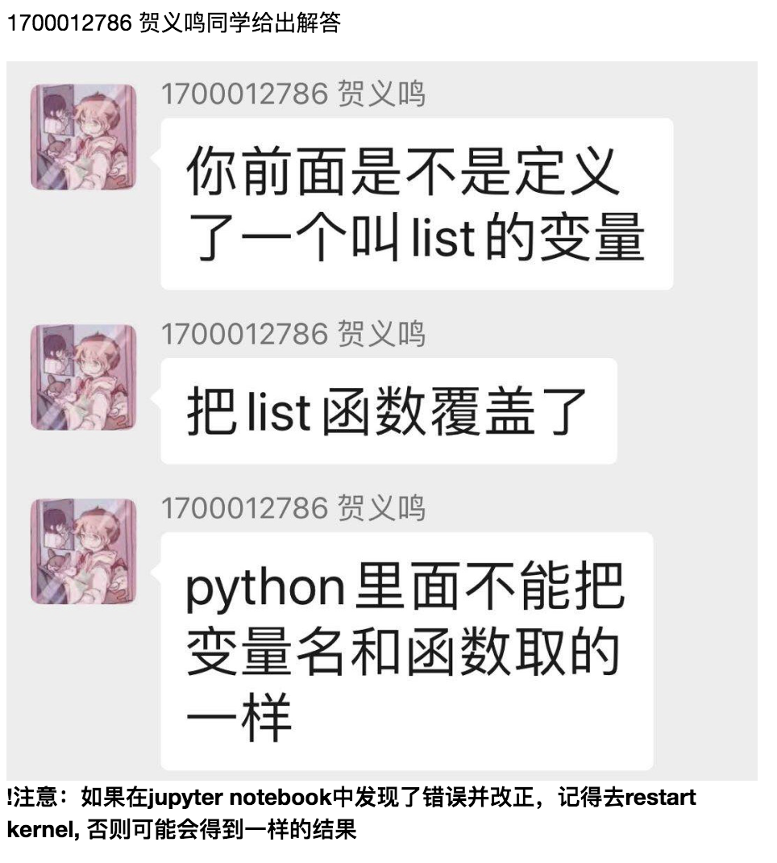
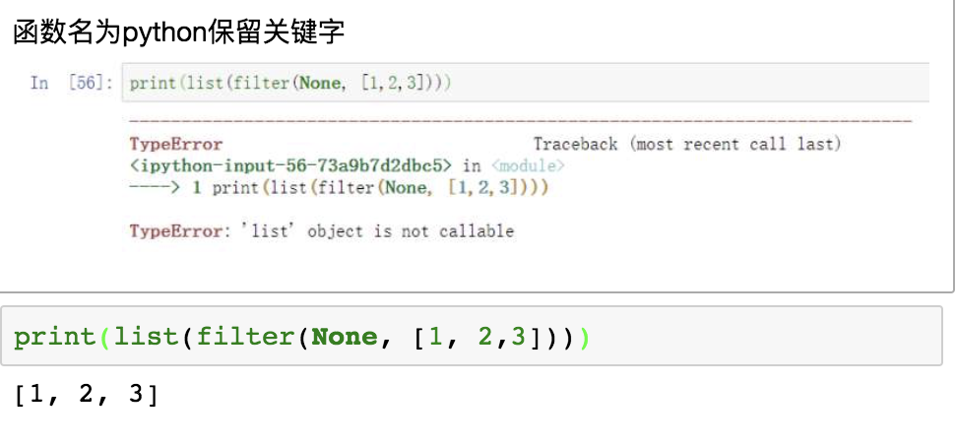
微信群问题
鼓励大家有问题在群里提出，助教和老师会帮大家解答，同时大家也能共同学习

Slide 3
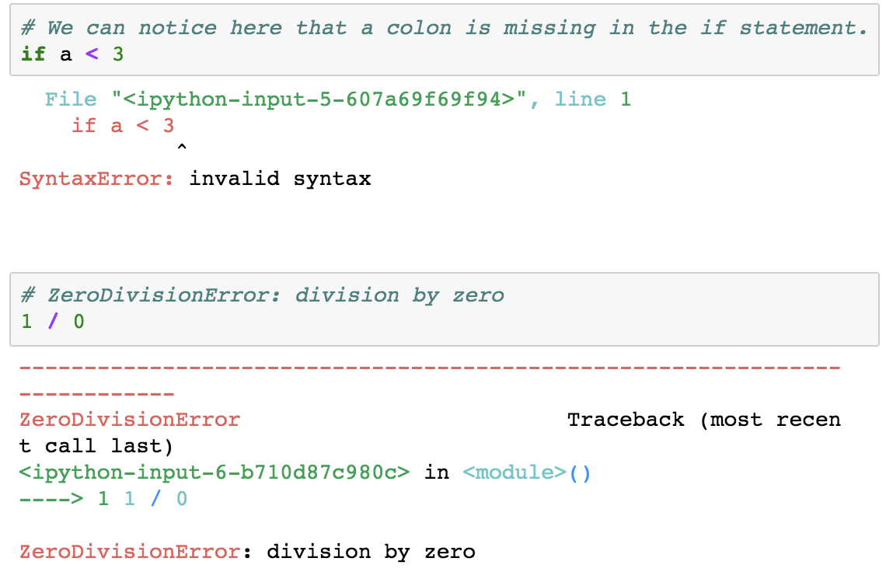
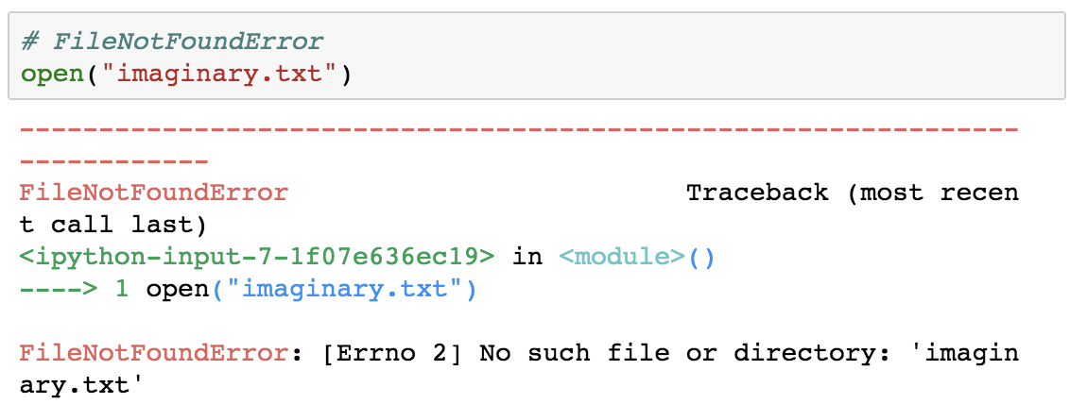
Examples

Slide 4
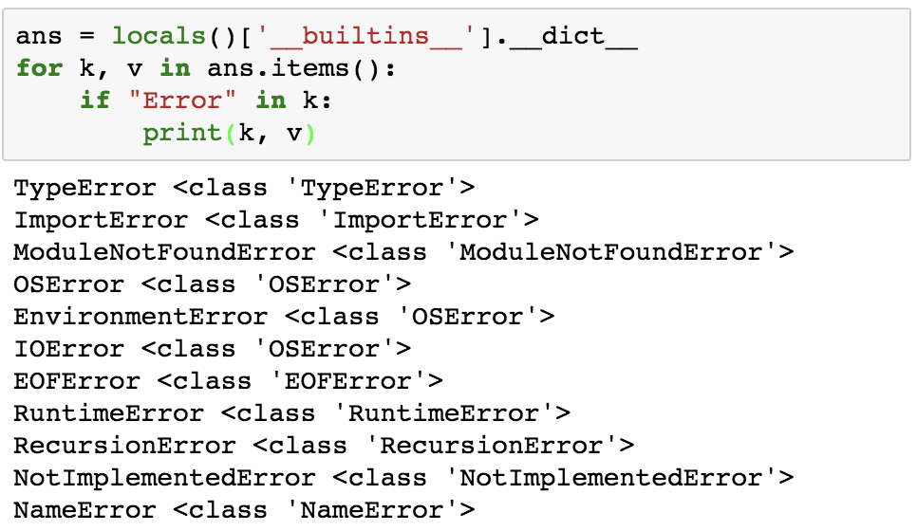
Python Built-in Exceptions
Illegal operations can raise exceptions. There are plenty of built-in exceptions in Python that are raised when corresponding errors occur. We can view all the built-in exceptions using the local() built-in functions as follows.
非法操作会引发异常。当发生相应的错误时，Python中会引发许多内置异常。我们可以使用local（）内置函数来查看所有内置异常，如下所示。

Slide 5
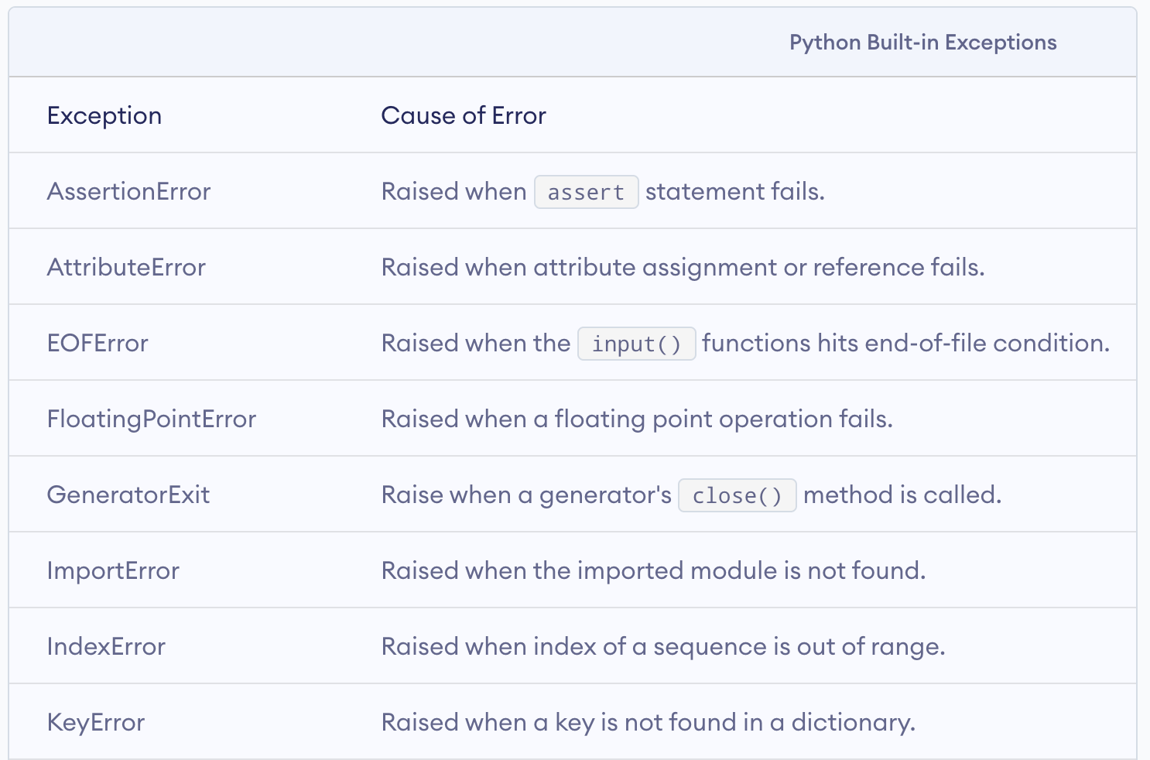

Slide 6
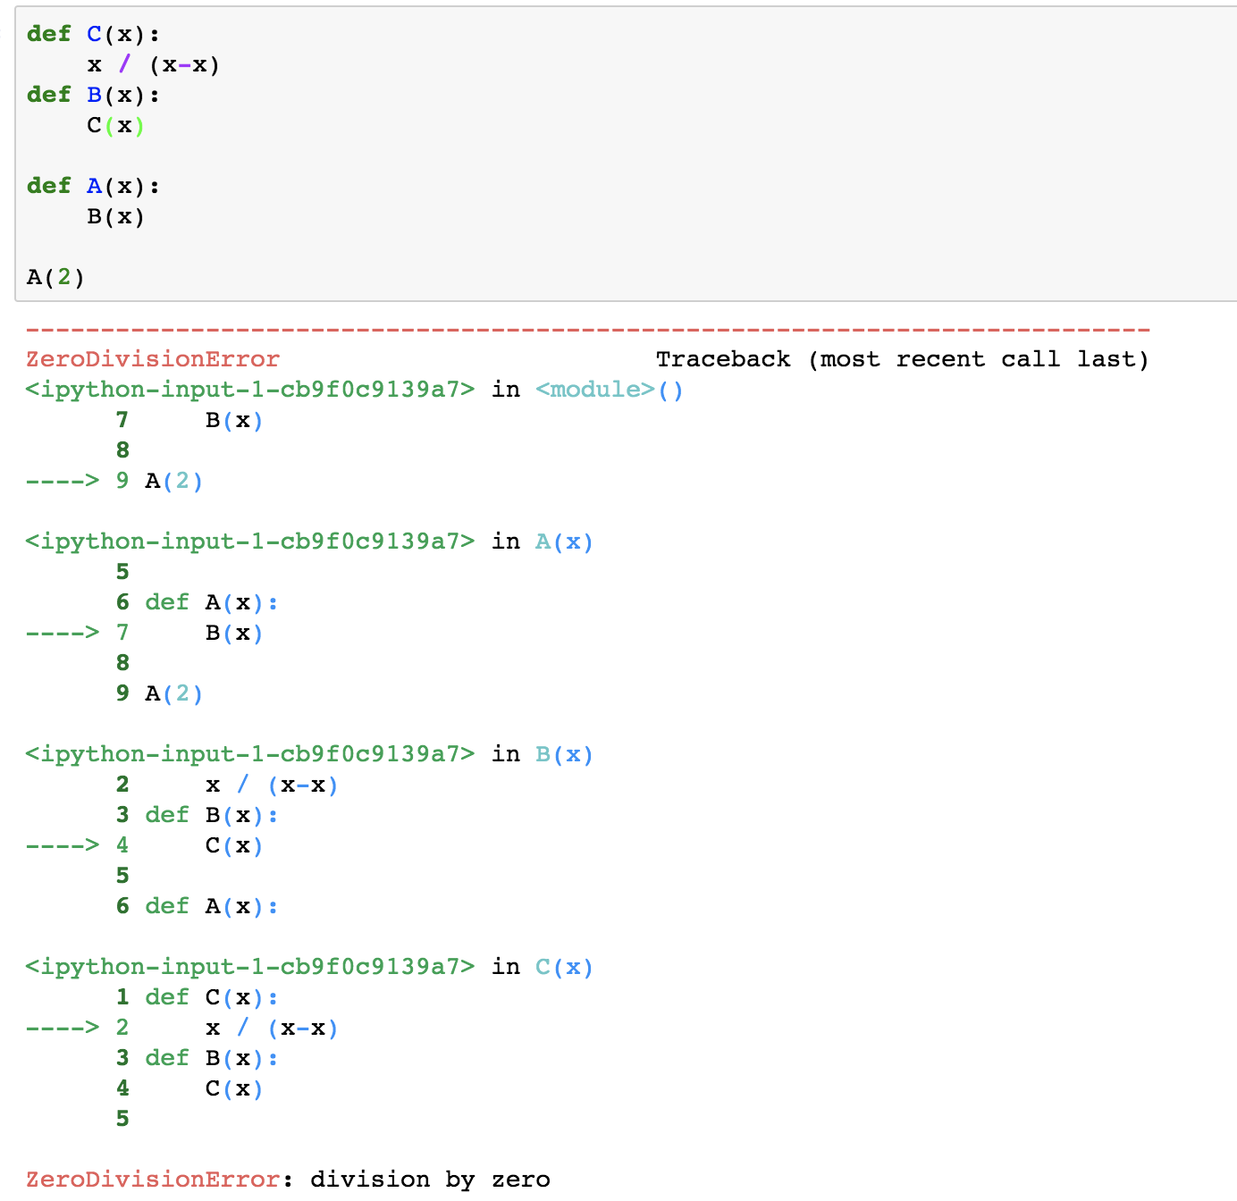
Python Exception Handling
When these exceptions occur, it causes the current process to stop and passes it to the calling process until it is handled.
当有异常出现时，它会使当前的进程停止，并且将异常传递给调用进程，直到异常被处理为止。
For example, if function A calls function B which in turn calls function C and an exception occurs in function C. If it is not handled in C, the exception passes to B and then to A.

Slide 7
Catching Exceptions in Python
In Python, exceptions can be handled using a try statement.
在Python中，可以使用try语句处理异常。
A critical operation which can raise exception is placed inside the try clause and the code that handles exception is written in except clause.
可能引发异常的关键操作放在try子句中，并且将处理异常的代码编写在except子句中。
If no exception occurs, except block is skipped and normal flow continues. But if any exception occurs, it is caught by the except block
如果没有异常发生，则跳过Except的内容，并继续正常流程。但是，如果发生任何异常，它将被Except捕获

Slide 8
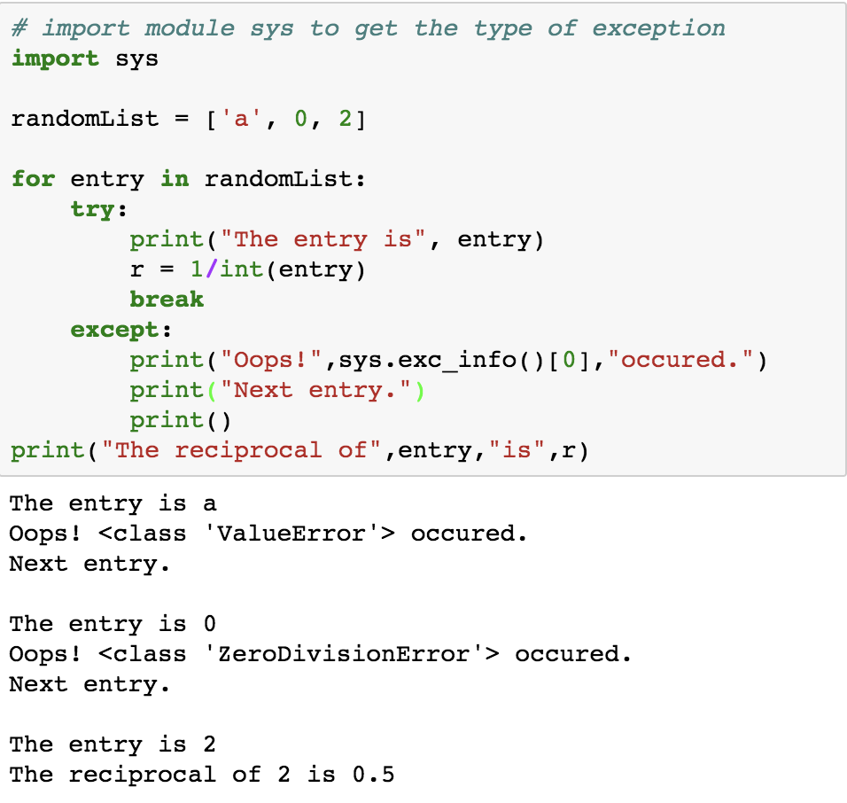
Catching Exceptions in Python

Slide 9
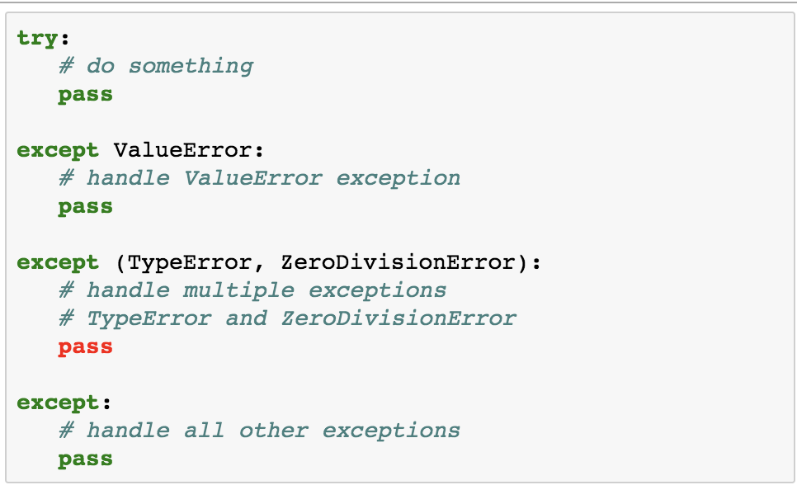
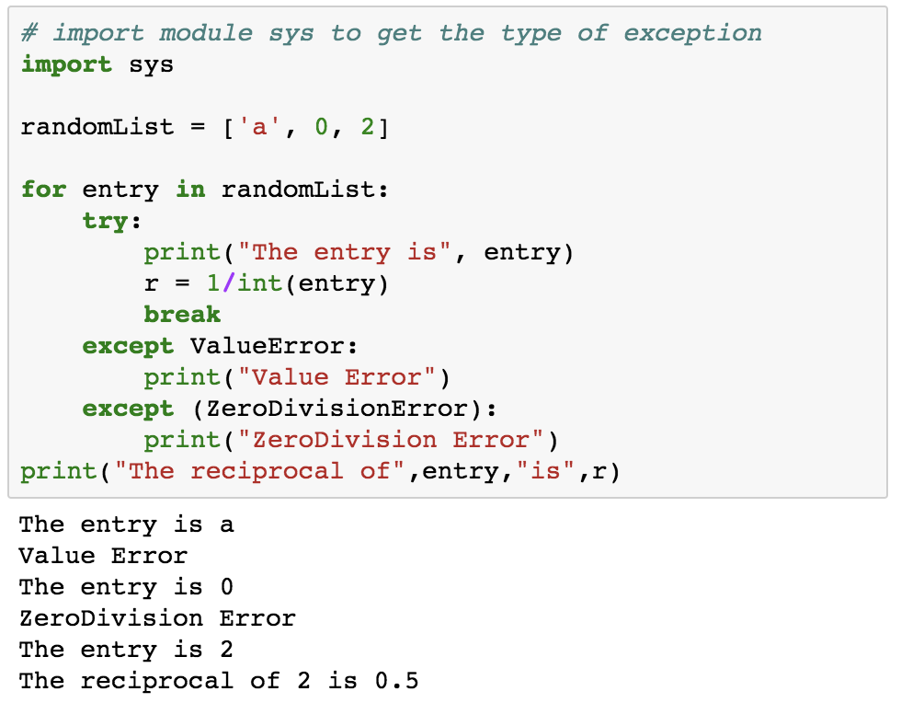
Catching Specific Exceptions in Python

Slide 10
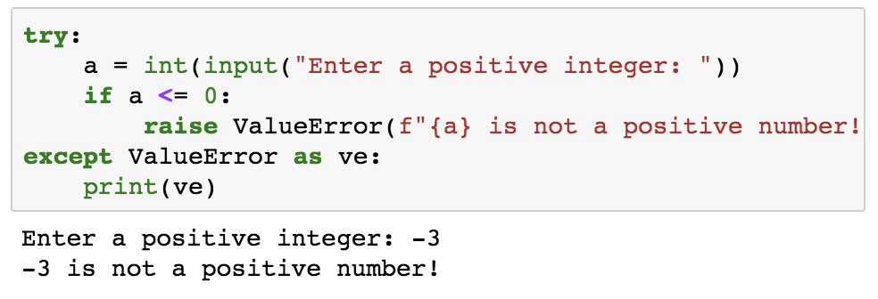
Rasing Exceptions
触发异常
In Python programming, exceptions are raised when corresponding errors occur at run time, but we can forcefully raise it using the keyword raise.
在Python编程中，当运行时发生相应的错误时会引发异常，但是我们可以使用关键字raise强制引发它。
We can also optionally pass in value to the exception to clarify why that exception was raised.
我们还可以选择将值传递给异常，以阐明引发该异常的原因。

Slide 11
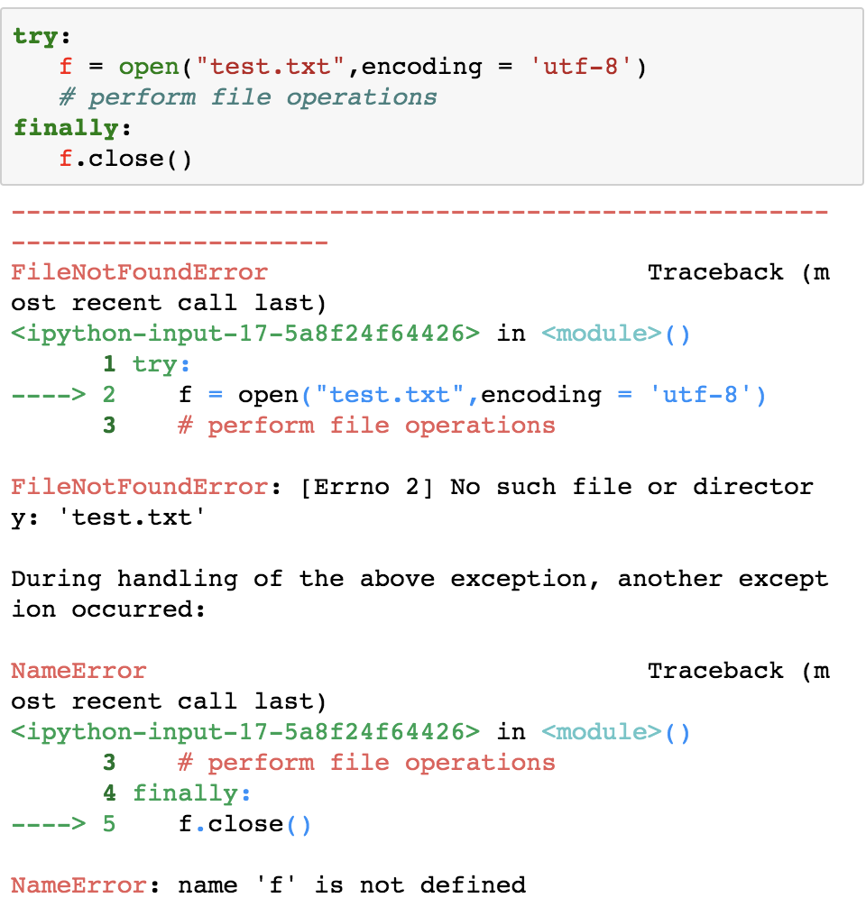
Try…finally语句
The try statement in Python can have an optional finally clause. This clause is executed no matter what, and is generally used to release external resources.
Python中的try语句可以有一个可选的finally子句。该子句无论如何执行，通常用于释放外部资源。
For example, we may be connected to a remote data center through the network or working with a file or working with a Graphical User Interface (GUI).
例如，我们可能通过网络或使用文件或使用图形用户界面（GUI）连接到远程数据中心。
In all these circumstances, we must clean up the resource once used, whether it was successful or not. These actions (closing a file, GUI or disconnecting from network) are performed in the finally clause to guarantee execution.
在所有这些情况下，无论资源是否成功，我们都必须清除该资源。这些操作（关闭文件，GUI或与网络断开连接）在finally子句中执行，以确保执行

Slide 12
Reference
https://www.programiz.com/python-programming/exception-handling

