Slide 1

Classifying : Microsoft Cybersecurity Incident
With Machine Learning
By
Gengatharan L

Slide 2
Problem Statement
As a data scientist at Microsoft, he/she is tasked with enhancing the efficiency of Security Operation Centers (SOCs) by developing a machine learning model that can accurately predict the triage grade of cybersecurity incidents.
Utilizing the comprehensive GUIDE dataset, the goal is to create a classification model that categorizes incidents as true positive (TP), benign positive (BP), or false positive (FP) based on historical evidence and customer responses.
The model should be robust enough to support guided response systems in providing SOC analysts with precise, context-rich recommendations, ultimately improving the overall security posture of enterprise environments.

Slide 3
Business Use Cases
The solution developed in this project can be implemented in various business scenarios, particularly in the field of cybersecurity. Some potential applications include:
Security Operation Centers (SOCs): Automating the triage process by accurately classifying cybersecurity incidents, thereby allowing SOC analysts to prioritize their efforts and respond to critical threats more efficiently.
Incident Response Automation: Enabling guided response systems to automatically suggest appropriate actions for different types of incidents, leading to quicker mitigation of potential threats.
Threat Intelligence: Enhancing threat detection capabilities by incorporating historical evidence and customer responses into the triage process, which can lead to more accurate identification of true and false positives.
Enterprise Security Management: Improving the overall security posture of enterprise environments by reducing the number of false positives and ensuring that true threats are addressed promptly.

Slide 4
Dataset Overview
The GUIDE dataset consists of over 13 million pieces of evidence across three hierarchical levels:
1. Evidence: Individual data points supporting an alert (e.g., IP addresses, user details).
2. Alert: Aggregated evidences indicating potential security incidents.
3. Incident: A comprehensive narrative representing one or more alerts.
4. Size: Over 1 million annotated incidents with triage labels, and 26,000 incidents with remediation action labels.
5. Telemetry: Data from over 6,100 organizations, including 441 MITRE ATT&CK techniques.
6. Training/Testing: The dataset is divided into a training set (80%) and a test set (20%), ensuring stratified representation of triage grades and identifiers.

Slide 5
Model Benchmarking and Optimization
Benchmarking
The GUIDE dataset aims to establish standardized benchmarks for guided response systems:
- Primary Metric: Macro-F1 score for incident triage predictions.
- Secondary Metric: Precision and recall for remediation action predictions.
Privacy Considerations
To protect sensitive information, the dataset underwent a stringent anonymization process, including:
- Pseudo-anonymization: Sensitive values are hashed using SHA1 to maintain uniqueness without revealing identities.
- Random ID Replacement: Hashed values are replaced with randomly generated IDs.
- Temporal Noise: Timestamps are modified to prevent re-identification.

Slide 6
Approach
Data Exploration and Understanding
Data Preprocessing
Exploratory Data Analysis (EDA)
Model Selection and Training
Model Evaluation and Tuning
Final Evaluation on Test Set
Final Results and Model Performance Analysis

Slide 7
Data Exploration and Understanding
Initial Inspection
- Loaded the `GUIDE_train.csv` and 'GUIDE_test.csv' dataset and performed an initial inspection to understand the structure of the data, including the number of features, types of variables (categorical, numerical), and the distribution of the target variable (TP, BP, FP).
- Train Dataset contained - rows x columns (9516837, 45)
- Test Dataset contained - rows x columns (4147992 x 46)
- one extra column called usage(Public or Private, which won't be utilized as it isn't in our train data)

Slide 8
Preprocessing
Handling Missing Data and Duplicates:
Identified missing values and dropped columns where missing values were more than 50% of the total rows. Duplicates were removed as well. Conversion of datatypes, for example string time to datetime done as well.
Feature Engineering:
Created new features or modified existing ones to improve model performance.
Entails the creation and selection of features that significantly contribute to the classification task. This includes transforming raw data into meaningful features, encoding categorical variables, and scaling numerical values to improve model performance.

Slide 9
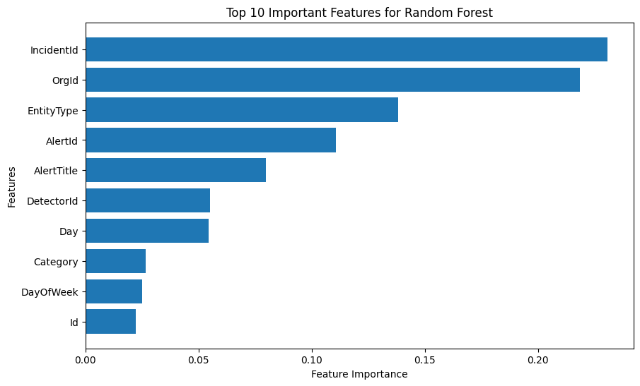
Exploratory Data Analysis
Importance & Misclassified Features:
Used visualizations and statistical summaries to identify patterns, correlations, and potential anomalies in the data.
Removing one of the columns where pairs are highly correlated and duplicates to avoid multicollinearity

Slide 10
Model Selection and Training
Machine Learning Models:
Experimented with more sophisticated models such as Random Forests, Gradient Boosting Machines (e.g., XGBoost or LightGBM).
Each model was tuned using techniques like grid search or random search over hyperparameters.
Train-Validation Split:
Before diving into model training, split the `train.csv` data into training and validation sets. This allowed for tuning and evaluating the model before final testing on `test.csv`.
A typical 70-30 or 80-20 split was used, varying depending on the dataset size.

Slide 11
Model Selection and Training
Encoding Categorical Variables: Converted categorical features into numerical representations using techniques like one-hot encoding or label encoding depending on the nature of the feature and its relationship with the target variable.
Stratification: Can use stratified sampling to ensure that both the training and validation sets had similar class distributions, especially since the target variable was imbalanced. But in this case we can attempt to proceed with as is at Random Forest and XGBoost are well equipped with dealing with imbalance data and it also represents real world scenario. We can look into other methods after testing this way and evaluating it's metrics.

Slide 12
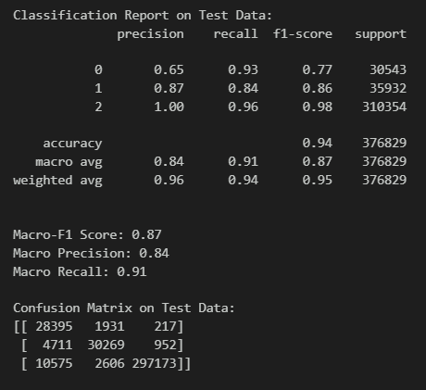
Final Results (Test Dataset)

