Slide 1
DVD Rental Using Deep Learning with AWS deployment
By
Gengatharan L

Slide 2
Problem Statement
Predict customer behavior in a DVD rental business, specifically focusing on customer churn, movie genre preferences, and rental demand forecasting. The objective is to use deep learning techniques to create models that can assist in decision-making, marketing strategies, and personalized customer recommendations.
Business Use Cases:
• Customer Churn Prediction: Identify customers likely to churn so proactive retention strategies can be applied.
• Movie Genre Preference Prediction: Recommend personalized movie genres to customers based on past rental behavior.
• Rental Demand Forecasting: Predict future rental demand to optimize stock and inventory planning at DVD rental stores.

Slide 3
Approach
Data Understanding & Preprocessing:
Collect and preprocess data from the DVD rental dataset.
Handle missing values, normalize numerical data, and encode categorical data.
Exploratory Data Analysis (EDA):
Conduct data exploration to understand the relationships between variables, using visualizations like histograms, box plots, and correlation matrices.
Feature Engineering:
Generate useful features from customer demographics, rental history, movie genres, and other transactional data.

Slide 4
Approach
Model Development:
Build an Artificial Neural Network (ANN) to predict customer churn (classification task).
Build a multi-class classification model for genre prediction.
Use RNN/LSTM models for rental demand forecasting (time-series analysis).
Model Evaluation:
Evaluate models using appropriate metrics such as accuracy, precision, recall, F1-score, and RMSE for regression tasks.
Deployment:
Deploy the best-performing model using AWS and integrate it with a streamlit application for interactive use.

Slide 5
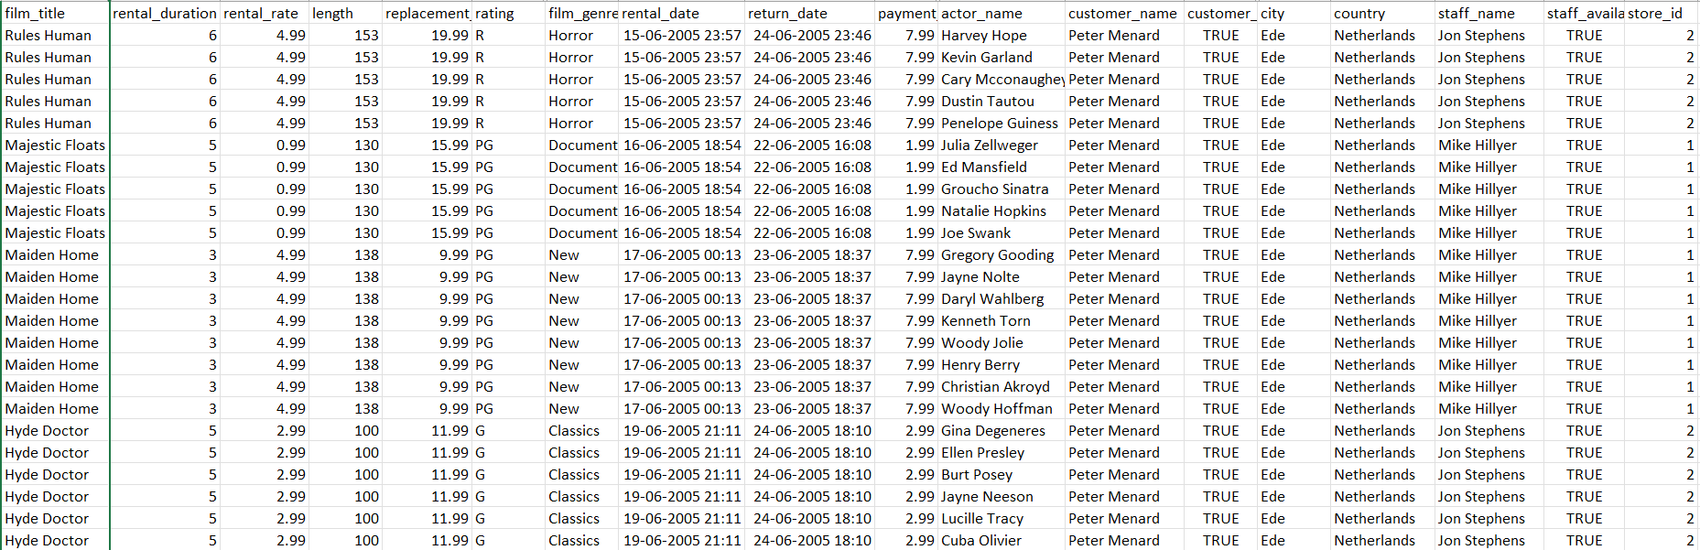
Data Cleaning and Preparation
Connecting tables using postgresql query:
Joined 15 tables based on the primary key from one tables to another and retrieve the relevant information like film, rental, customer, payment, store and staff details etc.

Slide 6
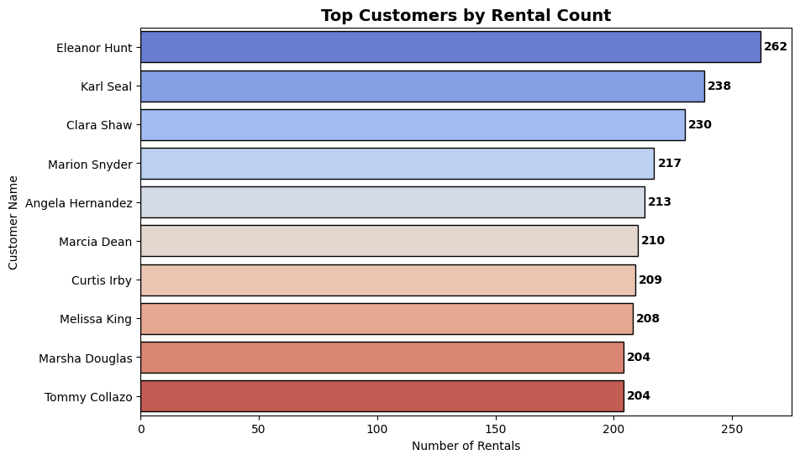
Customer Analysis
Customer-wise rental count:
Eleanor Hunt leads with 262 rentals, followed by Karl Seal (238), Clara Shaw (230), and others with similar high rental counts.

Slide 7
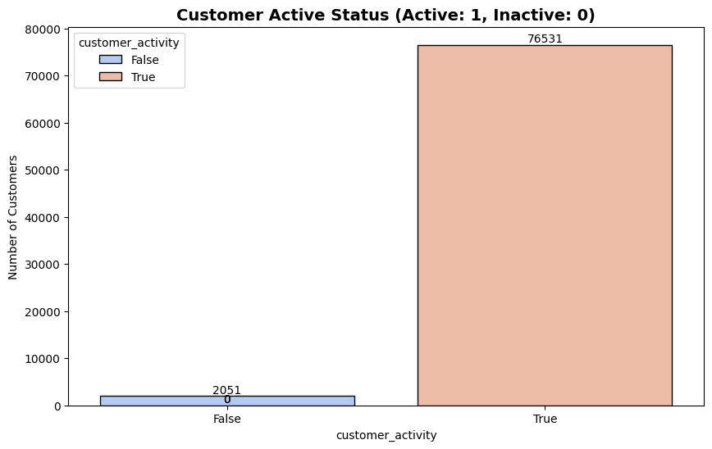
Customer Analysis
Customer Active Status:
The bar chart displays the Customer Active Status, where customers are categorized as active or non-active:
Active customers (True): 76,531 customers
Non-active customers (False): 2,051 customer
Result:
This means that the vast majority of customers (over 97%) are active, while only a small percentage are non-active.
The bar heights clearly emphasize the significant difference in the number of active vs. inactive customers.

Slide 8
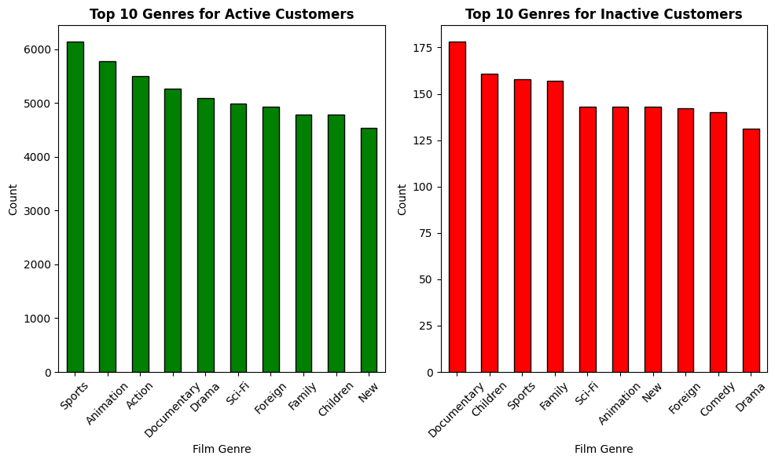
Customer Analysis
Film genres preferred by active and inactive customers:

Slide 9
Customer Analysis
The bar charts compare the top 10 film genres preferred by active and inactive customers:
Active Customers (left chart, green bars):
Sports is the most popular genre with over 6,000 rentals.
Animation and Action follow, with close to 5,500 and 5,000 rentals respectively.
Other notable genres include Documentary, Drama, and Sci-Fi.
Non-Active Customers (right chart, red bars):
Documentary is the top genre, with around 175 rentals.
Children, Sports, and Family are also common preferences.
Genres like Sci-Fi, Animation, and Comedy are also among the top choices for non-active customers.
This comparison shows different genre preferences, with Sports dominating among active customers and Documentary leading among non-active customers.

Slide 10
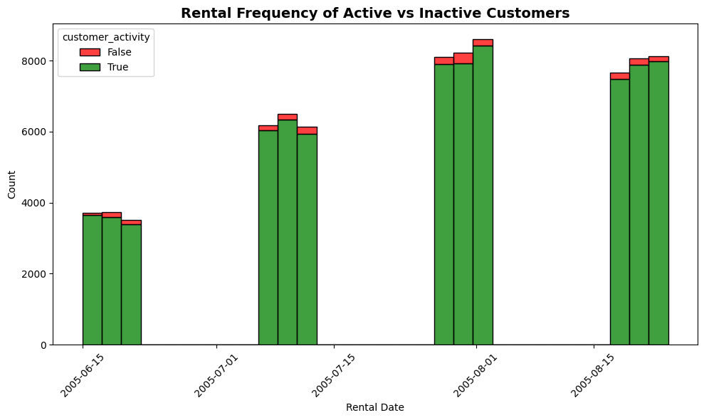
Customer Analysis

Slide 11
Customer Analysis
The stacked bar chart displays the rental frequency of both active and inactive customers over specific rental dates:
Active Customers (green bars) make up the majority of the rentals across all dates.
Inactive Customers (red bars) have consistently lower rental frequencies in comparison, contributing only a small portion to the overall count.
Peaks in rental activity occur around July 1st, July 15th, August 1st, and August 15th, 2005, where both active and inactive customers rented the most.
The data suggests that active customers dominate the rental activity, while inactive customers represent a smaller fraction, with the highest total rentals observed in early August 2005.

Slide 12
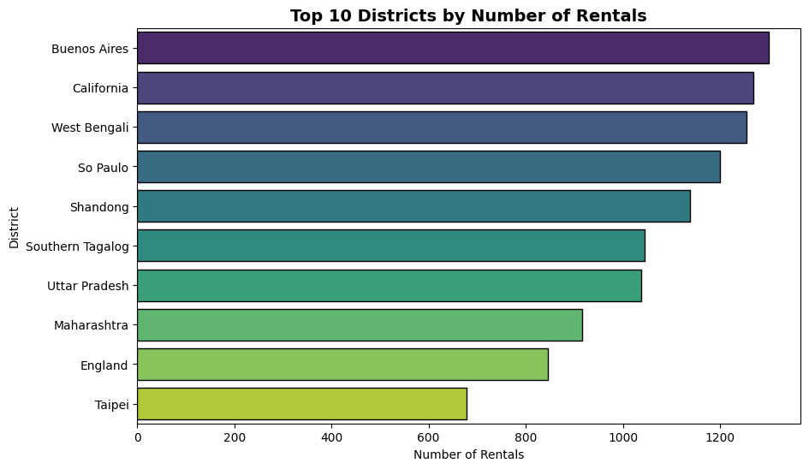
Geographical Analysis
Rental Counts by District:
Buenos Aires has the highest count (1,301 rentals), followed by California (1,268), West Bengali (1,254), and So Paulo (1,200).

Slide 13
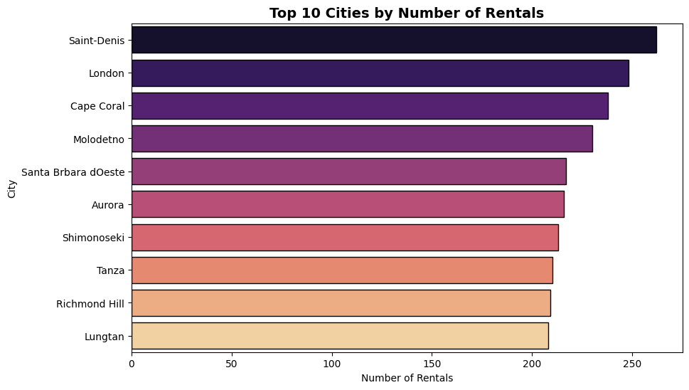
Geographical Analysis
Rental Counts by City:
Saint-Denis has the most rentals (262), followed by London (248) and Cape Coral (238).

Slide 14
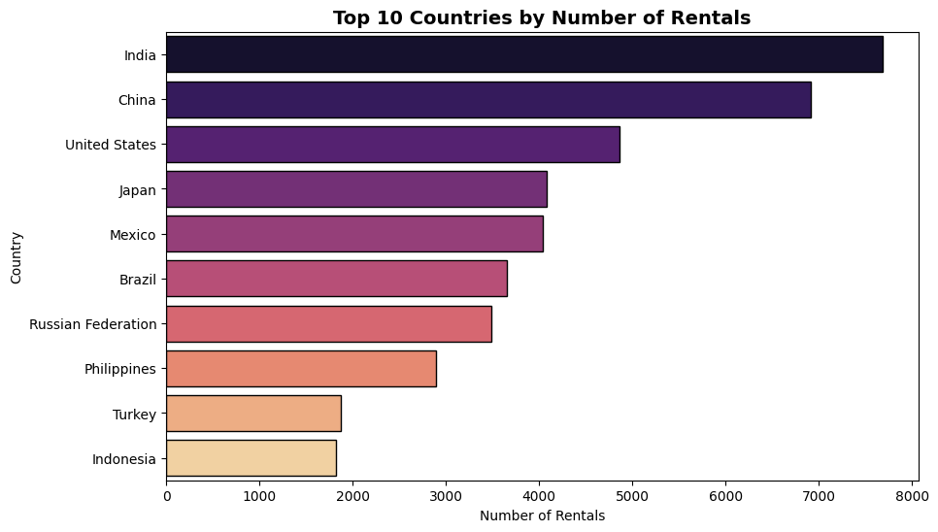
Geographical Analysis
Rental Counts by Country:
India leads with 7,686 rentals, followed by China (6,917), and the United States (4,866).

Slide 15
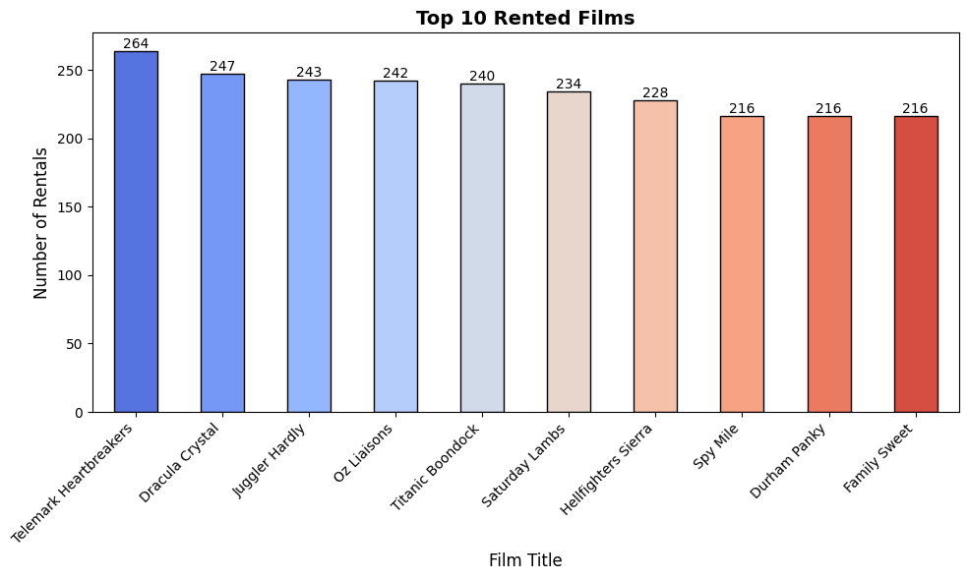
Rental Analysis
Most Rented film with rental count:
"Telemark Heartbreakers" with 264 rentals, followed by "Dracula Crystal" at 247. Other popular titles include "Juggler Hardly" and "Titanic Boondock," all with over 200 rentals.

Slide 16
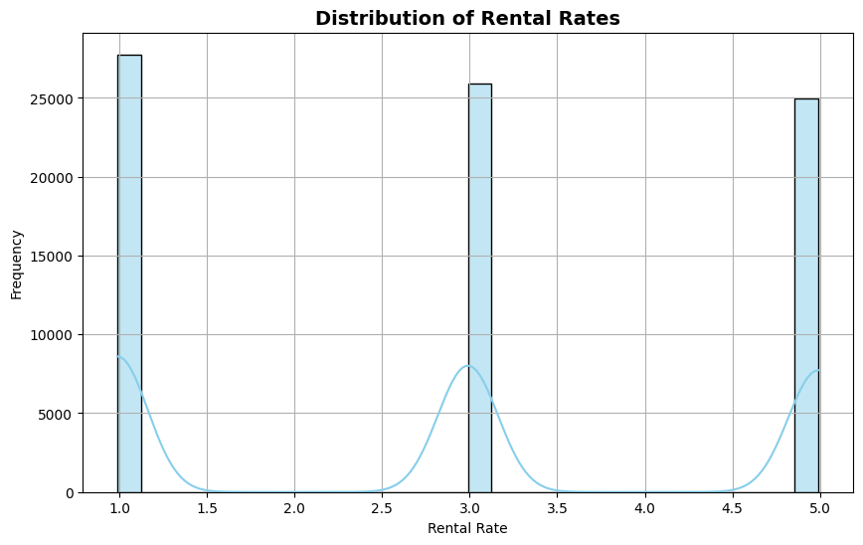
Rental Analysis
Rental Rates with Counts:
Rentals at $0.99 dominate with 27,759 rentals, followed by $2.99 (25,886) and $4.99 (24,937).

Slide 17
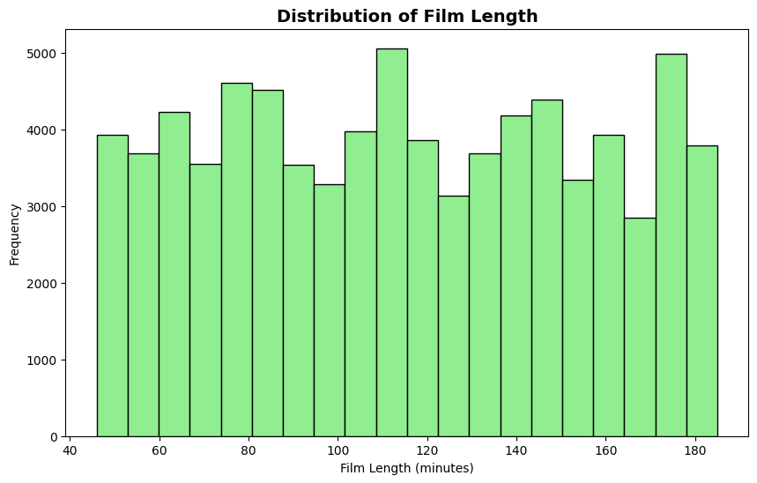
Rental Analysis
Film Length Groups:
Most films are either long (>180 min) with 36,477 rentals, medium (60-120 min) with 34,483 rentals and short (<60 minutes ) with 7,622 rentals.

Slide 18
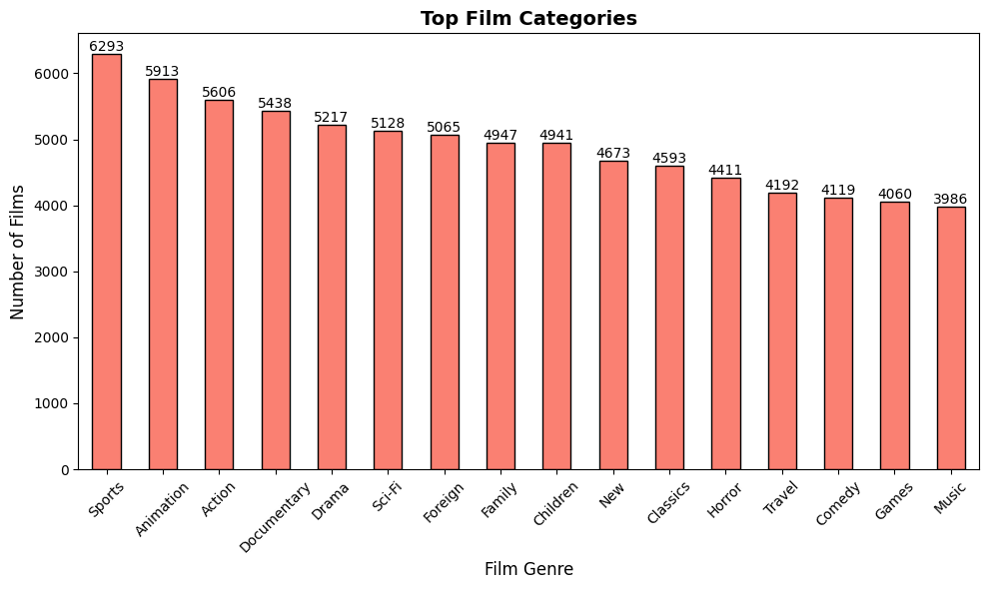
Rental Analysis
Top Rented Film Genres:
Sports leads the list with 6,293 rentals, followed by Animation and Action with 5,913 and 5,606 rentals, respectively. Other popular genres include Documentary, Drama, and Sci-Fi, all exceeding 5,000 rentals, while genres like Music and Games round out the list with nearly 4,000 rentals.

Slide 19
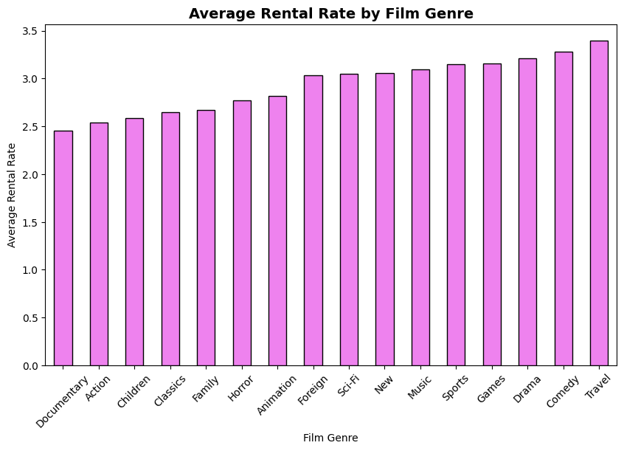
Rental Analysis
Average Rental Rate by Film Genre:
Documentary films have an average rate of $2.45, while genres like Comedy ($3.28) and Travel ($3.39) have higher averages.

Slide 20
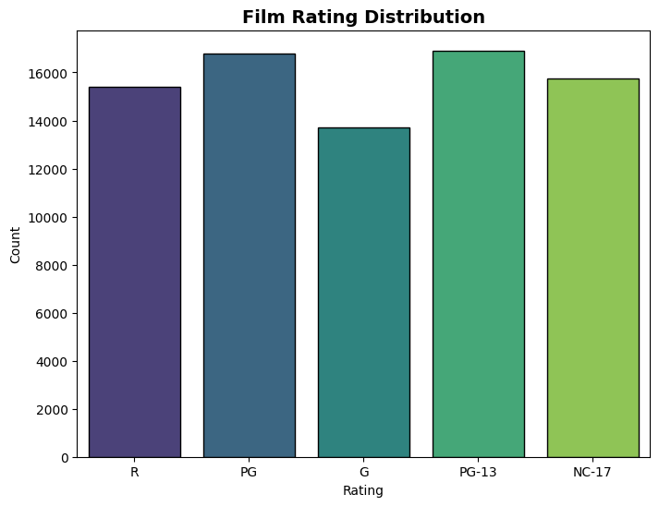
Rental Analysis
Film Ratings with Counts:
The film ratings will be categorized into five groups: R, PG, G, PG-13, and NC-17.

Slide 21
Rental Analysis
Film Ratings with Counts:
PG-13 (16,914 films): Most common rating, appealing to teens and adults, indicating a strong market for content suitable for older children and teenagers.
PG (16,779 films): Close in count to PG-13, reflecting a significant number of family-friendly films aimed at younger audiences.
NC-17 (15,768 films): Represents mature content, with a notable number of films targeting adult viewers, though less common than PG and PG-13.
R (15,403 films): Slightly less common, indicating films intended for mature audiences, often featuring more intense themes or content.
G (13,718 films): The least common rating, suggesting a smaller market for content strictly suitable for children.
Overall, the data indicates a preference for ratings that appeal to a broader audience, particularly in the PG-13 and PG categories, while there is room for growth in the G and R categories.

Slide 22
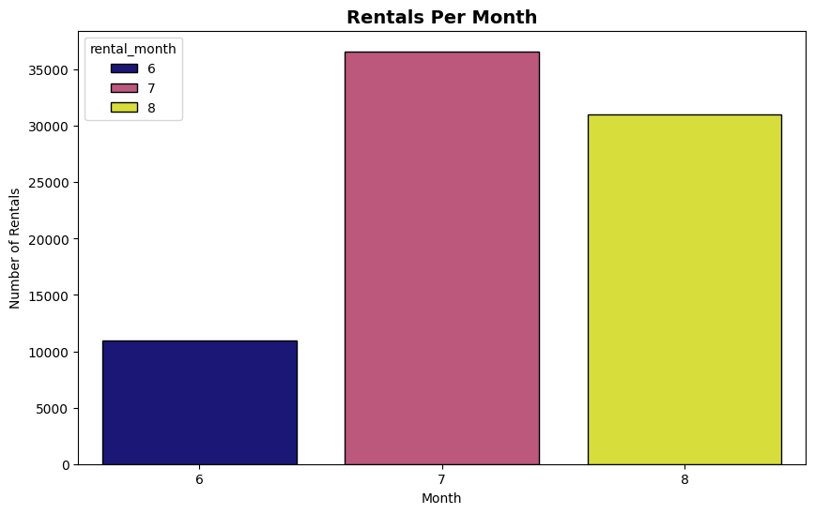
Time-series Analysis
Rental count by month:
In July, rentals peaked at 36,618, significantly higher than June's 10,969 and August's 30,995. This indicates a strong seasonal trend, with July being the most popular month for rentals.

Slide 23
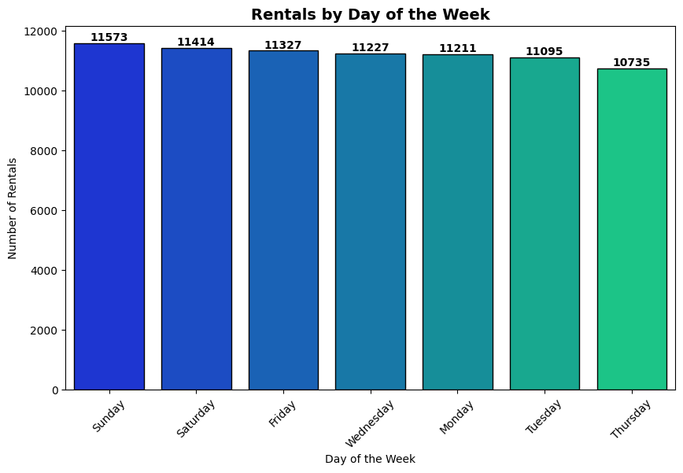
Time-series Analysis
Rental count by day of week:
The highest rental counts occurred on Sunday (11,573) and Saturday (11,414), followed closely by Friday (11,327). Rentals tend to decline midweek, with Thursday showing the lowest count at 10,735.

Slide 24
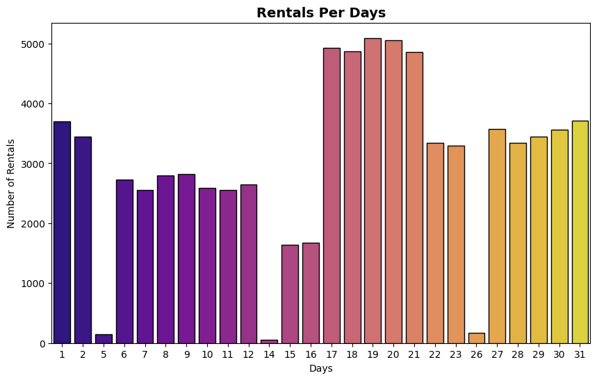
Time-series Analysis
Rental count by day:
The rental count varied significantly across the month, with notable peaks on the 17th (4,927), 19th (5,092), and 20th (5,059), indicating higher demand during mid-month. In contrast, rental counts were lowest on the 14th (54) and 26th (171), suggesting less activity on those days.

Slide 25
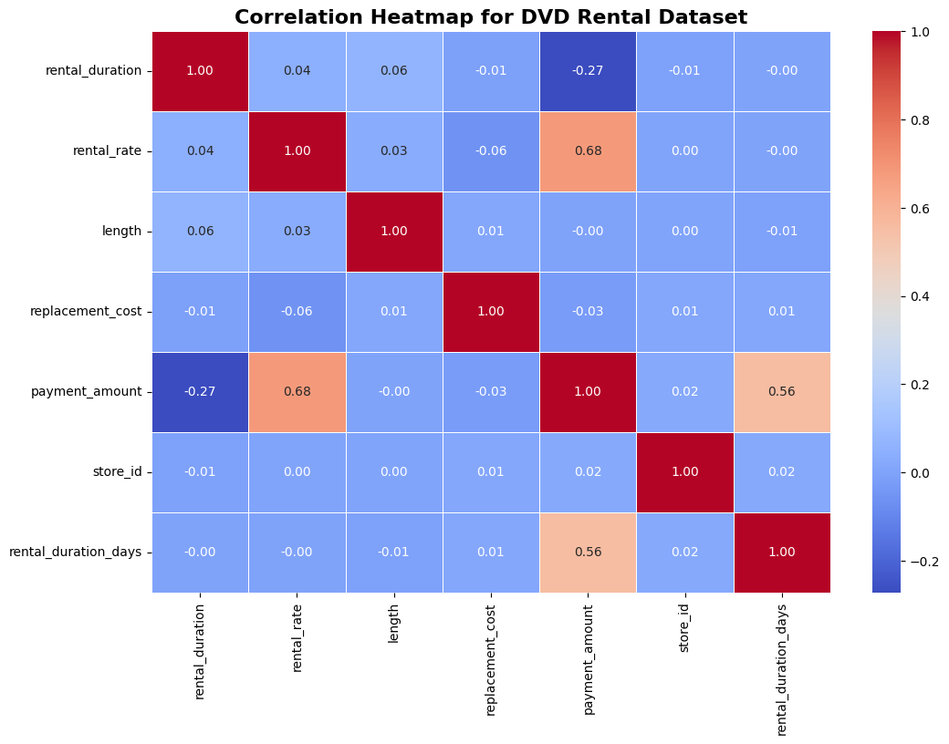
Correlation Analysis
Heatmap:
The heatmap reveals that payment_amount has a moderate positive correlation with both rental_rate (0.68) and rental_duration_days (0.56), suggesting higher payments with higher rates and longer rentals. Other variable pairs show weak correlations, indicating limited relationships among them.

Slide 26
Customer churn prediction
Predict_churn = {
"model_name": "churn",
"target": "active",
"features": [
"country_id",
"category_id",
"store_id",
"staff_id",
"amount",
"return_delay"
]
Overview:
Build an Artificial Neural Network (ANN) to predict customer churn (classification task).
Identify customers likely to churn so proactive retention strategies can be applied.
Data Fetching:
The data is retrieved from a SQL database using predefined queries. This data includes customer-related metrics, rental details, payment amounts, and other relevant features like store and staff details.
Data Preparation:
The target variable (customer.active) is defined, and features are separated.
The data is converted into NumPy arrays, and a train-test split is performed (80% training, 20% testing) with stratification based on the target.
Feature Scaling:
Features are standardized using StandardScaler to improve model performance and convergence during training.

Slide 27
Customer churn prediction
Model Architecture:
A Sequential neural network model is constructed with:
Two hidden layers (with Leaky ReLU activation) and Dropout layers to prevent overfitting.
An output layer using a sigmoid activation function suitable for binary classification.
Model Compilation and Training:
The model is compiled with the Adam optimizer and binary cross-entropy loss.
It is trained for 10 epochs with a batch size of 32, and validation is performed on a subset of the training data.
Model Evaluation:
After training, predictions are made on the test data.
Performance metrics (accuracy, F1 score, precision, recall) are calculated to evaluate the model’s predictive capability.
Data Encoding:
Encoding dictionaries are created for categorical variables like category_id, country_id and staff_id which will be useful for interpreting model predictions.
Model Saving:
The trained model, along with the scaler, feature names, and encoding mappings, is saved for future use. This includes a function to interpret predictions about customer churn.

Slide 28
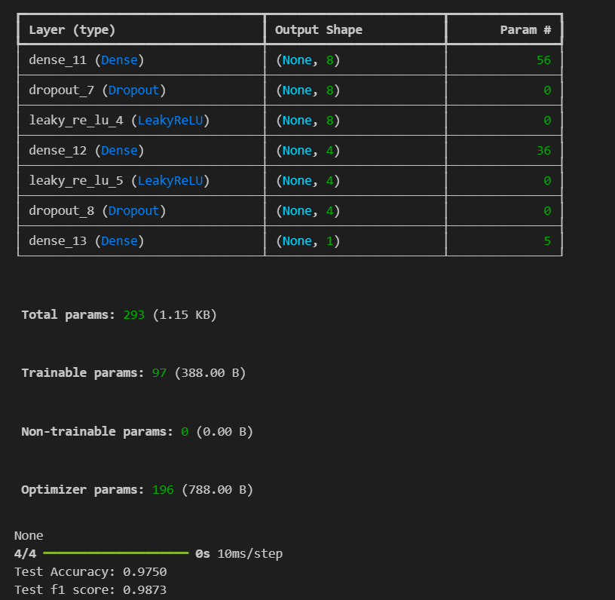
Customer churn prediction
Model Architecture (Final Report):

Slide 29
Predict_genre = {
"model_name": "genre",
"target": "category_id",
"features": [
"staff_id",
"store_id",
"city_id",
"rental_day",
"rental_month"
]
}
Film Genre prediction
Overview:
Build an Artificial Neural Network (ANN) to predict film genre.
Predict customer movie genre preferences with a multi-class classification.
Recommend personalized movie genres to customers based on past rental behavior.
Data Fetching:
The data is retrieved from a SQL database using predefined queries. This data includes customer-related metrics, rental details, payment amounts, and other relevant features like store and staff details.
Data Preparation:
The target variable (film.category_id) is defined, and features are separated.
The data is converted into NumPy arrays, and a train-test split is performed (80% training, 20% testing) with stratification based on the target.
Feature Scaling:
Features are standardized using StandardScaler to improve model performance and convergence during training.

Slide 30
Film Genre prediction
Data Encoding:
Target Encoding: The genre (film_category_id) column is encoded using LabelEncoder.
Categorical Encoding: Categorical variables (e.g., rating) are one-hot encoded.
Train-Test Split:
The dataset is split into training (80%) and testing (20%) sets using stratified sampling to maintain class distribution.
Neural Network Model Development:
A Sequential model is created with several Dense layers using ReLU activation function.
The output layer employs a softmax activation function for multi-class classification.
The model is compiled using Adam optimizer and sparse categorical cross-entropy loss function.
Model Training:
Early stopping is implemented to prevent overfitting, monitoring validation loss.
The model is trained for 30 epochs with a batch size of 32.
Model Evaluation:
The model is evaluated on the test set, yielding a test accuracy score.
Predictions are made, followed by a classification report and confusion matrix visualized using Seaborn.

Slide 31
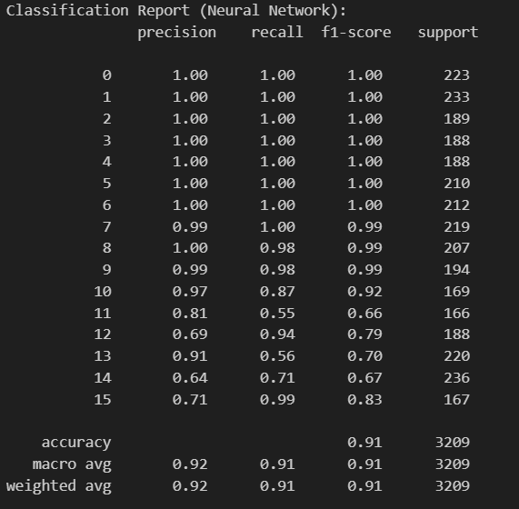
Film Genre prediction
Final Result:

Slide 32
Rental Demand Forecasting
Data Retrieval:
The SQL query retrieves rental counts per day and per store for a specified year.
Data Preprocessing:
Converts rental dates to datetime objects.
Pivots the DataFrame to create a matrix where each column represents a store's rental counts.
Fills any missing values with zeros and scales the data to a range of [0, 1] using MinMaxScaler.
Sequence Creation:
Creates sequences of rental counts to feed into the LSTM model.
Model Building:
An LSTM model is constructed with two LSTM layers and a Dense output layer.
The model is compiled with Mean Absolute Error as the loss function.
Model Training and Predictions: The model is trained, and predictions are made for the test set. The inverse scaling is applied to the predictions.
Model Evaluation: Computes the MAE for the test predictions and prints it.

Slide 33
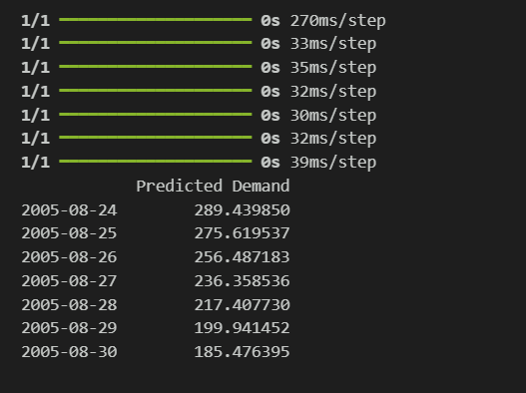
Rental Demand Forecasting
Future Demand Forecasting:
Predicts the rental demand for the next 7 days, using the last known rental counts as input for future predictions.

Slide 34
AWS Deployment using docker
Environment Setup: Start by installing the AWS CLI to interact with AWS services and Docker to build and test containerized applications locally.
Docker Image Creation: Build a Docker image for the application, packaging all code and dependencies. Running the container locally helps ensure everything functions as expected before deploying to AWS.
ECR Repository Creation: Set up an Elastic Container Registry (ECR) on AWS to store the Docker image. ECR provides a scalable, secure, and highly available repository for container images, which can be accessed by ECS.
Push Docker Image to ECR: After tagging the image, push it to the ECR repository for centralized storage and easy retrieval by ECS. This step makes the image securely available for deployment in AWS.
ECS Cluster Setup: Create an ECS cluster, a logical group of AWS resources where the containerized application will run. The cluster serves as the foundational environment for deploying and managing the application.
Task Definition Registration: Define the application’s task configuration, including CPU, memory, container image, and port settings. This task definition provides ECS with the details required to run containers effectively.
ECS Service Creation: Deploy the application by creating an ECS service, which ensures the desired number of task instances are running, providing automatic scaling, load balancing, and high availability.
Application Access: Finally, retrieve the public IP address from the ECS console under Task details to access the deployed application over the internet.

Slide 35
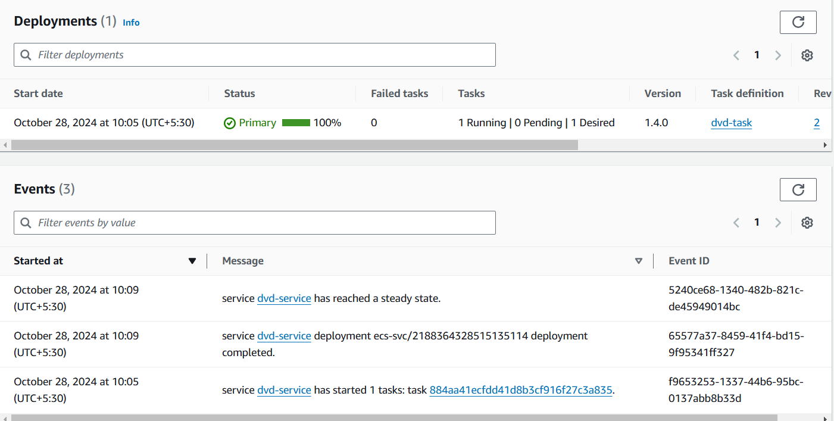
AWS Deployment
Deployment status:

Slide 36
THANK YOU

