Slide 1

Photo-Sketching:
Inferring Contour Drawings from Images^{[1]}
Xingchen Ming xingchen_ming@brown.edu
Ming Xu ming_xu1@brown.edu
Geng Yang geng_yang@brown.edu
[1] M. Li, Z. Lin, R. Měch, E. Yumer, D. Ramanan. Photo-Sketching: Inferring Contour Drawings from Images.
In arXiv:1901.00542

Slide 2
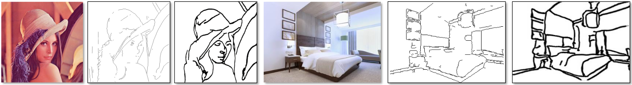
Introduction
Goals
Generate contour drawings
Adopt artistic style
Ideas
Adopt conditional GAN^{[2]}
Map 1 image to 5 ground truths
Input
Edge Detection
Contour Drawing
[2] M. Mirza and S.Osindero. Conditional Generative Adversarial Nets. In arXiv:1411.1784
Notes:
Mehdi Mirza et. al

Slide 3
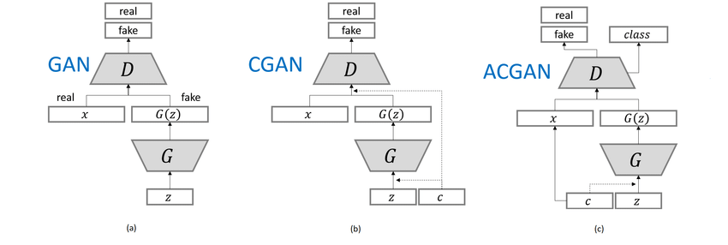
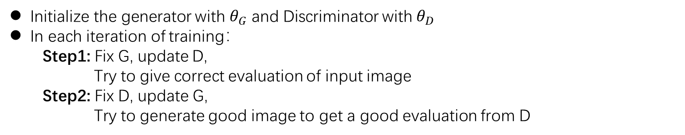
Conditional Generative Adversarial Network
I. Generative Adversarial Networks
II. Conditional GAN
III. Training scheme
Initialize the generator with $θ_{G}$ and Discriminator with $θ_{D}$
In each iteration of training：
Step1: Fix G, update D,
Try to give correct evaluation of input image
Step2: Fix D, update G,
Try to generate good image to get a good evaluation from D
Notes:
1.In this paper, conditional Generative Adversarial Networks method is used. It`s a kind of Generative Adversarial Networks(GAN)
2. Recently, GAN applications have increased rapidly and GAN becomes the most popular topic in deep learning. From the figure, we can find that the increase of papers about GAN is nearly exponential.
Also, Here is the comment on Adversarial Training from Yann LeCun, who is kind of Rockstar in deep learning area.
3.I suppose it`s necessary for me to introduce a little bit about GAN and conditional GAN. GAN is consisted of two neural networks, typically, a generator and a discriminator. A generator takes in a vector to output a image. A discriminator takes in a image and evaluate it and outputs a score or labels. We want these two NN to contest with each other. The discriminator tries to criticize the image generated by the generator, while the generator tries to generate good images.

Slide 4
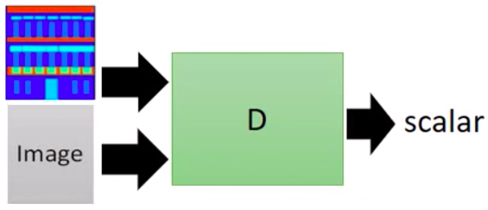
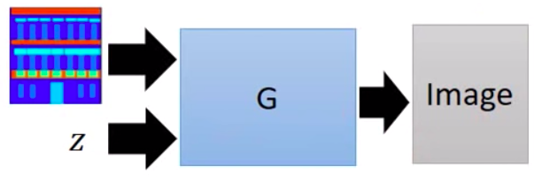
Conditional Generative Adversarial Network
III. What is Conditional Generative Adversarial Networks(GAN)?
Like supervised learning approach, the input has meanings, the input should be a pair
IV. Where to use Conditional Generative Adversarial Networks(GAN)?
Text to Image
Image to Image
Speech Enhancement
Generator
Discriminator
Notes:
Now I believe we have some understanding of the definition and features of GAN. But what`s a Conditional GAN?
Basically, the input vector of GAN is generated randomly. While in conditional GAN, the input has meanings, just like the supervised learning approach.
The conditional GAN can be used widely in many areas, such as make up an image based on input text, translate an image to another image, enhance the input speech signal, and so on. In this paper, it`s a typical image to image scenario.
That feature leads to difference of implementation of Generator and Discriminator in the GAN. We should input the random vector as well as the meaningful training data to generator. And input the generated image and training data to discriminator.

Slide 5
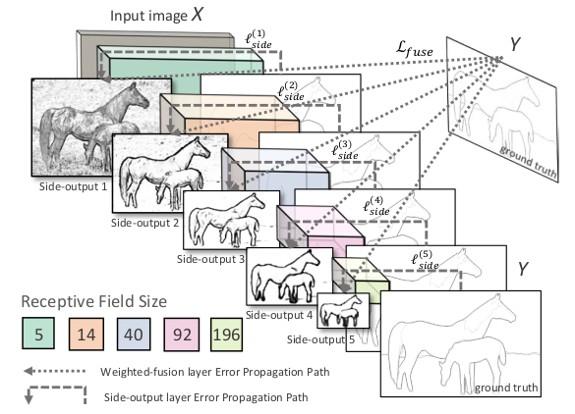
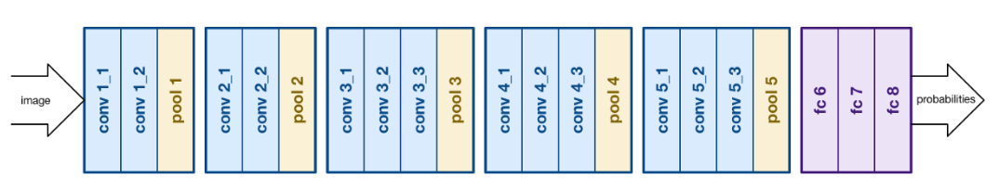
Related Approach
HED^{[5]} (boundary detection)
Adopt VGG-Net^{[6]}
Connect side output layer to the last convolutional layer in each stage
Cut the last stage (5th pooling layer and fully connected layers) of VGGNet
Cannot work with diverse ground truths
VGG-Net
[5] S. Xie and Z. Tu. Holistically-nested edge detection. In ICCV, 2015. 1, 6, 7
[6] K. Simonyan, A. Zisserman.Very deep convolutional networks for large-scale image recognition. In ICLR, 2015
Notes:
Karen et.al

Slide 6
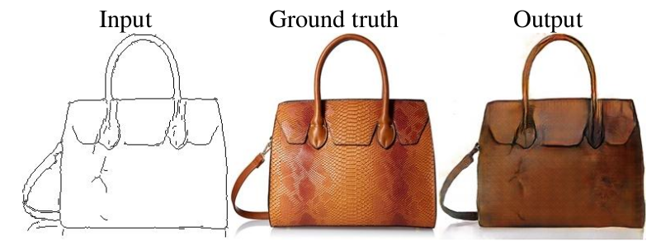
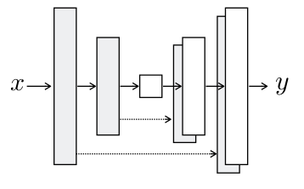
Related Approach
Pix2Pix^{[4]} (cGAN)
Generator: U-Net (autoencoder with skip connections)
Discriminator: patchGAN
Input
Input
Output
D
Ground truth
U-Net
PatchGAN
Output
[4] P. Isola, J.-Y. Zhu, T. Zhou, and A. A. Efros. Image-to-image translation with conditional adversarial networks. In CVPR, 2017. 3, 4

Slide 7
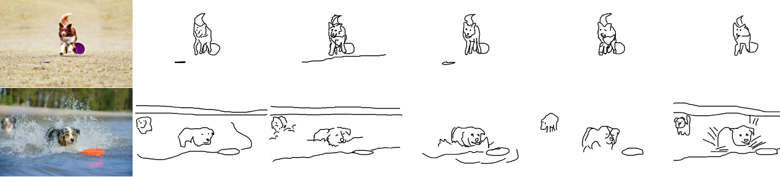
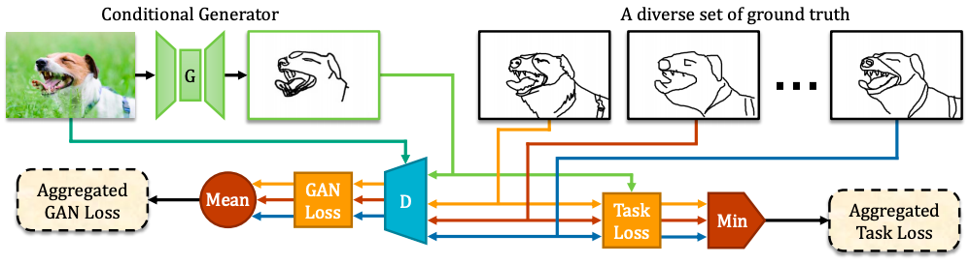
Specific Approach
Training data: 5 ground truths of sketch for 1 training image
Output: not a simple combination of ground truths, but soft representation
cGAN with a novel MM-loss
Notes:
In this paper, more than one target for each source image are used in the training data. That`s because …
Since there are multiple ground truth results, the output result must not be a linear combination of all the ground truths. In this paper, a soft representation which stands for how well the edges are matched.
Because the training data contains multiple ground truth result, the conditional GAN should be optimized. In this paper, the cGAN is combined with a novel Min-Mean-Loss. To rectify the conflicting gradients obtained by different ground truths, the GAN loss outputted by Discriminator and the regression task loss are aggregated carefully.

Slide 8

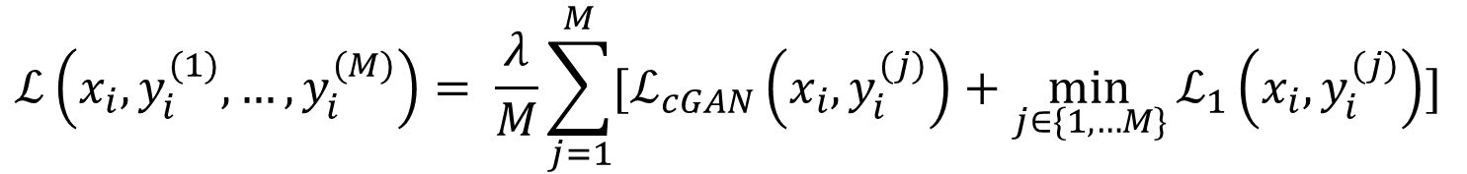
Basic Algorithm
Design the model(neural network/function set)
Loss function
In this paper, multiple targets for one image are used, the training data is
Find best parameter set
Backpropagate the gradients
$$ℒ_{cGAN}\left(x,y,z\right)=\min_{G}{\max_{D}{E_{x,y}\left[logD\left(x,y\right)\right]+E_{x,z}[log⁡(1−D(x,G(x,z)))]}}$$
$${ℒ_{c}\left(x,y\right)=λ∗ℒ}_{cGAN}\left(x,y\right)+ℒ_{1}(x,y)$$
Combined loss function
cGAN loss function
regression loss function
$$\left(x_{i},y_{i}^{(1)},…,y_{i}^{(M)}\right)$$
$$ℒ\left(x_{i},y_{i}^{(1)},…,y_{i}^{(M)}\right)= \frac{λ}{M}\sum_{j=1}^{M}{[ℒ_{cGAN}\left(x_{i},y_{i}^{(j)}\right)+\min_{j∈\{1,…M\}}{ℒ_{1}\left(x_{i},y_{i}^{(j)}\right)}] }$$
Notes:
Basically, there are three steps to develop a machine learning solution. Design the model, find the loss function and find the best set of parameters iteratively to minimize the loss function.
In this paper, the model is conditional GAN. The total loss function is a combination of cGAN loss and regression loss. And since the input image comes with multiple ground truths, the total loss function is modified.
The mean aggregate function can make the discriminator to learn from all modalities with equal importance.
The min aggregate function allows the generator to adaptively pick the most suitable modality to generate on-the-fly.
This is how this paper solve the conflicting gradients caused by multiple targets.
The last step is to find the best parameter set, that`s training the neural network. Backpropagate method is used.

Slide 9
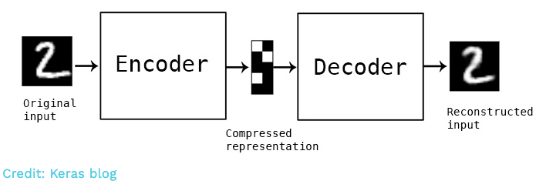
Architecture of Generator and Discriminator
Generator:
A standard encoder-decoder
Discriminator:
A regular global GAN
Notes:
In this paper, the generator in the cGAN has a standard encoder-decoder architecture. The authors found that removing the skip connections between encoder and decoder yields good performance.
This may because that the target in this paper is mainly object boundaries instead of the texture edges, removing the skip connections suppresses the low-level information.
The discriminator is a regular global GAN discriminator, takes in a whole image and output labels or a score.

Slide 10
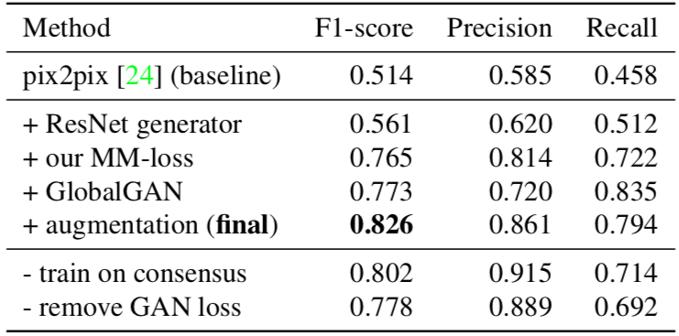
Diagnostic experiments on validation set
Training on consensus drawing outperforms the baseline method
Training on the complete set of sketches with MM-loss outperforms training on consensus
Notes:
A diagnostic experiments is done on validation set.
From the experiments, training on consensus drawing outperforms the baseline method
Training on the complete set of sketches with MM-loss outperforms training on consensus

Slide 11
Goals and Objectives
Test on other dataset to evaluate the algorithm(BSDS500, ImageNet etc.)
Data Augmentation(flip, rotation, translation, downsampling, etc.)
Explore different gradient descent algorithms(Adagram, etc.)
Explore different architecture of Generator(u-net, ResNet, etc.)
Explore different architecture of Discriminator(pathGAN, GlobalGAN, etc.)
Optimize for low-level representation of boundaries

Slide 12
Individual Responsibility
Xingchen Ming
Sourcing for other image dataset for contour detection
Data augmentation
Explore different gradient descent algorithms
Ming Xu
Optimize boundary detection
…
Geng Yang
Explore different architecture of Generator
Explore different architecture of Discriminator

Slide 13
Thank you!

Slide 14
Generative vs Discriminative
Discriminative:
Give a score or predict a label based on the features of the input data
Map features to labels or scores
Generative:
Predict features based on labels or scores of the input data
Map labels or scores to features
 | Generative | Discriminative
Pros | 1.Easy to generate even with deep learning model | 1.Consider the big picture, the correlation of each features
Cons | 1.Only imitate the appearance 2.Hard to learn the correlation between features | 1.Generation is not always feasible 2.Hard to do iterative sampling
Notes:
Discriminative algorithm seems more straightforward, given a data with features then determine the label based on the features.
Meanwhile, generative algorithm do the opposite job. Instead of predicting a label given certain features, they attempt to predict features given a certain label.
Both generative and discriminative networks have their own advantages and disadvantages. However, combine those two kind of neural networks together, we get the powerful GAN.

