Slide 1
Quantifying Process Model Generalization: A Generative N-gram Metric and a Cross-Paradigm Benchmark
Practical Process Mining
Christian Daniel Krengel, Tianhao Geng
17.07.2026

Slide 2
Generalization: the least validated dimension
A process model is judged on four quality dimensions.
Fitness
Precision
Simplicity
Generalization
allows observed behavior
forbids invalid behavior
structurally sparse
allows future valid behavior
Generalization asks: will the model accept Future/Unseen Valid Cases that are not in the log?
However, how can we measure it?…
Notes:
As shown in the slide, a process models is evaluated across four foundational dimensions. Fitness ensures observed behavior is allowed; Precision restricts invalid behavior; and Simplicity demands structural sparsity.
Our focus is the fourth, yet least validated dimension: Generalization. It measures whether a model can accept future, valid behaviors that are entirely absent from the original event log.
The fundamental problem is measurement. Because these valid future behaviors do not exist in empirical data. How can we objectively quantify a model's capacity to accommodate unseen behavior? This exact measurement gap is the problem our methodology resolves.

Slide 3
…no validated metric is in wide use
The metric in wide use is from PM4Py, but it was never validated against a ground truth
Published metrics disagree with one another. Prior studies compared them only to each other
A user who needs a generalization metric is left without a proper validated method
The state of the art
8 published metrics
0 validated against a ground truth on real logs
one representative per published paradigm (M2–M9) in our benchmark
The gap ShadowGen fills: validated against a ground truth, cheap enough to run on real logs
Notes:
The default generalization metric in PM4Py is widely adopted, yet it has never been validated against an objective ground truth.
While the literature offers eight distinct metrics representing different paradigms, they frequently contradict one another. Prior benchmark studies merely cross-compared these metrics, creating a circular validation loop rather than anchoring them to reality. The result is striking: none of them is validated against a ground truth on real logs. A user who needs a generalization metric is left without a proper validated method
This is the exact gap our metric, ShadowGen, fills. We provide a method that is strictly validated against a ground truth, while remaining computationally cheap enough to run on real-world event logs.

Slide 4
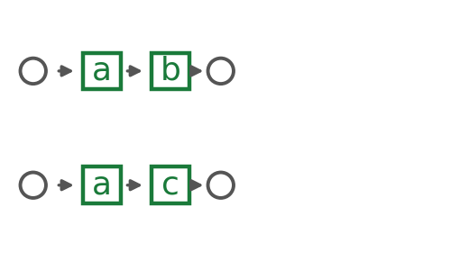
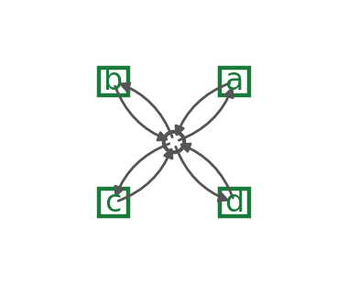
The models we test, and the litmus
The discovery algorithms are spread between memorizing the log or accepting everything
more permissive
six real miners
Alpha · Alpha+ · Heuristics · Heuristics-strict · Inductive-strict · Inductive-infrequent
Trace model
Flower model
The flower litmus. A pure generalization metric must score the flower 1.00
Anything less on the flower means the metric is not pure Generalisation and potentially folds in precision or structure
Notes:
To strictly evaluate our metric, we established a testing spectrum bounded by the theoretical extreme of process discovery. On the far left is the Trace Model, which only memorizes the event log, exhibiting zero generalization. On the far right is the Flower Model, a hyper-permissive structure designed to accept any sequence of activities. Between these theoretical boundaries, we analyze six real miners, including variants of the Alpha, Heuristics, and Inductive miners.
This spectrum introduces a fundamental baseline: the Flower Litmus test. Because a Flower Model inherently accepts all possible future behavior, a pure generalization metric must assign it a perfect score of 1.00.
If a metric scores the flower model below 1.00, it indicates the metric is improperly penalizing the model for poor precision or structural complexity, rather than strictly isolating generalization.

Slide 5
Our Metric: ShadowGen
Event log
N-gram model
Shadow log
Replay
Score
→
→
→
→
the observed traces
Katz backoff + Good–Turing
plausible-but-unseen traces
graded trace fitness
generalization estimate
The model is scored on behavior it has never seen but that is plausibly valid

Slide 6
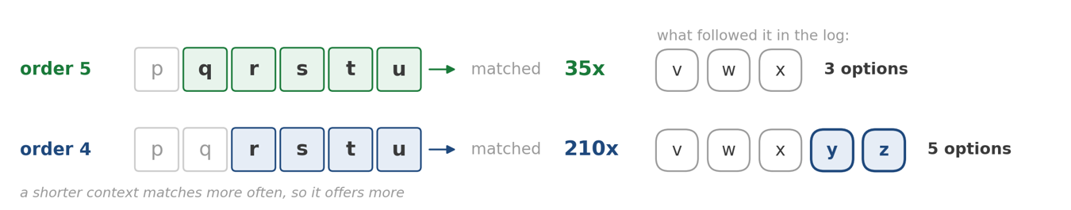
Two backoffs: resolve, then find
Both steps run Katz backoff until a valid output is found:
Step 1: Resolve the context
Step 2: Find a novel event
back off to the deepest context with support
when the mutation fires: back off again
order 6: seen 5×, all one-offs → too sparse, skip
order 5: its successors are all accounted for
↓ back off
↓ back off
order 5: seen 35× → resolved context
order 4: offers z, unseen here → insert z
The normal next step comes from here. Its one rare successor (1 in 35) sets the mutation-rate ≈ 3% (Good Turing)
z is novel for order 5, but is valid in a shorter order: novel and grounded in reality

Slide 7
How we validate
5 real-life logs
Ground truth: R1
L1–L5: Sepsis (15k events) to BPI 2018 (2.5M) — scale, depth, representativeness.
Variant-based k-fold cross-validation: does a re-discovered model accept held-out variants?
Four criteria
One-hour budget
Pearson (calibration), Spearman / Kendall (ordering), MAE, discriminative spread.
Uniform per cell; both poles included. Runtime is a first-class outcome.

Slide 8
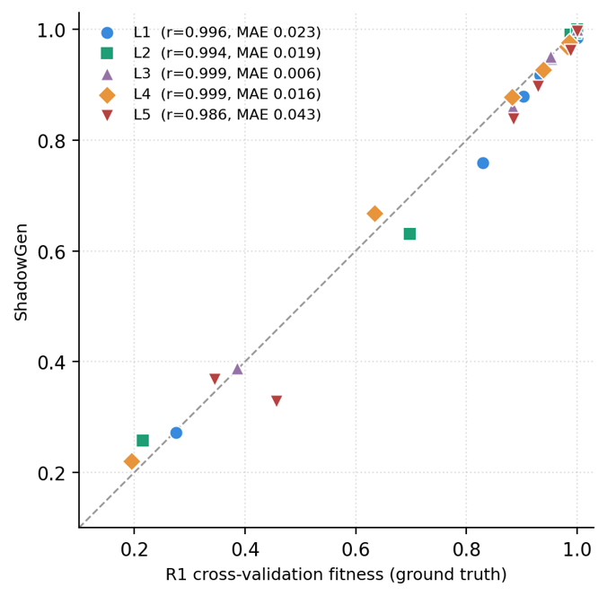
ShadowGen tracks the ground truth
On every one of the five logs:
0.99+
3 s
Pearson (0.986 – 0.999)
median per model (single draw, K=1)
Mean absolute error: 0.006 - 0.043
Ranking matches the ground truth (up to one near-tie swap, L3/L5)
Stable: One iteration holds Pearson 0.98+ and Std ca. 0.001, max. 0.008. More iterations (i.e. k=5) only add reliability

Slide 9
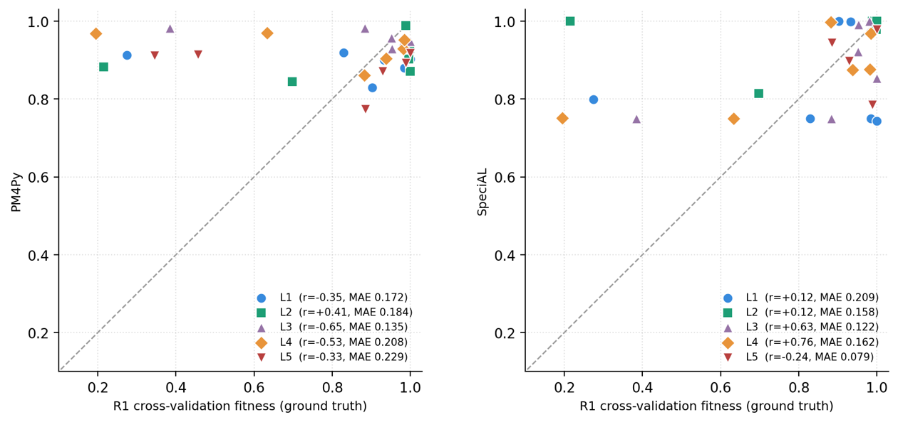
What not tracking looks like
SpeciAL: no stable relation to R1 (r −0.24 to +0.76). Flower 0.76–0.94 (litmus failed)
PM4Py: anti-correlated on 4 of 5 logs · flower 0.88–0.98 (litmus failed)

Slide 10
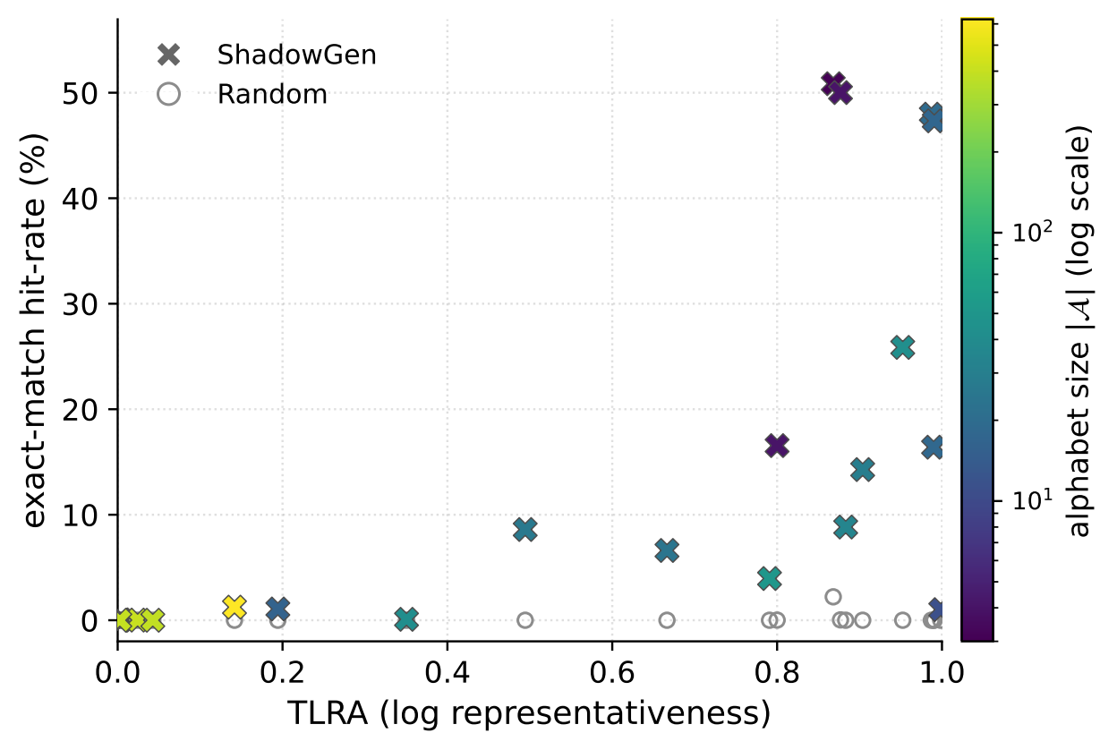
The shadow log is real future behavior
Train on a part of a log's variants, generate, then count exact matches with the other, unseen part
21 real-life logs

Slide 11
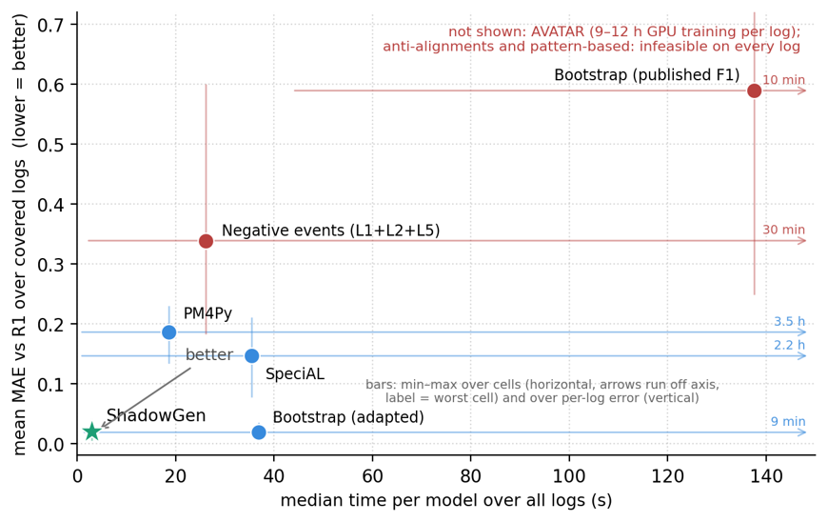
Accurate and affordable
Only ShadowGen and bootstrap (adapted) are decently accurate
ShadowGen runs at 3 s per model, 6× faster than PM4Py
PM4Py is decently fast but never accurate, Negative events tracks nothing useful. SpeciAL is inconsistent and crashes on the 1.6M-event log, Bootstrap original is the worst calibrated out of all
AVATAR needs 9–12 h of GPU training per log, M4, M8 never score properly
Notes:
This scatter plot maps the critical trade-off between computational cost on the x-axis and metric error to cross validation on the y-axis. The theoretical optimum is located in the bottom-left corner.
Our metric, denoted by the green star, successfully isolates this optimum. It minimizes the mean absolute error while executing in a median time of just 3 seconds per model—operating 6 times faster than the PM4Py baseline.
While PM4Py is relatively fast, its error rate is unacceptable. The adapted bootstrap method approaches our accuracy but scales poorly. Other metrics fail fundamentally: SpeciAL crashes on large-scale logs, Negative event generalization is fast but inaccurate, and neural models like AVATAR require up to 12 hours of GPU training per log. So far, bootstrap original is the worst calibrated out of all.

Slide 12
Conclusion
ShadowGen tracks empirical generalization on all five real-life logs, at 3 s per model (1-iteration)
It scores a model similarly to cross validation without the need to rediscover it
The flower litmus exposes what impure metrics fold in: structure in PM4Py, precision in Bootstrap
A validated, affordable, interpretable method for generalization
Notes:
In conclusion, ShadowGen successfully tracks empirical generalization across all five real-life event logs. Crucially, it achieves this at a computational cost of merely three seconds per model.
It delivers scoring consistency comparable to cross-validation, but entirely bypasses the computationally prohibitive requirement of rediscovering the process model.
Furthermore, the flower litmus proves helpful in diagnosing the systemic flaws of existing metrics. It exposes that PM4Py improperly conflates generalization with structural complexity, while AVATAR, bootstrap conflate it with precision.
In a word, we deliver a metric for quantifying generalization that is strictly validated against cross validation, computationally affordable, and theoretically interpretable.

Slide 13
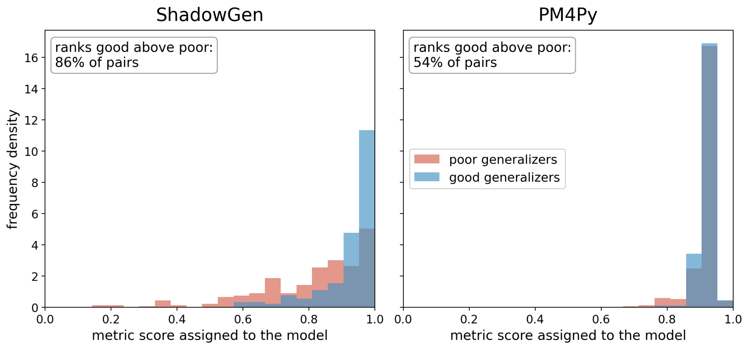
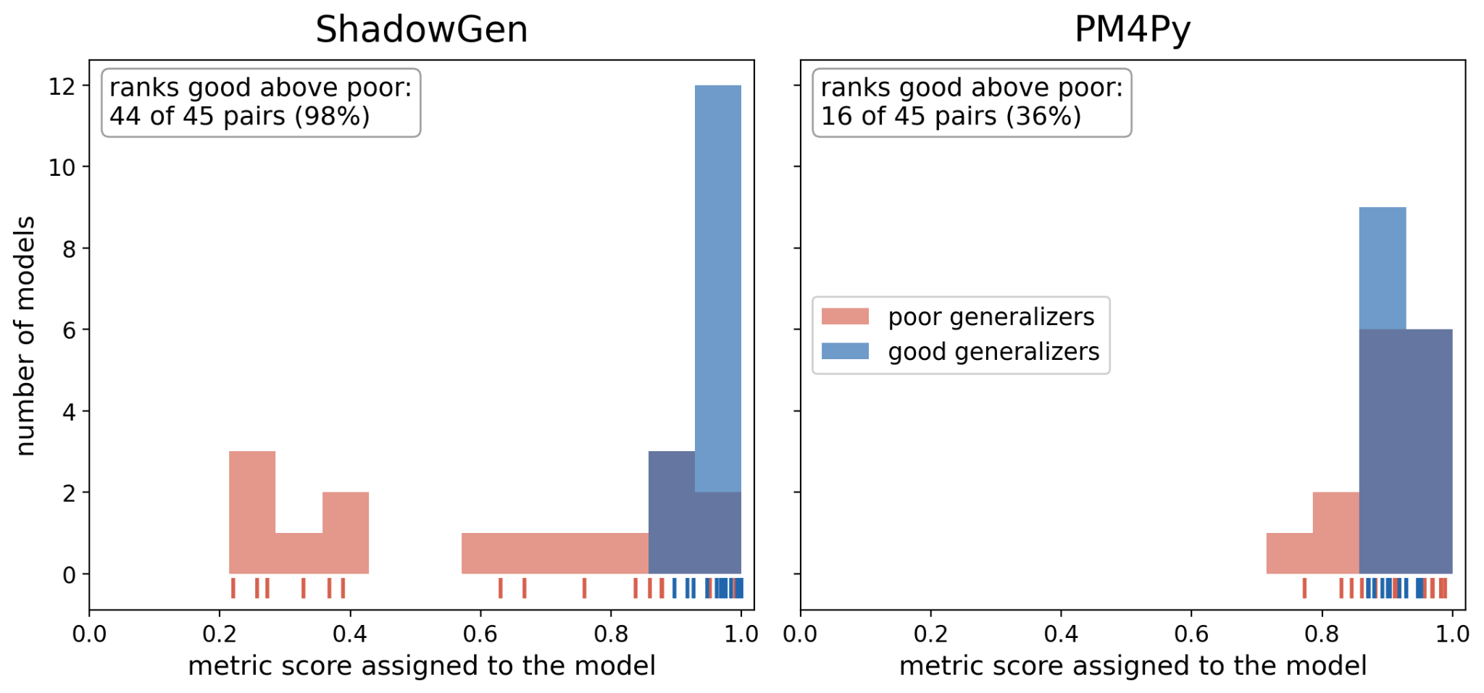
Discriminative Spread (Synthetic Systems and Real-life Logs)

Slide 14
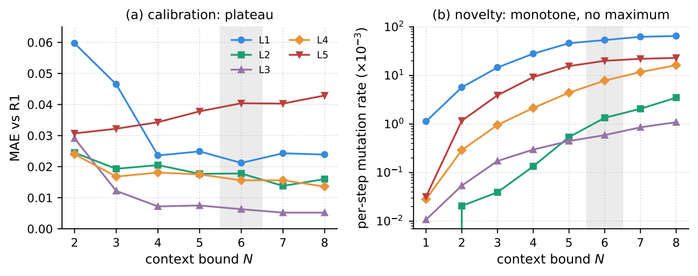
Backup: choosing the context order N
Picking N: MAE to R1 is a plateau. N=6 is optimal on L1 and within 0.004 of the optimum on L2–L4 (inside the metric's own noise). Mutation rate rises continuously with N on every log, higher N order only costs more with minimal improvement on some logs

Slide 15
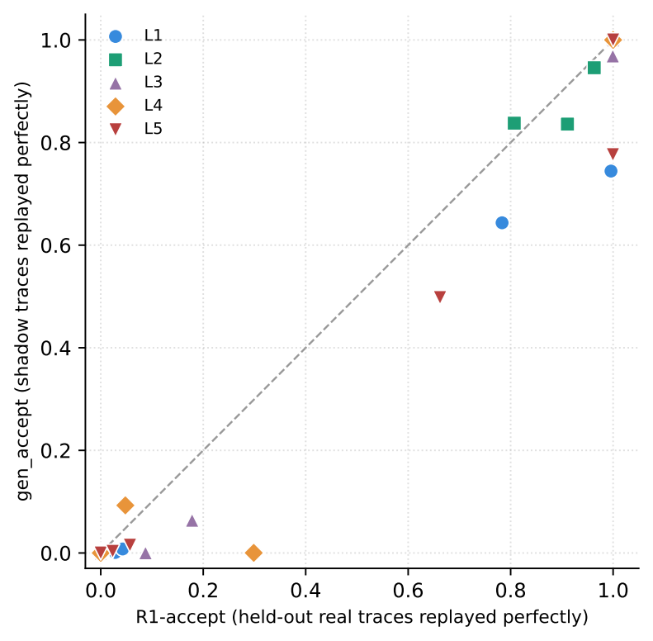
Backup: acceptance validation
Strict reading validated against R1-accept: the fraction of held-out real traces replayed exactly.
Poles anchor cleanly: flower 1.00, trace ≈ 0.
In some instances (i.e. 57 events/trace) the generator of ShadowGen struggles

Slide 16
Backup: one bootstrap sample, four scorings
Hold the bred bsgen sample fixed (L1), vary only the scoring, compare to R1:
-bgen F1 (precision + recall): Pearson 0.87 MAE 0.59 flower 0.18 fail
its precision component: Pearson 0.82 MAE 0.68 flower 0.10 fail
its recall component: Pearson 0.98 MAE 0.11 flower 1.00 pass
token-replay recall (M6adapted): Pearson 1.00 MAE 0.018 flower 1.00 pass
The precision component alone destroys calibration and the litmus: construct contamination, shown causally.

Slide 17
Backup: threats, measured
Shared “ruler”?: Recomputing R1 with cost-zero alignments instead of token replay keeps the ranking: Spearman 1.0, Pearson 0.96 over the five sound nets. (MAE 0.095)
Stochastic stability: per-cell std ≤ 0.008 (median 0.001), every single draw keeps Pearson ≥ 0.982 and the identical ranking
Replay nondeterminism: token replay tie-breaks unseeded on silent and duplicate transitions. Measured drift ≤ 0.024 (trace model), verdicts unaffected (L4 MAE 0.015 → 0.016)
Disclosures: five L4 cells kept despite overrunning the hour (e.g. PM4Py Ind-strict at 3.5 h), SpeciAL version skew on L5, R2 sampled 50 variants

Slide 18
Backup: Dataset Introduction
# | Name | Cases | Events | Variants | Avg Len | TLRA
D1 | Spesis | 1,050 | 15,214 | 846 | 14.5 | 0.19
D2 | BPI 2013 Incident | 7,554 | 65,533 | 1,511 | 8.7 | 0.80
D3 | BPI 2017 | 31,509 | 1,202,267 | 15,930 | 38.2 | 0.49
D4 | BPI 2018 | 43,809 | 2,514,266 | 28,457 | 57.4 | 0.35
D5 | BPI 2019 | 251,734 | 1,595,923 | 11,973 | 6.3 | 0.95

Slide 19
Backup: Metric Introduction
M2 (PM4Py Built-in) — token-based replay each log trace on the discovered Petri net and counts how many model elements (transitions/places) are rarely or never visited, deriving a generalization score from the fraction of under-exercised elements in the reachability graph.
M3 (Entropic Relevance) — Evaluates the stochastic quality of the discovered model using the Minimum Description Length (MDL) principle, measuring the average bits required to compress the original event log using a probabilistic automaton derived from the mined Petri net.
M4 (Anti-Alignment Generalization) — Quantifies generalization by measuring the shortest sequence
of activities that the model can accept but the log cannot reproduce, though its adversarial state-space search is computationally intractable on real-world datasets.
M5 (AVATAR) — Quantifies generalization as the model's acceptance rate of novel, synthetic process behaviors generated by GAN trained on a subset of the empirical log.

Slide 20
Backup: Metric Introduction
M6 (Bootstrap Generalization) — Evaluates generalization based on the model's fitness against synthetic out-of-sample traces, which are bred through the recursive structural recombination of homologous k-gram segments from the historical log.
M7 (SpeciAL4PM) — Adapts ecological unseen-species estimators to quantify generalization, comparing the incidence rate of strictly rare behavioral patterns (singleton traces and k-grams) generated by the model against the empirical baseline.
M8 (Pattern-based Generalization) — Assesses generalization by measuring the proportion of abstract behavioral patterns successfully realized within the model's valid alignments, though its underlying state-space resolution is computationally intractable on real-world datasets.
M9 (Negative-Event Generalization) — Estimates generalization via the ratio of permitted versus rejected artificially induced negative events, though empirical validation reveals severe construct drift that structurally conflates the metric with precision rather than true unseen fitness.

