Slide 1
Quantifying Process Model Generalization: A Generative N-gram Metric and a Cross-Paradigm Benchmark
Practical Process Mining
Christian Daniel Krengel, Tianhao Geng
17.07.2026

Slide 2
Generalization: the least validated dimension
A process model is judged on four quality dimensions.
Fitness
Precision
Simplicity
Generalization
allows observed behavior
forbids invalid behavior
structurally sparse
allows future valid behavior
Generalization asks: will the model accept Future Valid Cases that are not in the log?
However, how can we measure it?…

Slide 3
…no validated metric is in wide use
The metric in wide use is from PM4Py, but it was never validated against a ground truth
Published metrics disagree with one another. Prior studies compared them only to each other
A user who needs a generalization metric is left without a proper validated method
The state of the art
8 published metrics
0 validated against a ground truth on real logs
one representative per published paradigm (M2–M9) in our benchmark
The gap ShadowGen fills: validated against a ground truth, cheap enough to run on real logs

Slide 4
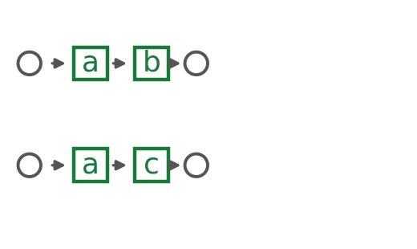
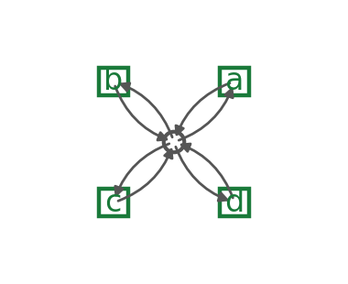
The models we test, and the litmus
The discovery algorithms are spread between memorizing the log or accepting everything
more permissive
six real miners
Alpha · Alpha+ · Heuristics · Heuristics-strict · Inductive-strict · Inductive-infrequent
Trace model
Flower model
The flower litmus. A pure generalization metric must score the flower 1.00
Anything less on the flower means the metric is not pure Generalisation and potentially folds in precision or structure

Slide 5
Our Metric: ShadowGen
Event log
N-gram model
Shadow log
Replay
Score
→
→
→
→
the observed traces
Katz backoff + Good–Turing
plausible-but-unseen traces
graded trace fitness
generalization estimate
The model is scored on behavior it has never seen but that is plausibly valid

Slide 6
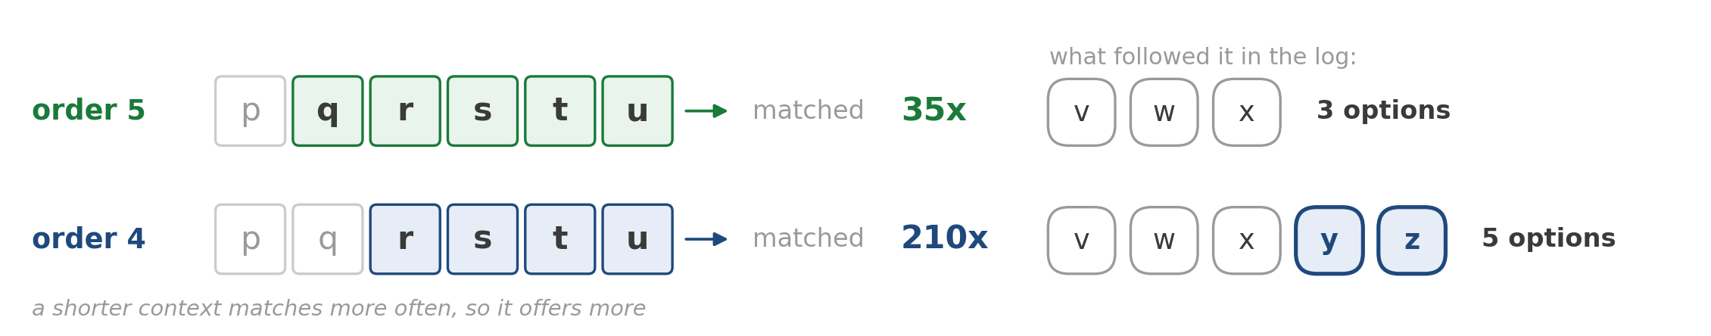
Two backoffs: resolve, then invent
Every step runs Katz backoff, and it does the work twice:
1 · Resolve the context
2 · Invent a novel event
back off to the deepest context with support
only when the roll fires: back off again
order 6: seen 5×, all one-offs → too sparse, skip
order 5: its successors are all accounted for
↓ back off
↓ back off
order 5: seen 35× → resolved context
order 4: offers z, unseen here → insert z
The normal next step comes from here. Its one rare successor (1 in 35) sets the mutation-rate ≈ 3%
z is novel for order 5, but is valid in a shorter order: novel and grounded in reality

Slide 7
How we validate
5 real-life logs
Ground truth: R1
L1–L5: Sepsis (15k events) to BPI 2018 (2.5M) — scale, depth, representativeness.
Variant-based k-fold cross-validation: does a re-discovered model accept held-out variants?
Four criteria
One-hour budget
Pearson (calibration), Spearman / Kendall (ordering), MAE, discriminative spread.
Uniform per cell; both poles included. Runtime is a first-class outcome.

Slide 8
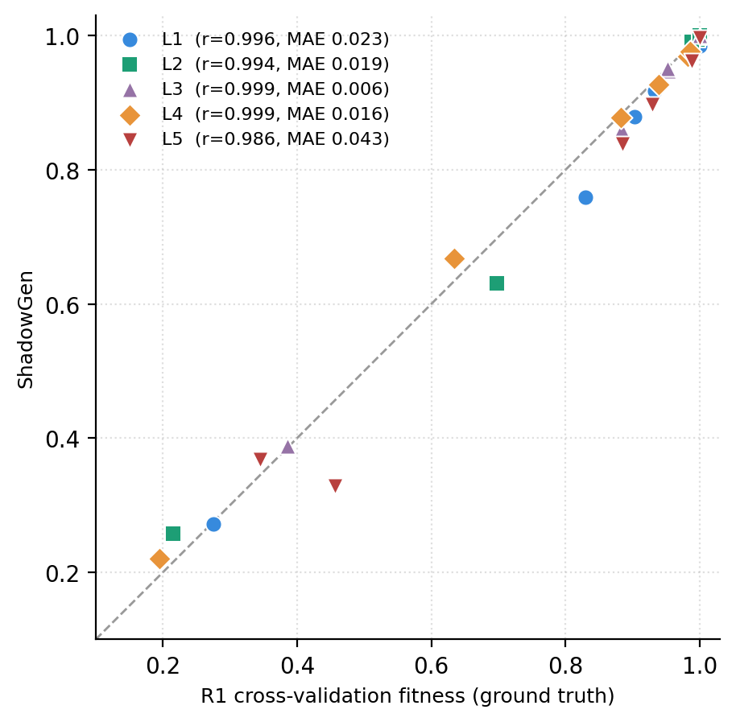
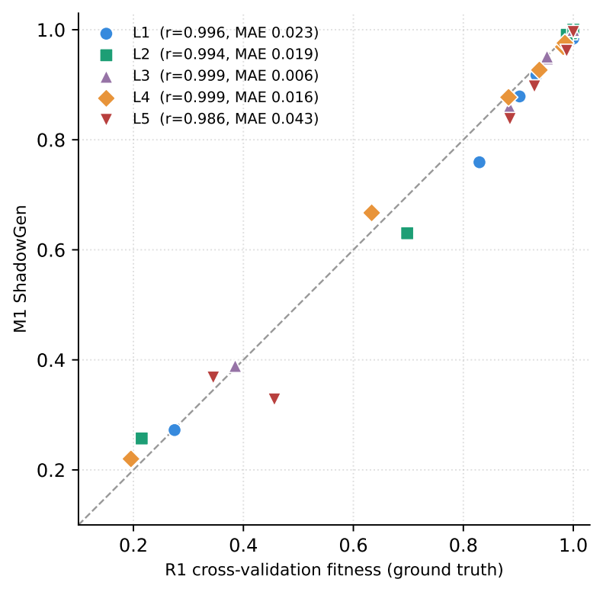
ShadowGen tracks the ground truth
On every one of the five logs:
0.99+
3 s
Pearson (0.986 – 0.999)
median per model (single draw, K=1)
Mean absolute error: 0.006 - 0.043
Ranking matches the ground truth (up to one near-tie swap, L3/L5)
Stable: one draw alone holds Pearson 0.98+ and the same ranking. Std ca. 0.001, at most 0.008. More iterations (i.e. k=5) only add reliability, technically

Slide 9
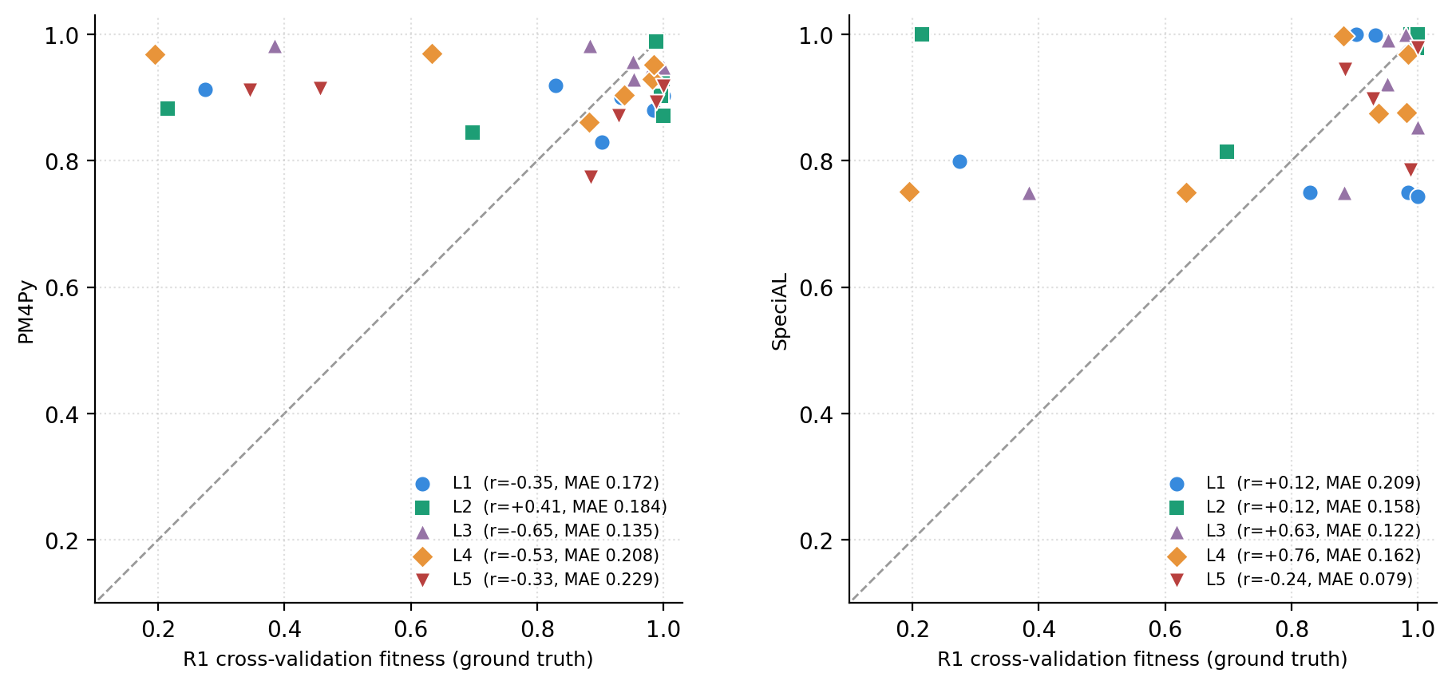

What not tracking looks like
– ShadowGen: tracks R1 on all 5 logs · flower 1.00
– Bootstrap (adapted): tracks R1 on all 5 logs · flower 1.00
– PM4Py: anti-correlated on 4 of 5 logs · flower 0.88–0.98 (litmus failed)

Slide 10
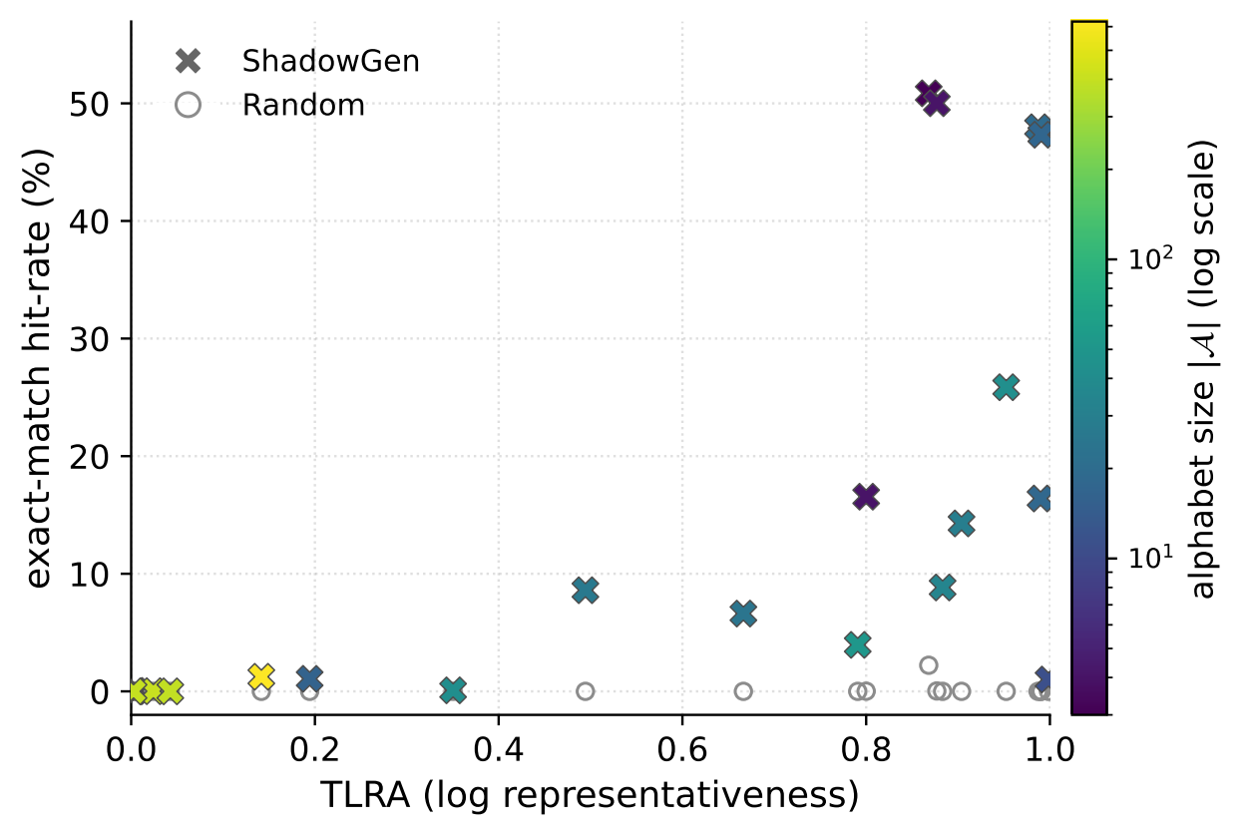
The shadow log is real future behavior
Train on a part of a log's variants, generate, then count exact matches with the other, unseen part
Exact-matchability is a based on the representativeness and alphabet size of the log
one point per log · 21 real-life logs

Slide 11
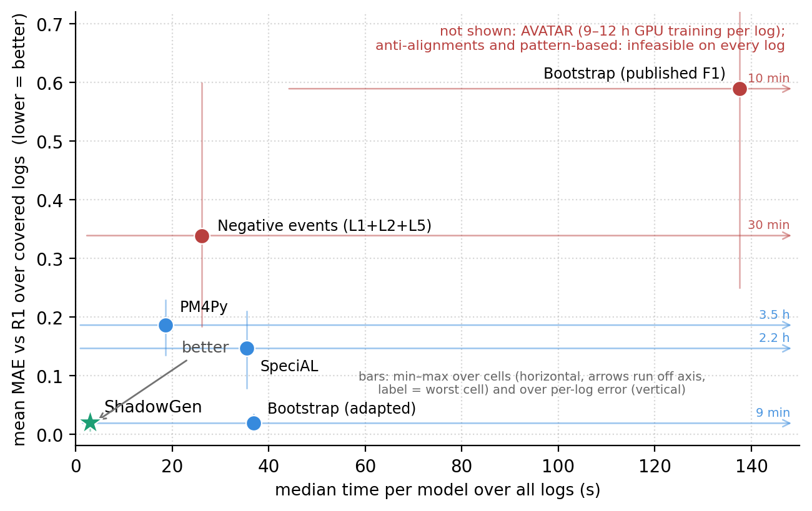
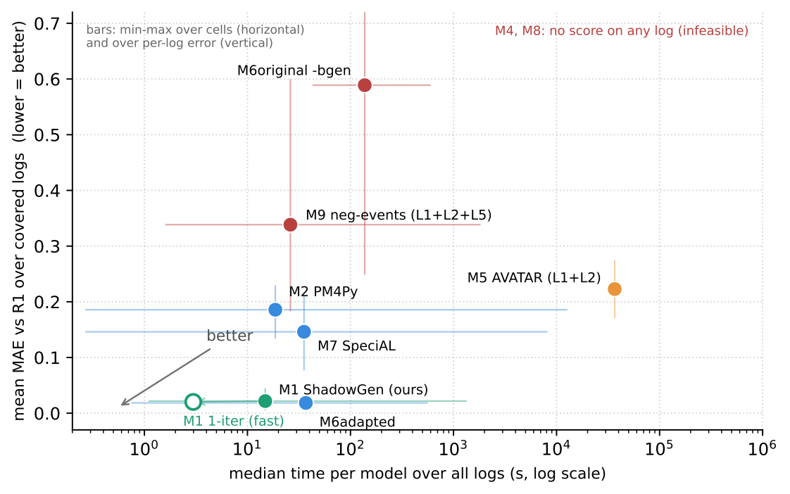
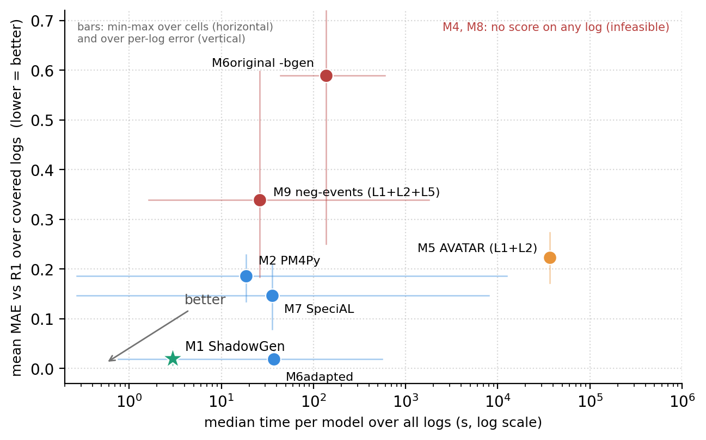
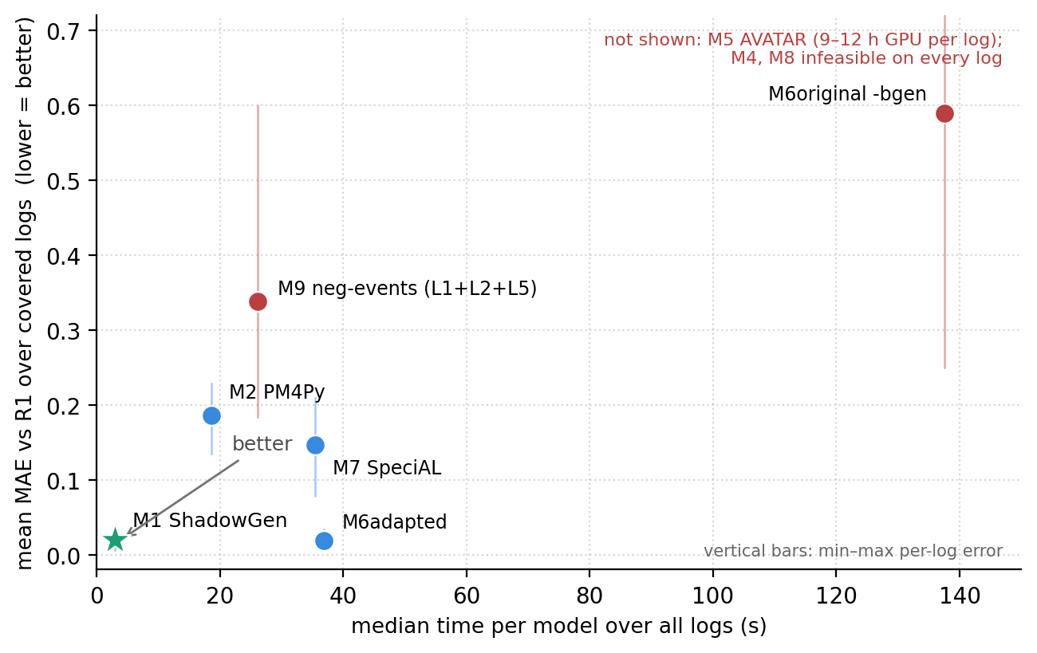
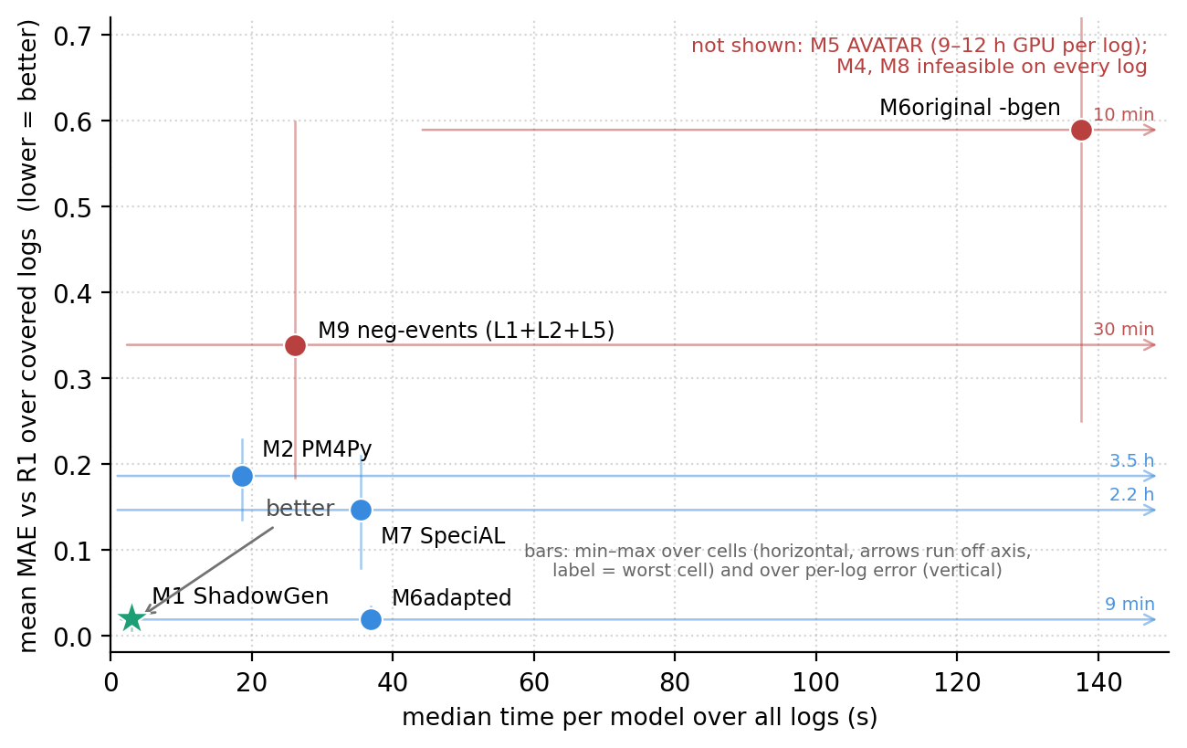
Accurate and affordable
ShadowGen and bootstrap (adapted) are the only ones decently accurate
The single-draw default ShadowGen runs at 3 s per model, 6× faster than PM4Py
PM4Py is decently fast but never accurate. M9 negative events tracks nothing useful. SpeciAL is inconsistent and crashes on the 1.6M-event log. M6 original is the worst calibrated out of all
AVATAR needs 9–12 h of GPU training per log, M4, M8 never score properly

Slide 12
Conclusion
ShadowGen tracks empirical generalization on all five real-life logs, at 3 s per model (1-iteration)
It scores a model similarly to cross validation without the need to rediscover it
The flower litmus exposes what impure metrics fold in: structure in PM4Py, precision in the neural GAN
A validated, affordable, interpretable method for generalization

Slide 13
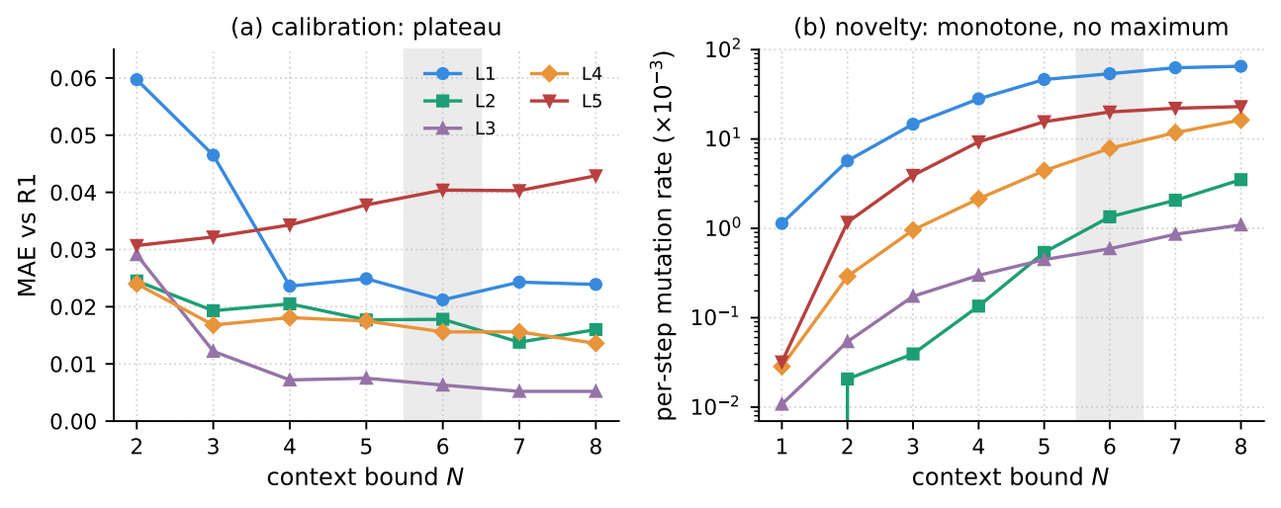
Backup: choosing the context order N
Picking N: MAE to R1 is a plateau. N=6 is optimal on L1 and within 0.004 of the optimum on L2–L4 (inside the metric's own noise). The mutation rate rises continuously with N on every log, higher N order only costs more with minimal improvement on some logs

Slide 14
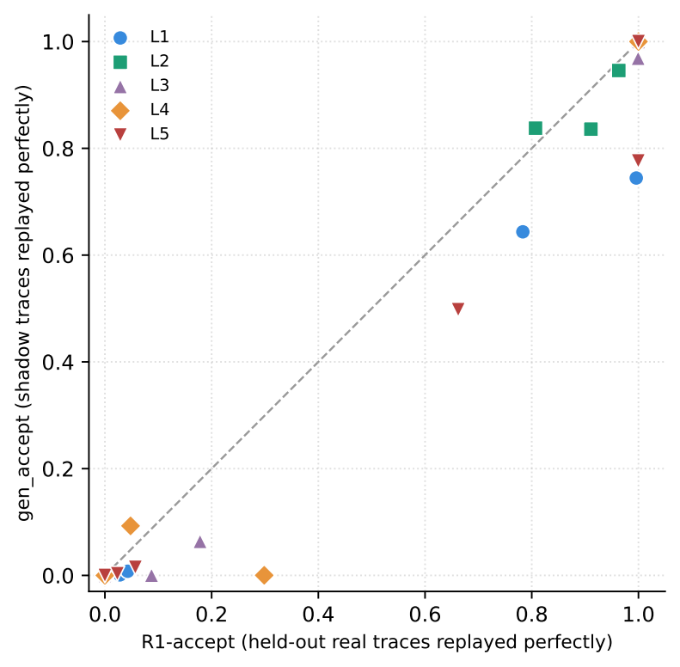
Backup: acceptance validation
Strict reading validated against R1-accept: the fraction of held-out real traces replayed exactly.
Poles anchor cleanly: flower 1.00, trace ≈ 0.
In some instances (i.e. 57 events/trace) the generator of ShadowGen struggles

Slide 15
Backup: one bootstrap sample, four scorings
Hold the bred bsgen sample fixed (L1), vary only the scoring, compare to R1:
-bgen F1 (precision + recall): Pearson 0.87 MAE 0.59 flower 0.18 fail
its precision component: Pearson 0.82 MAE 0.68 flower 0.10 fail
its recall component: Pearson 0.98 MAE 0.11 flower 1.00 pass
token-replay recall (M6adapted): Pearson 1.00 MAE 0.018 flower 1.00 pass
The precision component alone destroys calibration and the litmus: construct contamination, shown causally.

Slide 16
Backup: threats, measured
Shared “ruler”?: Recomputing R1 with cost-zero alignments instead of token replay keeps the ranking: Spearman 1.0, Pearson 0.96 over the five sound nets. (MAE 0.095)
Stochastic stability: per-cell std ≤ 0.008 (median 0.001), every single draw keeps Pearson ≥ 0.982 and the identical ranking
Replay nondeterminism: token replay tie-breaks unseeded on silent and duplicate transitions. Measured drift ≤ 0.024 (trace model), verdicts unaffected (L4 MAE 0.015 → 0.016)
Disclosures: five L4 cells kept despite overrunning the hour (e.g. PM4Py Ind-strict at 3.5 h), SpeciAL version skew on L5, R2 sampled 50 variants

