Slide 1
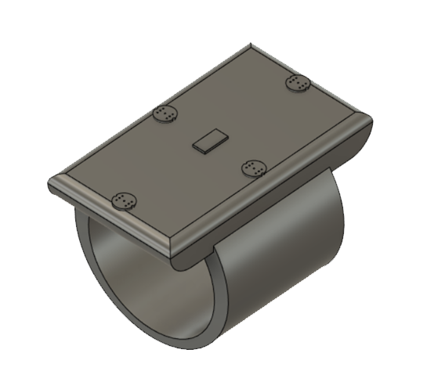
GLAID
AID FOR THE HEARING IMPAIRED
Aishwarya Omar- IIT Gandhinagar
Daksh Adhar – IIT Guwahati

Slide 2

HEARING LOSS
According to the World Health Organization, over 5% of the world population suffers from disabling hearing loss
By 2050 nearly 2.5 billion people are projected to have some degree of hearing loss

Slide 3

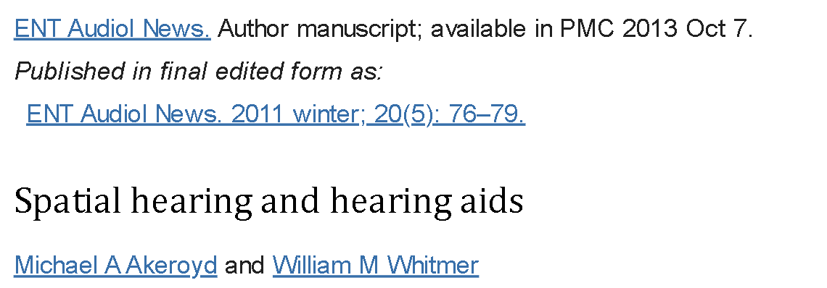
“Spatial hearing is a central part of everyday listening . . . performance by hearing-impaired listeners is considerably degraded, and generally hearing aids do not offer any benefit.”
Notes:
Spatial hearing which is the ability to determine the direction of sound

Slide 4
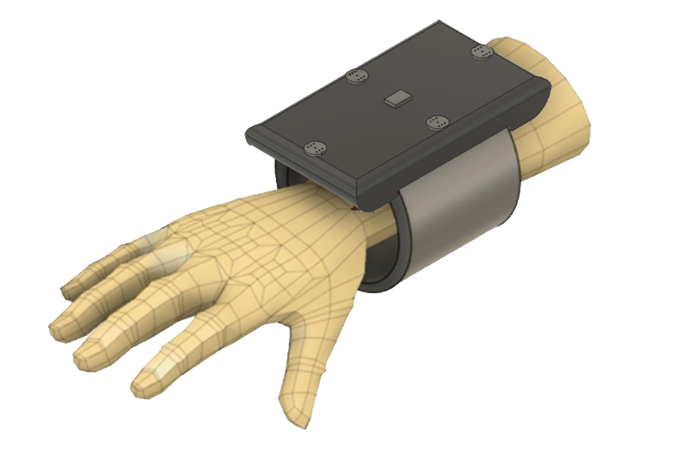
OUR INVENTION
OUR INVENTION
Wearable Device
Array of Microphones
Directionality of sound
Tactile feedback

Slide 5
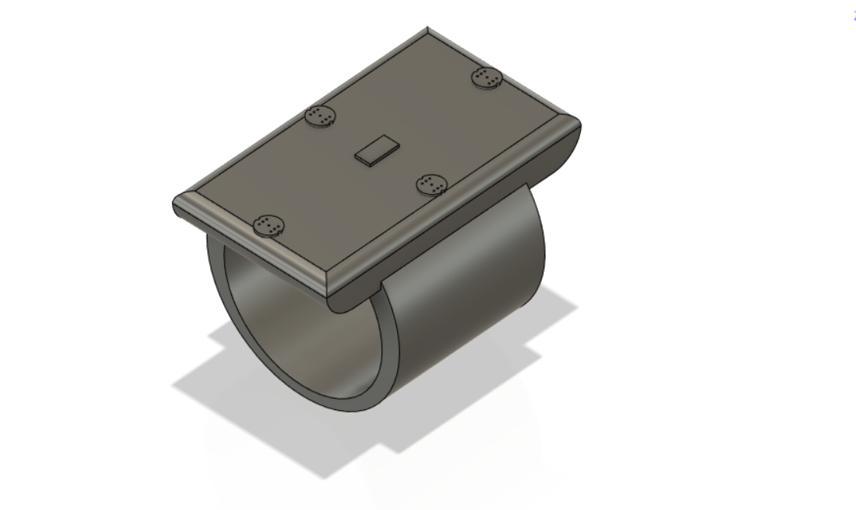
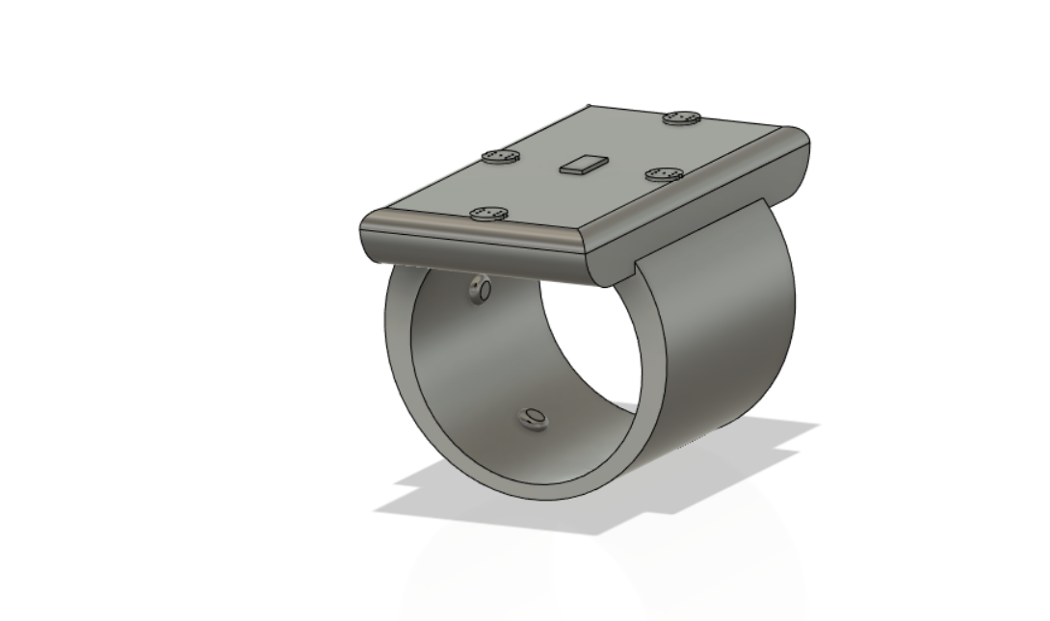
OUR INVENTION
MICROPHONE
IMU SENSOR
MICROCONTROLLER
(custom ML algorithm)
VIBRATING MOTORS

Slide 6
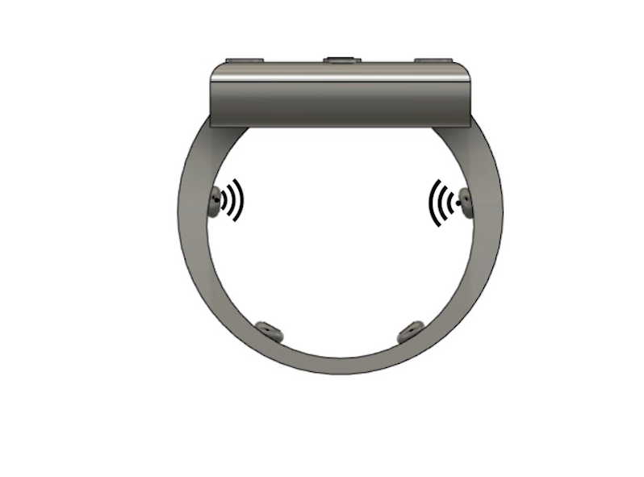
HOW?
Front
Front
Back
Back

Slide 7
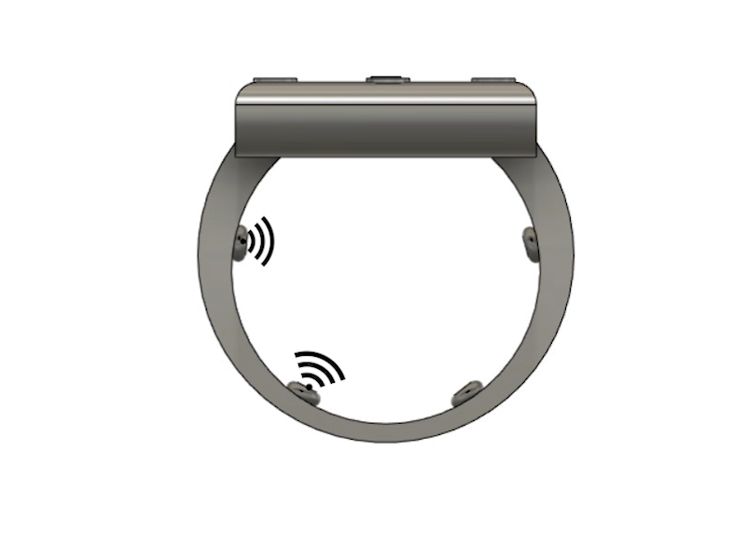
HOW?
Left
Right
Left
Right

Slide 8
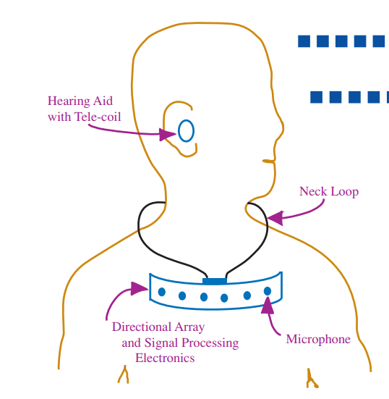
PRIOR ART
NECKLACE ARRAY
Not compatible with all hearing aids
Amplifies all sounds
Widrow, Bernard. "A microphone array for hearing aids." IEEE Circuits and Systems Magazine 1.2 (2001): 26-32.
Classification: (A61F11/045)

Slide 9
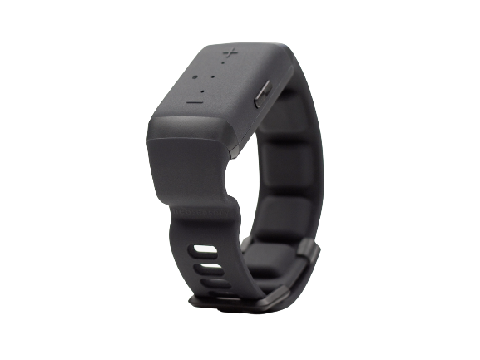
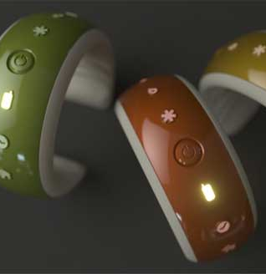
PRIOR ART
BUZZ
US20210117002
Uses Frequency Modulation
NO SENSE OF DIRECTION
ARIA
Source: India Times
Visual Patterns
Limited to alerts
NO SENSE OF DIRECTION
Classification: (A61F11/045)

Slide 10
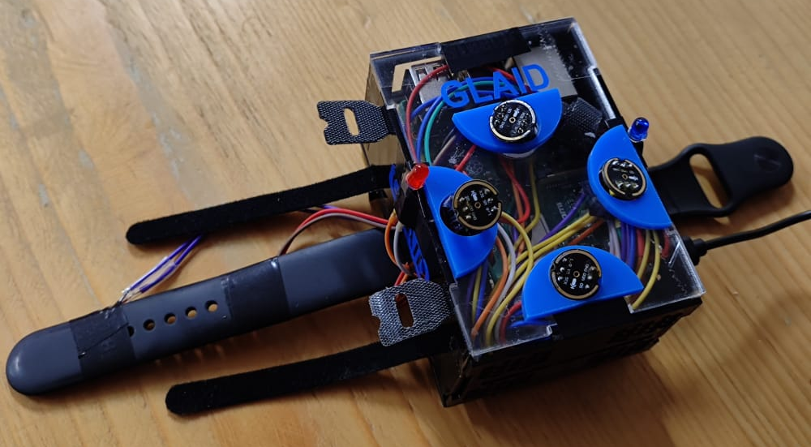
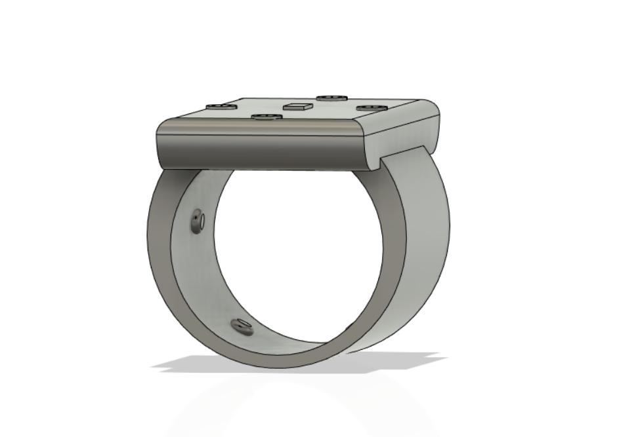
SUMMARY
OUR INVENTION
* Current prototype. Final device miniaturized to the size of a watch

