Slide 1

Core Java
Geniobits

Slide 2
Session 1

Slide 3
About Java
Java is a high-level programming language
Originally developed by Sun Microsystems
Released in 1995
Java is cross platform

Slide 4
Why Java?
Java is Platform Independent
Robust
Secure
Portability
Dynamic

Slide 5
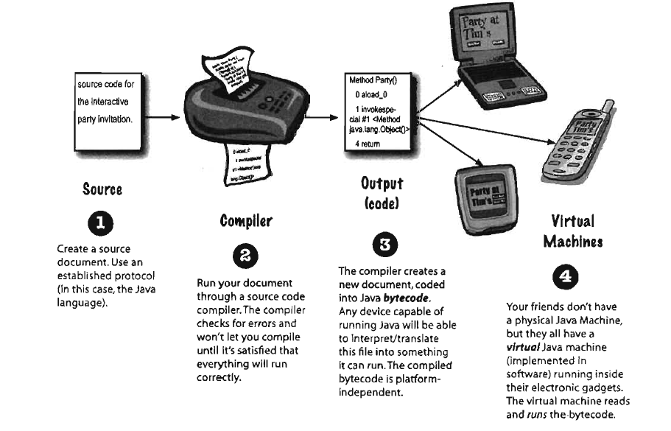

Slide 6
Where can we use it?
To create Desktop Applications
To create Web Applications
To create Enterprise Applications (banking applications)
Develop Mobile Applications
Embedded System, Smart Card, Robotics, Games, etc.

Slide 7
Let’s Install it!
Download from (https://www.oracle.com/in/java/)
Add path [Computer -> Properties -> Advanced System Settings -> Environment Variable -> New [1st] -> Add Java Bin Path -> Done]
In Linux use, export PATH=$PATH:/home/jdk1.6.01/bin/

Slide 8
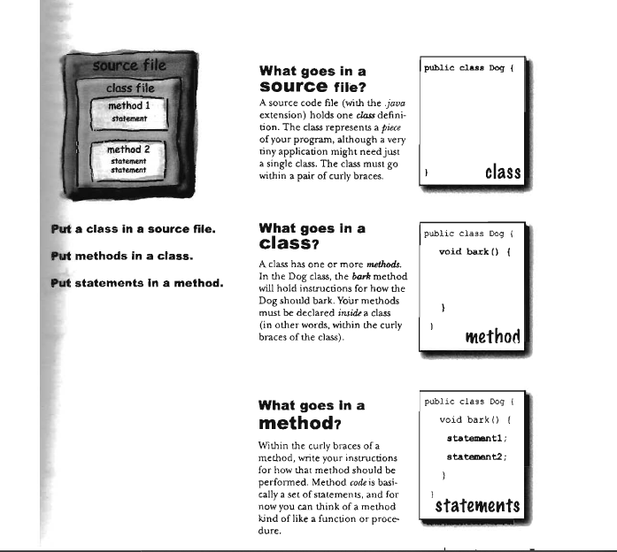

Slide 9
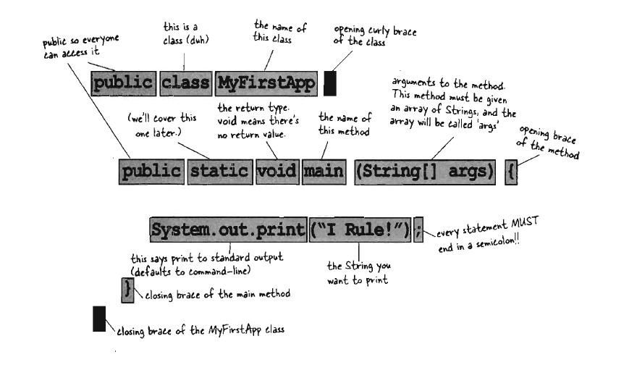

Slide 10
Hello World
Let us look at a simple code that will print the string Hello World

Slide 11
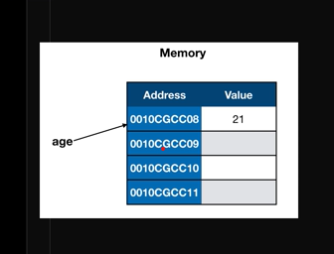
Variables

Slide 12

Variables

Slide 13
Java If - Else
The Java if statement is used to test the condition
It checks for true or false
An if code block will execute only if the condition is true else it will skip it

Slide 14
Loops
For
for(initialization; condition; iteration) {
// body
}
the initialization portion - sets control variable to an initial value. Condition - Boolean expression that tests the loop control variable.
outcome = true, the for loop continues to iterate.
outcome = false, the loop terminates.

Slide 15
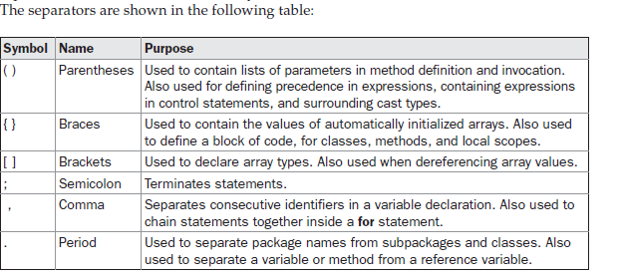

Slide 16
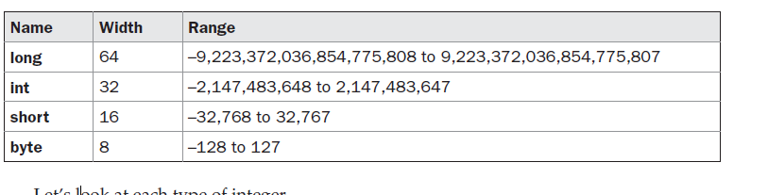
Data Types
There are two types of data types in Java: primitive and non-primitive.
8 types of data types
int, char, short, boolean, byte, long, float, double

Slide 17
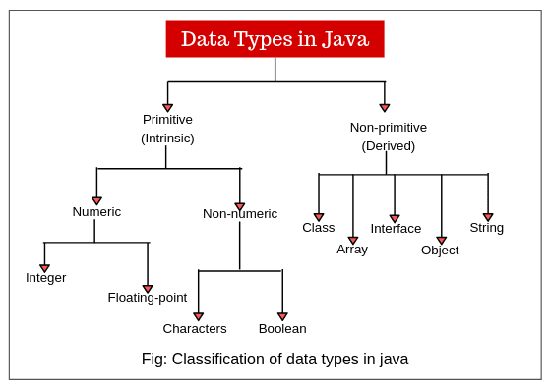

Slide 18
Variables
A variable is a container which holds the value
3 types of variables
Local Variable
You can use this variable only within that method
Instance Variable
Value is instance specific and is not shared among instances
Static variable
A static variable can be shared among all the instances of the class

Slide 19
Accept Input From User
Import Scanner from java.utils class
Create an instance of Scanner
Scanner myObj = new Scanner(System.in);
Get user input using myObj.nextInt( );

Slide 20
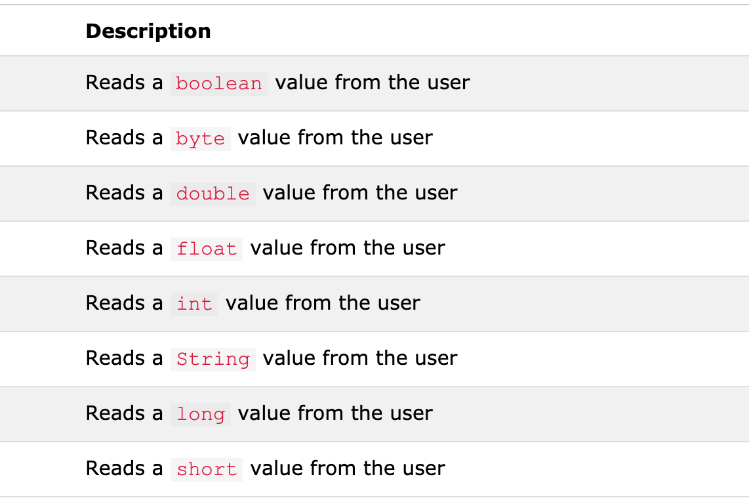

Slide 21
Exercise
Write a program to check if a user is eligible to vote.
Write a program that accepts user name and greet user “Welcome to Nutshell, Username”;

Slide 22
Download NetBeans
Download url:
https://netbeans.apache.org/download/index.html

Slide 23
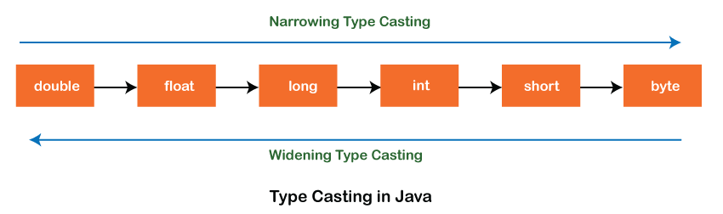
Type Casting
(manually)
(automatically)
Narrowing Type Casting
In Narrowing Type Casting, we manually convert one data type into another using the parenthesis.
Widening Type Casting
In Widening Type Casting, Java automatically converts one data type to another data type.

Slide 24
Type casting is changing a data type to another type
Syntax: DataType var1 = (DataType Casting) var2;
Ex. double marks = 80.29;
int marks = (int) marks;
Output: 80
Int height = 160;
double height_double = (double) height;
Output: 160.0

Slide 25
Exercise
Create a program which accepts age as a string from user and converts it into int and calculates user’s year of birth.

Slide 26
Arrays
An array is a group of like-typed variables that are referred to by a common name.
Arrays of any type can be created and may have one or more dimensions.
element in an array is accessed by its index
convenient means of grouping related information.

Slide 27
Types of Arrays
One-Dimensional -
type var-name[ ]; //contains null
var-name = new type[size]; //Allocated memory
month_days = new int[12];
int month_days[] = { 31, 28, 31, 30, 31, 30, 31, 31, 30, 31, 30, 31 };

Slide 28
Exercise
Write a Java program to sum values of an array.
Write a Java program to test if an array contains a specific value.
Write a Java program to find the index of an array element
Write a Java program to remove a specific element from an array.

Slide 29
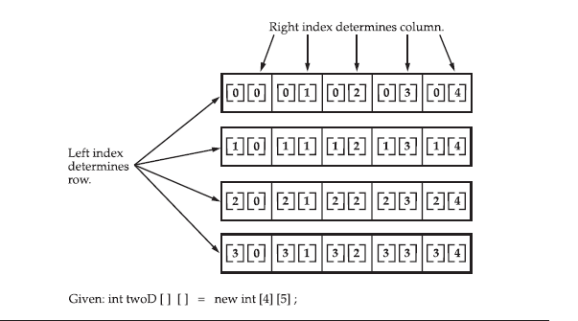
Types of Arrays
Two-Dimensional -

Slide 30
Exercise
Practice using two dimensional arrays to input and output data in a tabular format. Print 1 to 100.
Declare and initialize a two-dimensional String array called students with the names “Brice, Marvin, Anna” in the first row and “Kamal, Maria, Elissa” in the second. The finished code will print all the names in the array starting with all in the first row followed by all in the second row.

Slide 31
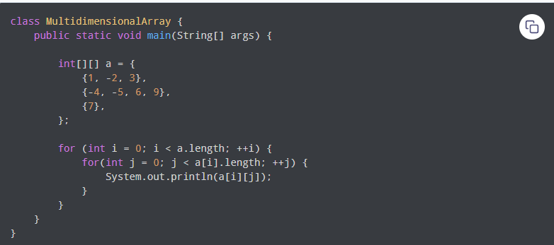
2D Array
Initialization

Slide 32
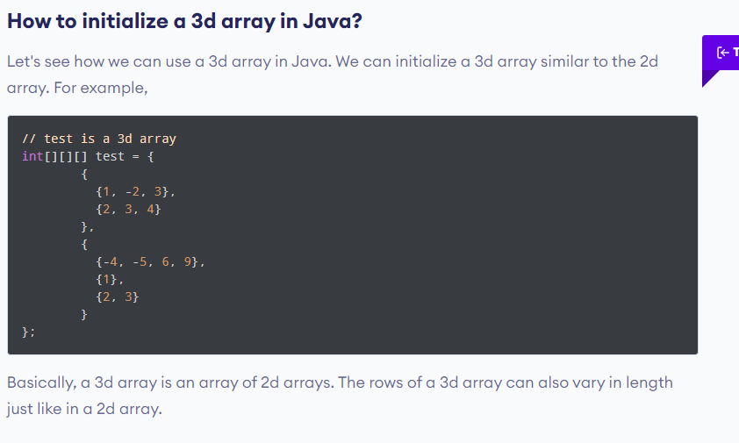
Types of Arrays
Multi-Dimensional Array

Slide 33
Java Operators
Arithmetic operators
+ Addition
- Subtraction
* Multiplication
/ Division
% Modulus
++ Increment
- - Decrement

Slide 34
Java Operators
Assignment operators
= -> x = 10
+= -> x += 20, x = 10; x = x + 20; x += 20;
-= -> x -= 10, y = 100; y = y - 200; y -= 200
*= -> x *= 10
/= -> x /= 10
%= -> x %= 10

Slide 35
Java Operators
Comparison Operators
== -> Equal to
!= -> Not equal
> -> Greater than
< -> Less than
>= -> Greater than or equal to
<= -> Less than or equal to

Slide 36
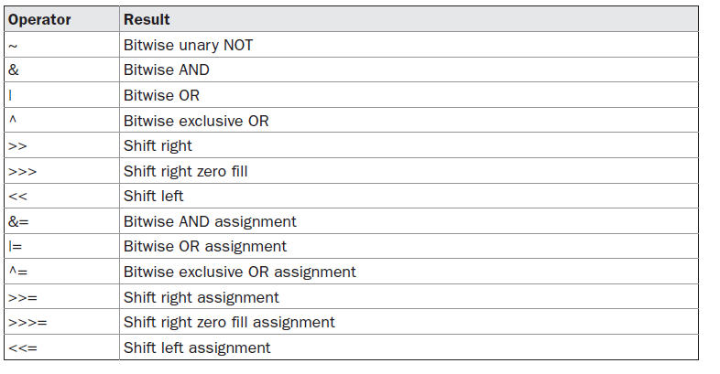
Java Operators
Bitwise Operators

Slide 37
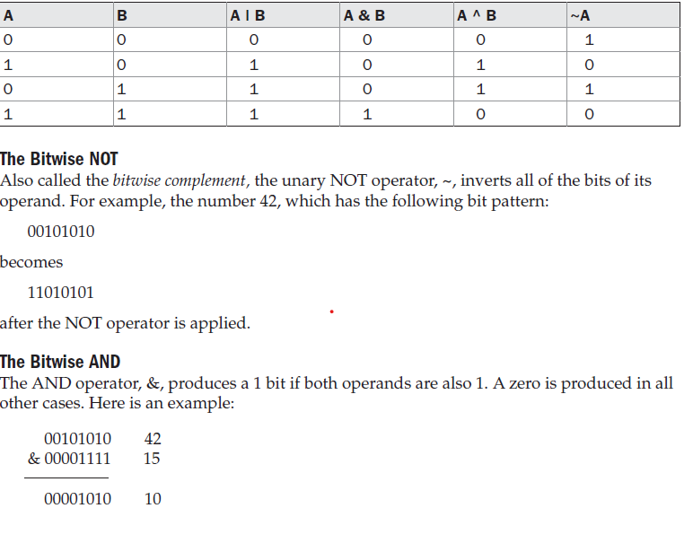

Slide 38
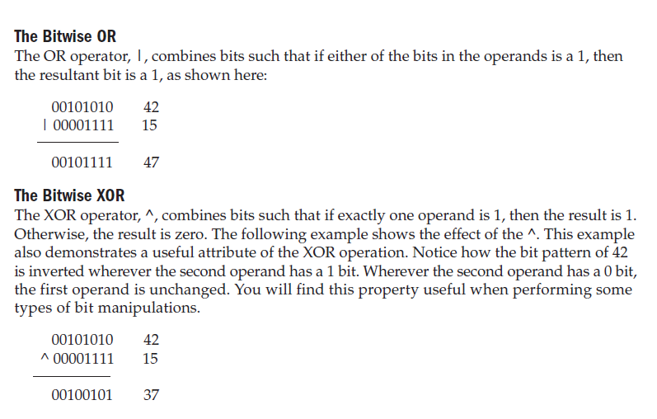

Slide 39
Java Operators
Logical Operators
+ + -> +
- - -> -
- + -> -
+ - -> -
&& -> Logical and
|| -> Logical or
! -> Logical not

Slide 40
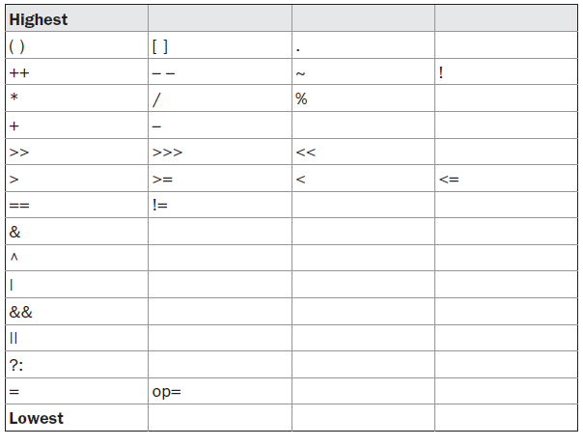

Operator Precedence

Slide 41
Exercise
// Java Program to Find the Largest Among Three Numbers
//Java Program to Check Leap Year
//Java Program to Check Whether a Number is Positive or Negative

Slide 42
Loops
while
The while loop is Java’s most fundamental loop statement. It repeats a statement or block while its controlling expression is true. Here is its general form:
while(condition) {
// body of loop
}
find midpoint between i and j

Slide 43
Loops
Do-while
do {
// body of loop
} while (condition);
Each iteration of the do-while loop first executes the body of the loop and then evaluates the conditional expression.

Slide 44
Exercise
// Program to find the sum of numbers from 1 to 1000.

Slide 45
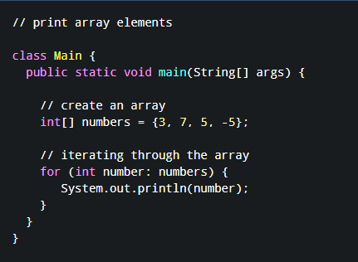
For-Each Loop
Java for-each Loop
The Java for loop has an alternative syntax that makes it easy to iterate through arrays and collections.

Slide 46
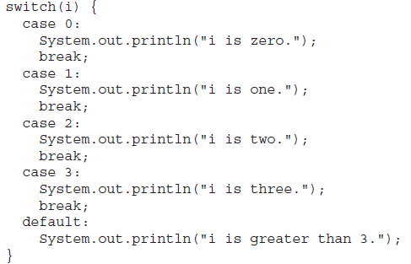
Switch case
Java’s multiway branch statement.
execution to different parts of your code based on the value of an expression
better alternative than a large series of if-else-if statements
Notes:
About break desirable. Less than 5 less than 10 example

Slide 47
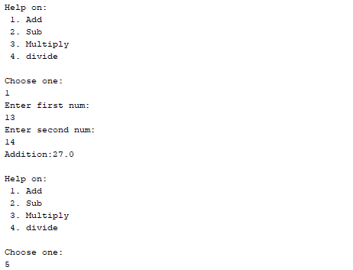
Exercise
Create calculator to add, subtract, multiply, divide. Use loop and switch case. Take numbers and operation input from user.
After every operation take next input from user. And when input is ‘Exit’ stop the program.

Slide 48
String Handling
char c[] = {'J', 'a', 'v', 'a'};
String s1 = new String(c);
Using concatenation
String Conversion and toString( ) and valueOf
charAt( )
s.getChars(start, end, buf, 0);
getBytes( )
Contains()
Split()
Notes:
About break desirable. Less than 5 less than 10 example

Slide 49
String Handling
equals( ) and equalsIgnoreCase( )
startsWith( ) and endsWith( )
equals( ) Versus ==
s.indexOf('t’) and s.lastIndexOf('t’)
org.substring(0, i);
Length()
String s = "Hello".replace('l', 'w’);
str = str.trim(); // remove whitespace
toUpperCase() and toLowerCase().
Notes:
About break desirable. Less than 5 less than 10 example

Slide 50
Exercise
Write a program that takes your full name as input and displays the abbreviations of the first and middle names except the last name which is displayed as it is. For example, if your name is robert Brett roser, then the output should be R. B. Roser.

Slide 51
Holliday Project
Student management sys-
Take and store students full name, div, roll num
Search students by name
show students
Delete by roll num
Edit data of student by roll num
Use loops, 2d arrays, string manipulation, Switch case

Slide 52
Writing Classes
The programs we’ve written in previous examples have used classes defined in the Java standard class library
Now we will begin to design programs that rely on classes that we write ourselves
The class that contains the main method is just the starting point of a program
➔ True object-oriented programming is based on defining classes that represent objects with well-defined characteristics and functionality

Slide 53
Classes and Objects
Consider a six-sided die (singular of dice)
Its state can be defined as which face is showing
Its primary behavior is that it can be rolled
We can represent a die in software by designing a class called Die that models this state and behavior
The class serves as the blueprint for a die object
We can then instantiate as many die objects as we need for any particular program. Each die might have a different ‘state’ (value of its attribute, face) but the same ‘behaviors’ (can be rolled – a method)

Slide 54
Classes
A class can contain data declarations and method declarations
Data declarations
int size, weight;
char category;
Usually call these ‘attributes’ or ‘properties’
Each of these has a ‘state’ that is, its ‘value’ at
any particular instance in time.
Method declarations
These are the ‘behaviors’ or ‘methods’ or
‘services’ objects of this class can provide.
e.g. rollDie(); might be such a behavior.
Also called the object’s responsibilities.
All the ‘functionalities’, that is, the ‘actions’ that
can take place on the attributes are included
here and here alone.

Slide 55
Classes
The values of the data define the state of an object created from the class
The functionality of the methods define the behaviors of the object
For our Die class, we might declare an integer that represents the current value showing on the face
One of the methods would “roll” the die by setting that value to a random number between one and six

Slide 56
Exercise
Create calculator to add, subtract, multiply, divide. Use loop and switch case. Take numbers and operation input from user.[Use class and methods]
After every operation take next input from user. And when input is ‘Exit’ stop the program.

Slide 57
Arguments and Parameters
Consider statements:
Arguments/parameters in call match in number and type to formal parameters in definition
Name joe = new Name();
joe.setFirst("Joseph");
joe.setLast("Brown");
public void setFirst(String firstName)
{
first = firstName;
} // end setFirst

Slide 58
This
public void setFirst(String first)
{
first = first;
} // end setFirst
Note incorrect, ambiguous use of identifier first
Solvable by use of this
this.first refers to data member
Note: possible but not typical
data object first
parameter first
public void setFirst(String first)
{
this.first = first;
} // end setFirst

Slide 59
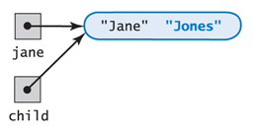
Passing Object as Parameter
When a formal parameter has a class type
Formal parameter initialized with memory address of object passed to it.
public void giveLastNameTo(Name child)
{
child.setLast(last);
} // end giveLastNameTo
jamie.giveLastNameTo(jane);

Slide 60
Passing Arguments
However, a method cannot replace an object passed to it as an argument
public void giveLastNameTo2(Name child)
{
String firstName = child.getFirst();
child = new Name();
child.setFirst(firstName);
child.setLast(last);
} // end giveLastNameTo2
child is considered local.
It will disappear when the method finishes

Slide 61
Constructors
Tasks of a constructor
Allocate memory for object
Initialize data fields
Properties
Same name as class
No return type (not even void)
Can have any number of parameters (including no parameters)

Slide 62
Method Overloading
Sometimes you want to have a multiple methods with the same name be able to do different operations on different parameters.
Java allows this through a process called overloading.
Overloading is having multiple methods in the same class with the same name, but accept different types of parameters.
For instance:
public double add(double num1, double num2) {
return num1 + num2;
}
public String add(String str1, String str2) {
return str1 + str2;
}
Even though both of these methods are named add, they perform different operations on different parameters.

Slide 63
Constructor Overloading
One of the more useful uses of method overloading is to overload constructors.
For example, you want to give programmers the option to create a rectangle without worrying about the length and width or the option to set the length and width when they create the object.
You can create two constructors, one with no parameters and one with two that initialize the attributes

Slide 64
access specifiers
In Java, we accomplish encapsulation through the appropriate use of access specifiers
A access specifiers is a Java reserved word that specifies particular characteristics of a method or data
We've used the final modifier to define constants
Java has three access specifiers: public, protected, and private
The protected access specifiers involves inheritance, which we will discuss later

Slide 65
access specifiers
Members of a class that are declared with public visibility can be referenced anywhere (via the object name.Membername.
Members of a class that are declared with private visibility can be referenced only within that class
Members declared without a visibility modifier have default visibility and can be referenced by any class in the same package (package scope!)
An overview of all Java modifiers is presented in Appendix E

Slide 66
access specifiers
Public variables violate encapsulation because they allow the client to “reach in” and modify the values directly (Encapsulation is one of the ‘sacred truths’ in OOP!)
Therefore instance variables should not be declared with public visibility. They are usually always ‘private.’ (Will talk about ‘protected’ later)
It is acceptable to give a ‘constant’ public visibility, which allows it to be used outside of the class
Public constants do not violate encapsulation because, although any client can access it, its value cannot be changed – and that is the key.

Slide 67
access specifiers
Methods that provide the object's services are declared with public visibility so that they can be invoked by clients
Public methods are also called service methods
A method created simply to assist a service method is called a support method
Since a support method is not intended to be called by a client, it should not be declared with public visibility
Example: Have method to computePay(….). But the code requires help of computePerDiem(…). So, computePay would invoke (private!) computePerDiem method.

Slide 68
access specifiers
public
private
Violate
encapsulation
Enforce
encapsulation
Variables
Support other
methods in the
class
Provide services
to clients
Methods

Slide 69
Static Fields and Methods
A static data field does not belong to any one object
Also called a class variable
Only one instance of the variable exists for all instances of the class
Note that a static data field is not a constant (final)

Slide 70
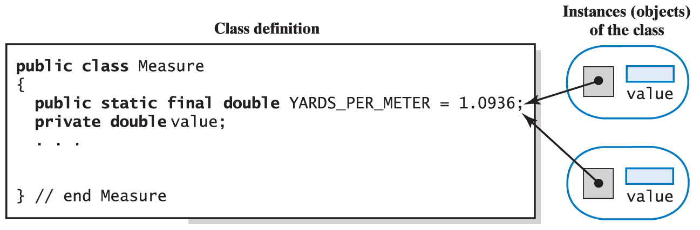
Static Fields and Methods
All instances of the class reference that one variable

Slide 71
Static Fields and Methods
Consider the need of a method that does not belong to an object of any type
Examples
A method to find the max or min of two or more numbers
A square root method

Slide 72
Static Fields and Methods
When specified static, a method is still a member of the class
However, does not need an object as a prefix to the call
Call with the name of the class
int maximum = Math.max(2, 3);
double root = Math.sqrt(4.2);

Slide 73
Inner Classes
Description
Class defined in scope of another class
Property
Can directly access all variables & methods of enclosing class (including private fields & methods)
Example
public class OuterClass {
public class InnerClass {
...
}
}

Slide 74
Inner Classes
May be named or anonymous
Useful for
Logical grouping of functionality
Data hiding
Linkage to outer class
Examples
Iterator for Java Collections
ActionListener for Java GUI widgets

