Slide 1

DEPARTMENT OF ELECTRONICS & COMUNICATION ENGINEERING
Intelligent Classroom automation with AI-Driven IOT Solution
Batch No: A4
1. 21471A0436 Pokala Naga Krishna
2. 21471A0437 Potluri Bhulakshmi
3. 21471A0439 Sanampudi Pavan Kalyan
4. 21471A0407 Duddukuri Vachalya
5. 21471A0435 Pilli Bhavana
6. 21471A0441 Shaik Althaf Raj
Name of Guide: Dr.B.Siva NageswaraRao
Designation: Asst Prof

Slide 2
Outline of the Presentation
Introduction
Objective of the Project
Components
Literature Survey
References

Slide 3
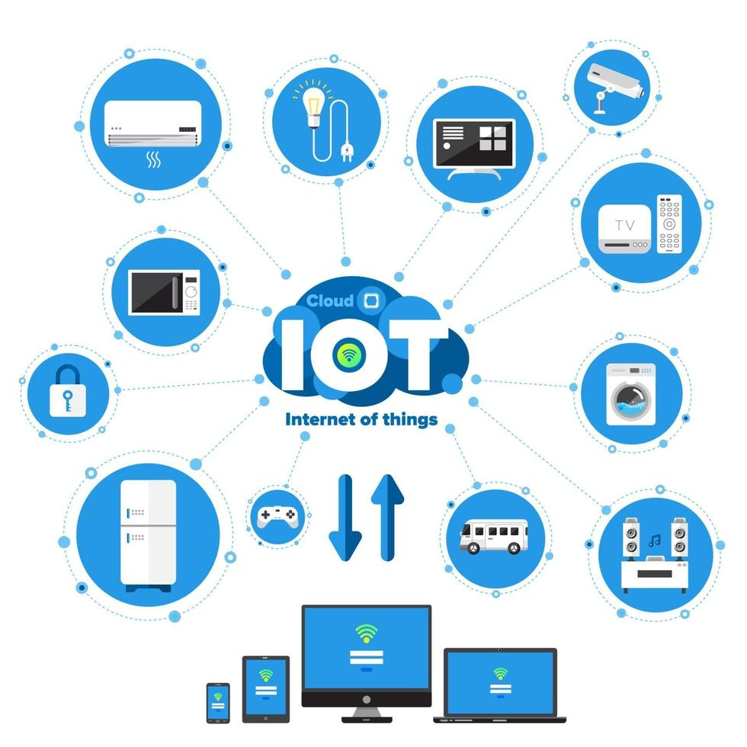
Introduction
What is an IOT ?
IoT (Internet of Things) is a dynamic innovation with a powerful impact on today’s world which can make human life simple and effortless.
The scope of this field is limitless and has emerged as a winner in various areas ranging from Medicine, Engineering, Computer Science, Space and Technology, Automobiles and so on.
The center of purpose is utilizing IoT based technology in accomplishing automation for classrooms.

Slide 4
Introduction cont..
Intelligent Classroom :
We propose an approach to control and manage electrical equipments such as fans and lights based on human presence.
Our focus is towards building a solution which could help in reducing overutilization of energy.
A camera is used for recognizing the presence of people in the classroom and for analyzing their seating position. Here a classroom is divided into two segments. Whenever a human presence is detected in a particular segment then the light and fan will be switched ON.
The reasonable objective of this paper is how to build up a smart classroom where we can automate the electrical equipments with a focus towards energy conservation

Slide 5
Objectives of the Project
Make Classroom Management Easier: AI can help teachers with administrative tasks, like tracking attendance or grading, giving them more time to focus on teaching and supporting students.
Offer Insights to Teachers: By analyzing data, AI can give teachers valuable insights into how their students are attending, helping them adjust their teaching methods to better meet everyone’s needs.
Make Education Accessible: With AI, learning can be scaled to reach more students, ensuring that quality education is available to a wider range of people, regardless of location or resources.
Support All Learners:AI can make students more discipline while learning ,ensuring that everyone has the opportunity to succeed in a supportive and inclusive environment.

Slide 6
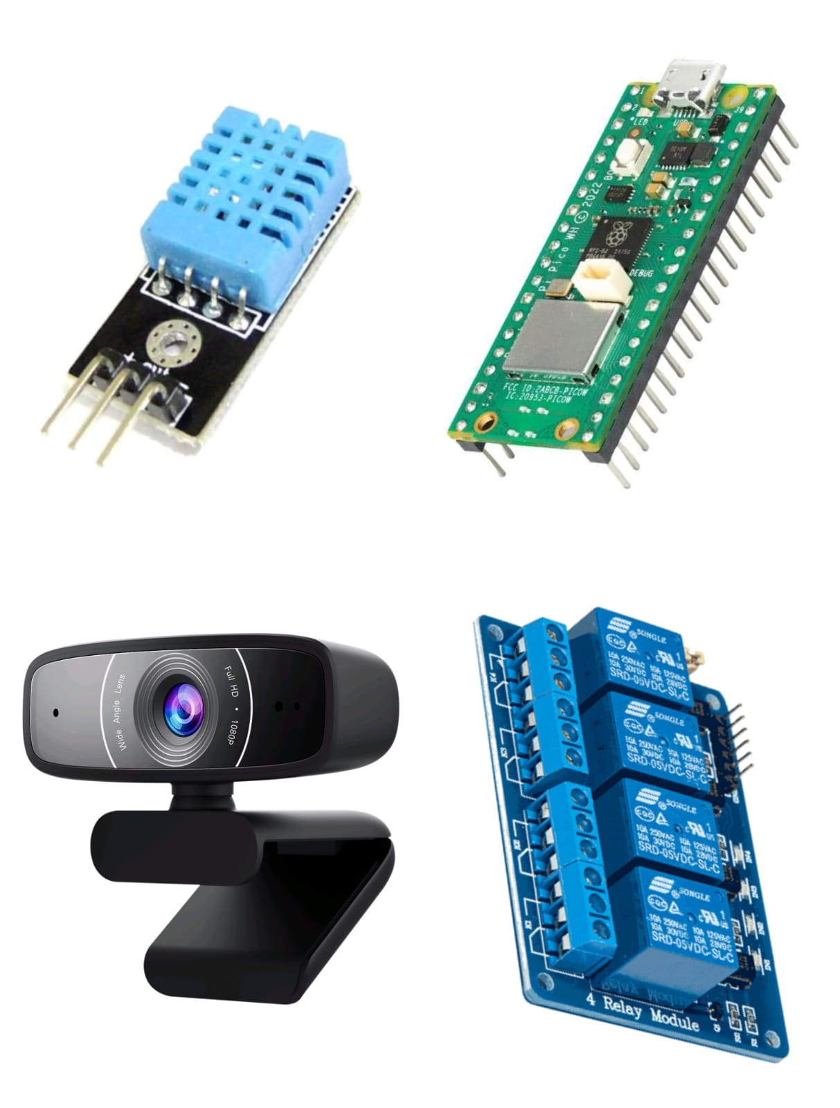
COMPONENTS :
Raspberry Pi Pico
5VDC Relay Module 4 Channel
DHT11
USB Camera

Slide 7
LITERATURE SURVEY
Ref. no | Authors | Title | Journal | Observation/remarks | Applications
1. | S. S. Rao et al. | "Automated Attendance System using IoT Sensors and AI” | International Journal of Advanced Research in Computer Science | Proposed a novel attendance system using IoT sensors and AI, achieving 95% accuracy. | Education, Attendance Tracking
2. | K. Singh et al. | "Personalized Learning Platform using Machine Learning and IoT“ | International Journal of Intelligent Systems and Applications | Developed a personalized learning platform using machine learning and IoT, resulting in improved student engagement. | Education, Personalized Learning |
3. | R. K. Sharma et al. | "Real-time Feedback System using AI-powered Chatbots and IoT" | International Journal of Advanced Research in Computer Science | Designed a real-time feedback system using AI-powered chatbots and IoT, enhancing student-teacher interaction. | Education, Feedback Systems

Slide 8
References
K. Atukorala, D. Wijekoon, M. Tharugasini, I. Perera, and C. Silva, “SmartEye - Integrated solution to automation, security and monitoring through mobile phones,” NGMAST 2009 - 3rd Int. Conf. Next Gener. Mob. Appl. Serv. Technol., no. May 2016, pp. 64–69, 2009.
P. S. Nagendra Reddy, K. T. Kumar Reddy, P. A. Kumar Reddy, G. N. KodandaRamaiah, and S. N. Kishor, “An IoT based automation using android application,” 2016 Int. Conf. Signal Process. Commun. Power Embed. Syst., pp. 285–290, 2016.
K. Puthea, R. Hartanto, and R. Hidayat, “A Review on Attendance Marking System based on Face Recognition,” 2017 2nd Int. Conf. on Information Technology, Information . Syst and Elect Eng., pp. 303–308, 2017.
G. Sfikas, “Creating a Smart Room using an IoT approach,” ResearchGate, no. May, 2016.
J. Lohokare, R. Dani, A. Rajurkar and A. Apte, "An IoT ecosystem for the implementation of scalable wireless automation systems at smart city level," TENCON 2017 - 2017 IEEE Region10 Conference, Penang, 2017, pp. 1503-1508

Slide 9


