Slide 1
Share of Wallet Intelligence Engine
How much of each client's banking does Syn Bank actually hold?
Team The Independent Variable
Daniel Mataranyika · Herton Mabongue
Standard Bank × Data School Hackathon 2026

Slide 2
THE PROBLEM
You cannot measure what you cannot see
Syn Bank sees every transaction that flows through Syn Bank — and none of the ones
that flow through its competitors.
So share of wallet cannot be read off the internal data. It has to be estimated from
outside, and the estimate has to be independent of what we already hold.
Getting that independence wrong is subtle — and we got it wrong first.

Slide 3
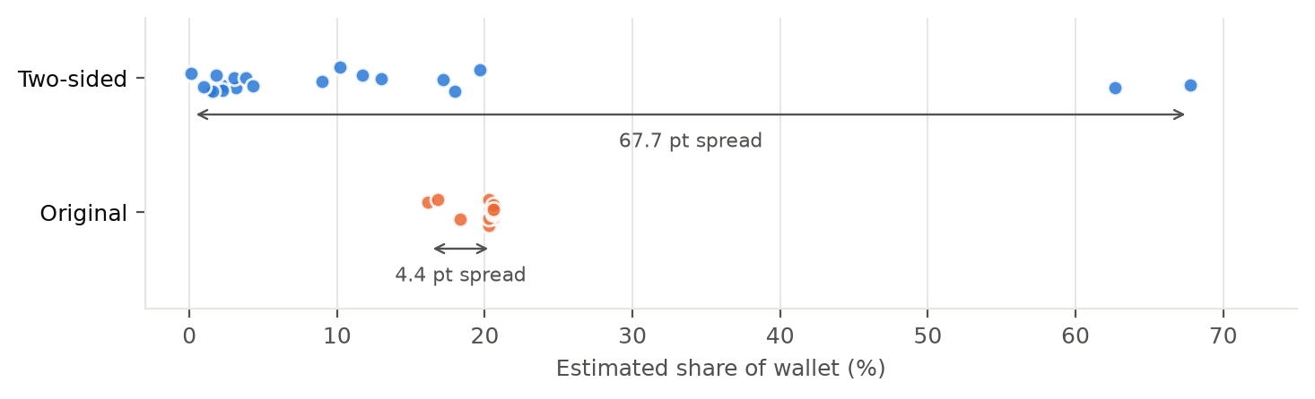
WHAT WE FOUND
Our first model could not see the data
We sized the wallet from internal flow, then took captured
volume as a fraction of it:
share = (wallet × capture_ratio) / wallet
The wallet term cancels. Share was identical to the
assumed capture rate — the data never entered it.
It passed every obvious check: values between 0 and 1,
a plausible-looking ranking.
2,757×
4.4 pts
DIFFERENCE IN CLIENT SIZE
DIFFERENCE IN SHARE

Slide 4
THE MODEL
Two sides, two independent sources
TOP-DOWN — estimated
BOTTOM-UP — measured
Addressable flow, from published FY2025 statements:
• Revenue → transactional banking
• Foreign revenue → cross-border / FX
• Cost of sales + inventory → trade finance
Each scaled by an explicit SA-attribution share.
Captured flow, summed over the trailing 12 months
of Syn Bank's own datasets.
No assumption enters this side at all.
That is what makes the sensitivity test in a
later slide meaningful.
share = captured flow ÷ addressable flow
Share now spans 0.1% to 67.8% across the portfolio.

Slide 5
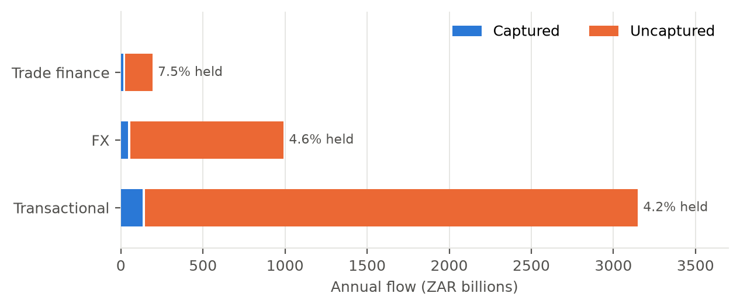
THE FINDING
Syn Bank holds 4.5% of its clients' banking flow
4.5%
R4.29tn
R4.10tn
R9.65bn
SHARE OF WALLET
ADDRESSABLE FLOW
UNCAPTURED GAP
FEE OPPORTUNITY / YR
Transactional is the gap
It is the largest uncaptured pillar in absolute terms
and the lead pillar for 19 of 20 clients.
That makes cash-management consolidation the
repeatable conversation across the whole book —
one proposition, twenty meetings.

Slide 6
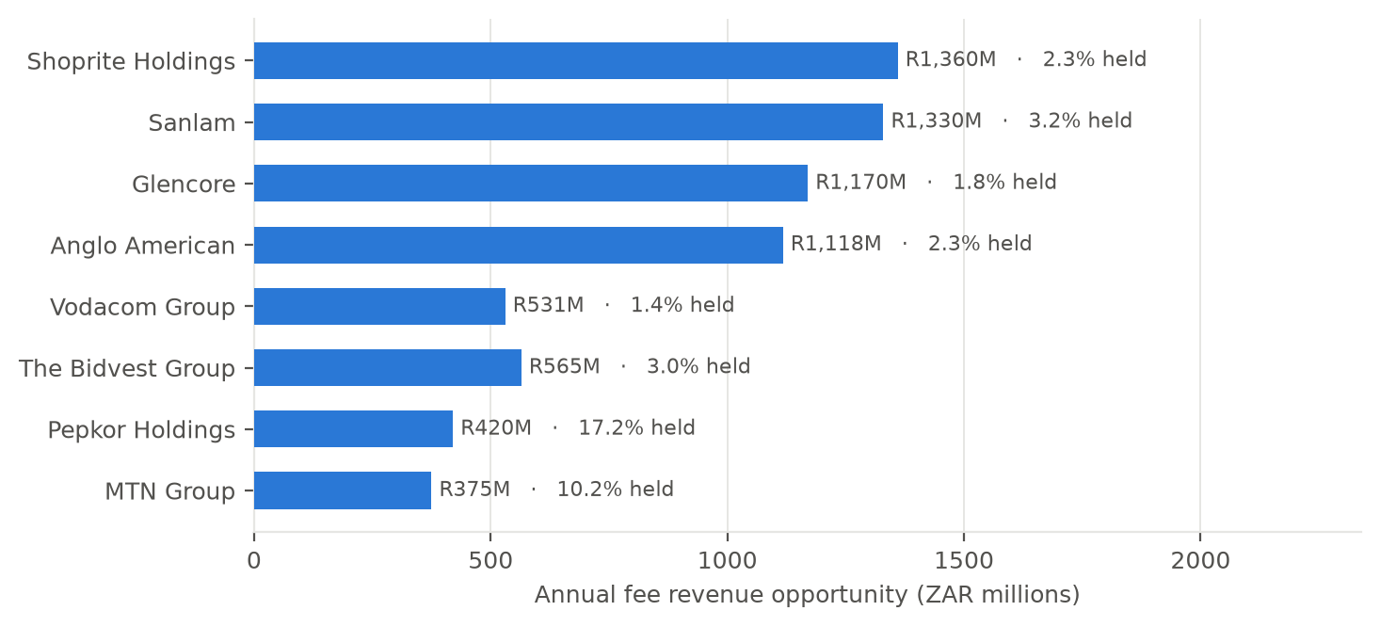
PRIORITISATION
Where a banker should start on Monday
Ranked by winnable value
The composite score blends:
50% gap size
20% ease of conversion
15% relationship depth
15% 90-day urgency
So the list is ordered by what is realistically
winnable, not simply by client size.

Slide 7
GENERATIVE AI
The model writes the briefing; the engine owns the numbers
How it is grounded
Why it survives a live demo
Every figure is computed by the wallet engine and
passed in as an evidence block. The model is told to
reuse those figures verbatim — it does language,
not arithmetic.
Each output is then re-read by a grounding check
that flags any rand amount or percentage that did
not appear in the evidence.
Currently zero unsupported figures across all
generated briefings.
• Falls back to deterministic text, section by
section, if the API is unavailable
• Responses cached to disk, so it runs offline
and costs no quota to repeat
• One call, not an agent hierarchy — answers
land in about three seconds
• /ai-status reports which model answered
It writes pre-meeting briefings and answers open questions over the portfolio in natural language.

Slide 8
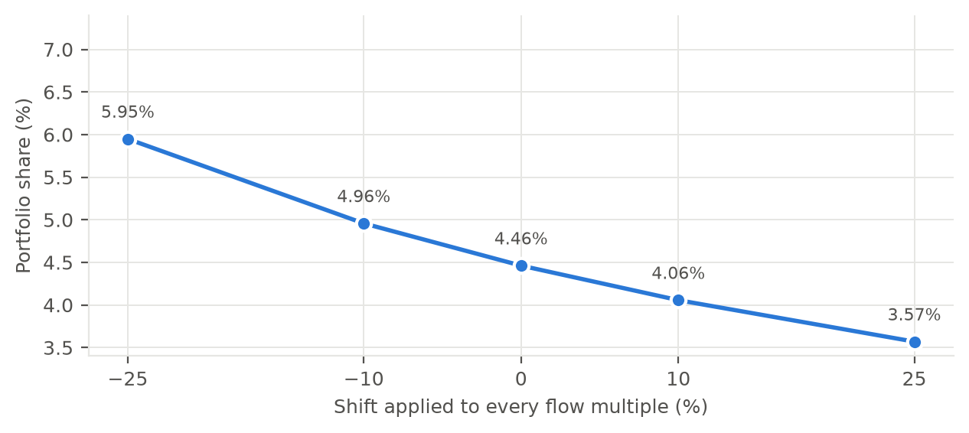
RIGOUR
The conclusion survives our assumptions being wrong
±25% on every multiple
Portfolio share moves only between
3.6% and 5.9%.
The captured side does not move at all —
it is measured, not assumed. If it did, the
model would still be circular.
Cross-check: our multiples imply banking
fees of ~0.47% of revenue, inside the
0.4–0.7% range the brief itself cites.

Slide 9
LIMITATIONS
What we would fix next
Known limitations
Next steps
• 20 clients supplied, not the 50 described.
We modelled what we were given.
• Flow multiples are benchmarks, not
observations.
• SA-attribution is the most judgmental input.
• Revenue basis differs by industry and is
recorded per client.
• Gaps assume our records are complete.
• Replace SA-attribution with disclosed
segment data from the statements.
• Extend to lending and DCM using the debt
schedules already collected.
• Forecast cash cycles from three years of
daily flow to time the engagement, not just
target it.
• Back-test share estimates against any
mandate wins that follow.

Slide 10
IN ONE LINE
Syn Bank holds 4.5% of a R4.29 trillion flow.
The other 95.5% is worth R9.65bn a year in fees —
and we can name who to call first.
Every number traceable to a computed field.
Every external figure cited. Every assumption tested.
Team The Independent Variable · Daniel Mataranyika · Herton Mabongue

