Slide 1


NPS LAB- EL
Distributed Multi Hop Communication System using Quantum Key Exchange
NAME | USN | E-Mail
M P Pretham | 1RV23CS122 | mppreetham.cs23@rvce.edu.in
M R Nithish | 1RV23CS123 | mrnithish.cs23@rvce.edu.in
Neeraj Gowda M | 1RV23CS150 | neerajgowdam.cs23@rvce.edu.in

Slide 2
Problem statement
Communication networks are vulnerable to eavesdropping, which can compromise the confidentiality of transmitted data.
Attackers can perform Man in the Middle (MITM) and Replay attacks, leading to message tampering and unauthorized message retransmission.
Traditional security mechanisms do not effectively demonstrate attack detection during key exchange and multi hop communication.
There is a need for a secure multi hop messaging system that can establish secure keys, protect data integrity, and detect network attacks in real time.

Slide 3
Objectives
Primary Objective
• To develop a secure messaging system that enables reliable communication across multiple network nodes while protecting data from unauthorized access and network attacks.
Secondary Objectives
• To establish a secure key exchange mechanism between communicating nodes using Quantum Key Distribution principles.
• To ensure confidentiality and integrity of transmitted messages through encryption and authentication techniques.
• To detect and prevent network attacks such as eavesdropping, man in the middle, and replay attacks.
• To enable secure multi hop communication and monitor network activities through an interactive dashboard.

Slide 4
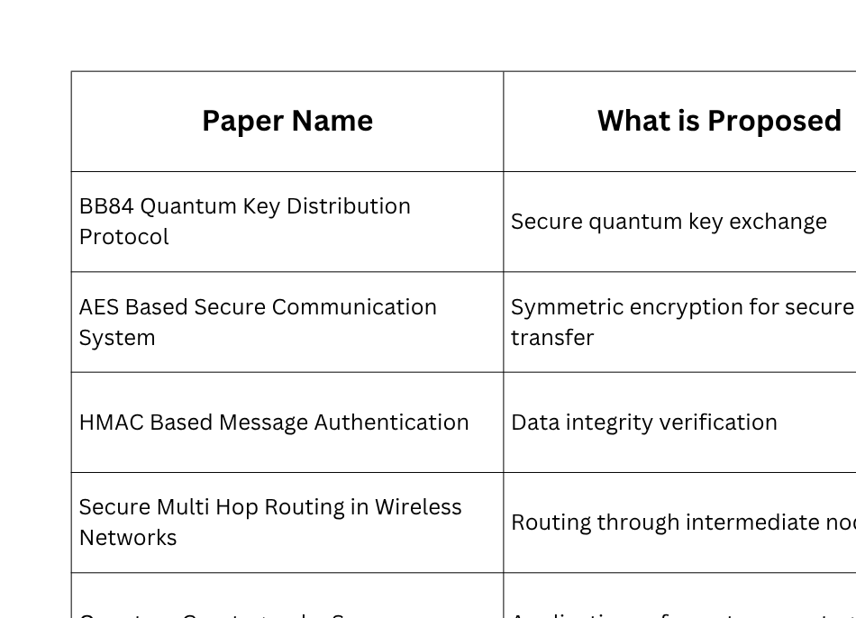
Literature Survey

Slide 5
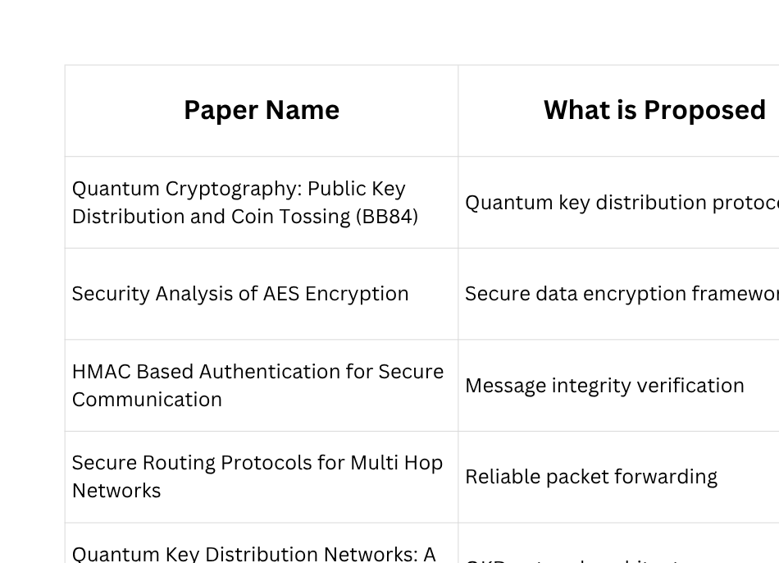
Literature Survey

Slide 6
Research Gap
Lack of Integrated Quantum Secure Communication Systems
• Existing solutions focus on either quantum key distribution, encryption, or secure routing individually rather than providing a unified security framework.
Limited Protection Against Multiple Attack Types
• Most secure communication systems address specific threats but do not simultaneously detect and mitigate eavesdropping, man in the middle, and replay attacks.4
Insufficient Multi Hop Security Mechanisms
• Many communication models secure end points but provide limited security monitoring and key management across intermediate routing nodes.
Lack of Interactive Visualization and Testing Platforms
• Existing research is often theoretical and does not offer practical tools for visualizing key generation, packet routing, attack detection, and security events in real time.

Slide 7

Methodology
Message Creation
BB84 Key Generation
Encryption & Authentication
User enters a message and selects the destination node through the dashboard.
Sender and receiver simulate Quantum Key Distribution to establish a secure shared key and calculate QBER.
The message is encrypted using AES and protected with HMAC to ensure confidentiality and integrity.
Secure Delivery & Visualization
Attack Detection
Multi Hop Routing
The system checks for Eavesdropping, Man in the Middle, and Replay attacks using QBER analysis, HMAC verification, and nonce validation.
The encrypted packet is forwarded through multiple network nodes with secure processing at each hop.
The receiver decrypts the message and the dashboard displays routing details, attack status, and packet journey information.

Slide 8
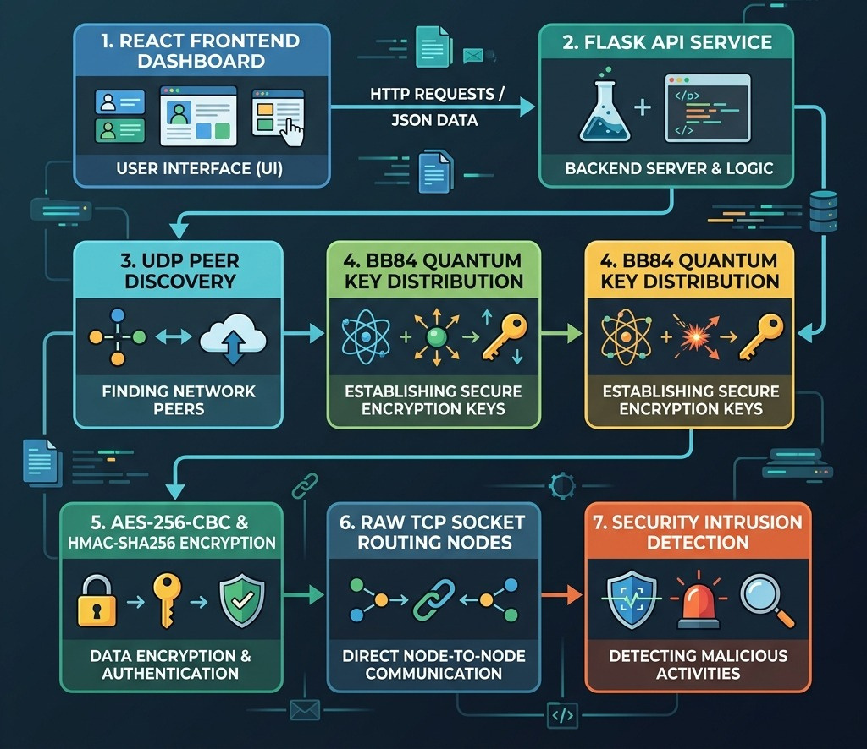
Methodology Flowchart

Slide 9
Technology Stack
Programming: Python, JavaScript
• Backend: Flask REST API
• Frontend: React.js, HTML, CSS
• Networking: TCP/IP Socket Programming, Multi Hop Routing
• Quantum Security: BB84 Quantum Key Distribution Simulator
• Encryption: AES 256 CBC
• Integrity Verification: HMAC SHA256
• Data Exchange: JSON
• Attack Detection: QBER Analysis, Nonce Verification, HMAC Validation
• Deployment Environment: Local LAN Network
• Version Control: Git & GitHub

Slide 10
Outcomes and Results
• To establish secure communication using BB84 Quantum Key Distribution (QKD)
• To securely exchange encryption keys while detecting eavesdropping attempts
• To implement AES 256 CBC encryption for confidential message transmission
• To ensure message integrity using HMAC SHA256 verification
• To enable secure multi hop message routing across intermediate nodes
• To support real time peer to peer communication over a local network
• To detect eavesdropping attacks using Quantum Bit Error Rate (QBER) analysis
• To detect Man in the Middle (MITM) attacks through HMAC validation
• To prevent replay attacks using unique nonce verification
• To automatically discover devices on the LAN using peer discovery protocols
• To provide a real time dashboard for monitoring packet flow and security events
• To visualize packet journeys, hop wise processing, and attack detection mechanisms
• To demonstrate the practical integration of quantum security concepts with classical cryptography
• To improve network security through layered protection using BB84, AES, HMAC, and routing controls
This project successfully demonstrates a Quantum Secure Multi Hop Messaging System that combines BB84 Quantum Key Distribution, AES 256 encryption, HMAC based integrity verification, and secure multi hop routing. The system effectively detects eavesdropping, Man in the Middle, and replay attacks while providing real time visualization and secure communication across networked devices. It showcases how quantum inspired security techniques can enhance modern communication systems and strengthen protection against emerging cyber threats.

Slide 11
The End

