Slide 1
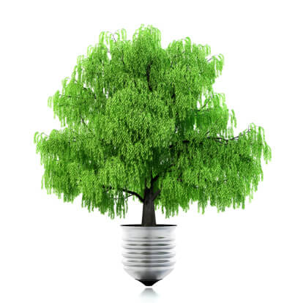
Team 3:
Smart Lighting Control System
Shihao, Dylan, Tsz-Wai

Slide 2
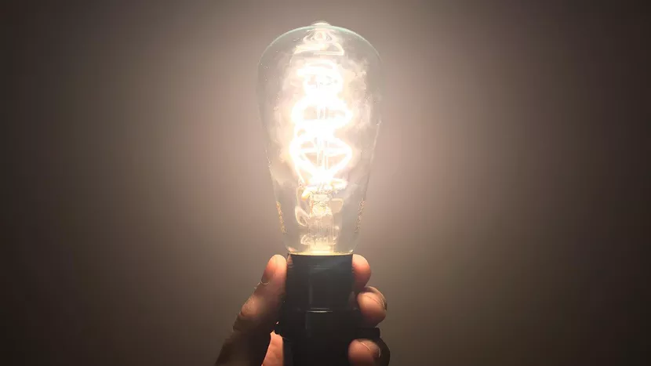
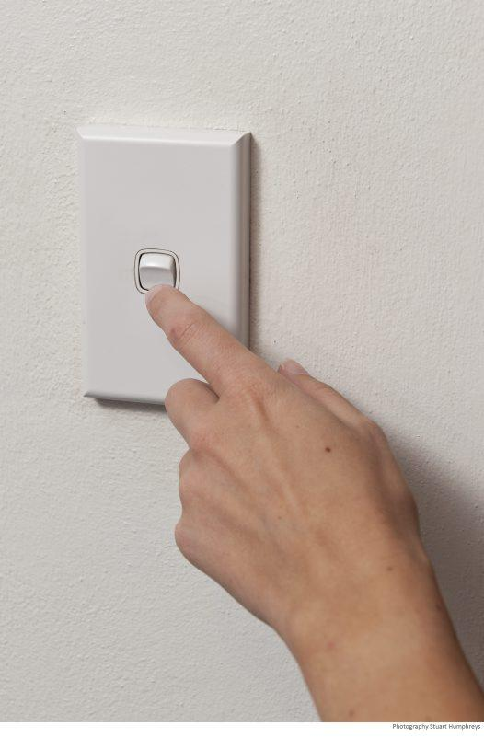
Introduction
Theme: Environmental Sustainability
Problem: People forget to turn off lights
Solution: We built a product that helps people turn off lights
How our product works:
Input: Thermo Sensors to detect the presence of users
Output: System that turns on / switches off lights
Notes:
Introduce theme of this quarter’s projects: theme, what problems we discussed and proposed a solution to.
Our problem: Lights always on, in school: classrooms, meeting rooms, dining halls, resident halls, etc
Our product: how it differs from public restrooms, emergency: those are motion sensors, eventually turn off, hard to program it in rooms, multiple users or doors
Describe: what it is, inputs and outputs, how it solves some of the issues (sleeping, efficiency)

Slide 3
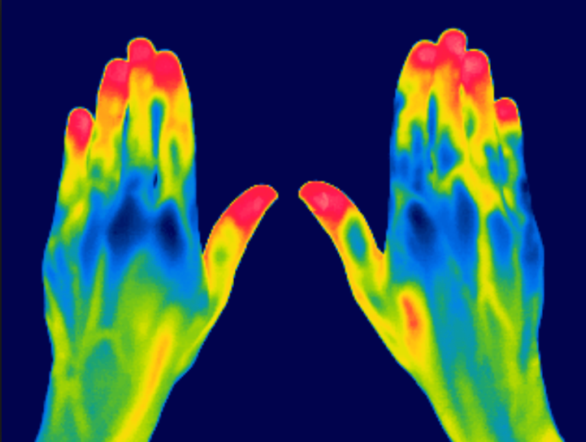
Build Process: Thermal IR Sensor
Distinguish between human body and non human objects
Material | Emissivity Value
Polished Aluminum | 0.05
Cement | 0.54
Concrete | 0.92
Glass | 0.92
Sand | 0.90
Skin, human | 0.98
Notes:
The central part for this project is the thermal sensor we chose. We actually spent a lot of time finding the correct sensor in our preparation. The big problem: how to distinguish between human and non human objects with only one sensor. E.g. hot water and human objects? Thermal sensor we chose has the function to distinguish between different objects’ emissivity.
Emissivity is a relative measure of how efficiently an object radiates heat. A perfect thermal emitter has a emissivity of 1.0, but most real-world objects range from 0 to 1.

Slide 4
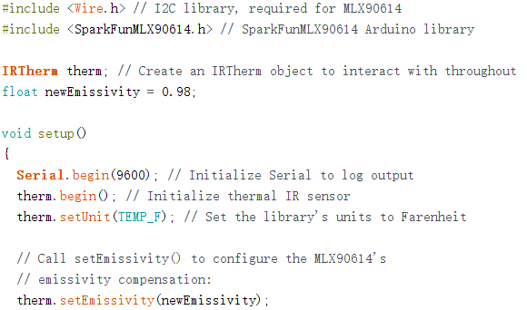
Build Process: Thermal IR Sensor
Distinguish between human body and non human objects
Notes:
So in the coding, we can set emissivity for the object that we want the sensor to actually detect. In this project, we set it to human body, which is 0.98. In other scenarios, like detecting pets or something, we can set it to different kinds of fur that pets have for further applications of the project. Basically it will detect the most accurate temperature for the specific emissivity that we set. In this case, the sensor will only detect the temperature of human body, and when it comes other non human objects, it will just return the room temperature or not so accurate one of the unknown object.

Slide 5
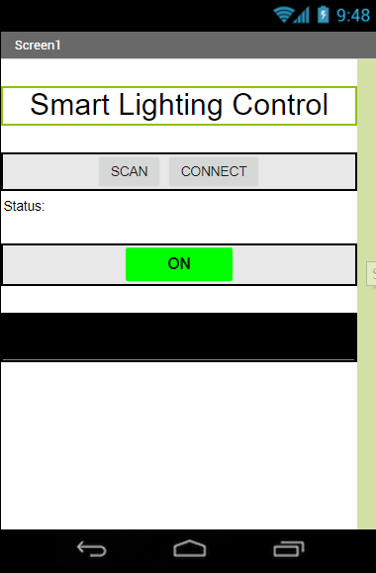
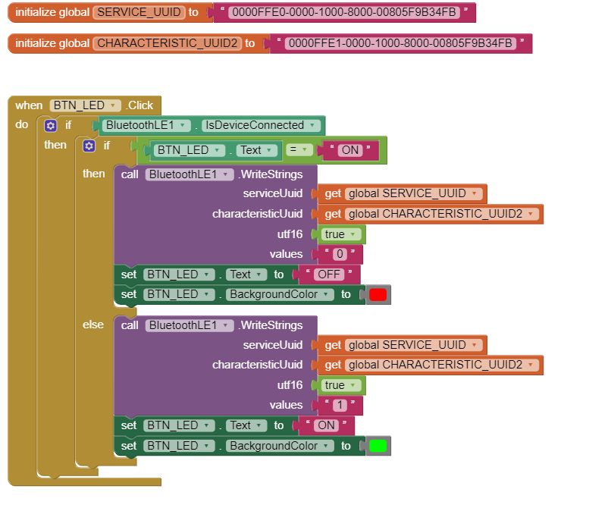
Build Process: App Inventor: Mobile App Control
Notes:
We designed an app to control the whole intelligent system, which makes it pretty convenient for people to switch on the function whenever they want. This is the main part of the visual programming. I left out the bluetooth setup since that’s not directly related to our project. After clicking the Button (when phone is connected to HM-10), we send 0 to the Arduino if it’s an “off”, and send 1 to Arduino if it’s an “on”, changing the color of the button at the same time. (Green is on and Red is off)

Slide 6
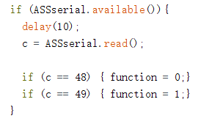
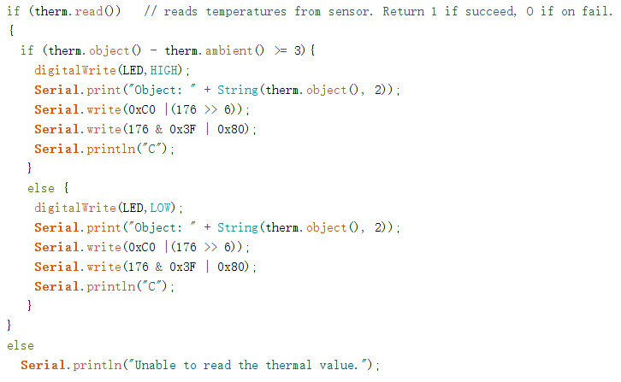
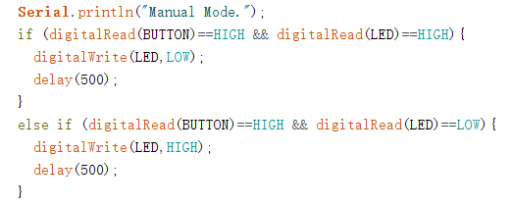
Build Process: Software
Notes:
in the main loop, Check if the board receives any value from the bluetooth. If so, store the value (0 or 1) into character c. Print out c for testing. Set the function off if c is 0 and set it on if c is 1 (48 in ASCII stands for integer 0 and 49 stands for 1). If the function is on, then we are going to detect human body in the room automatically via the Thermal Sensor. Print “Unable to read” if there’s no value. The difference is 3 after multiple tests. If the difference between the temperature of the object right below the sensor and that of the ambient environment is greater than or equal to 3, we say there’s a human body! Hence we turn on the light and print out the temperature in Celcius to the Serial Monitor. Otherwise, the difference is less than 3, so there’s no human at all and turn the light off. If the function is off, it enters a manual mode. For sleeping or watching movies.

Slide 7
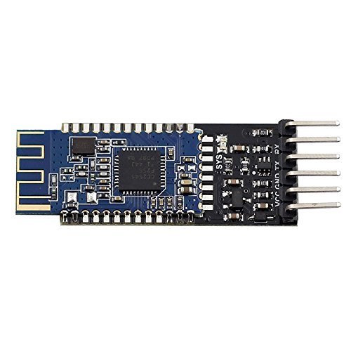
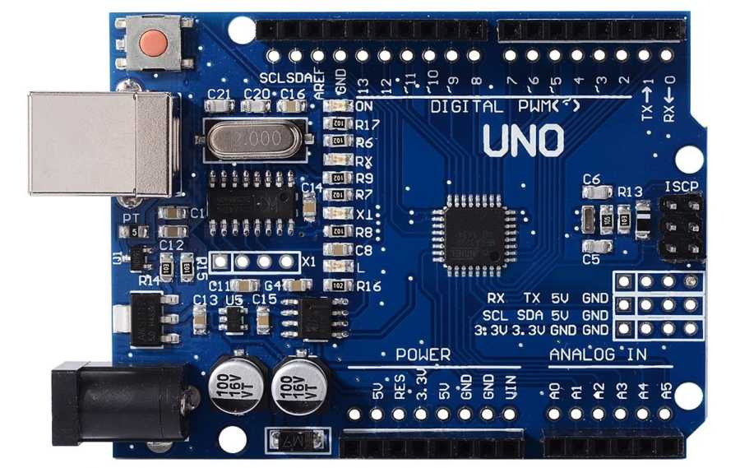

Build Process: Hardware
Thermo Sensor
Bluetooth Module
Arduino UNO
Notes:
Briefly explain the function of each one: outputs
Thermo Sensor: measures ambient temperature, compares it with object temperature
Bluetooth Module: ???
Arduino UNO: stores the program, and executes it.

Slide 8
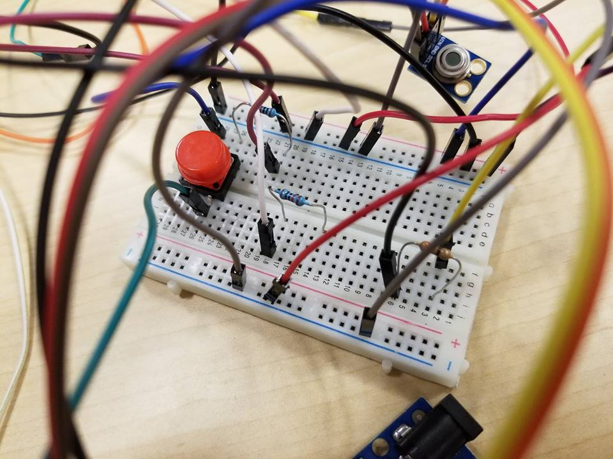
Piecing Together
Many electrical components
Different circuits on 1 board
Communication with Arduino

Slide 9
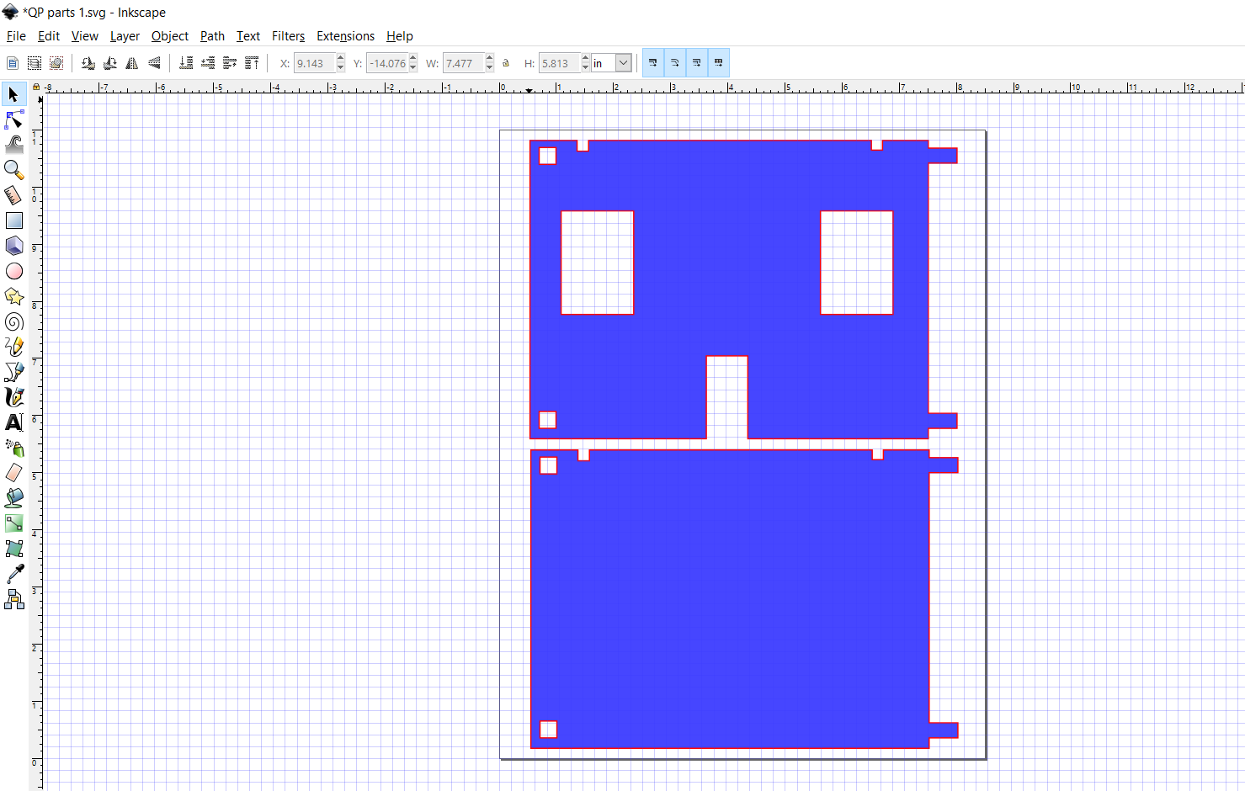
Creating Parts
Design through InkScape
Many imperfections

Slide 10
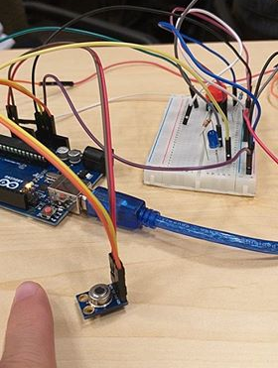
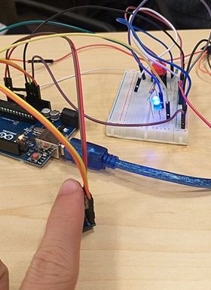
Going Through Tests
Debugging process
Learning experience

Slide 11
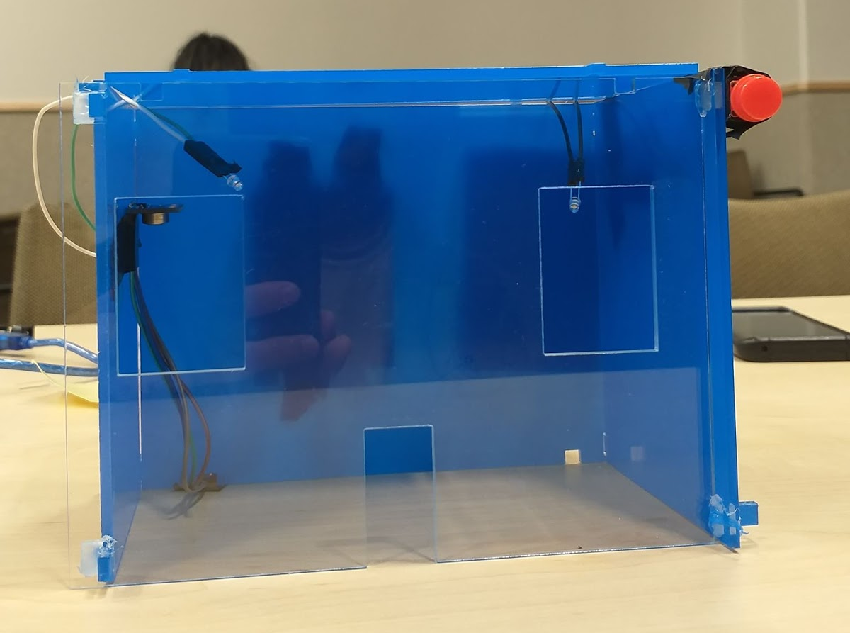
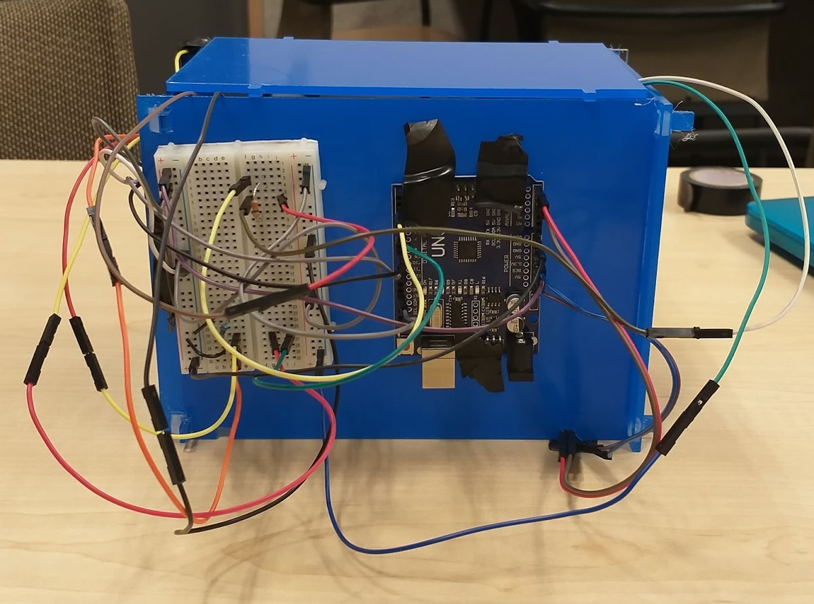
Putting it all together
Notes:
Talk about acrylic pieces and laser cutting, building the house and attaching the components together to make it look nice from the front

Slide 12

Some Issues We Faced
Bluetooth not working
Weird wiring setup
Arduino board fried
Notes:
Issues with bluetooth connections:

Slide 13
Conclusion
Accomplishments of the project
Lights switch on when the thermal sensor detects human presence
App can toggle the sensor and its output
House looks ‘nice’ from the front
Potential Further extensions
Larger scale
Potential further applications

