Slide 1
Misinformation on Reddit
Alice Renegar • Stephanie Wang • Genki Marshell • Vicky Wang • Richard Wu • Young Chan Kim • Neha Deshmukh
Research based on work with Drew Margolin

Slide 2
Reddit Content Model
Personal Projects
Research Subject
Method (Defining “Snopes”)
Results
Further Questions

Slide 3
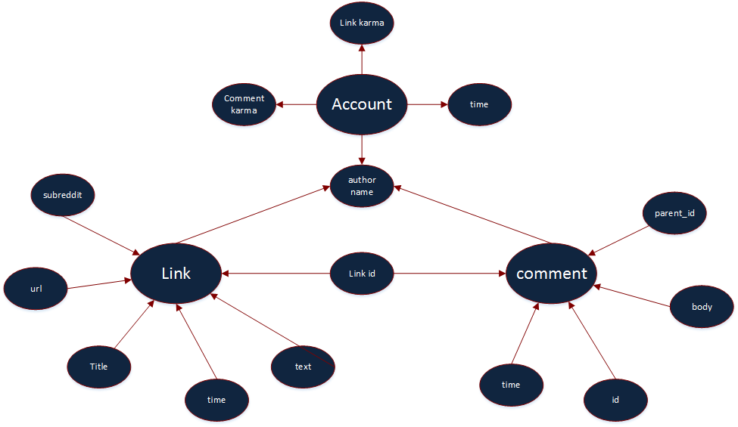
Reddit Content Model
Data fields are obtained from Reddit.com and RedditAnalytics.com

Slide 4
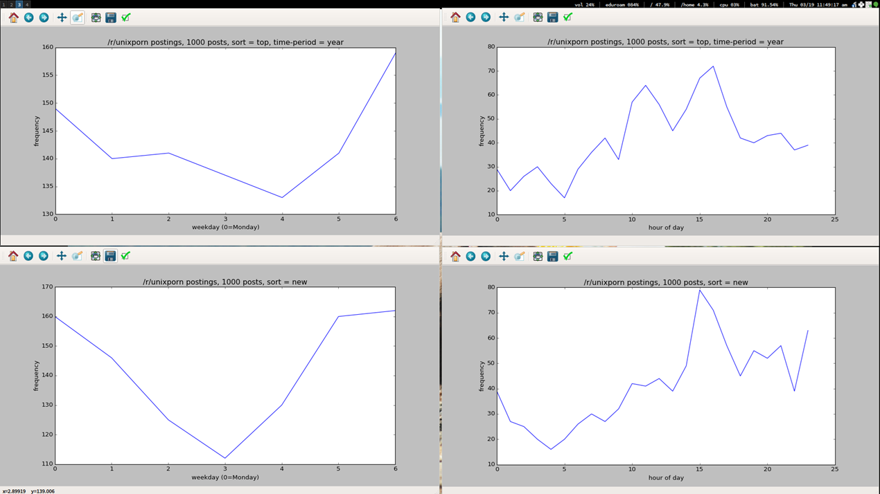
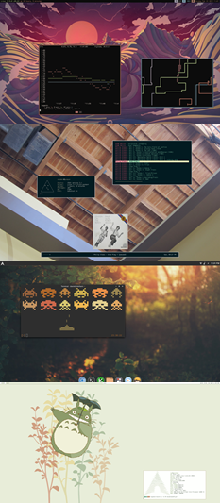
Genki Marshall
Introductory projects
Posts in /r/unixporn by day of the week and by time

Slide 5
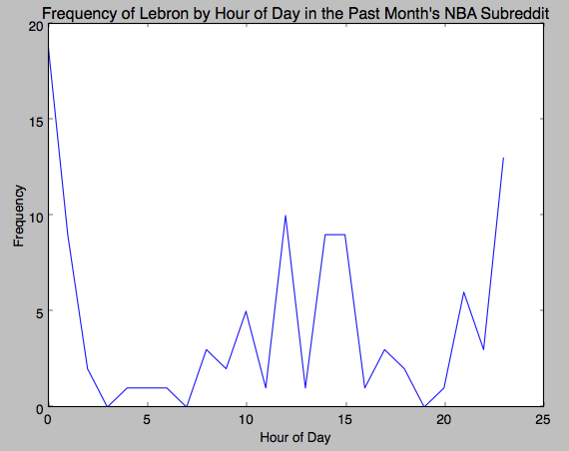
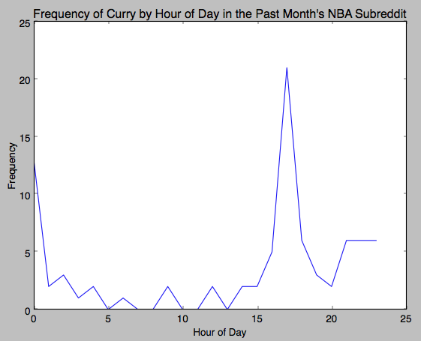
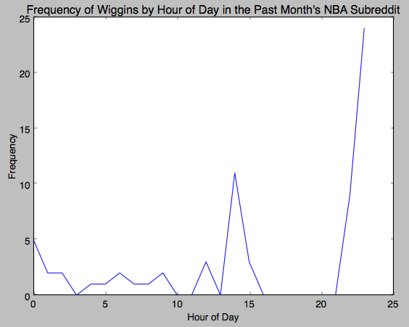
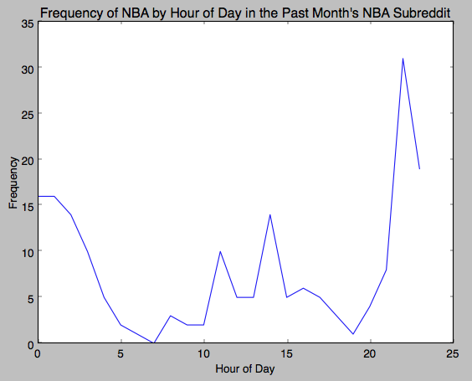
Young Chan Kim
Introductory projects
Frequency of specific words by time of day in /r/nba during the past month
‘Lebron’
‘Curry’
‘Wiggins’
‘NBA’
Frequencies generally peaked in the afternoon and evening EST

Slide 6
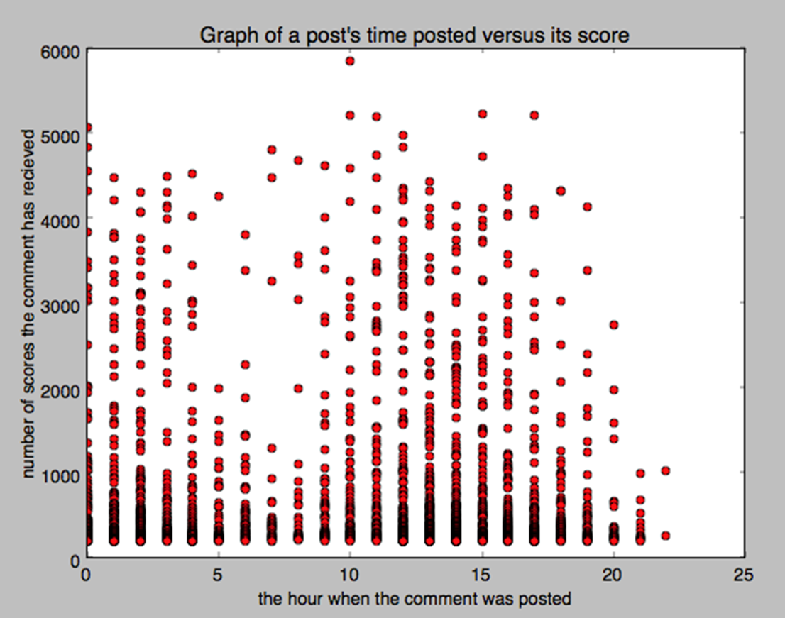
Vicky Wang
Introductory projects
Assumed popularity (by score) and time of post in the last 2000 ‘top’ posts
2-4am EST showed very little ‘top’ activity and lower scores. ‘Top’ is an unknown sorting algorithm, this limits the observations we can make.

Slide 7
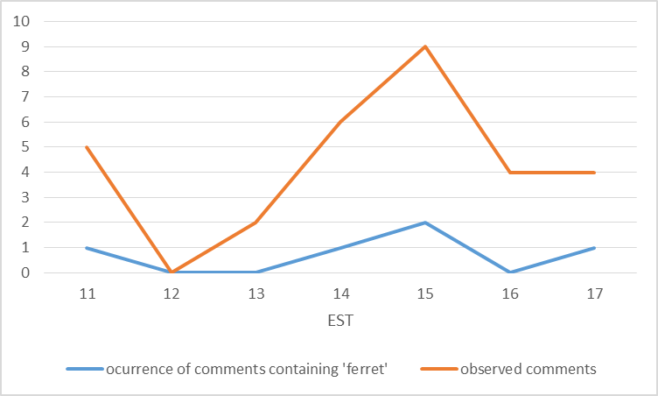
Stephanie Wang
Introductory projects
Observed repetition of a chosen word in link title in ‘top’ comments for that link
The frequency of the word’s occurrence followed the same trends as the ‘top’ comment volume. Observations are limited by the pre-selected nature of the comments.

Slide 8
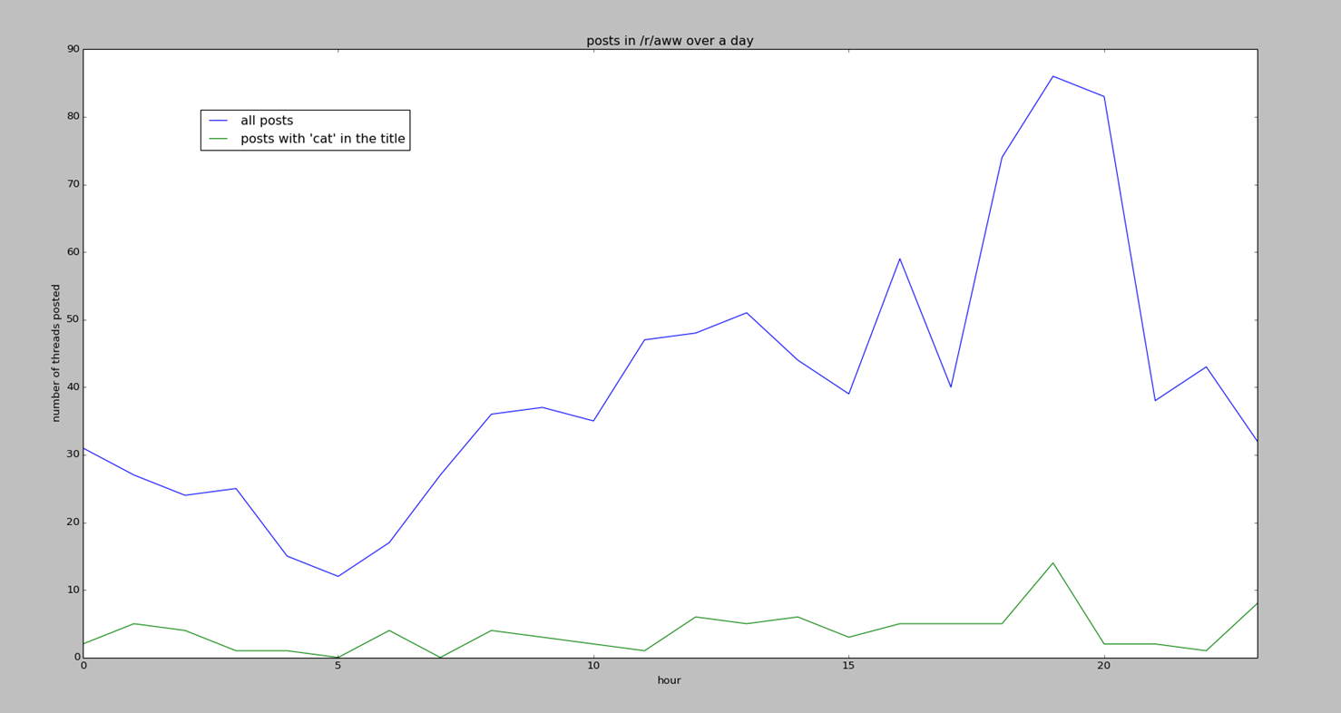
Richard Wu
Introductory projects
Posts in /r/aww and posts with cat in the title, by time
Cat posts roughly correlated to overall post volume during the time surveyed

Slide 9
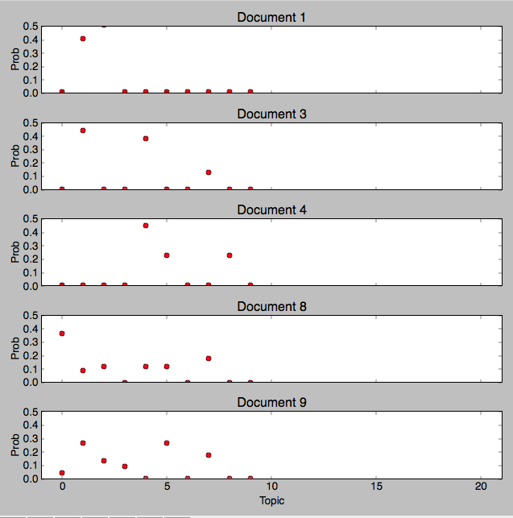
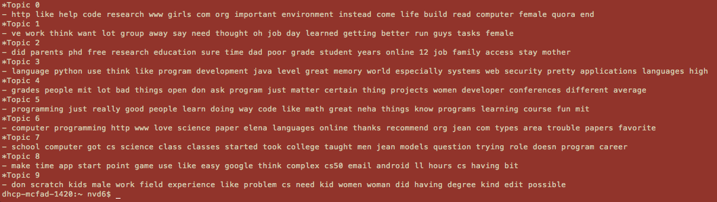
Neha Deshmukh
Introductory projects
Assumed popularity (by score) and time of post in the last 2000 ‘top’ posts
Topical Analysis of comments in from one of the Reddit AMA posts
For each document, the topic/category out of 10 topic classifications, that is most relevant showed the highest frequency. The method used for generating topics was Latent Dirichlet Allocation, which is unsupervised.

Slide 10
Research Subject
Response to misinformation in social networks:
How do users respond to being corrected?
How do users respond to misinformation?
How do users respond to corrections?
Research project by Drew Margolin

Slide 11
What is a “Snope”?
A “Snope” is a reply that includes a URL from one or more of the fact checking websites Politifact, Snopes, and FactChecker

Slide 12
What is a “Snope”?
A “Snope” is a reply that includes a URL from one or more of the fact checking websites Politifact, Snopes, and FactChecker
A “snoped comment” is a comment or an original post with a “snope” reply

Slide 13
What is a “Snope”?
A “Snope” is a reply that includes a URL from one or more of the fact checking websites Politifact, Snopes, and FactChecker
A “snoped comment” is a comment or an original post with a “snope” reply
A comment that is a snope is a “snoping comment”

Slide 14
What is a “Snope”?
A “Snope” is a reply that includes a URL from one or more of the fact checking websites Politifact, Snopes, and FactChecker
A “snoped comment” is a comment or an original post with a “snope” reply
A comment that is a snope is a “snoping comment”
A “snoping author” is an author who made one or more snoping comments

Slide 15
What is a “Snope”?
A “Snope” is a reply that includes a URL from one or more of the fact checking websites Politifact, Snopes, and FactChecker
A “snoped comment” is a comment or an original post with a “snope” reply
A comment that is a snope is a “snoping comment”
A “snoping author” is an author who made one or more snoping comments
A “snoped author” made a post or comment that was snoped

Slide 16
Why do we care about Snopes?
Easily identifiable
Likely to signal misinformation in the snoped comment
The sites that constitute “snopes” URLs may carry some authority

Slide 17
Current Scope
The majority of work done so far has focused on a subset of the available data

Slide 18
Current Scope
The majority of work done so far has focused on a subset of the available data:
From room /r/politics

Slide 19
Current Scope
The majority of work done so far has focused on a subset of the available data:
From room /r/politics
Start: 5/1/2013 00:00:00
End: 5/1/2014 00:00:00

Slide 20
Current Scope
The majority of work done so far has focused on a subset of the available data:
From room /r/politics
Start: 5/1/2013 00:00:00
End: 5/1/2014 00:00:00
Approximately 1,600,000 comments

Slide 21
Research Questions • Observed Trends
Do snopees react differently to snopes than to regular replies?
Authors are more likely to respond to a snoping reply (32%) than a non-snooping reply (23%) Significant by Wilcox test rank Authors take more time to respond to snoping replies than to regular replies– 41 minutes vs. 24 minutes median Significant by Wilcox test rank

Slide 22
Research Questions • Observed Trends
Do snoped comments draw different kinds of responses than regular comments?
Comment Trees with a snoped root (and at least 1 reply) have more direct replies (p < .001) Multilevel Poisson model Snoped statements draw slower replies than non-snoped statements in general – median 5.99 hrs vs. 2.7 hrs Significant by Wilcox test rank Snoping replies are faster than replies to non-snoped statements in general – median 1.52 hrs vs. 2.7 hrs Significant by Wilcox test rank

Slide 23
Research Questions • Observed Trends
Do snoped comments draw different kinds of audience reactions than regular comments?
Comment trees with a snope (and at least 1 reply) have more comments and more authors. (p < .001) Multilevel Poisson model Variables controlled for: In comments - Number of replies at depth 2 In authors - Number of comments and the number of direct replies to the original comment

Slide 24
SWOT Analysis
Strong results
Successful data collection without the boundaries Reddit.com enforces early on in project
Strengths
Weakness
Opportunities
Threats

Slide 25
SWOT Analysis
The project didn’t start this semester, so there is a lot to learn, and a lot has already been done
Data is challenging to interpret
Sentiment analysis so far unsuccessful, some things need to be hand coded
Strengths
Weakness
Opportunities
Threats

Slide 26
SWOT Analysis
Strengths
Weakness
Opportunities
Threats
RedditAnalytics.com is not currently operational
We can’t draw more than 1000 objects in any direction from Reddit.com with any type of specificity.

Slide 27
SWOT Analysis
Strengths
Weakness
Author behavior analysis is
promising
Large scale collection from Reddit.com is possible with dedicated clients (Approx. 37 days per client per year required to pull top level posts)
Opportunities
Threats

Slide 28
Questions

