Slide 1



Gennadii Mishchevskii, Ciklum, Ukraine
JavaScript Understanding Asynchronism

Slide 2
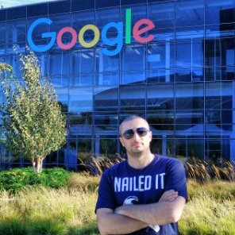
whoami
Gennadii Mishchevskii
Senior Automation QA Engineer at Ciklum
4 years in the industry
Automated back-end, front-end and mobile
https://www.linkedin.com/in/gennadiimishchevskii/

Slide 3
Agenda
Async in Protractor Control Flow
A bit about test runners (Cucumber, Jasmine, etc.)
Typical mistakes
Solving tasks

Slide 4
Protractor
ElementFinder.anything -> Promise
browser.anything -> Promise
https://github.com/SeleniumHQ/selenium/issues/2969

Slide 5


Test Runners

Slide 6
Typical mistakes
const logDate = msg => console.log(new Date());
Promise.resolve() .then(_ => logDate());
console.log('I should be logged before promise');
Promise.resolve() .then(logDate());
Promise.resolve() .then(logDate);
// mistakes

Slide 7

Solving tasks
// tasks

Slide 8

Chat
https://goo.gl/2no6Zc

Slide 9

Repo
https://github.com/Gennadiii/testingStage18

Slide 10

The End

