Slide 1
TEST I/TEST II Summary & Translation

Slide 2
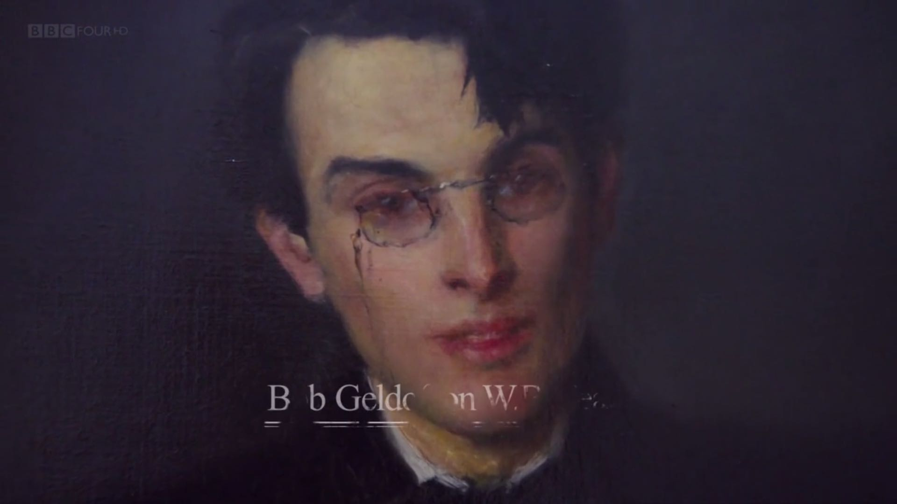
W. B. YEATS

Slide 3
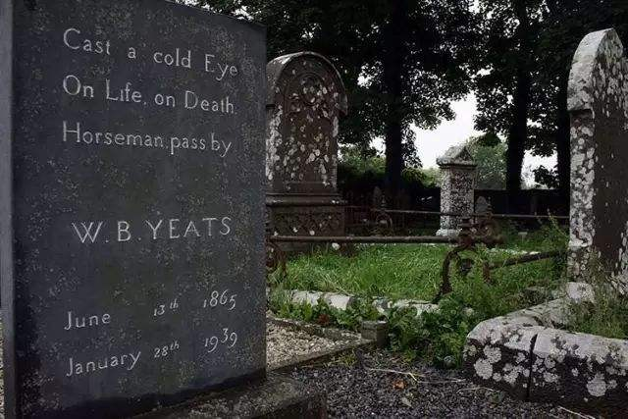
W. B. YEATS
I have spread my dreams under your feet;
Tread softly because you tread on my dreams.
Mad Ireland hurt you into poetry. ——Auden,
“In Memory of W. B. Yeats”
Long years ago, a church stands near,
By the road an ancient cross.
No marble, no conventional phrase;
On limestone quarried near the spot
By his command these words are cut:
Cast a cold eye
On life, on death.
Horseman, pass by!
——Under Ben Bulben, 1938,9

Slide 4
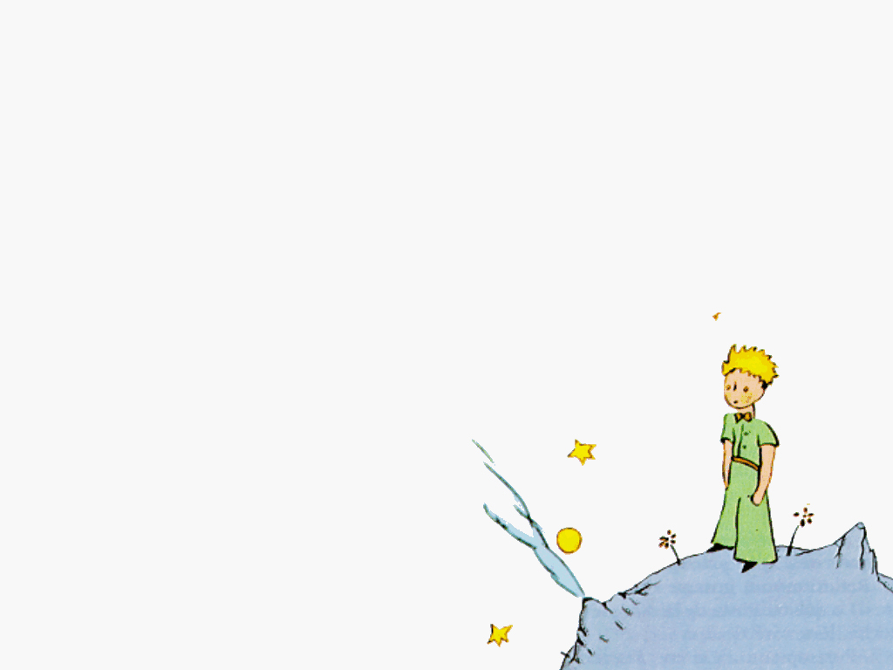
What Then? by William Butler Yeats
His chosen comrades thought at school He must grow a famous man; He thought the same and lived by rule, All his twenties crammed with toil; 'What then?' sang Plato's ghost. 'What then?’
Everything he wrote was read, After certain years he won Sufficient money for his need, Friends that have been friends indeed; 'What then?' sang Plato's ghost. ' What then?'
All his happier dreams came true - A small old house, wife, daughter, son, Grounds where plum and cabbage grew, poets and Wits about him drew; 'What then.?' sang Plato's ghost. 'What then?’
The work is done,' grown old he thought, 'According to my boyish plan; Let the fools rage, I swerved in naught, Something to perfection brought'; But louder sang that ghost, 'What then?'
Notes:
One of his last poems

Slide 5
Test I：Managing Stress During College
分析文章结构：总分
总起：
For most people, stress is a fact of life. College students, who have to balance academic work, romantic relationships, a busy social calendar and growing financial responsibility, are particularly exposed to pressure. Luckily, there are ways to help students successfully manage and reduce their stress.
Summarize: There exist 3 ways to help college students(, especially suffering from pressure,) deal with and relieve stress.

Slide 6
The most basic way that college students can relieve stress is to maintain a healthy lifestyle, which includes adequate sleep, sufficient exercise and a balanced diet. Without plenty of rest, it is hard for students to function properly or respond effectively to new challenges. Likewise, regular exercise and a nutritious diet not only promote students’ physical health, but also keep them feeling relaxed and positive.
Summarize: First, lead a healthy lifestyle including enough sleep and workout, and balancing your diet.

Slide 7
Another valuable way for students to ward off pressure is to stay well-organized. To begin with, they can use a day-planner to record the dates and specifics of upcoming exams, projects, social engagements and other activities. If students rely solely on memory to keep track of a busy schedule, something will inevitably be forgotten, creating further stress and pressure. A “to-do-list” can also be used to record and prioritize unfinished tasks, such as writing an essay, applying for jobs and doing laundry.
Summarize: Second, be well-organized by using a day-planner and “to-do-list”.

Slide 8
Last but not least, college students need some relaxation time in order to release their stress. There are many ways to relax, such as watching movies, listening to music, reading a magazine, or chatting with friends. These activities not only help students to clear their mind of worries for a while, but also enable them to recharge and keep their energy levels high.
Summarize: Third, make time for relaxing activities to sweep away worries and stay energetic

Slide 9
Build your vocabulary:
减少压力：reduce/ relieve/ ward off/ release/ clear … of
有条理的：well-organized
恢复体力、精力：recharge
e.g. I need a bite to recharge

Slide 10
TEST II:
分析文章结构：总分总
The world’s natural resources are being used at an alarming rate. In recent years, both individuals and governments have become more interested in better managing the world’s resources. To achieve this, the phrase ‘reduce, reuse, recycle’ is often presented as a strategy with which to approach these problems.
To avoid a catastrophic depletion of vital natural resources in the future, urgent action is required now. The ‘reduce, reuse and recycle’ strategy is certainly a manageable and memorable one that can be practised by individuals as well as larger organizations and even governments.
Summarize: ‘Reduce, reuse, recycle’ is a feasible strategy to curb the excessive use of natural resources.
Notes:
为什么可行、如何可行、存在的问题

Slide 11
The main idea behind reducing the amount of resources we use is clear: namely that each individual should use less. This can be achieved by being more aware of our day-to-day resource use, such as reducing the number of electrical items on standby, using less water and avoiding motorized transport. In addition, we can introduce energy-saving mechanisms into the household: energy-saving light bulbs and water meters, for example. It is difficult to persuade people to use less energy and water, or to eat less food, but the most effective way to motivate people to change wasteful practices is to make these essential commodities much more expensive.
Summarize: First, reduce individual resource use by increasing awareness, promoting energy-saving equipment and raising prices.

Slide 12
Reusing objects is another strategy for addressing the problem of resource use. As the name suggests, reuse is when old, unwanted items are restored to a state in which they can be used again for a similar purpose. So glass bottles, for instance, can be cleaned and reused without having to be broken and remade. Reusing things is a very efficient process and consumes much less energy than recycling. It does, however, often require a lot of expensive organization and administration. There are also concerns about reusing medical equipment and food-storage items, for example, because of safety and hygiene issues.
Summarize: Moreover, reuse proves energy-efficient, but requires better organizing and administrating and raises concern over safety and hygiene.

Slide 13
Recycling is the third and probably best-known option for conserving natural resources. Materials such as paper and plastic can be turned into new products, which are then reused. This process involves lower energy usage and greenhouse gas emissions than producing articles from raw materials would. However, sorting through used materials before recycling them is a dirty and difficult job and breaking up electronic equipment to recycle rare metals is time-consuming and potentially dangerous.
Summarize: Finally, recycle is more environment-friendly, but the process is tough and dangerous.

Slide 14
积累作文素材：（节能）
1. be more aware of our day-to-day resource use
2. introduce energy-saving mechanisms into the household
3. make these essential commodities much more expensive
…

Slide 15
Test I: Translation
1.
(1) 同龄人 peer
kids of the same age
(2) 对…...束手无策 have no idea/at a loss/ be at one’s wits’ end as to what to do with him
3.每个人都应该心知肚明埋怨别人的过失是毫无意义的…...
(1) 心知肚明：心里明白、但不说破
Be well aware/ be fully aware
(2) 做某事是毫无意义的
There is no point (in) doing
4.
(1) qualify sb for sth
Be qualified for the 2022 Tokyo Olympic Games

Slide 16
Test II: Translation
(2) 溢于言表: our joy was shown both in our words and facial expressions
(3) 油然而生：arise/ well up in one’s heart/ feel
(4) 得知…...我们的喜悦之情
The moment we/ As soon as we … our joy ...
1.一年后有关部门才将肇事者绳之以法。(blame)
有关部门：the department concerned／involved
It was … before sb did
绳之以法：bring sb to justice
2. 扬长避短 develop／make the best use of our strong points/ advantages and avoid our shortcomings/ disadvantages

Slide 17
3.
对……赞誉有加 （compliment）
pay sb a compliment/great compliments
(2) 一切努力都是值得的
be worth the effort/ all the efforts are worthwhile

Slide 18
Thank you! Email: 407265734@qq.com

