Slide 1
Concurrent Program Verification
with
Lazy Sequentialization
and
Interval Analysis
Truc L. Nguyen U. of Southampton, UK
Bernd Fischer Stellenbosch U., South Africa
Salvatore La Torre U. of Salerno, Italy
Gennaro Parlato U. of Southampton, UK
Netys – 18th May 2017

Slide 2
Concurrency & Bug finding
Multicore Architectures
- faster programs must be concurrent
Developing concurrent programs is difficult
- large number of interleavings to consider
- automatic bug-finding tools are essential
Testing is ineffective for rare bugs
- like looking for a needle in a haystack
needs to be complemented by automated analyses that handle schedules symbolically

Slide 3
Concurrent Programs - Reachability Problem
SHARED MEMORY
Concurrent C programs
POSIX threads
SC memory model
Reachability problem
assertion failure
out-of-bound array
division-by-zero, …
linearizability → reachability
[ Bouajjani, Emmi, Enea, Hamza - POPL’15, ICALP’15 ]
…
T₁
T₂
T_{N}
THREADS

Slide 4
Concurrent Programs - Reachability Problem
SHARED MEMORY
Concurrent C programs
POSIX threads
SC memory model
Reachability problem
assertion failure
out-of-bound array
division-by-zero, …
linearizability → reachability
Bounded Model Checking (BMC)
Effective for rare bugs
dominated SV-COMP (concurrency) of in the last 4 editions
…
T₁
T₂
T_{N}
THREADS

Slide 5

BMC approach – Sequential Programs
BOUNDED
PROGRAM
SAT/SMT
FORMULA
SOLVER
PROGRAM
inlining
unrolling
SSA form
Efficient tools for C
BLITZ [ Cho, D'Silva, Song – ASE’13 ]
CBMC [ Clarke, Kroening, Lerda – TACAS’04 ]
LLBMC [ Falke, Merz, Sinz – ASE’13 ]
ESBMC [ Cordeiro, Fischer, Marques-Silva – ASE’09 ]

Slide 6
BMC approach – Concurrent Programs
CONC
PROGRAM
BOUNDED
PROGRAM
SAT/SMT
FORMULA
SOLVER
concurrency
handling
direct SAT/SMT approach
encode each thread as in the sequential case
add a conjunct for shared memory operations
all possible interleavings in the bounded program
φ_{threads} ∧ φ_{concurrency}
papers:
[ Sinha, Wang – POPL’11 ]
[ Alglave, Kroening, Tautschnig – CAV’13 ]

Slide 7
Sequentialization
CONC
PROGRAM
BOUNDED
PROGRAM
SAT/SMT
FORMULA
SOLVER
SEQUENTIALIZATION
(code-to-code translation)
BMC
SEQ TOOL
SEQ
PROGRAM
Keep focus on the concurrency aspects of programs, delegate sequential reasoning to an existing analysis tool
code-to-code translation is much easier to implement than a full-fledged analysis tool
simplifies experimentation with different approaches
can be designed to target multiple backends for sequential program analysis

Slide 8
Sequentialization
CONC
PROGRAM
BOUNDED
PROGRAM
SAT/SMT
FORMULA
SOLVER
SEQUENTIALIZATION
(code-to-code translation)
BMC
SEQ TOOL
SEQ
PROGRAM
Papers
proposal [ Qadeer, Wu – PLDI’04 ]
eager, bounded context-switch, finite # threads [ Lal, Reps – CAV’08 ]
[Tomasco, Inverso, La Torre, Fischer, P. – TACAS’15]
lazy, finite # threads, parameterized [Tomasco, Inverso, La Torre, Fischer, Parlato – CAV’14]
[La Torre, Madhusudan, Parlato – CAV’09, CAV’10]
thread creation [Bouajjani, Emmi, Parlato – SAS’11]
[Emmi, Qadeer, Rakamaric – POPL’11]
Lal/Reps for real-time systems [Chaki, Gurfinkel, Strichman – FMCAD’11]
message-passing programs [Bouajjani, Emmi – TACAS’12]
weak memory models [Tomasco, Nguyen, Inverso, La Torre, Fischer, Parlato–FMCAD’16]
…

Slide 9
Sequentialization
CONC
PROGRAM
BOUNDED
PROGRAM
SAT/SMT
FORMULA
SOLVER
SEQUENTIALIZATION
(code-to-code translation)
BMC
SEQ TOOL
SEQ
PROGRAM
BMC-based tools
Corral (microsoft research) [ Lal, Qadeer, Lahiri – CAV’12, FSE’14 ]
MU-CSeq [ Tomasco, Inverso, La Torre, Fischer, Parlato – TACAS15 ]
Lazy-CSeq [ Inverso, Nguyen, La Torre, Fischer, Parlato – CAV’14, ASE’15 ]
Rek [ Chaki, Gurfinkel, Strichman – FMCAD’11 ]
SMACK [ Rakamaric, Emmi, … – ICSE’16 ]
STORM [ Lahiri,Qadeer,Rakamaric CAV’09 ]

Slide 10
What is this talk about ?
BMC tools can find bugs where testing fails but …
[ concurrency complexity ]
BMC tools still struggle on programs that have
very large number of interleavings &
very small number of buggy interleavings
Nguyen, Schrammel, Fischer, La Torre, Parlato
Parallel Bug-finding in Concurrent Programs via Reduced Interleaving Instances
(under submission)
[ data complexity ]: this talk
Experiments on hard benchmarks show that a large effort is spent on searching the for right values of the original variables
How can we reduce data complexity ???

Slide 11
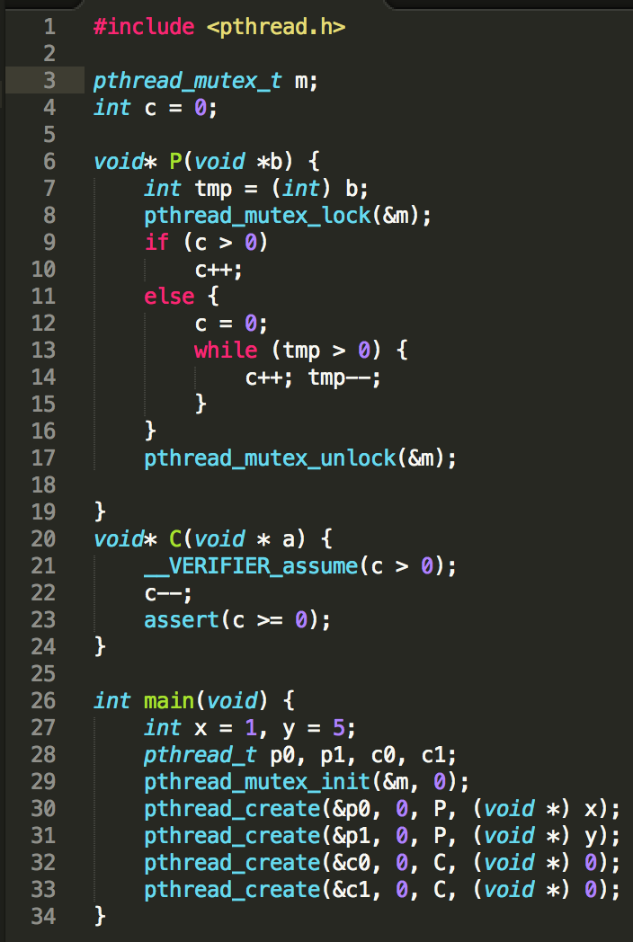
IDEA: Value Analysis (small range of values)
Value Analysis
for each variable in the program returns
either
a finite set, or
an interval
representing a superset of the possible values a variable can take along any execution.
By unrolling the loops twice:
m IN {-1; 2; 3}
c IN {-2; -1; 0; 1; 2; 3; 4; 5}
Small range of values!!!

Slide 12
IDEA: Value Analysis (small range of values)
Value Analysis
for each variable in the program returns
either
a finite set, or
an interval
representing a superset of the possible values a variable can take along any execution.
Represent each program variable in the SAT formula with a much smaller number of bits!!!
Reducing the data sizes would pay-off

Slide 13
From data types to Bitvectors
Bit reduction can be done by changing data type of variables
Integer variables:
minimal number of bits for 2-complement representation, for example
x IN {1} bitvector[2] x;
y IN {-2; -1; 0; 1; 5} bitvector[4] y;
i IN [-10..20] bitvector[6] i;
Arrays:
maximum bitvector size of each element
Structures:
each field is assigned bitvector size recursively

Slide 14
How can we build a scalable Value analysis tool for concurrent programs
???

Slide 15

For sequential programs already exists !!
Frama-C is an extensible platform dedicated to source-code analysis of
sequential C software
Scalable Value Analysis for sequential C programs
based on abstract interpretation

Slide 16
Our approach
Lazy Sequentialization
Code-to-code transformation into
bounded sequential program
Lazy: no spurious data values
Value Analysis
Compute bounds on the possible values
of each variable (along any compution)
Model Refinement
Replace variables with bit-vectors of sufficient size
We reuse:
value analysis tools for sequential programs
verification tools for sequential programs
Sequential Verification

Slide 17
Lazy-CSeq: Schema Overview
(a sequentialization for BMC)

Slide 18
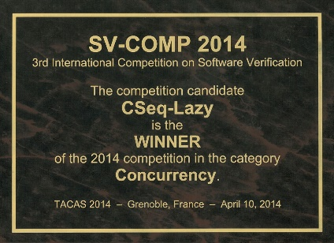
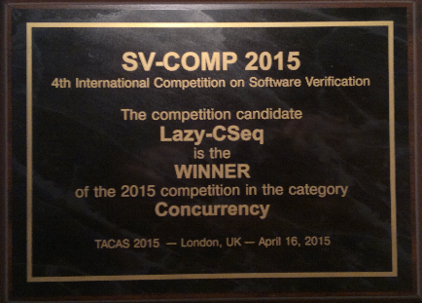
We build on Lazy-CSeq
Lazy-CSeq is a sequentialization targeted to BMC
lazy
based on bounded round-robin computations
efficient for bug-hunting
simple to implement and modify (CSeq framework)
[ Inverso, Nguyen, Tomasco, Fischer, La Torre, Parlato CAV’14, ASE’15 ]
Lazy-CSeq won 2 gold medals in the Concurrency category of the software verification competition SV-COMP
all verification tasks solved

Slide 19
Implementation

Slide 20
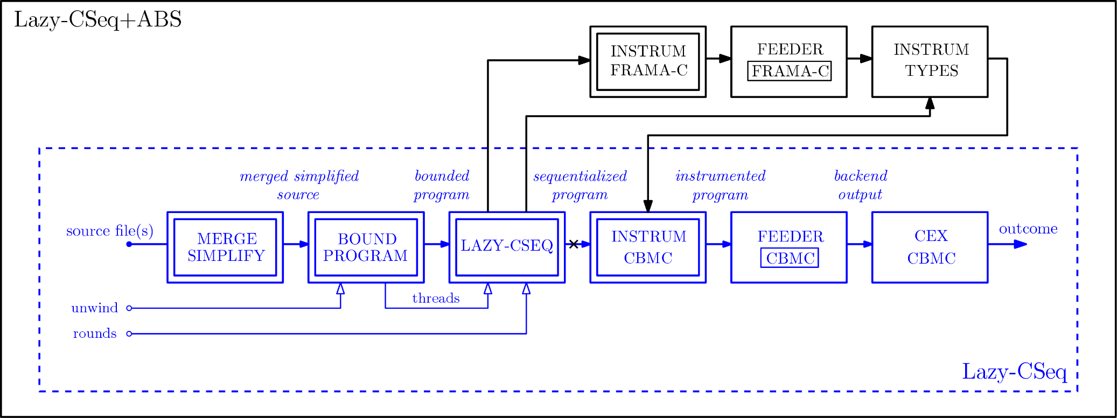
Lazy-CSeq+ABS Architecture

Slide 21
Experiments
SV-COMP

Slide 22
SV-COMP Unsafe Benchmarks
 |  |  | Lazy-CSeq |  |  |  | Lazy-CSeq+ABS
 |  |  | CBMC |  |  |  | CBMC |  |  |  | Frama-C | Total
Subcategory | #files | LOC | Time (s) | Memory (MB) | #vars | #clauses | Time (s) | Memory (MB) | #vars | #clauses | Time (s) | Time (s)
pthread | 17 | 4085 | 34.7 | 84.9 | 89K | 336K | 18 | 66.8 | 48K | 184K | 5.5 | 23.5
pthread-atomic | 2 | 204 | 1.7 | 33.3 | 9K | 29K | 1.8 | 46.2 | 6.2K | 18K | 0.9 | 2.7
pthread-ext | 8 | 780 | 6.5 | 358.4 | 648K | 2655K | 4.5 | 83.1 | 89.7K | 423K | 1.1 | 5.5
pthread-lit | 3 | 123 | 1.9 | 38.3 | 10K | 31.2K | 1.9 | 49.3 | 5.8K | 16.4K | 1.2 | 3.1
pthread-wmm | 754 | 236K | 2.0 | 31.4 | 2.4K | 5.6K | 2.2 | 46.1 | 2.4K | 5.5K | 0.9 | 3.1

Slide 23
SV-COMP Safe Benchmarks
 |  |  | Lazy-CSeq |  |  |  | Lazy-CSeq+ABS
 |  |  | CBMC |  |  |  | CBMC |  |  |  | Frama-C | Total
Subcategory | #files | LOC | Time (s) | Memory (MB) | #vars | #clauses | Time (s) | Memory (MB) | #vars | #clauses | Time (s) | Time (s)
pthread | 15 | 1285 | 172.4 | 1124.4 | 1732K | 7270K | 98.6 | 945.3 | 1425K | 6004K | 8.4 | 107.0
pthread-atomic | 9 | 1136 | 2.7 | 37.9 | 19K | 68K | 2.9 | 47.7 | 16.6K | 58.3K | 2.0 | 4.9
pthread-ext | 45 | 3683 | 71.7 | 876.8 | 1660K | 6950K | 49.4 | 552.6 | 937K | 4037K | 2.2 | 51.6
pthread-lit | 8 | 432 | 5.8 | 43.7 | 15.2K | 57.3K | 4.9 | 51.6 | 11K | 42.1K | 1.0 | 5.9
pthread-wmm | 144 | 29K | 1.6 | 31.5 | 3.1K | 9.4K | 1.6 | 45.7 | 3K | 9K | 0.9 | 2.5

Slide 24
Experiments
Complex benchmarks

Slide 25
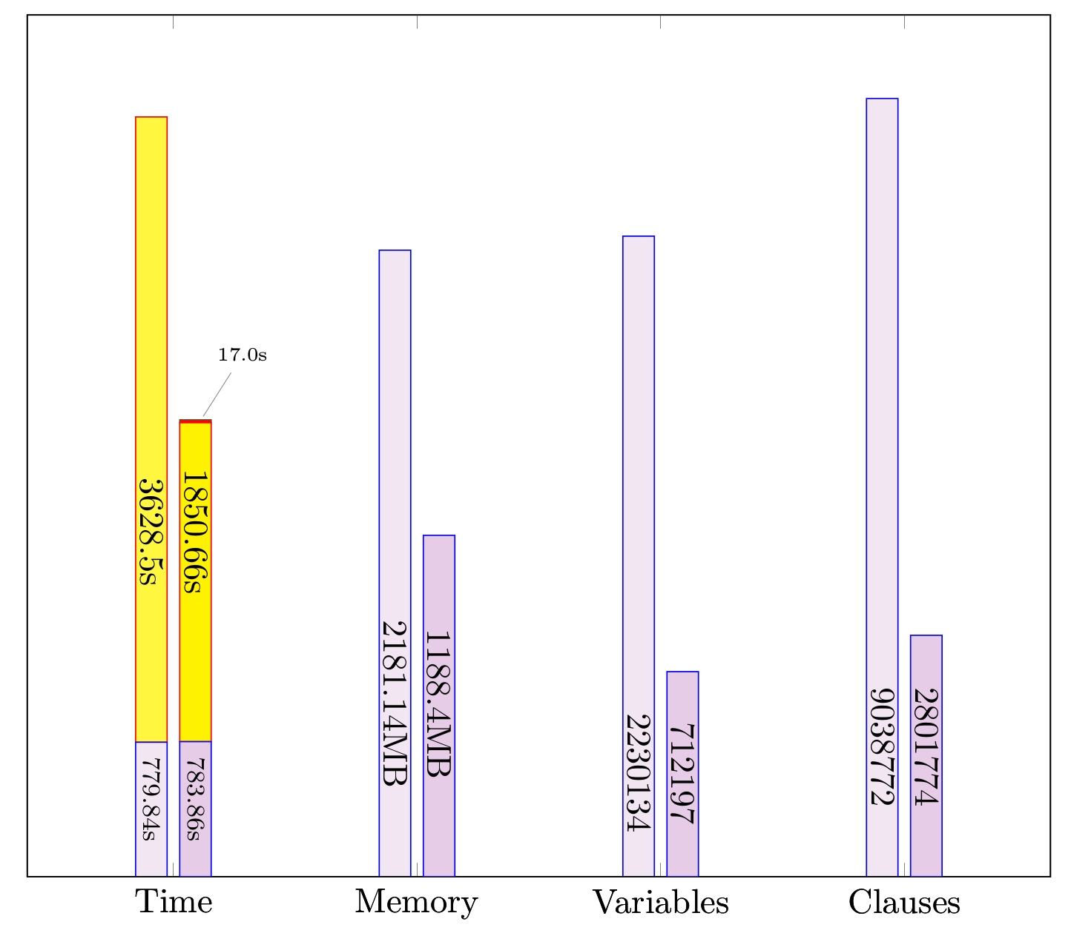
SafeStack Experiments
extremely rare bugs
3 threads
at least 5 context switches
1.7x speed up
half memory consumption

Slide 26
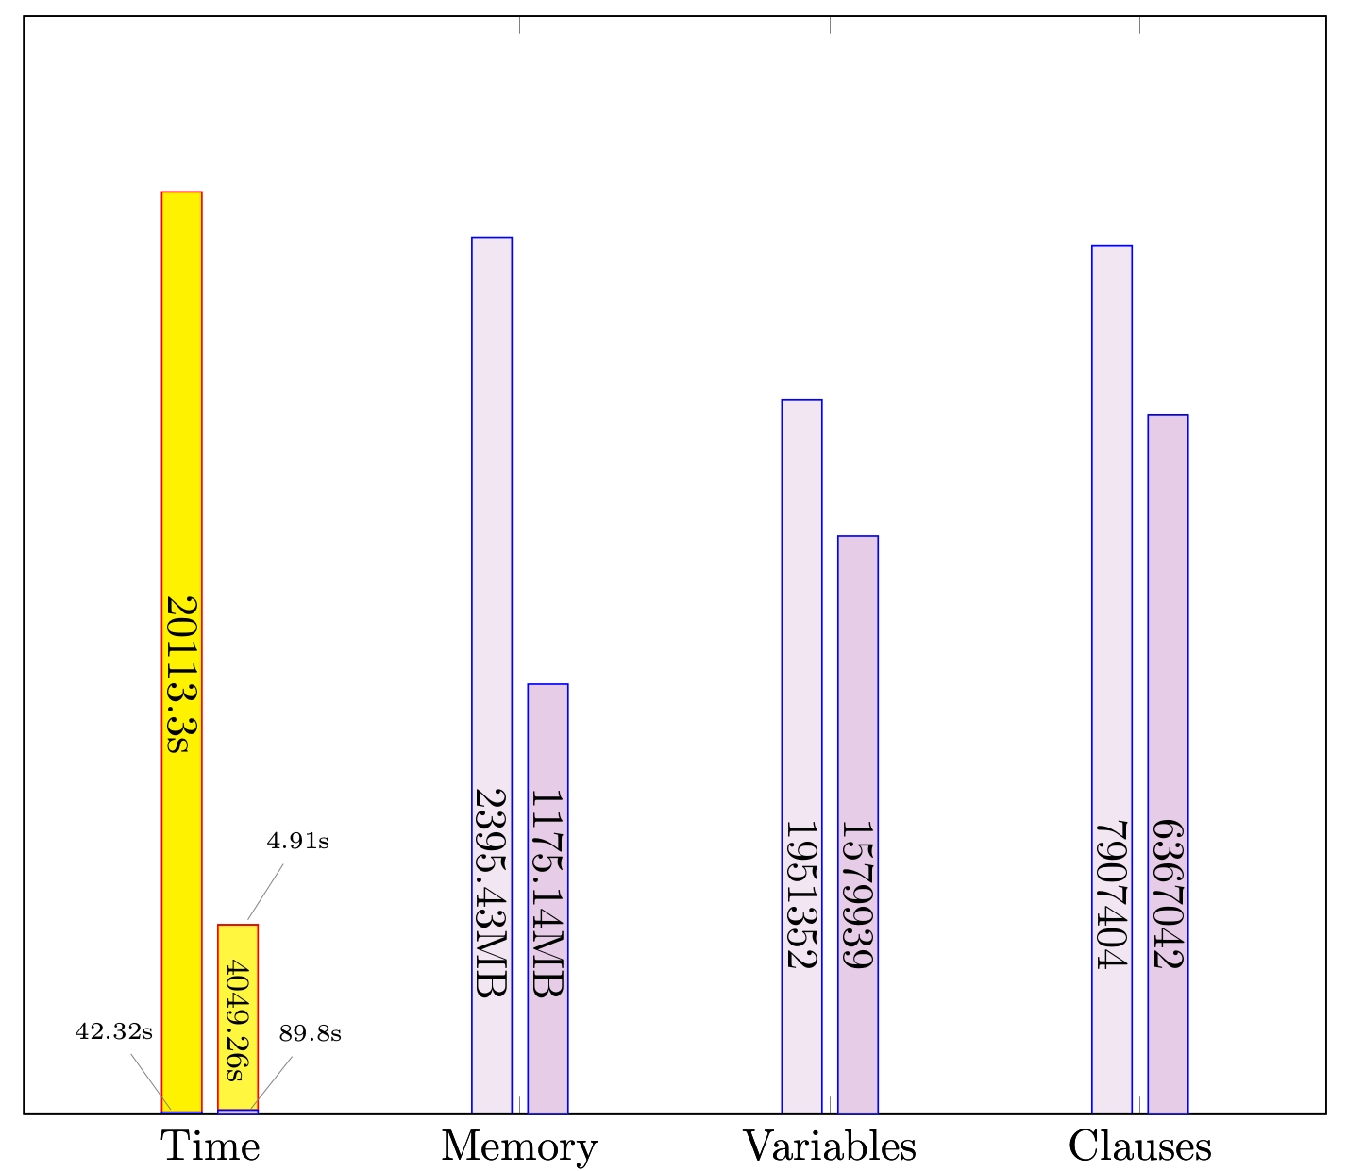
EliminationStack Experiments
infamous ABA problem
8 threads
5x speed up
half memory consumption

Slide 27
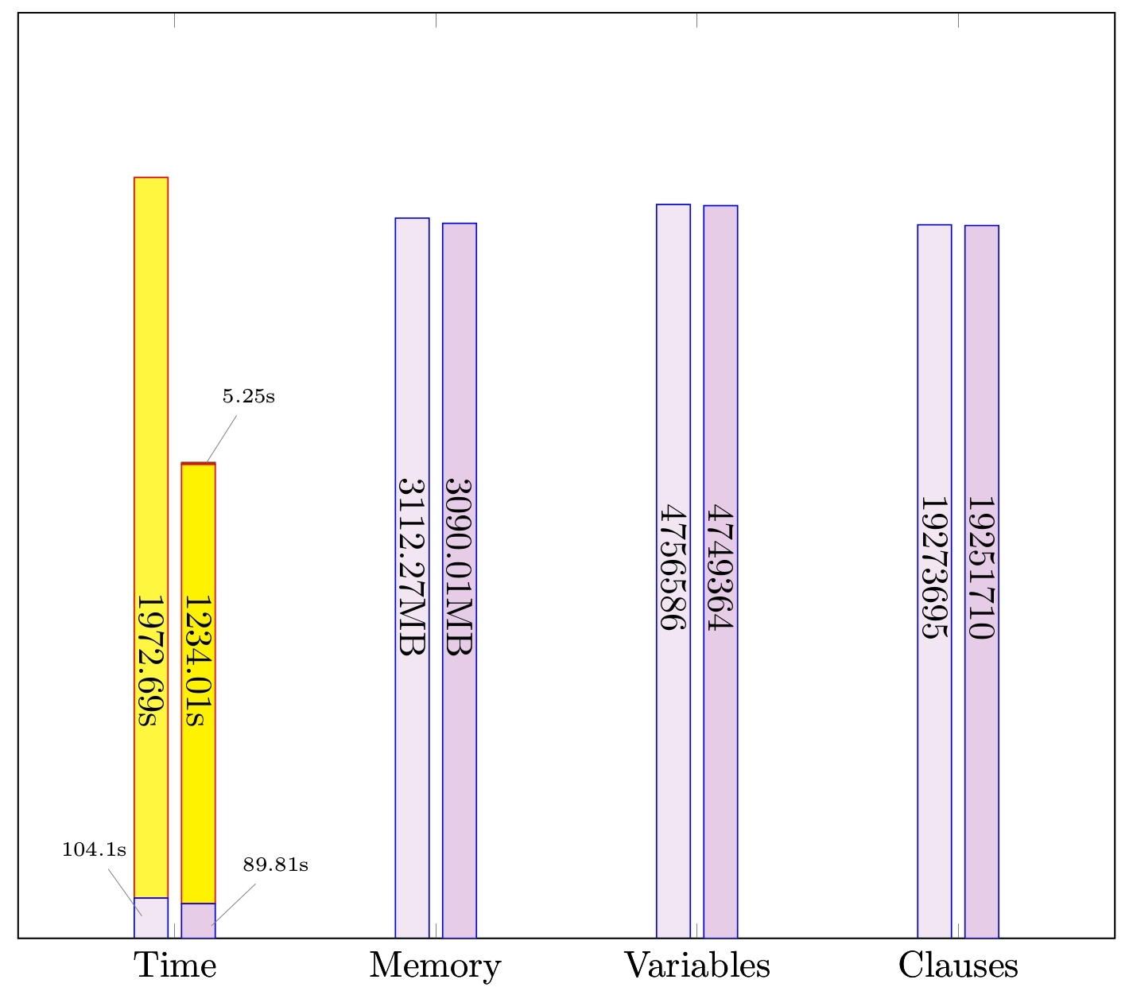
DCAS Experiments
Challenging for explicit approach
138h of CPU-time (1000 cores)
10¹¹ states
1.6x speed up

Slide 28
Ongoing & Future Work

Slide 29
Ongoing work & Future work
Sequentializations based on BMC and Abstraction for programs communication through FIFO channels
weak memory models (TSO) [Atig, Bouajjani, – CAV 2011 ]
message passing interface (MPI)
Symbolic partial order reduction based on interleaving partitioning combining:
abstraction interpretation to discard “safe” partitions
bug-finding for partitions with “potential” bugs with few interleavings
swarm verification (on clusters)
implemented using Lazy- and MU-Cseq sequentialization

Slide 30

Thank You
users.ecs.soton.ac.uk/gp4/cseq

