Slide 1





CBMC-SSM:
Bounded Model Checking of C Programs with
Symbolic Shadow Memory
Bernd Fischer, Stellenbosch University, South Africa, bfischer@sun.ac.za
Salvatore La Torre, University of Salerno, Italy, slatorre@unisa.it
Gennaro Parlato, University of Molise, Italy, gennaro.parlato@unimol.it
Peter Schrammel, University of Sussex and Diffblue, UK, p.schrammel@sussex.ac.uk

Slide 2
Rapid Development of Efficient Program Analyses for C
Requires iterative experimentation and improvement on real/realistic programs
Support for most/all C features slows down iterations
Goal:
Methodology and tool support for fast experiment-improve cycles
Shadow Memory
shadow
memory
Useful for implementing program analyses
Allows to associate data inferred during the analysis with the memory objects of the analyzed program
memory object

Slide 3
Methodology
Input program
We follow the approach of implementing program analyses
By automated source-level instrumentation
Using shadow memory API
Shadow memory API implementation provided by tool CBMC-SSM
Instrumentation using
shadow memory API
Instrumented program
CBMC-SSM
Analysis result

Slide 4
Shadow Memory API
Declare a field with name, type and initial value:
__CPROVER_field_decl_global(name, (type)value)
__CPROVER_field_decl_local(name, (type)value)
Get value of field with name for memory at address:
__CPROVER_field_get(address, name)
Set field with name to value for memory at address:
__CPROVER_field_set(address, name, value)

Slide 5
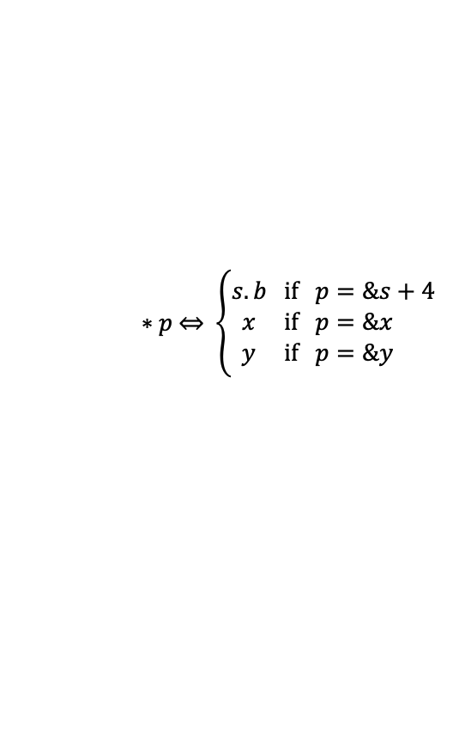
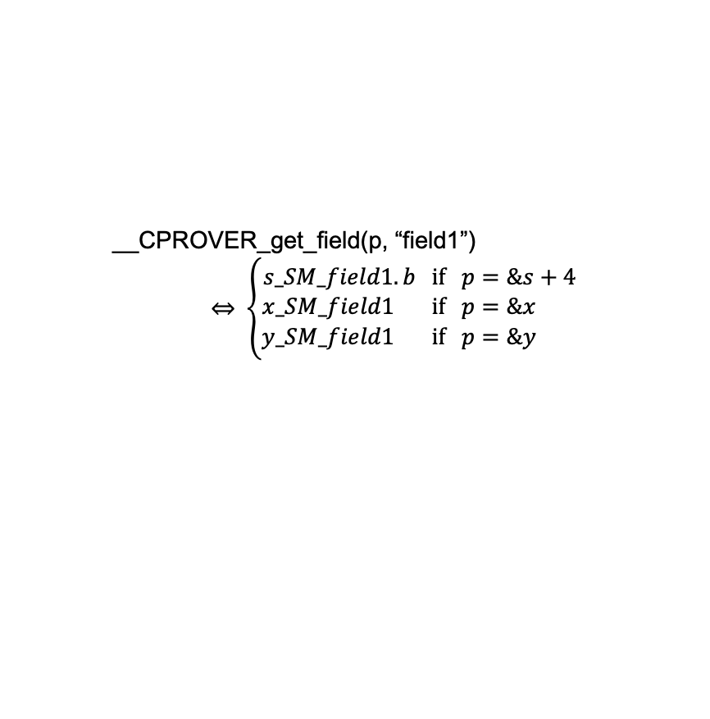
API Implementation in CBMC
Bounded model checker for C programs (Clarke, Kroening, Lerda 2004)
Shadow memory API functions interpreted during symbolic execution
Resulting formula solved by SAT/SMT solvers
memory object
shadow memory
memory object
maps to
shadow memory
may point to
memory object
shadow memory
address
may points-to analysis
int *p
p ⇾ {&s + 4, &x , &y}
symbolic dereferencing
Notes:
This may be cut to safe time, but it does explain the cause of all the complexity…

Slide 6
Taint Analysis Example
Example program
tainted
Manual taint analysis Instrumentation using
shadow memory API
peter
ase2022
uname passwd
encode
json
Instrumented
example program
expected to be untainted
{
“username”: “peter”,
“password”: “ase2022”
}
CBMC-SSM
expected to be tainted
Analysis result

Slide 7
Taint Analysis Example
tainted
void main(){
// declare shadow fields
__CPROVER_field_decl_local("tainted", (_Bool)0);
// create harness for SUT
char uname[8]; char passwd[8];
make_nondet_len_string(uname, 0); // untainted
make_nondet_len_string(passwd, 1); // tainted
// call SUT
char json[46];
encode(json, uname, passwd);
// check properties
check(json, uname, passwd);
}
$ cbmc taint-example.c --unwind 15
…
VERIFICATION SUCCESSFUL
peter
ase2022
uname passwd
encode
json
expected to be untainted
{
“username”: “peter”,
“password”: “ase2022”
}
expected to be tainted

Slide 8
Taint Analysis Example
tainted
void main(){
// declare shadow fields
__CPROVER_field_decl_local("tainted", (_Bool)0);
// create harness for SUT
char uname[8]; char passwd[8];
make_nondet_len_string(uname, 0); // untainted
make_nondet_len_string(passwd, 1); // tainted
// call SUT
char json[46];
encode(json, uname, passwd);
// check properties
check(json, uname, passwd);
}
$ cbmc taint-example.c --unwind 15
…
VERIFICATION SUCCESSFUL
peter
ase2022
uname passwd
encode
json
expected to be untainted
// Taint the input data
__CPROVER_set_field(&src[i], "tainted", 1);
{
“username”: “peter”,
“password”: “ase2022”
}
expected to be tainted

Slide 9
Taint Analysis Example
tainted
void main(){
// declare shadow fields
__CPROVER_field_decl_local("tainted", (_Bool)0);
// create harness for SUT
char uname[8]; char passwd[8];
make_nondet_len_string(uname, 0); // untainted
make_nondet_len_string(passwd, 1); // tainted
// call SUT
char json[46];
encode(json, uname, passwd);
// check properties
check(json, uname, passwd);
}
$ cbmc taint-example.c --unwind 15
…
VERIFICATION SUCCESSFUL
peter
ase2022
uname passwd
encode
json
expected to be untainted
{
“username”: “peter”,
“password”: “ase2022”
}
// Propagate taint
buf[pos + i] = src[i];
__CPROVER_set_field(&buf[pos + i], "tainted",
__CPROVER_get_field(&src[i], "tainted"));
expected to be tainted

Slide 10
Taint Analysis Example
tainted
void main(){
// declare shadow fields
__CPROVER_field_decl_local("tainted", (_Bool)0);
// create harness for SUT
char uname[8]; char passwd[8];
make_nondet_len_string(uname, 0); // untainted
make_nondet_len_string(passwd, 1); // tainted
// call SUT
char json[46];
encode(json, uname, passwd);
// check properties
check(json, uname, passwd);
}
$ cbmc taint-example.c --unwind 15
…
VERIFICATION SUCCESSFUL
peter
ase2022
uname passwd
encode
json
expected to be untainted
{
“username”: “peter”,
“password”: “ase2022”
}
// Check property
_Bool actual =
__CPROVER_get_field(&buf[pos + i], "tainted");
assert(actual == expected);
expected to be tainted

Slide 11
Taint Analysis Example
tainted
void main(){
// declare shadow fields
__CPROVER_field_decl_local("tainted", (_Bool)0);
// create harness for SUT
char uname[8]; char passwd[8];
make_nondet_len_string(uname, 0); // untainted
make_nondet_len_string(passwd, 1); // tainted
// call SUT
char json[46];
encode(json, uname, passwd);
// check properties
check(json, uname, passwd);
}
$ cbmc taint-example.c --unwind 15
…
VERIFICATION SUCCESSFUL
peter
ase2022
uname passwd
encode
json
expected to be untainted
{
“username”: “peter”,
“password”: “ase2022”
}
expected to be tainted

Slide 12
Taint Analysis Example
tainted
void main(){
// declare shadow fields
__CPROVER_field_decl_local("tainted", (_Bool)0);
// create harness for SUT
char uname[8]; char passwd[8];
make_nondet_len_string(uname, 0); // untainted
make_nondet_len_string(passwd, 1); // tainted
// call SUT
char json[46];
encode(json, passwd, uname);
// check properties
check(json, uname, passwd);
}
$ cbmc taint-example.c --unwind 15
…
VERIFICATION FAILED
peter
ase2022
uname passwd
encode
json
expected to be untainted
{
“username”: “ase2022”,
“password”: “peter”
}
expected to be tainted

Slide 13
Evaluation Study: Data Race Detection
SV-COMP benchmarks
Two-phase data race detection:
1. Nondeterministically select shared
memory write operation
2. Detect read/write
operations that race with
selected write operation
Uses shadow memory to track byte-precise information between phases.
Automated
data race detection instrumentation using
shadow memory API
Instrumented SV-COMP benchmarks
CBMC-SSM
Analysis result
Notes:
The data race stuff could be skipped to gain time, or if you run out of time.

Slide 14
Evaluation Study: Data Race Detection
Thread
Sanitizer
PorSE
Correct | 136 | 107 | 102
Safe (78) | 70 | 60 | 43
Unsafe (76) | 66 | 47 | 59
Incorrect | 2 | 21 | 40
Safe | 2 | 14 | 10
Unsafe | 0 | 7 | 30
Unknown | 6 | 0 | 4
Timeout | 7 | 2 | 8
Memoryout | 0 | 0 | 0
Error | 3 | 24 | 0
CBMC-SSM
Implementation just 600 lines of code within Lazy-CSeq instrumentation framework
(Inverso, Nguyen, Fischer, La Torre, Parlato 2015)
Comparison on SV-COMP benchmarks
Competitive with dedicated tools
ThreadSanitizer and PorSE
(Serebryany, Potapenko, Iskhodzhanov, Vyukov 2011)
(Schemmel, Büning, Rodríguez, Laprell, Wehrle 2020)

Slide 15

CBMC-SSM:
Bounded Model Checking of C Programs with
Symbolic Shadow Memory
Artifact:
https://zenodo.org/record/7026604

