Slide 1
Mu-CSeq:
Sequentialization by Read-implicit
and
Coarse-grained Memory Unwindings
Ermenegildo Tomasco | University of Southampton, UK
Omar Inverso | University of Southampton, UK
Bernd Fischer | Stellenbosch University, South Africa
Salvatore La Torre | Università di Salerno, Italy
Gennaro Parlato | University of Southampton, UK

Slide 2

Cseq framework
problem: analysis of concurrent programs
approach: reduction to sequential analysis
sequential
non-deterministic
C program
concurrent
C program
sequential
analysis
tool
CSeq
P
P'

Slide 3
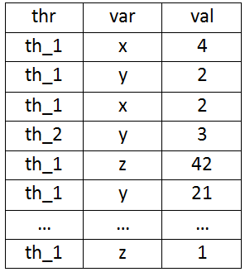

Memory Unwinding
Stores a sequence of writes
(thread, variable, value)

Slide 4
Sequentialization
convert concurrent programs into equivalent sequential programs
Mu-CSeq Approach:
T₁ ∥ T₂ ∥ …. ∥ Tn ↝ MU; T̕₁; C₁; T̕₂; C₂;… ;T̕n; Cn
MU is a guessed Memory Unwinding
T̕ _{i} simulates the execution of T_{i}
checkers Cᵢ ensure that threads T’ᵢ used memory consistently

Slide 5
Fine- Coarse-grained MU
Fine-grained MU: all the writes of the shared variables in a run are exposed (SV-COMP 14-15)
Coarse grained MU: only relevant writes of the shared variables in a run are exposed (SV-COMP 15)
More details: TACAS, Tomorrow @ 10.30

Slide 6
Thank You
users.ecs.soton.ac.uk/gp4/cseq

