Slide 1
The Tree-Width of automata with auxiliary storage
Gennaro Parlato
(LIAFA, CNRS, Paris, France)
joint work with
P. Madhusudan (Univ of Illinois at Urbana-Champaign, USA)

Slide 2
Automata with aux storage
Turing machines = finite automata + 1 infinite tape
Undecidable membership and emptiness
CFLs = nondeterministic finite automata + 1 stack Decidable membership and emptiness
Finite automata + 2 stacks; Finite automata + 1 queue
→ undecidable membership and emptiness
Studies into finding the “boundary” of decidability

Slide 3
Verification: renewed interest in automata+aux storage
PDA emptiness
Emptiness algorithm using “summaries”
Result due to Buchi that reachable configurations of a PDA is regular
Static analysis of control
Reps-Horowitz-Sagiv; Pnueli-
Context-sensitive static data-flow analysis of programs with recursion is essentially PDA emptiness
SLAM project from Microsoft Research
Predicate abstraction of software that abstracts data to Boolean domains [Ball-Rajamani-’90]
Constructs a PDA model and checks emptiness/reachability.
BEBOP: PDA emptiness using “summaries” MOPED: PDA emptiness using regularity of reachable configs

Slide 4
Verification: renewed interest in automata+aux storage
Concurrent program verification using abstraction
Each program has its own “control stack”
Static analysis ←→ Emptiness of multi-stack automata
Distributed systems
(message-passing systems – OS – event-driven)
Processes communicate using message queues
Static analysis ←→ Emptiness of Finite state automata + queues
When individual processes have recursion,
Static analysis ←→ Emptiness of FSA + stacks + queues !

Slide 5
Decidable emptiness
Multistack pushdown automata with
k-context-switches (Rehof, Qadeer - TACAS’05)
k-phases (La Torre, Madhusudan, Parlato - LICS’07)
ordered (Breveglieri, Cherubini, Citrini, Crespi-Reghizzi – JFOCS’95)
Parameterized pushdown automata with k contexts
(La Torre, Madhusudan, Parlato - CAV’10)
Distributed automata with finite processes & FIFO queues
finite state processes with polyforest architecture
pushdown processes with forest architecture + well queuing
(La Torre, Madhusudan, Parlato. - TACAS’08)
Non-confluent architectures + size 1 queues
(Heußner, Leroux, Muscholl, Sutre - FOSSACS’10)
Uniform property:
Awkward definitions
and fragile

Slide 6
The question is …
So many decidable subclasses; so much awkwardness
Is there a robust common principle that explains their decidability?
Answer:
We present a general criterion that uniformly explains many of such results:
Simulated by graph automata working on graphs of bounded tree-width.

Slide 7
Graph automata
Fix a class C of Σ-labeled graphs
A graph automaton over C is a triple GA = ( Q, {tiles_{a}} _{a ∈ Σ}, type )
Q is a finite set of states
tiles_{a} ⊆ Q x Q
type: Q → 2^{Σ} x 2^{Σ}
A graph G is accepted by GA if we can decorate each node with a state such that
Each edge can be tiled
Each node v decorated with state q_{i} must satisfy the type condition
If type( q_{i} ) = ( IN, OUT ) then Incoming-edges = In, Outgoing-edges = Out
q₂
q₁
a
a
c
c
b
a
q₄
q₅
q₃

Slide 8
Main schema
If C has bounded
Tree-width
(decidable)
Automaton with
auxiliary storage
MSO satisfiability
over graphs
(Undecidable)
Extension of
Courcelle’s Theorem
Empt. M reduces to Empt. GA
Empt. GA reduces to
All classes C
corresponding to decidable
classes turn out to have
bounded tree-width
Graph Automata over a class of graphs C
(MSO definable)
Class of graphs C
working over automaton behaviors
Tiling the
graphs in C

Slide 9
PDA ←→ Nested words
int
int
int
int
int
push
push
push
pop
pop
push
pop
pop
A NW graph captures the behavior of a run
The stack is compiled down into the nested word (nesting edges)
The class of NWs is MSO definable (linear order + nesting edges; nesting edges should not cross)
Graph automata working over this graph can simulate a PDA
NWs have tree-width 2
Hence decidable emptiness

Slide 10
We give simulations for …
Pushdown automata
Behavior graphs: nested words
Tree-width: 2
n-stack pushdown automata
Behavior graphs: n-nested words (unbounded tree-width)
Restrictions
k-contexts tree-width: O( k )
k-phases tree-width: O( 2^{k} )
ordered tree-width: O( n 2^{n} )
Distributed automata with n-processes & FIFO queues
Behavior graphs: stack-queue graphs (unbounded tree-width)
Restrictions:
finite state processes with polyforest architecture - tree-width: O(n)
pushdown processes with forest architecture + well queuing - tree-width: O(n)

Slide 11
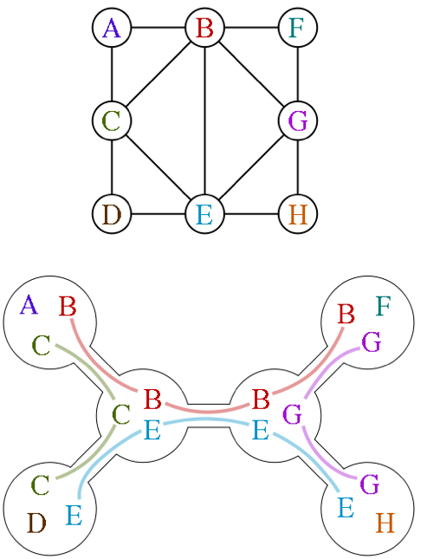
Tree-width of graphs G=(V,E)
A tree decomposition of G is a pair (T, {bag_{z} }_{z is a node of T} ), where T is a tree and bag_{z} is a subset of G nodes, such that
every edge of G has both endpoints in some bag
for every node of G the set of bags that contain it form a subtree of T
The width of the tree decomposition is the maximum of |bag_{z}|-1 over all T nodes z
The treewidth of a graph G, is the minimum such width over all tree decompositions of G
Tree width of a tree is 1 ☺

Slide 12
Monadic second-order logic on graphs
For a fixed alphabet Σ, a Σ-labeled graph is a structure (V, {E_{a}} _{a ∈ Σ} ) where
V is a finite set of vertices
E_{a} ∈ V x V is a set of edges labeled by a
MSO is given by the following syntax
ϕ ::= x=y | E_{a}(x,y) | ϕ∨ϕ | ¬ϕ | ∃x. ϕ(x) | ∃X. ϕ(X)
where
x, y are first-order variables, X is a second-order variable
E_{a}(x,y) is a binary relation
A class of Σ-labeled graphs C is MSO-definable if there is a ϕ such that
ϕ holds on G iff G is a graph in C

Slide 13
MSO on graphs
Satisfiability problem for MSO on a class of graphs C:
Given ϕ is there a graph G in C satisfies ϕ ?
Over the class of all graphs, MSO is undecidable (even FO is undecidable).
Satisfiability problem for MSO is decidable on the class of all graphs of tree width k, for any k. [Courcelle]
In fact, if C is any class of graphs of bounded tree-width that is MSO definable, then satisfiability of MSO on C is decidable.
Hence graph automata emptiness is decidable of any class C of bdd tw that is MSO definable.

Slide 14
Simulation for pushdown automata

Slide 15
Nested words
int
int
int
int
int
push
push
push
pop
pop
push
pop
pop
A NW graph captures the behavior of a run
The stack is compiled down into the nested word (nesting edges)
The class of NWs is MSO definable

Slide 16
Nested words have tree-width 2
int
int
int
int
int
1
2
3
4
5
6
7
8
9
10
11
12
13
14
push
push
push
push
pop
pop
push
pop
pop
1
Tree decomposition of NW
Nodes of NW and T are the same
Edges:
If (u,v) is a linear edge of NW
and v is not a pop node then
v is the left-son of u
If (u,v) is a nesting edge then v is
the right-son of u
2
3
14
4
9
5
7
10
6
8
11
12
13

Slide 17
Nested words have tree-width 2
1
2
3
4
5
6
7
8
9
10
11
12
13
14
1
Tree decomposition of NW
Nodes of NW and T are the same
Edges:
If (u,v) is a linear edge of NW
and v is not a pop node then
v is the left-son of u
If (u,v) is a nesting edge then v is
the right-son of u
2
3
14
4
9
5
7
10
6
8
11
12
13

Slide 18
Nested words have bounded tree-width
1
2
3
4
5
6
7
8
9
10
11
12
13
14
1
Tree decomposition of NW
Bags:
u is un the Bag_{u}
if (u,v) is an edge of NW add u to the
bags of all nodes of the unique path
in T from u to v
3, 2, 8,13
2
3
14
4
9
5
7
10
6
8
11
12
13

Slide 19
Simulation for multistack pushdown automata

Slide 20
Multistack pushdown automata
Finite number of stacks S₁, …,S_{n}
Stack alphabet Γ
Finite set of states Q
Initial state q₀
Final states F ⊆ Q
A set of moves :
Internal move: (q, q’)
Pop move: (q, γ, stack_num, q’)
Push move: (q, γ, stack_num, q’)
Finite Control
…
S₁
S₂
S_{n}

Slide 21
Multiply Nested Words (MNW)
push₂
push₂
pop₂
int
pop₂
push₁
push₁
push₁
pop₁
pop₁
push₁
pop₁
pop₁
A MNW graph captures the behavior of a run
Stacks are compiled down into the graph (nesting edges)
The class MNWs is MSO definable
Unbounded tree-width
(undecidable emptiness problem)

Slide 22
Bounded-context MPAs
k-contexts MVPA (Qadeer, Rehof: TACAS’05)
In a context only one stack can be used
The class of MNWs with k contexts is
MSO definable
tree-width: k + 1
The emptiness problem for bounded-context MPAs can be proved to be decidable by using the schema
…

Slide 23
Bounded-phase MPAs
k-phase MVPA (La Torre, Madhusudan, Parlato - LICS’07)
In a phase only one stack can be popped (all the stacks can be pushed)
MNWs with k phases are
MSO definable
tree-width: 2^{k} + 2^{k-1} + 1
(not easy to show; complex tree decomposition)
The emptiness problem for bounded-phase MPAs is
hence proved to be decidable by using the schema

Slide 24
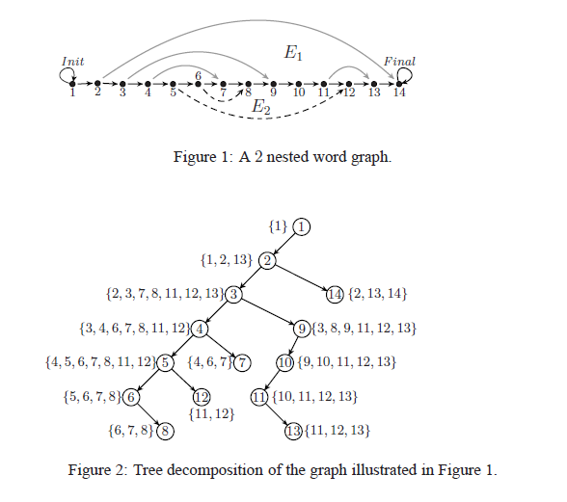

Slide 25
Ordered MPAs
Ordered MVPAs (Breveglieri et al, J. Found. Comput. Sci.’95)
Only the first non empty stack can be popped
All stacks can be pushed
Ordered MNWs are
MSO definable
tree-width: (n+1) 2^{n-1}+1, where n is the number of stacks
The emptiness problem for ordered MPAs can be proved to be decidable by using the schema

Slide 26
Simulation for distributed automata with queues

Slide 27
Distributed automata with queues
Distributed automata with queues with
finite state processes
pushdown processes

Slide 28
Queue graphs (finite processes)
P₁:
P₂:
P₃:
A queue graph captures the behavior of a run
queues are compiled down into the graph (blue edges)
The class of queue graphs is MSO definable (linear orders for each process, FIFO edges)
Unbounded tree-width

Slide 29
Stack-queue graphs (PD processes)
P₁:
P₂:
P₃:
A stack-queue graph captures the behavior of a run
Stacks and queues are compiled down into the graph
The class stack-queue graphs is MSO definable
Unbounded tree-width

Slide 30
Decidable class (La Torre, Madhusudan, Parlato, TACAS’08)
Pushdown processes - directed forests + well-queuing
Well-queuing condition:
each process can receive a message only when its stack is empty
TREE-WIDTH
Any run can be simulated by a
push-down automaton
- These stack queue graphs can be
decomposed in nested words
with nested-word-width n
- Graph decompositions compose
- Tree-width: 3n-1

Slide 31
Decidable class (La Torre, Madhusudan, P., TACAS’08)
Finite processes - polyforest architectures
A directed graph is a polyforest if the underlying undirected graph is a forest
TREE-WIDTH
edges can be reversed to make
it a directed tree
- These queue graphs can be seen
as stack-queue graphs for directed
forests + well queuing (no stack)
- Tree-width: 3n-1

Slide 32
Conclusions and Future directions

Slide 33
Decidable emptiness problem
Multistack pushdown automata with
k-contexts (Rehof, Qadeer - TACAS’05)
k-phases (La Torre, Madhusudan, P. - LICS’07)
ordered (Breveglieri, Cherubini, Citrini, Crespi-Reghizzi
- Int. J. Found. Comput. Sci.’95)
Parameterized pushdown automata with k-rounds
(La Torre, Madhusudan, P. - CAV’10)
Distributed automata with finite processes & FIFO queues
finite state processes with polyforest architecture
pushdown processes with forest architecture + well queuing
(La Torre, Madhusudan, P. - TACAS’08)
Non-confluent architectures + eager runs
(Heußner, Leroux, Muscholl, Sutre - FOSSACS’10)

Slide 34
Conclusion
A general criterion that uniformly explains many decidability results for automata with auxiliary storage (stacks,queues)
New results can be easily derived
For multistack pushdown automata considering phases where in each phase only one stack can be pushed but all the stacks can be popped can be shown decidable
Flipping the direction of edges you get bounded-phase MNWs
General result can be extended to graphs of bdd clique width
Extends to infinite words
Eg. Buchi/parity ordered multi-stack automata is decidable

Slide 35
Conclusion
New view of automata with storage
Don’t be “mesmerized” by the storage capabilities and restrictions
Look instead at the the underlying graph that captures the storage
(graph automaton working on these graphs must be able to
simulate the automaton with aux storage)
Look at the tree-width of this graph
Complexity: matches best known time complexity

Slide 36
Future work
Graph automata working over bounded tree-width graphs are a powerful class that can explain many emptiness results
But what about complementation?
Is there a “graph-theoretic” property that captures when automata can be complemented? (Bounded phase visibly pushdown languages are complementable!)
We cannot handle counters effectively
Decision procedures for counters are very different (Petri-net coverability/WQO)
Can we incorporate this decision procedure also into a general theory?

Slide 37
Future work
Automata played an important role in hardware verification
LTL ←→ Automata
Automata on infinite words
Model-checking finite-state systems
The role of automata in software verification
Models of programs obtained by data-abstraction
Interfaces for software modules (capturing module usage; learning automata)
Deciding logics for program verification, especially heap logics
(Recent work on using decidable logics on graphs of bdd tw to decide properties of heaps – [Madhusudan, Parlato, Qiu’10]
Thank you

